Slide 1
Module 4 - Networking
MIS5122: Enterprise Architecture for the IT Auditor

Slide 2
Agenda
Computer Networks
  Network topology
  Addressing and routing
  Media access control
  Network hardware
  TCP/IP

Slide 3
Case Study – Focus on Networks
LANs
Switches
DNS & DHCP
Routers

Slide 4
Question
What is “network topology”?
Notes:
Spatial organization of network devices, physical routing of network cabling, and flow of messages from one network node to another

Slide 5
Network Topology
What are the three basic geometric shapes upon which all network design is based?
Notes:
Three types – star, bus, ring – differentiated by
Length and routing of network cable
Type of node connections
Data transfer performance
Susceptibility of network to failure

Slide 6
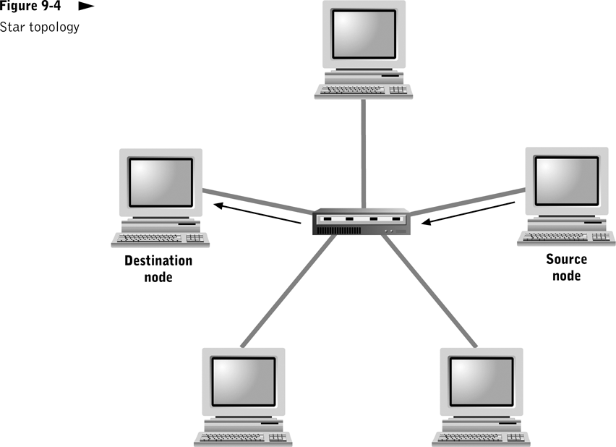

Slide 9
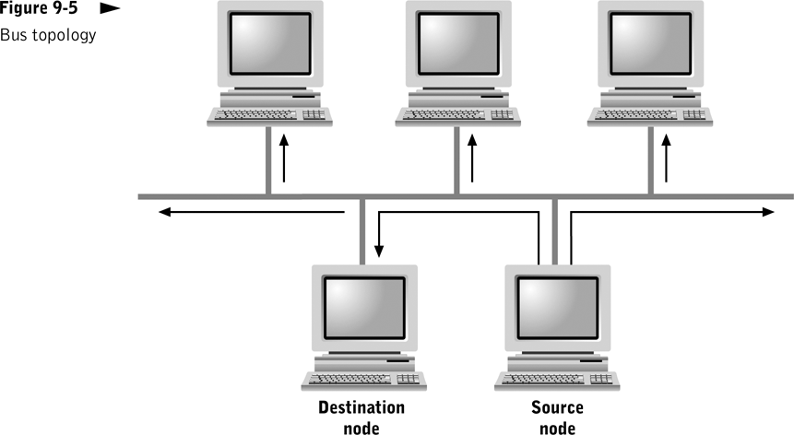

Slide 11
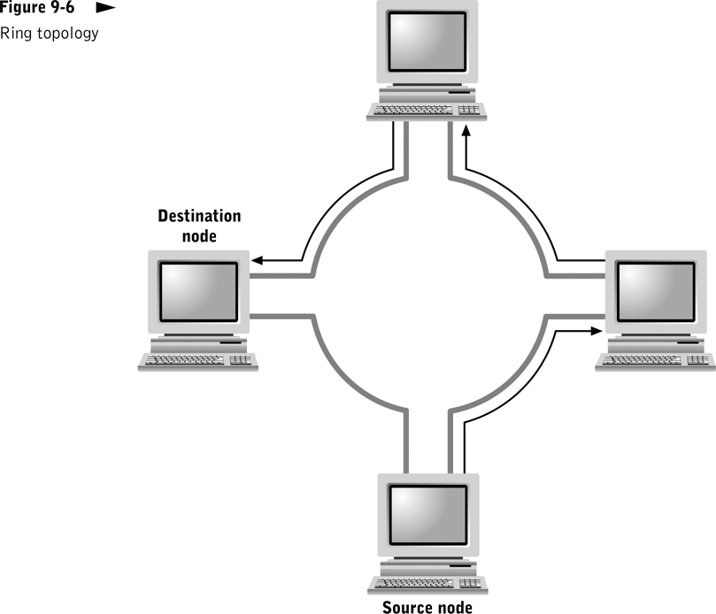

Slide 14
Case Study – Topology
Star?
Bus?
Ring?

Slide 15
What did you learn?
What are the three basic topologies used for computer networks, ____, ___, and ____.
A network using a physical ____ topology connects all nodes to a central device.
star
bus
ring
star

Slide 16
Addressing and Routing
How messages sent by end nodes find their way through transmission lines and central nodes to their ultimate destination
Local area networks (LANs)
Wide area networks (WANs)

Slide 17
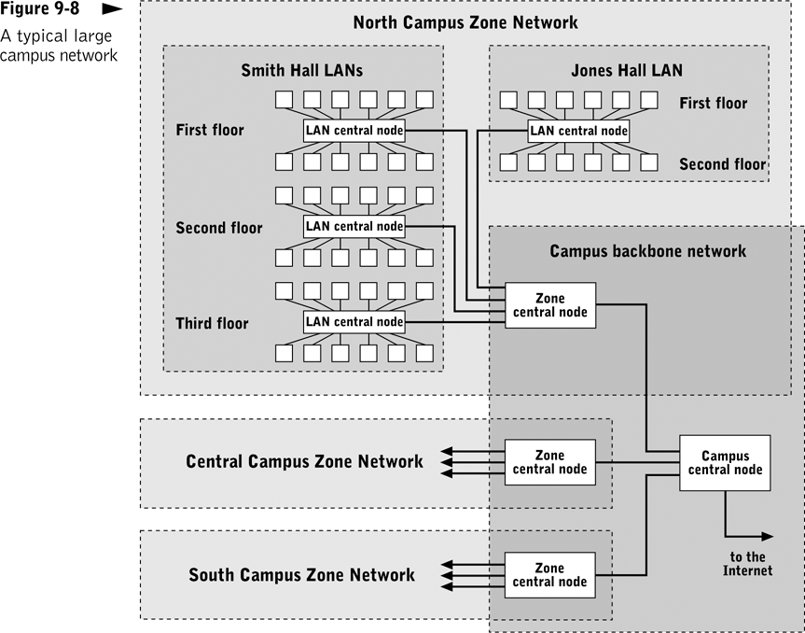
Example of a WAN including end nodes, LANs, zone networks, the campus backbone network, and central nodes.
Notes:
LAN Routing
Each central node maintains and uses a routing table to make routing decisions
LAN hub or switch usually handles packet routing
WAN Routing
Packet routing uses a store and forward approach
Forwarding stations can be implemented using bridges and routers

Slide 18
Question?
In your own words, what happens on an Ethernet network when network utilization gets high (i.e. > 70%)? Why?

Slide 19
Media Access Control
What is a “media access control” protocol?
What are the two types of media access control protocols you will most likely encounter?
Notes:
Uses a protocol that specifies rules for accessing a shared transmission medium
Carrier Sense Multiple Access/Collision Detection (CSMA/CD)
Token passing MAC protocol

Slide 20
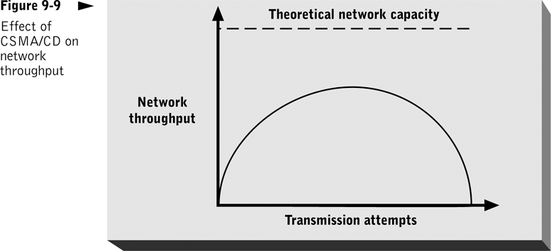
Notes:
CSMA/CD
Process
Node listens for an idle state, transmits a packet, and listens for a collision
If a collision is detected, node retransmits after waiting a random waiting period
Primary advantage: simplicity
Primary disadvantage: potentially inefficient use of data transfer capacity

Slide 22
What did you learn?
When two messages are transmitted at the same time on a shared medium, a(n) ________ has occurred.
Under the __________ media access strategy, collision can occur, but they are detected and corrected.
collision
CSMA/CD

Slide 23
Question?
Why should you always talk about “Network Interface Cards (NICs)” and not “Network Interface Units (NIUs)”?
Notes:
NIC
Interface between network node and network transmission medium
Scan destination address of all packets
In bus network: ignores all those not addressed to it
In ring network: retransmits all packets not addressed to it
Implement media access control functions
Wireless NIC in laptops and iPod Touch

Slide 24
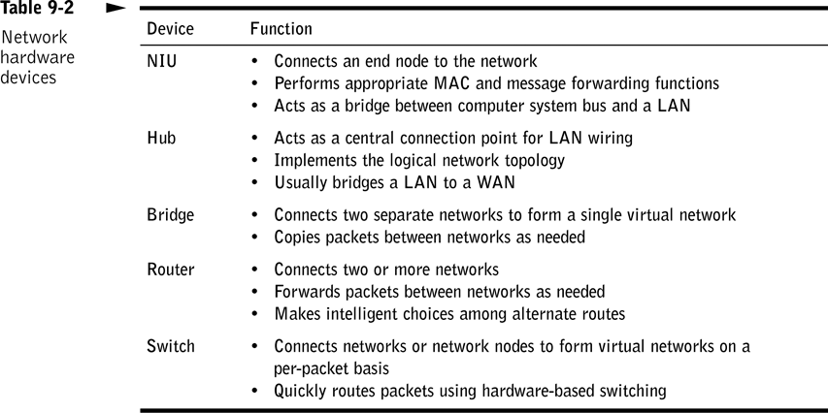
Network Hardware

Slide 25
Question?
In your own words, which is better, a hub or a switch? Why?
Notes:
Function of a switch vs. a hub. A switch is used to connect various network segments. A network switchis a small hardware device that joins multiple computers together within one local area network (LAN). A Hub connects multiple Ethernet devices together, making them act as a single segment.

Slide 26
Case Study – Switches & Hubs
Connectivity Devices:
Hubs
Switches
Notes:
Hubs
Connect nodes to form a LAN
Combine separate point-to-point connections between nodes and the hub into a single shared transmission medium by repeating all incoming packets to every connection point
Low-cost alternative for home and small office networks
Managed or unmanaged

Slide 27
Case Study – Switches & Hubs
Connectivity Devices:
Hubs
Switches
Notes:
Switches
High-speed devices that create virtual LANs on a per-packet basis
Each input connection is treated as a separate LAN
Dramatically increase network performance
Connection decisions made by hardware are based only on destination address
Each virtual LAN has only one sending and one receiving node; eliminates congestion
Managed or unmanaged

Slide 28
Case Study – Routers
Making backbone networks and WANS:
Routers
Bridges
Notes:
Routers
Intelligently route and forward packets among two or more networks
Forward packets based on information other than destination address
Build internal “map” of the network; constantly scan it to monitor traffic patterns and network node changes
Modular routers/Managed or unmanaged

Slide 29
What did you learn?
A microcomputer or workstation hardware interface to a network transmission medium is called a(n) ____.
NIC

Slide 30
What did you learn?
When creating a LAN using the star topology, you will typically use either a ____ or a ______ as the connectivity device.
When creating a WAN, you will typically use either a ______ or a ______ as the connectivity device.
hub
switch
router
bridge

Slide 31
Question?
How many of you have wireless networks at home?
Have you secured your network? If so, how?
If not, you better!

Slide 32
Wireless Networks
  Association - communication that occurs between a station and an access point
    A station might choose a different access point through a process called re-association
  There are two types of scanning: active and passive
    In active scanning, the station transmits a special frame, known as a probe, on all available channels within its frequency range
    In passive scanning, a wireless station listens on all channels within its frequency range for a special signal, known as a beacon frame, issued from an access point
  Service Set Identifier (SSID), a unique character string used to identify an access point
Notes:
Not in book so simply discuss, don’t ask tough questions.

Slide 33
Wireless Networks (continued)
  802.11b – 11 Mb/sec
    Also known as “Wi-Fi,” for Wireless Fidelity
    802.11b was the first to take hold
    It is also the least expensive of all the 802.11 WLAN technologies
  802.11a – 54Mb/sec
    Faster but more expensive than 802.11b so not popular
    Not compatible with 802.11b or 802.11g
  802.11g – 54 Mb/sec
    As fast as 802.11a but using the same basic, inexpensive technology as 802.11b
    Compatible with 802.11b
  802.11n – 150 Mb/sec
  802.11ac (still in draft), 802.11 ad (expected February 2014)

Slide 34
Case Study – Wireless
How would you provide wireless connectivity?

Slide 35
TCP/IP
The core Internet protocol suite
Delivers most services associated with the Internet
  File transfer via FTP
  Remote login via Telnet protocol
  Electronic mail distribution via SMTP
  Access to Web pages via HTTP
Notes:
IP
Provides connectionless packet transport across LANs and WANs
Assumes datagram will traverse multiple networks via nodes called gateways
Determines transmission routes via related protocols (ICMP, RIP)
IP nodes - Identified by unique 32-bit address (nnn.nnn.nnn.nnn)
IP is the mailman…
does the mailman know what is in your mail? No!
does the mailman care what is in your mail? No!

Slide 36
TCP/IP
The core Internet protocol suite
Delivers most services associated with the Internet
  File transfer via FTP
  Remote login via Telnet protocol
  Electronic mail distribution via SMTP
  Access to Web pages via HTTP
Notes:
TCP
Provides connection-oriented packet transport to higher-level Internet service protocols, including HTTP, FTP, and Telnet
Performs connection management functions (verifying receipt, verifying data integrity, controlling message flow, securing message content)
Sender and recipient TCP layers maintain information about one another (message routes, errors encountered, transmission delays, status of ongoing data transfers)
Uses positive acknowledgment protocol to ensure data delivery

Slide 37
Life and Death of an IP Packet…

Slide 38
What did you learn?
Packet loss can't always be detected by a receiver if a(n) _____________ protocol is in use.
Under TCP/IP, a _______________ is the basic data transfer unit.
connectionless
datagram or packet

Slide 39
Question?
How many bits in an IP address?
How many of these bits identify the network?
How many of these bits identify the host on a particular network?

Slide 40
TCP/IP Addressing
Two kinds of addresses: Logical or physical
  Logical (or Network layer) can be manually or automatically assigned and must follow rules set by the protocol standards
  Physical (or MAC, or hardware) addresses are assigned to a device’s network interface card at the factory by its manufacturer
  Addresses on TCP/IP-based networks are often called IP addresses

Slide 41
TCP/IP Addressing (continued)
  IP addresses are assigned and used according to very specific parameters
    Each IP address is a unique 32-bit number, divided into four octets, or sets of 8-bits, that are separated by periods
    An IP address contains two types of information: network and host
    From the first octet you can determine the network class
      Class A
      Class B
      Class C

Slide 42
TCP/IP Addressing (continued)
Binary and Dotted Decimal Notation
  A decimal number between 0 and 255 represents each binary octet (for a total of 256 possibilities)
  The binary system is the way that computers interpret IP addresses
  In this system every piece of information is represented by 1s and 0s and each 1 or 0 constitutes a bit

Slide 43
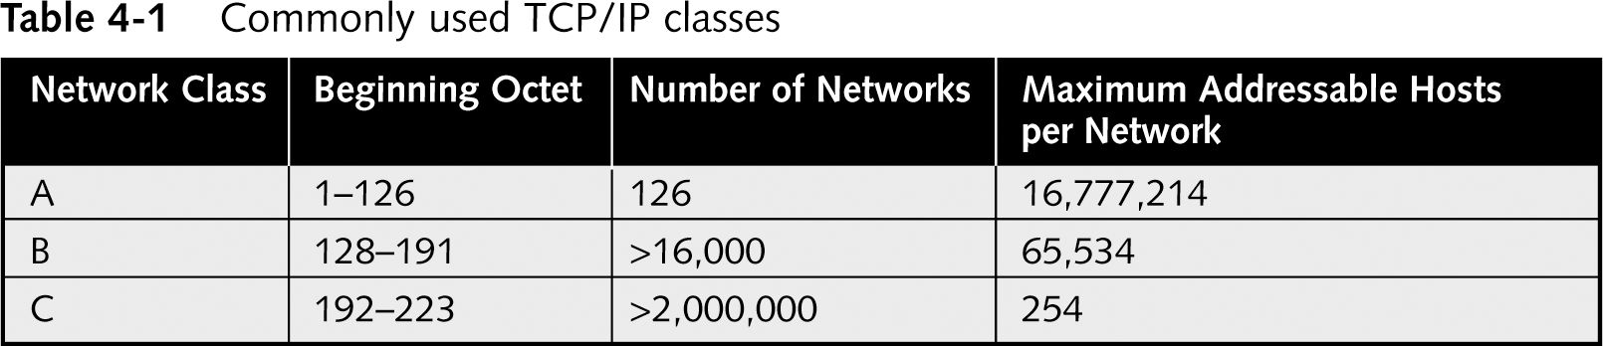
TCP/IP Addressing (continued)

Slide 44
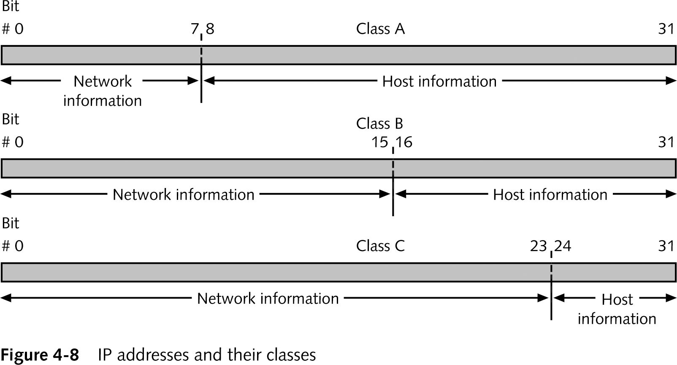
TCP/IP Addressing (continued)

Slide 45
In Class Activity – ipconfig /all
IP Addresses & Default Gateway

Slide 46
Question?
What technology do we use to hand out IP addresses?
How to I check my current IP address and see which server handed it out?
What technology do we use to map IP addresses to names?
What technology do we use to map names to IP addresses?
What tool do I use to query either a name or an IP address?

Slide 47
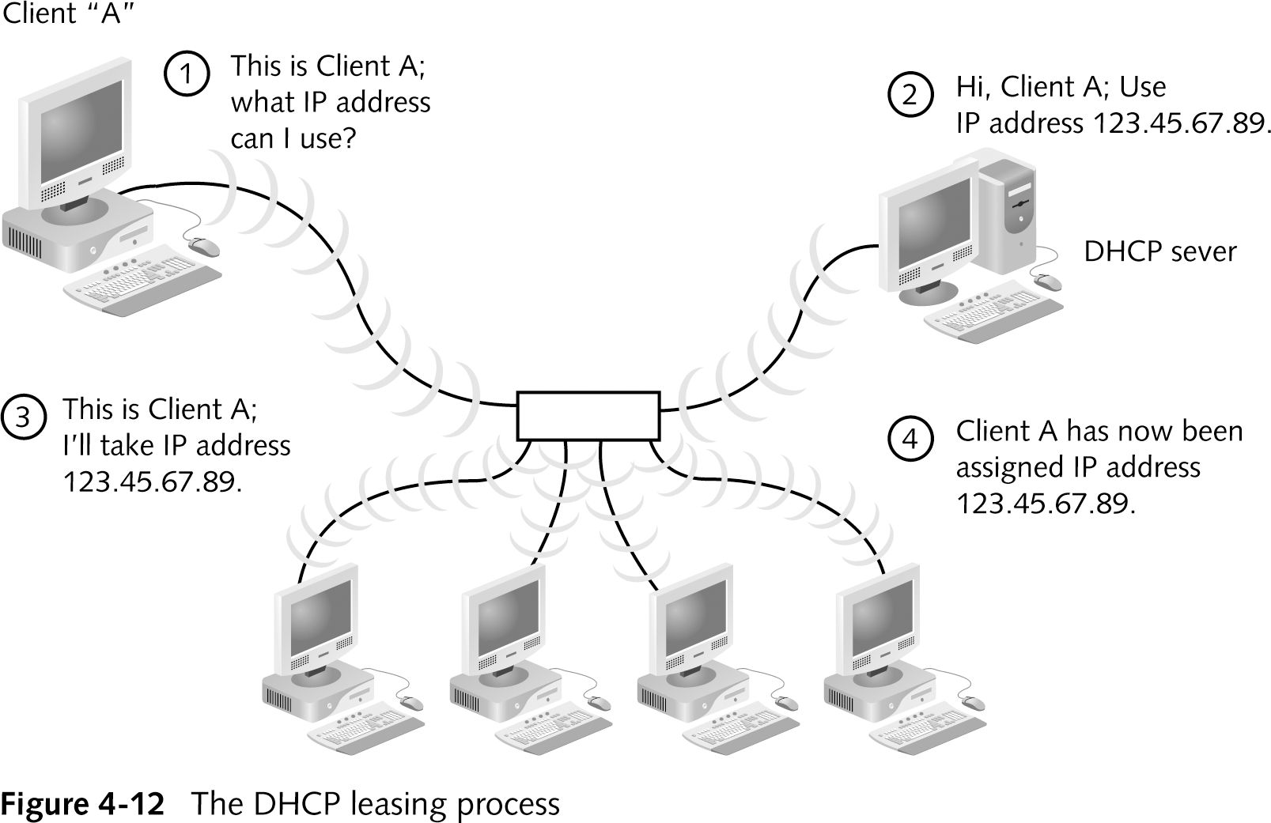
DHCP
Notes:
Dynamic Host Configuration Protocol (DHCP)
An automated means of assigning a unique IP address to every device on a network
DHCP does not require a table of IP and MAC addresses on the server. Uses policy instead of table.
DHCP does require configuration of DHCP service on a DHCP server
Remember plugging in the IP address on your laptop or iPod Touch?
Terminating a DHCP Lease
A DHCP lease may expire based on the period established for it in the server configuration or it may be manually terminated

Slide 48
In Class Activity – ipconfig /release & ipconfig /renew
DHCP Servers

Slide 49
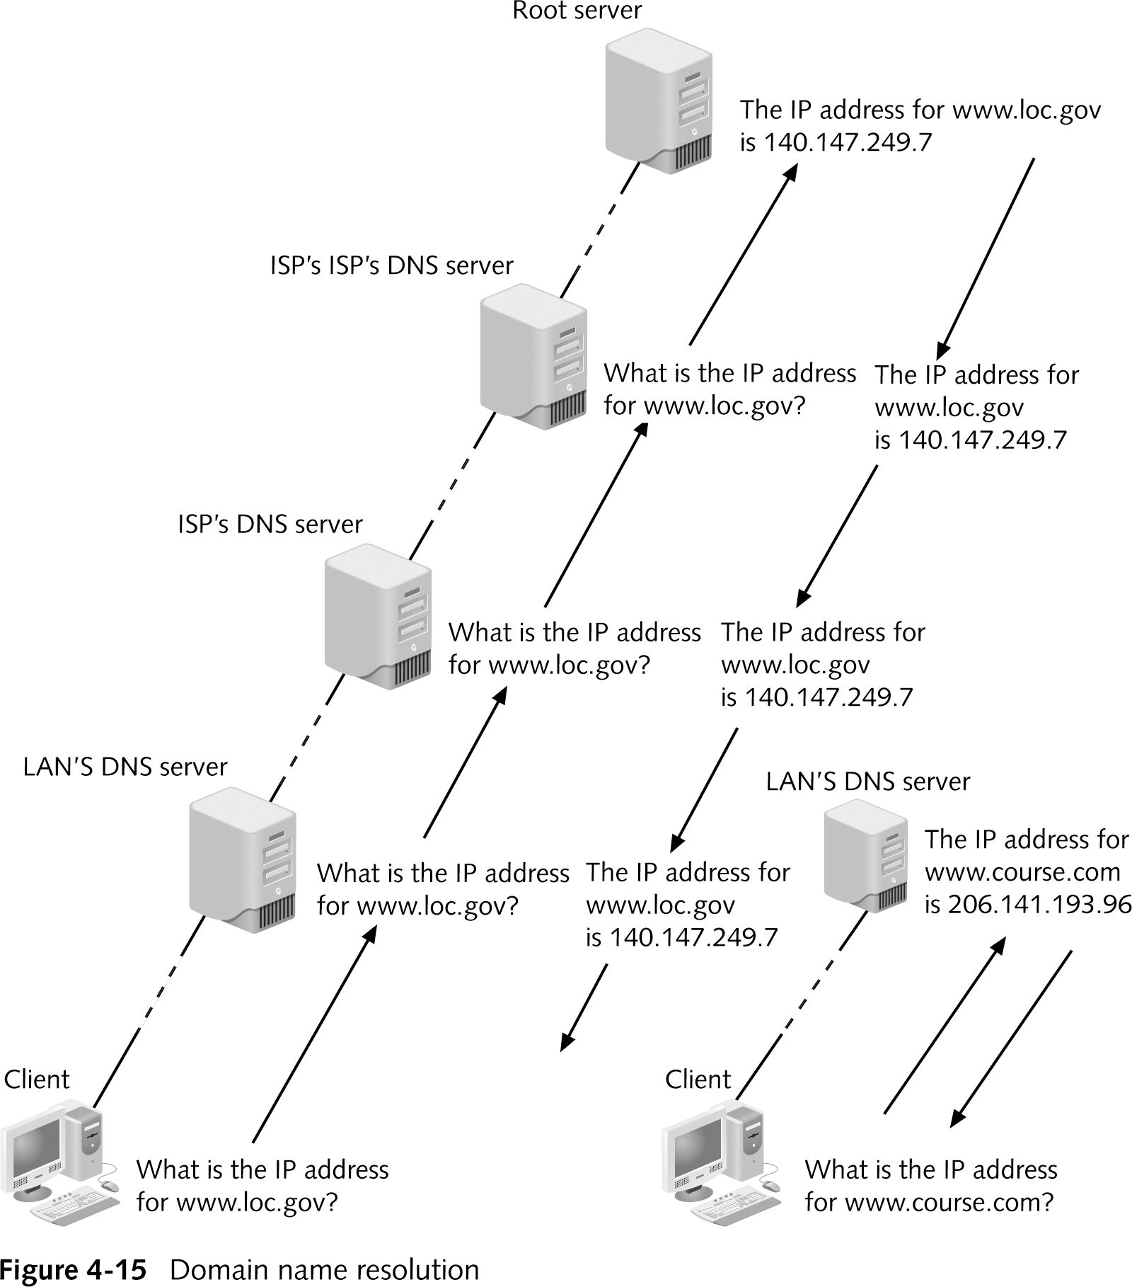
TCP/IP (continued)
Notes:
A hierarchical way of associating domain names with IP addresses
The DNS service does not rely on one file or even one server, but rather on many computers across the globe
These computers are related in a hierarchical manner, with thirteen computers, known as root servers, acting as the ultimate authorities

Slide 50
DNS

Slide 51
In Class Activity - nslookup
DNS Servers

Slide 52
What did you learn?
Machines can be configured to utilize ______ which will hand out IP addresses from a pool of available IP addresses.
When an application needs to map a name to an IP address or an IP address to a name, the application depends on services from ____.
DHCP
DNS

Slide 53
Case Study – Focus on Networks
LANs
Switches
DNS & DHCP
Routers

Slide 54
Review
Computer Networks
  Network topology
  Addressing and routing
  Media access control
  Network hardware
  TCP/IP

