Slide 1
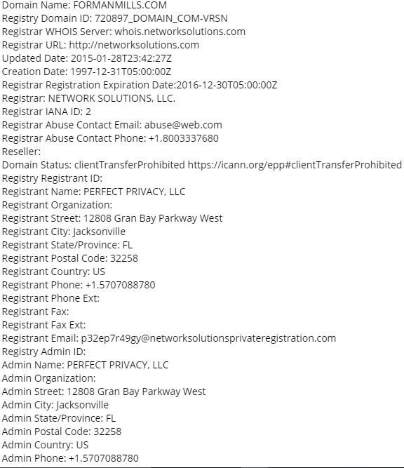
WHOIS ANALYSIS
Mauchel Barthelemy – MIS 5211 | Fall 2016
Reconnaissance Analysis Report
ForManMills - www.formanmills.com
Reveals Domain ID information
Headquarters location
Administration emails
Domain start/expiration dates
Critical server names

Slide 2
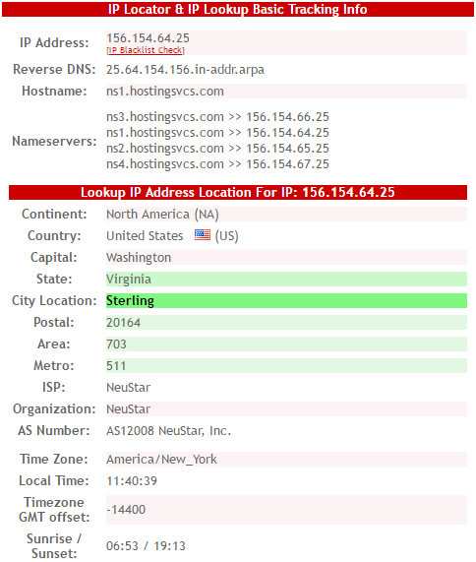
DNSSTUFF & IP-TRACKER ANALYSES
Mauchel Barthelemy – MIS 5211 | Fall 2016
Reconnaissance Analysis Report
ForManMills - www.formanmills.com
General IP address and server info
http://www.ip-tracker.org reveals

Slide 3
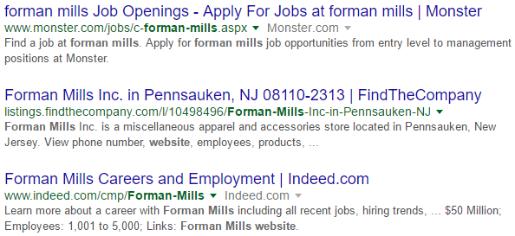
ACCCESSIFY ANALYSIS AND GOOGLE HACKS
Mauchel Barthelemy – MIS 5211 | Fall 2016
Reconnaissance Analysis Report
ForManMills - www.formanmills.com
Accessify discloses technology resources
Site:formanmills.com -www.formanmills.com

Slide 4
MITIGATION STRATEGIES
Mauchel Barthelemy – MIS 5211 | Fall 2016
Reconnaissance Analysis Report
ForManMills - www.formanmills.com
Test systems regularly
Interpret IT Security as a priority and corporate culture
Think like a hacker (in an ethical manner)
Apply IDS, firewalls and vulnerability scanner programs (Nessus)

