Slide 1
Aramark Corporation
1) Aramark is an American provider of food, facilities, and uniform services provider to education, healthcare, business & industry, and sports, leisure & corrections clients
2) It is headquartered at the Aramark Tower in Center City, Philadelphia, Pennsylvania. Aramark's revenues reached 14.329 billion USD in 2015 and was listed as the 21st largest employer on the Fortune 500

Slide 2
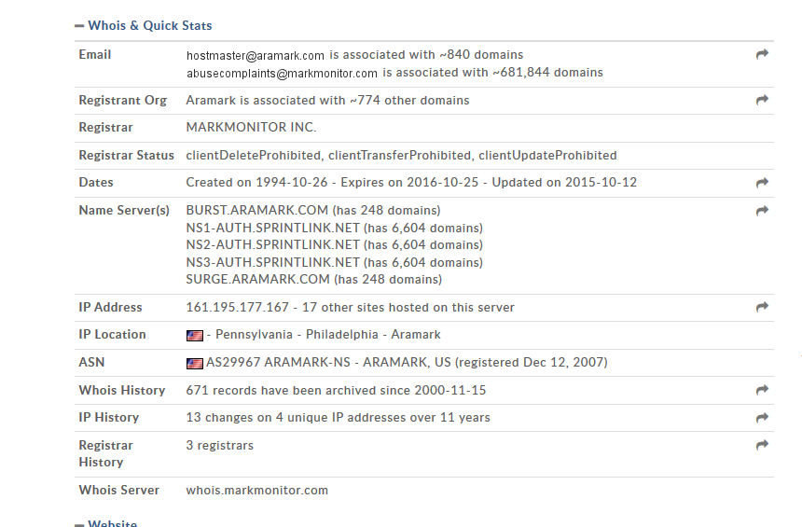
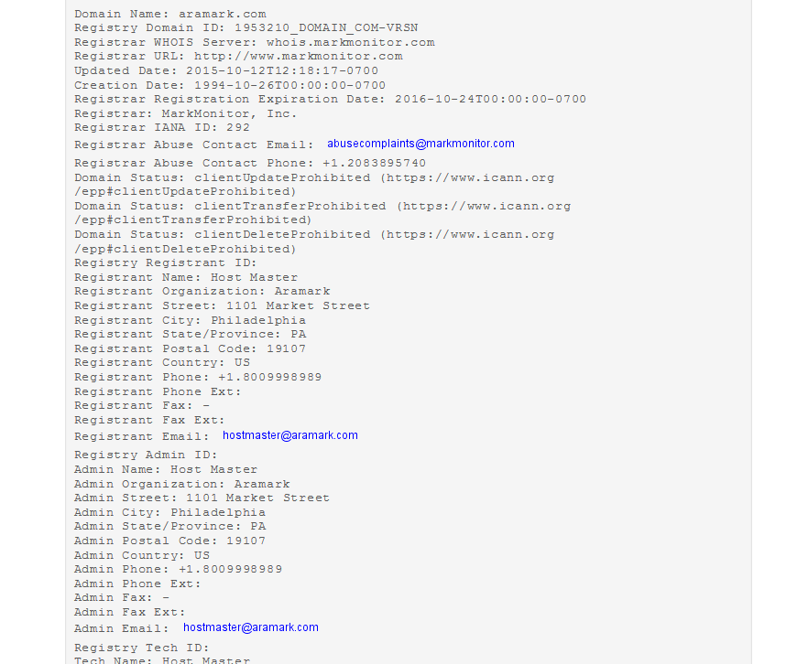
Steps to gather information as passive reconnaissance—
WHOIS

Slide 3
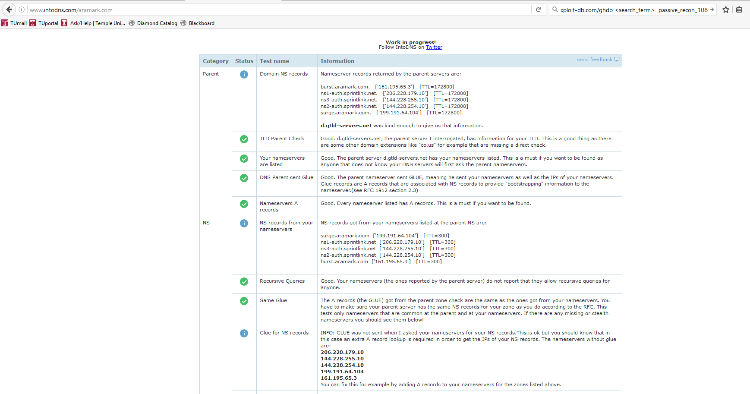
2) Intodns.com –To find list of DNS

Slide 4
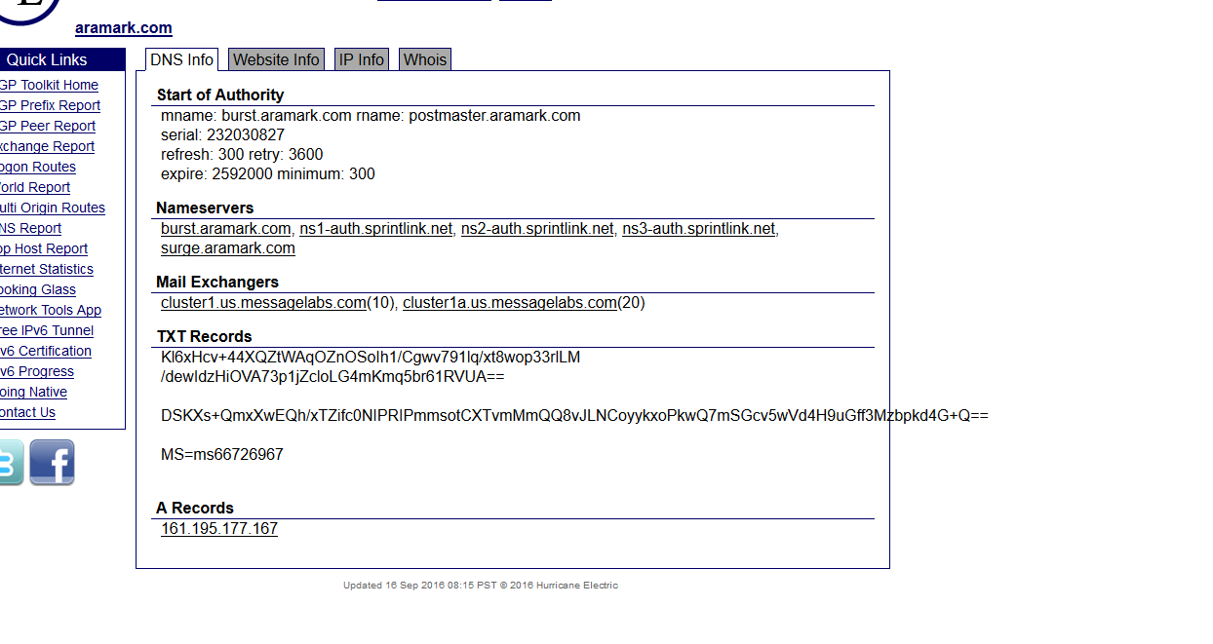
3) Trying to figure out the IP Address of the subdomains

Slide 5
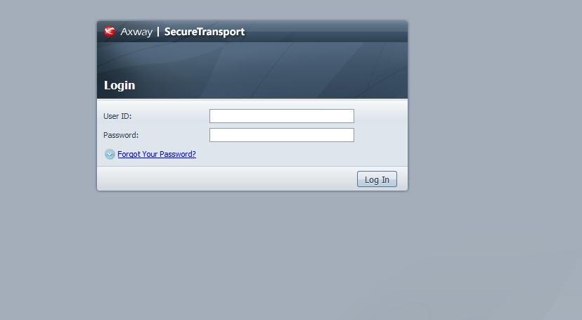
4) Google search through use of keywords like :site, :inurl to
more information regarding the Domains and subdomains

Slide 6
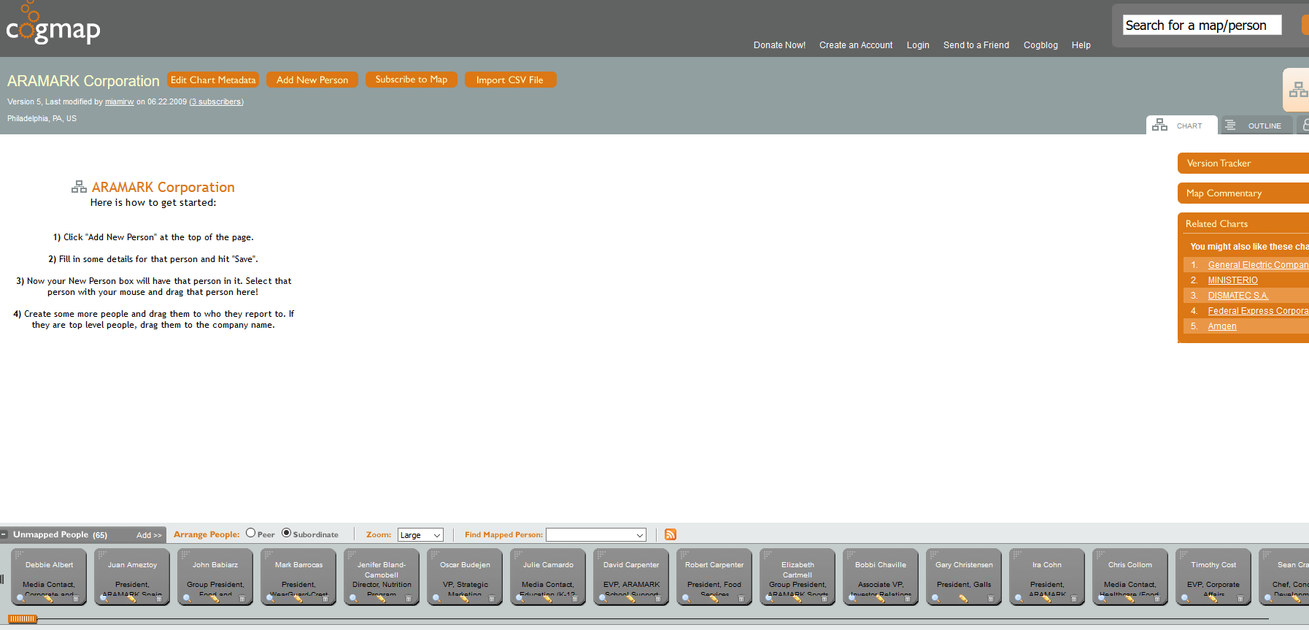
5) Cogmap site to get names of employee

Slide 7
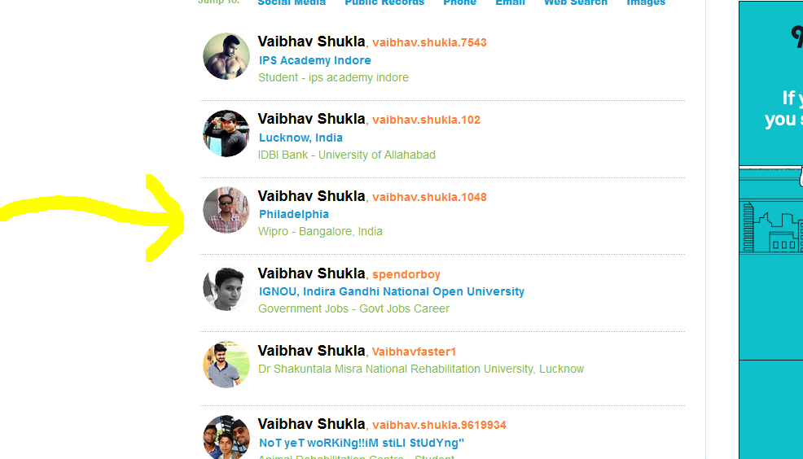
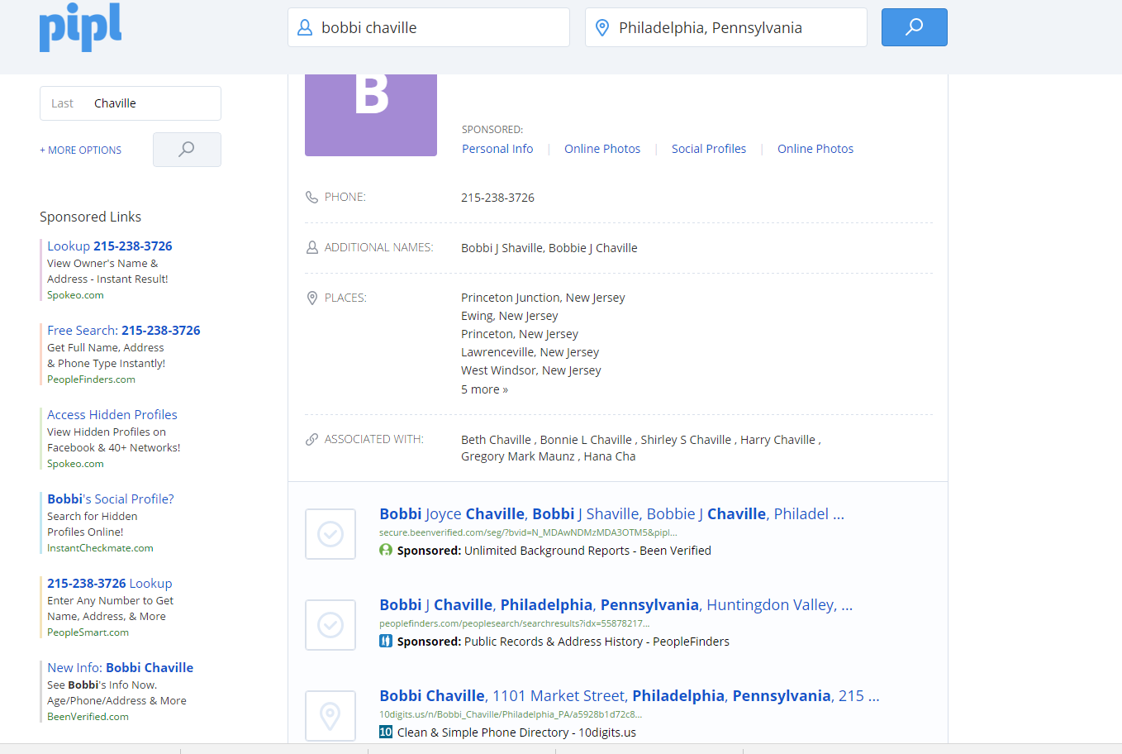
6) Pipl-To gather the more information with
the popularly used usernames by the employee on internet

