Slide 1
Aramark Reconnaissance
Anthony Fecondo

Slide 2
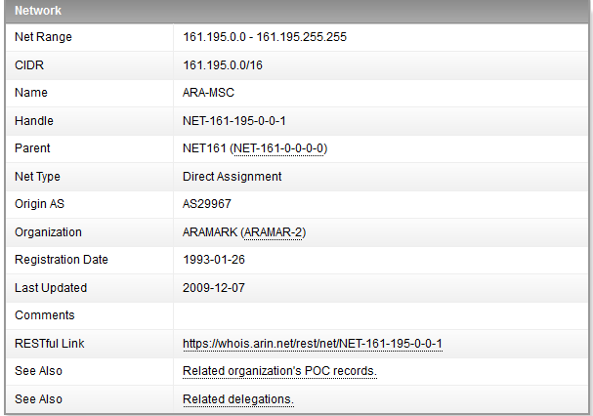
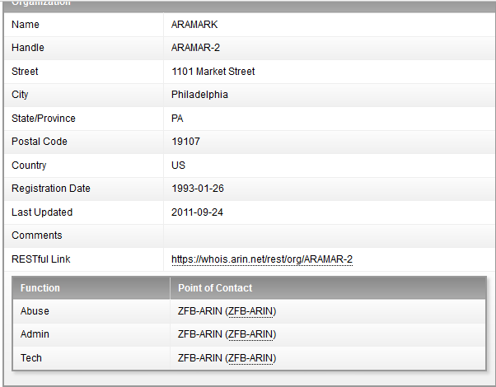
Nslookup & ARIN
IP Addresses
Address
Point of Contact
Cell number
Office number
Work E-mail

Slide 3
Google Hacking
Intext: Aramark board of directors
CEO, COO, CFO, VPs
Site: Aramark filetype: pdf and Site: Aramark filetype: xlsx
Site: Aramark intext: confidential
Filetype: xlsx intext: Aramark phone number

Slide 4
Conclusions
Found some information!!
Well handled data, kudos Aramark

