Slide 1
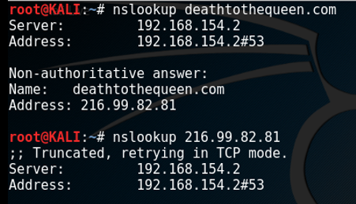
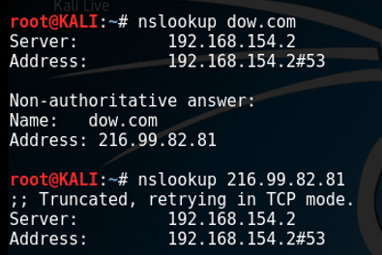
The Purpose of Reconnaissance – Analysis
Dow Chemical → AgroFresh Holdings Berhad
Tools Used
Summary of Findings
Hard Target (v) Soft Target

Slide 2
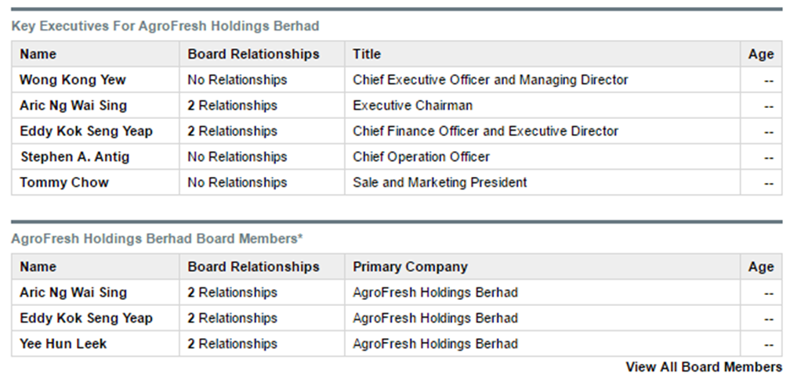
THE ORGANIZATIONAL STRUCTURE:
Familial Ties
Executive Board and Board of Directors
Increased Risk of Ransom/Hacking/Kidnapping

Slide 3
KEY SUPPLIERS AND BUYERS:
Found the working .xls file of buyers and suppliers
Full contact info
Increased Supply Chain Risk
Increased Risk of Social Engineering / Phishing

Slide 4
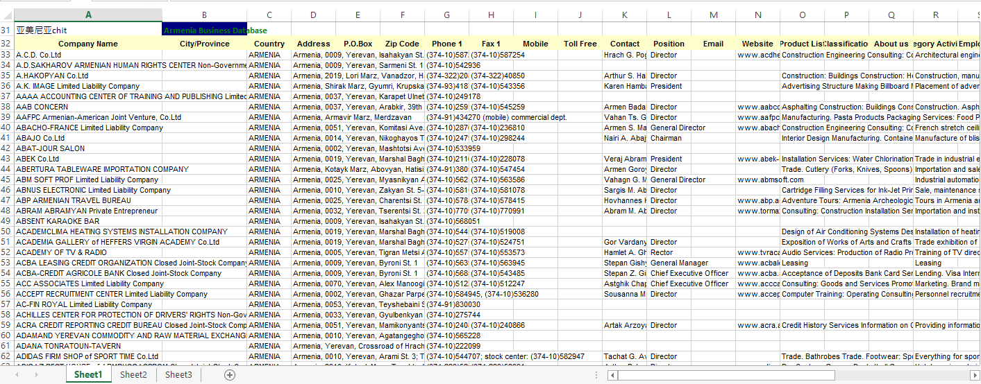
KEY SUPPLIERS AND BUYERS:
Found the working .xls file of buyers and suppliers
Full contact info
Increased Supply Chain Risk
Increased Risk of Social Engineering / Phishing

Slide 5
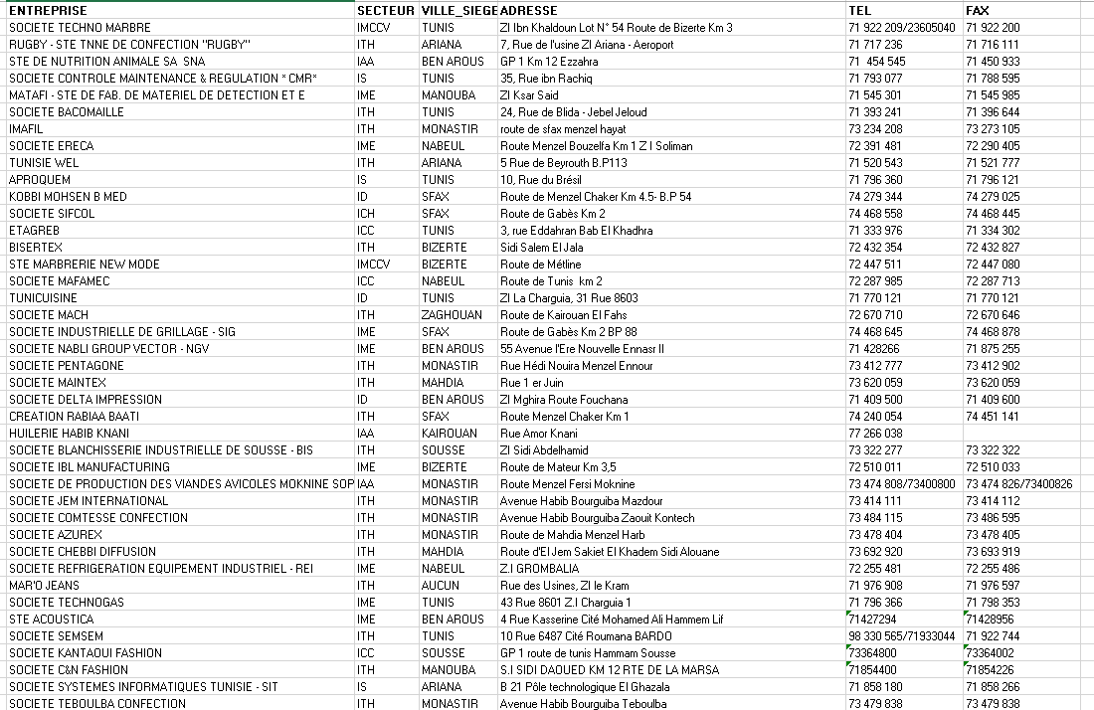
GLOBAL ENTERPRISE PARTNERS:
Obtained an international economic development plan .xls
Contained one of AgroFresh Holding’s subsidiaries
Increased Operational Risk and Takeover Risk
Threaten long-term viability of firm

