Slide 1
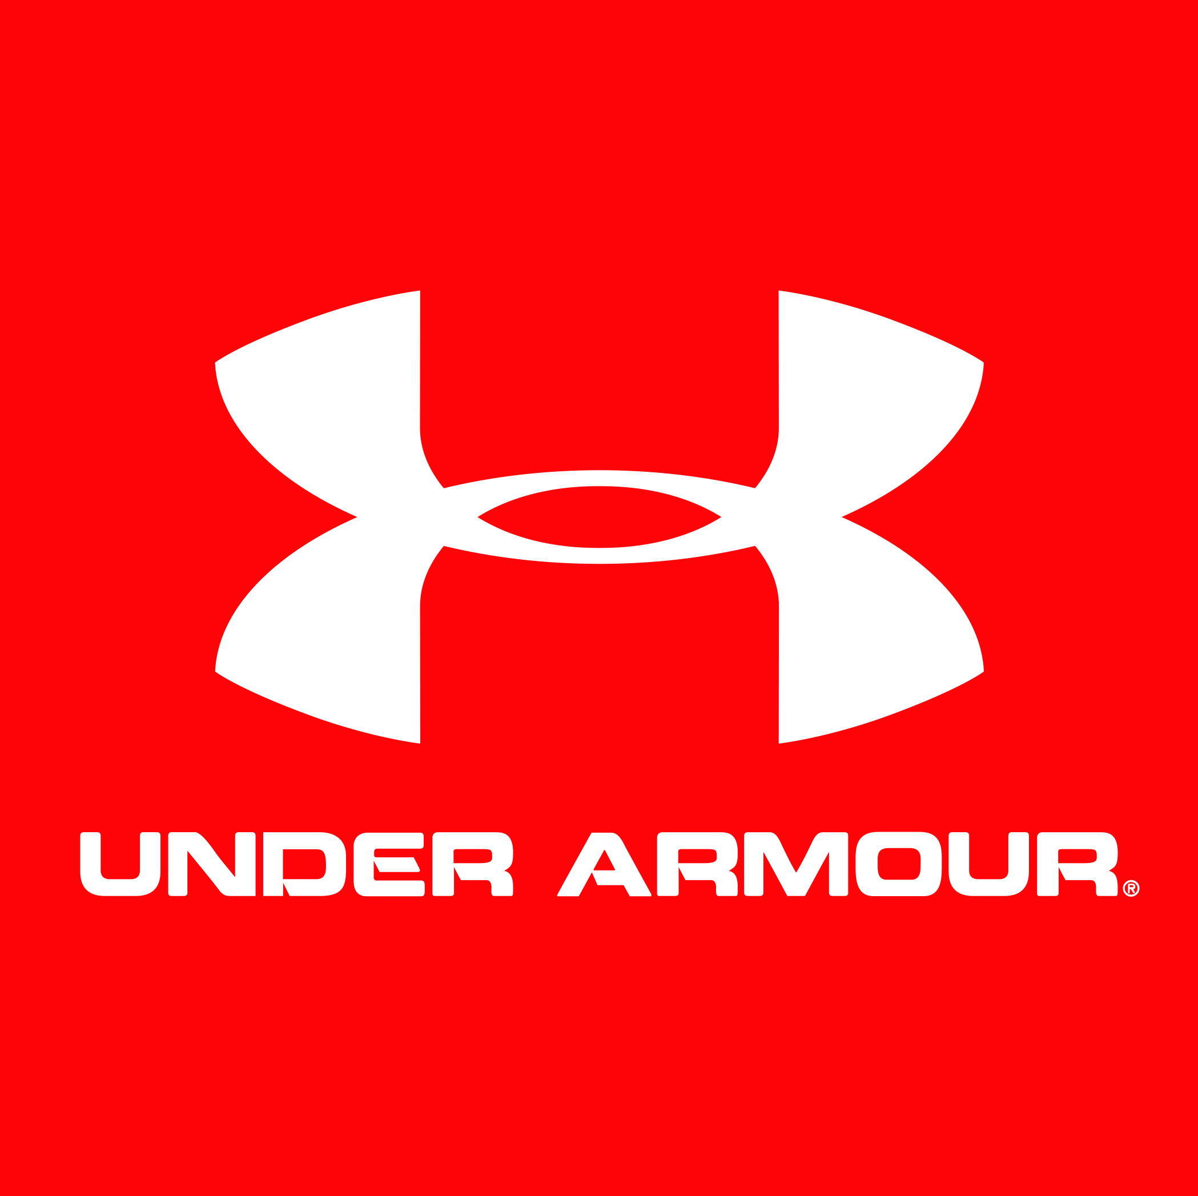
Global performance apparel company founded in 1996 by former athlete, Kevin Plank. The company develops, markets, and distributes several athletic product lines that are meant to prepare athletes for any environment such as heat, cold, and “all-environment”.
Headquarters in Baltimore, Maryland
3.9 Billion in Revenue
11,000 Employees
Corporate & Retail Locations in > 10 countries
1020 Hull Street
Baltimore, MD 21230
Kevin Plank- CEO
Founded company
“Data is the new oil”
Heat Gear, Cold Gear, and All-Weather Gear are biggest product offerings
Major Competitors: Nike, Adidas, Reebok
In 2014, Under Armour hired the former Baltimore Chief of Police as Director of Security

Slide 2
Network Details
Domain Name: UNDERARMOUR.COM
Registrar: CSC Corporate Domains, INC. Registrant details blocked by CSC Corporate Domains, INC.

Slide 3
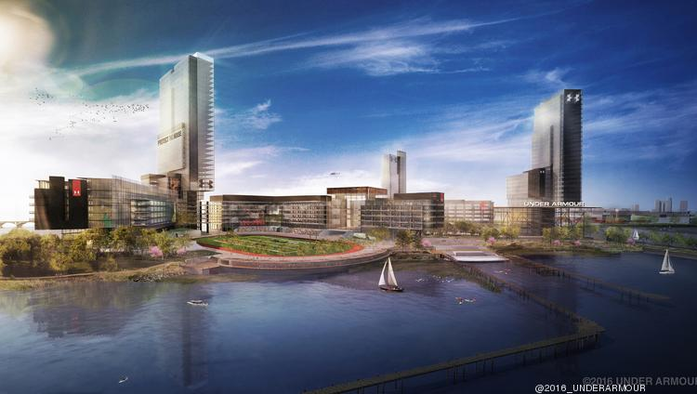
Under Armour in the News
Purchased 100 million users worth of fitness data in 2015
Building new 50 acre waterfront corporate headquarters
Rumors of CEO planning to sell $72 million in company stock

Slide 4
Sources and References
http://gizmodo.com/under-armor-just-bought-100-million-users-worth-of-fitn-1683836948
http://www.underarmour.jobs
http://www.bloomberg.com/news/articles/2016-09-02/under-armour-ceo-to-sell-72-million-in-stock-jolting-investors
https://whois.arin.net/rest/customer/C01933936
https://www.underarmour.com/en-us/customer-service/security-and-privacy-policy
https://en.wikipedia.org/wiki/Under_Armour
http://www.uabiz.com/company/managementTeam.cfm
https://www.linkedin.com/in/paulfipps
https://www.linkedin.com/in/fred-bealefeld-81a6527a?trk=seokp-title_posts_secondary_cluster_res_author_name
http://www.djc.com/news/co/12092864.html
http://www.wareable.com/under-armour/under-armour-health-data-connected-fitness-sxsw-2453
http://www.bizjournals.com/baltimore/blog/real-estate/2016/01/under-armour-port-covington-headquarters-campus.html

