Slide 2
Reconnaissance Report Trillium Technologies
Introduction to Ethical Hacking
Roberto Nogueda

Slide 3
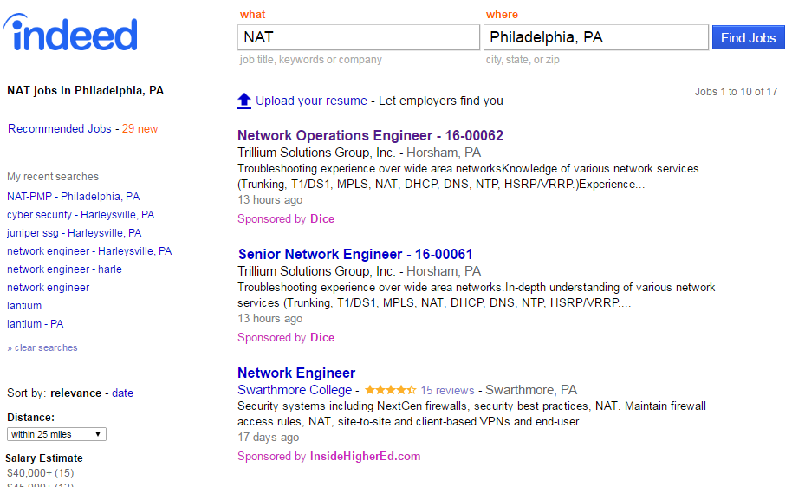
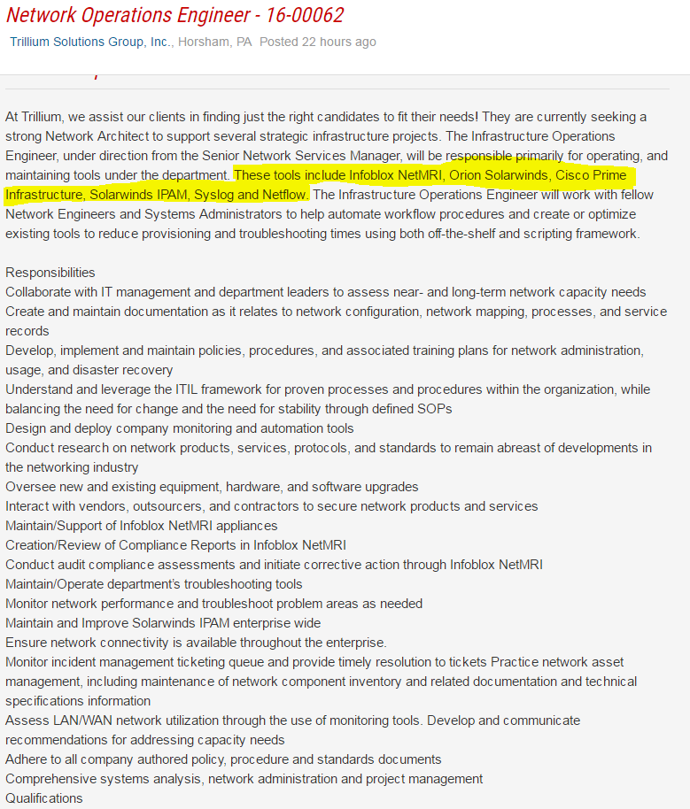

Slide 4
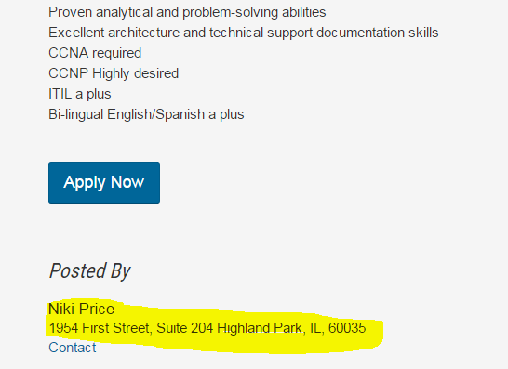
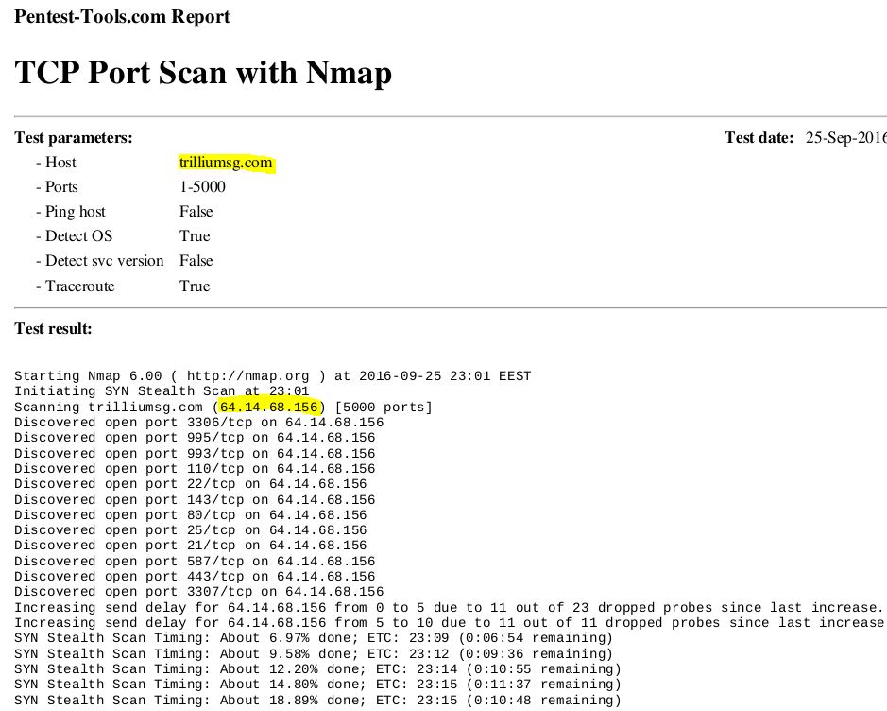
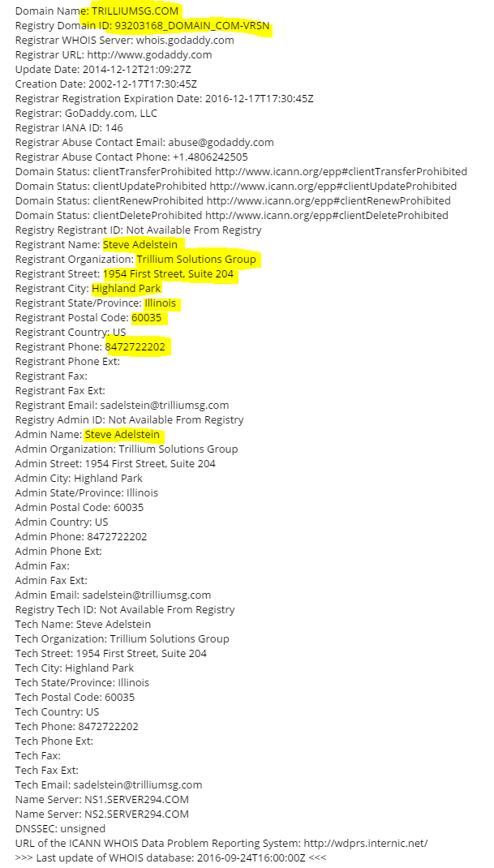
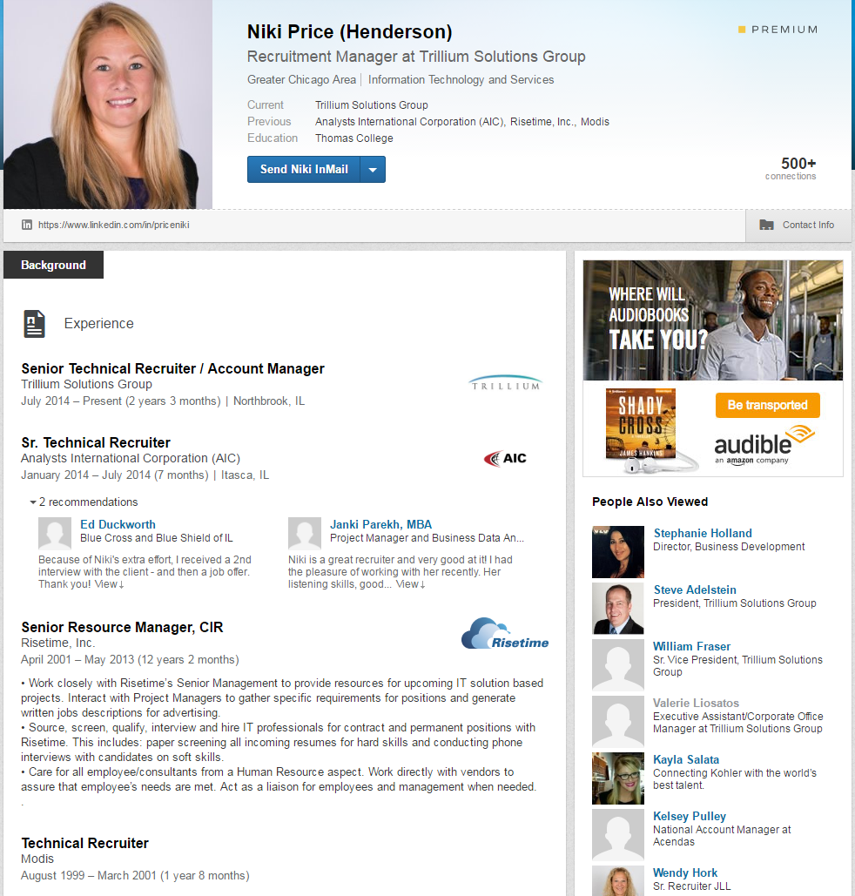
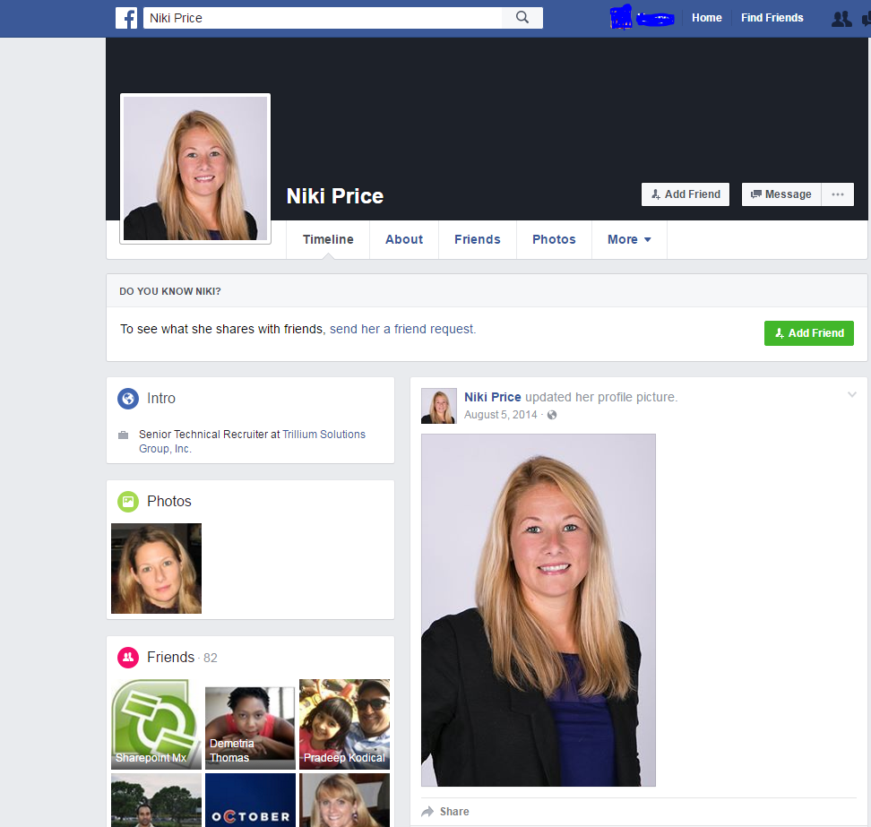

Slide 5
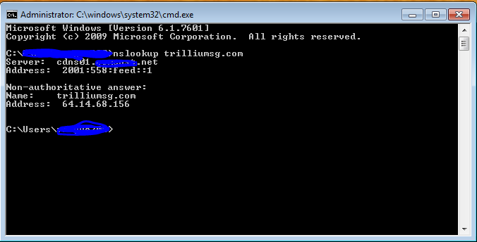
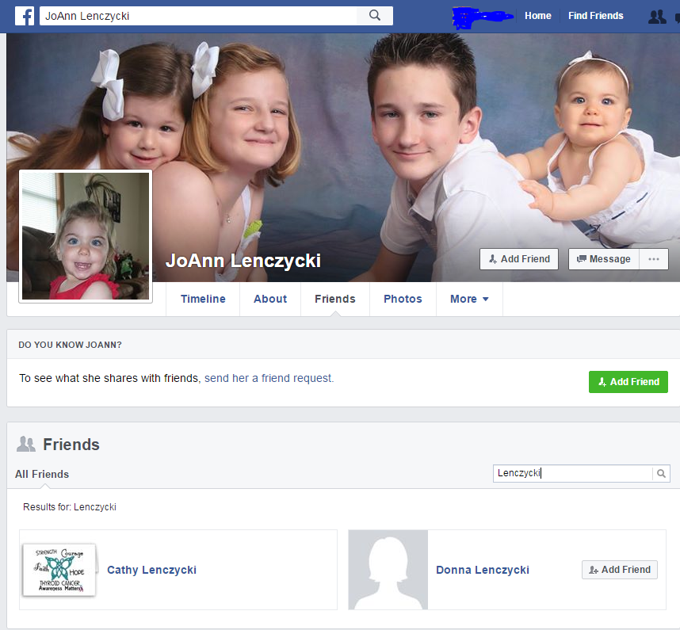
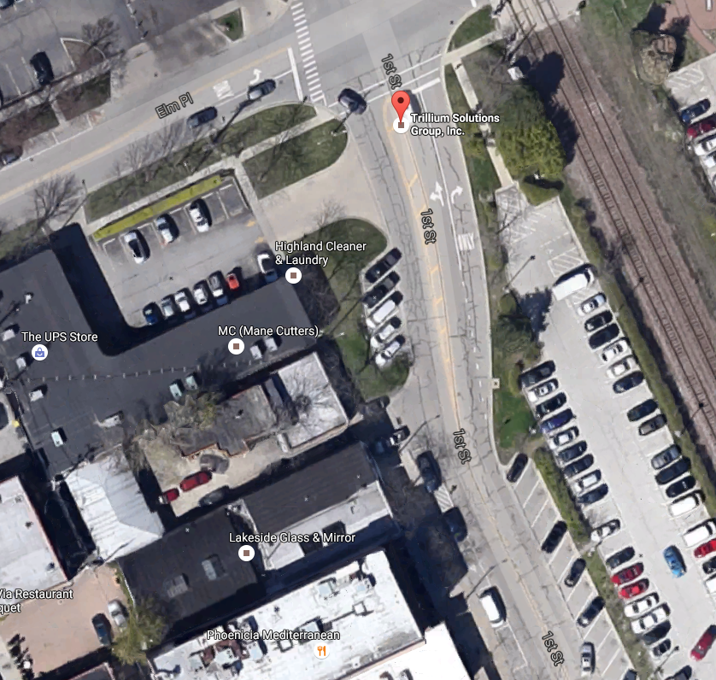
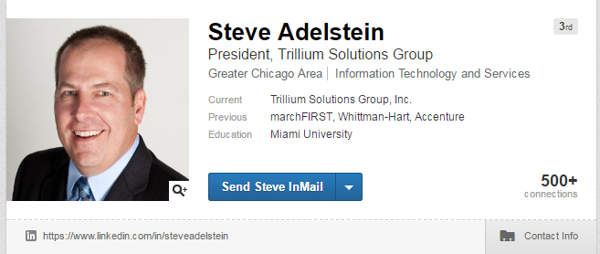
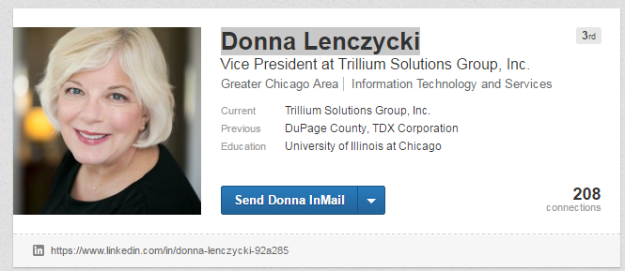

Slide 6
Mitigations and Recommendations for potential attacks
Prevention:
Initiate strong encryption technology on websites and public sites
Avoid exposure to unauthenticated access, unnecessary access to users or employees
Do not click blindly on the hyperlinks that appear in e-mails that came from an unknown source
Increase the perimeter defense of the server with updated firewalls
Website owners should establish trust & reduce risk of Phishing Attack by implementing EV Certificate
Avoid visiting suspicious websites like those, that are not secured with digital certificates, also install appropriate antivirus, anti-malware, and anti-phishing tools
Keep a data backup and place them at a safer place.
Install tools that can test the capacity of your web server against any DOS or DDOS attacks.
Hackers:
Phishing Threats:
Infected Websites:
Spywares, Adware, Trojans:
Social engineering:
Denial of Service (DOS):

