Slide 1
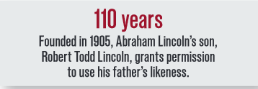
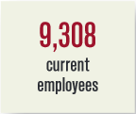
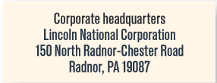
Reconnaissance Report of
Lincoln Financial Group
Mengxue Ni, Mengqi He

Slide 2
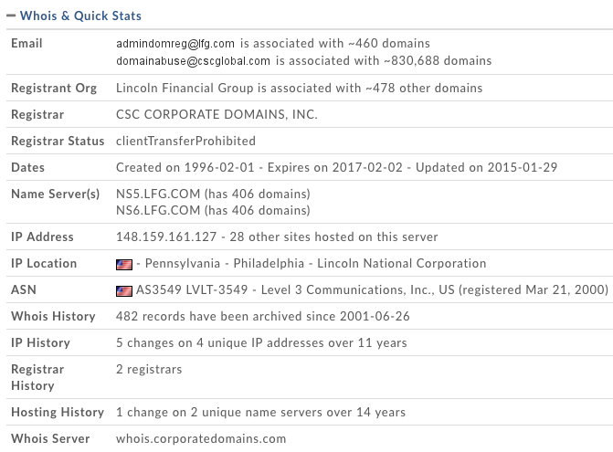
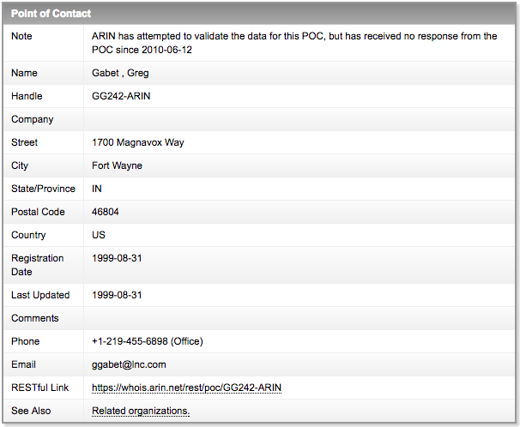
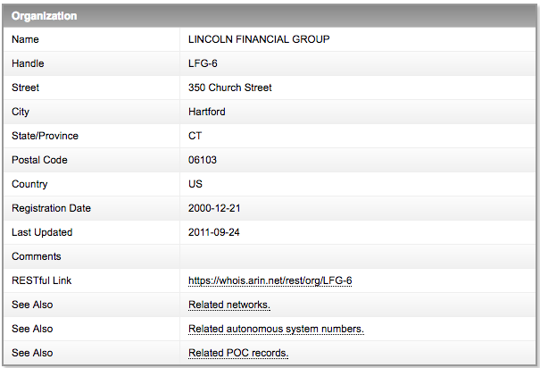
WHOIS ANALYSIS
Domain: ww.flg.com
Domain ID: 2984204_DOMAIN_COM-VRSN
Registration date: 02/01/1996
Expiration date: 02/02/2017
Last update: 01/29/2015
IP address: 148.159.161.127
Location: Philadelphia
5 changes in 11 years.
Name servers:
NS5.LFG.COM and
NS6.LFG.COM.
Emails: admindomreg@lfg.com
Lcation: 1300 S Clinton Street, Fort Wayne, IN.
Whois server: whois.cscproratedomains.com.
2 Point of Contact (PoCs)
Anytown,VA
Fort Wayne, IN.
Tools used: domaintools, DNSstuff, ARIN, netcraft, ip-tracker

Slide 3
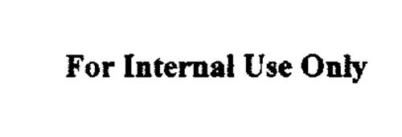
Google Hacking
Used commands:
Intext
Site
Filetype
Inurl
Keywords:
Confidential, sensitive, internal and etc.
Results:
Word (.doc): nothing
PDF(.pdf)::
company overview
key facts about LFG
LFG luxury expenditures policy (internal use only)
Lincoln Marketing Guidelines (internal use only)
Lincoln financial advisors corporation financial planning brochure
Spreadsheets(.xlsx): statistical supplement for fourth quarter 2015

Slide 4
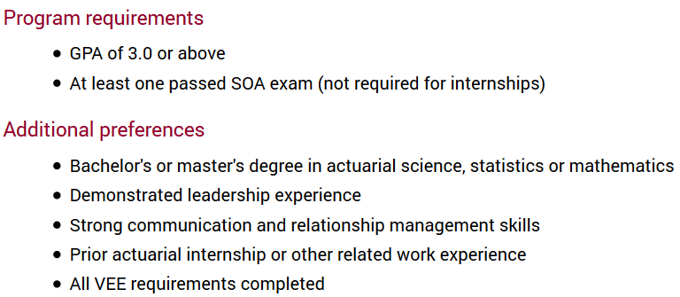
LinkedIn and Job Posting
LinkedIn
Homepage
Glassdoor

