Slide 1
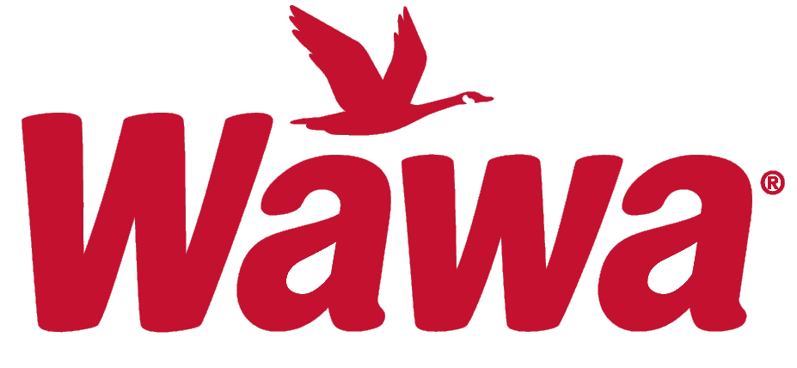
Reconnaissance of Wawa Inc.
By Shain Amzovski
MIS 52011

Slide 2
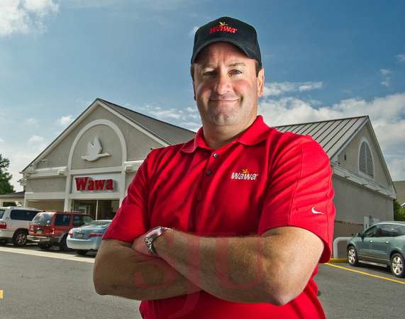
Company Background
Wawa Inc., was founded in Folsom, PA, when its first store opened in April 1964.
The headquarters is located in Wawa, Pennsylvania.
The parent company of Wawa Inc. is Wild Goose Holding Co., which is located in Wilmington, Delaware.
The current CEO and “Head Goose” of Wawa is Chris Gheysens, a Villanova, and St. Joe’s graduate.
Wawa is best-known for its on-the-go food products, coffee, and dairy products. More recently Wawa’s have added gas stations to their stores.
Chris Gheysens
Wawa CEO

Slide 3
Whois Wawa?

Slide 4
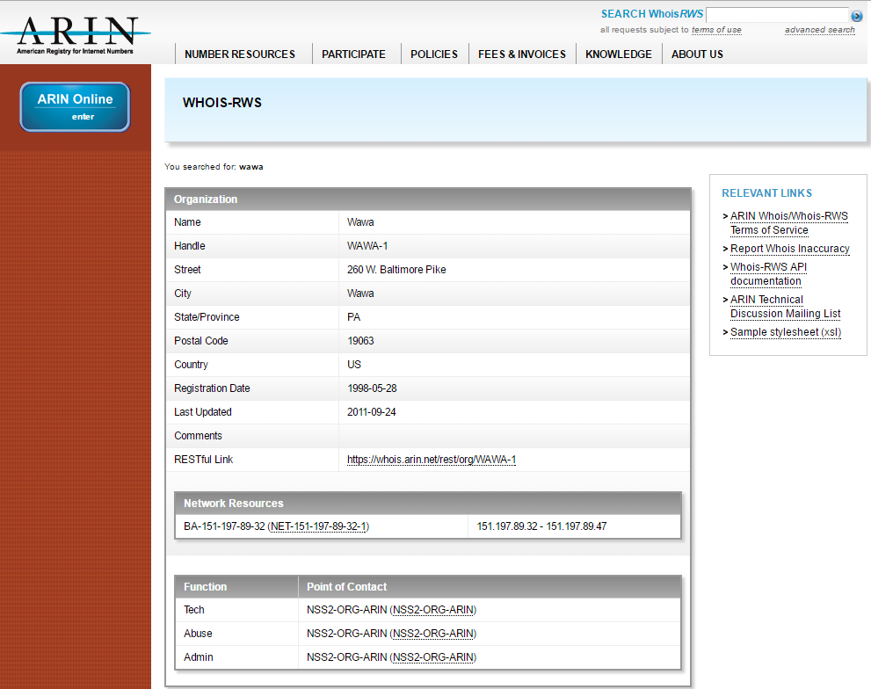
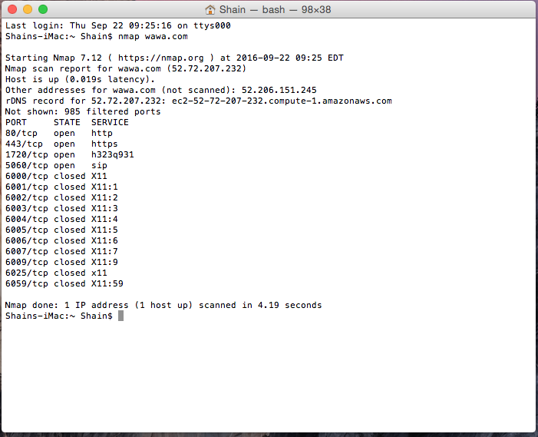
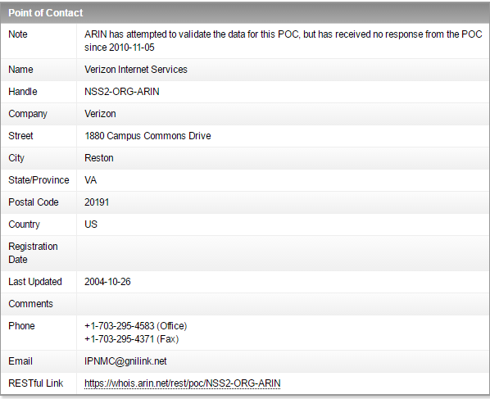
ARIN and nmap

Slide 5
NS Lookup and Dig of Wawa.com

