Slide 1
SHIPPING/TRANSPORTATION INDUSTRY
Banking, technology, government, retail
“follow the data: analyzing breaches by industry”-trend micro
“2016 data breach industry forecast”-experien
Shipping industry “Soft” target

Slide 2
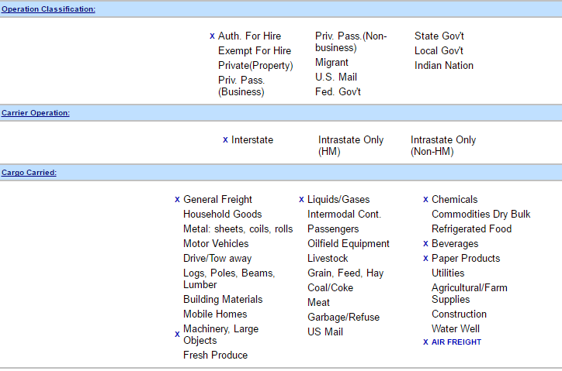
Philadelphia Truck Lines
Medium sized Trucking co. – 49 drivers
Sharon Hill PA base & 11 other locations
Integrated shipping solutions, Time definite air & ocean freight trucking services, expedited & specialized services, container freight station
http://saferfmcsa.dot.gov

Slide 3
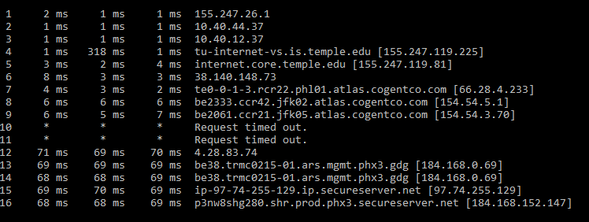
Reconnaissance - http://phltrucklines.com 184.168.152.147
Employees:
Steve Piscitelli, dispatch
Vikey ianoale, director human resources
Nolan smith, operations manager
Bobby brown, corporate sales
Affiliations with major airports
Affiliations with large unions
Road service for large airlines
Open ports/service:ftp, http, https, LSA (windows), iis, ms-lsa, hermers (webmail)

