Slide 1
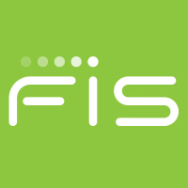
SunGard Reconnaissance
What is SunGard?
Provider of information systems to financial companies
Acquired by FIS
Headquartered in Wayne, PA
Tools used for recon:
Google hacking – best results
ARIN – able to see point of contact for domain
Netcraft – identified web server used
Job posting boards – not much luck, jobs focusing on financial related areas

Slide 2
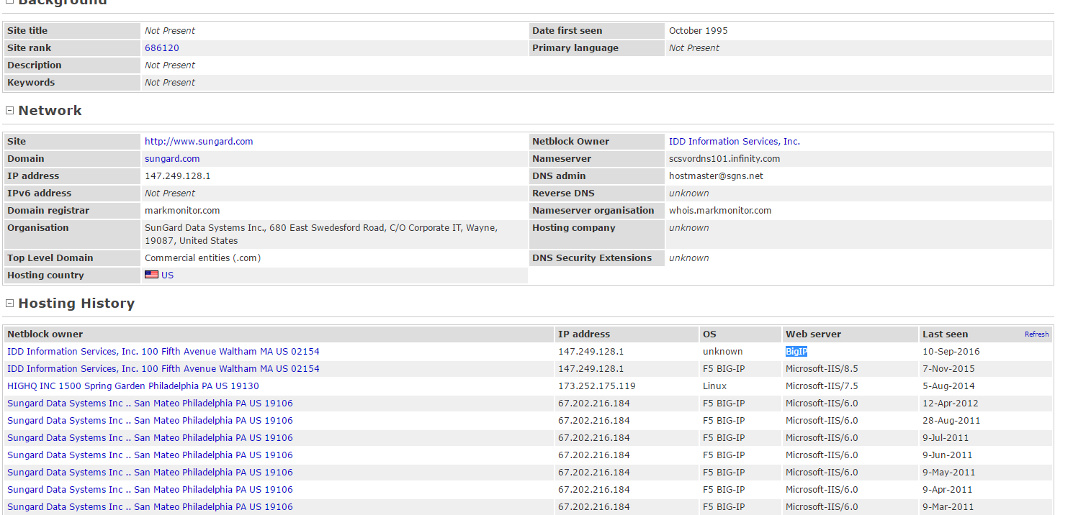
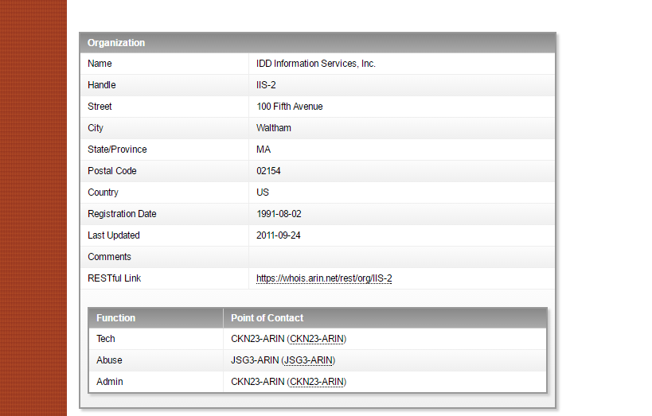
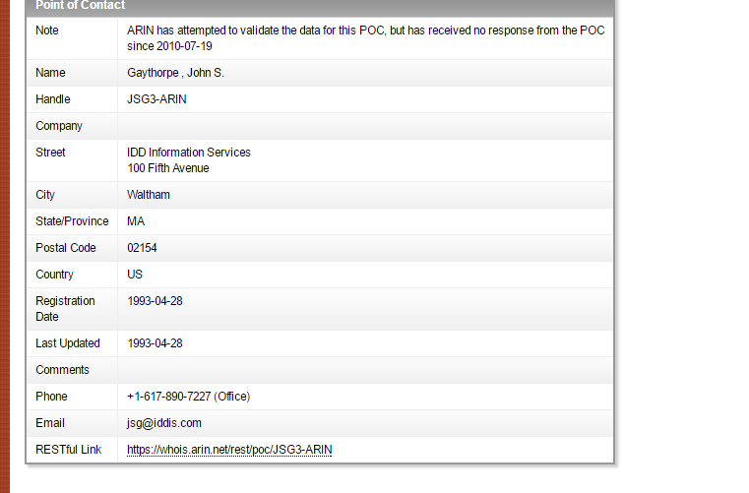
Arin, Netcraft, and Job Postings
Netcraft
Helped identify IP address: 147.249.128.1
Web Server: BigIP
ARIN
Not a lot of information disclosed
Identified one Point of Contact for domain
Job posting
Limited tech jobs
Mostly financial related jobs
Account Manager
Billing Analyst
Compensation Analyst

Slide 3
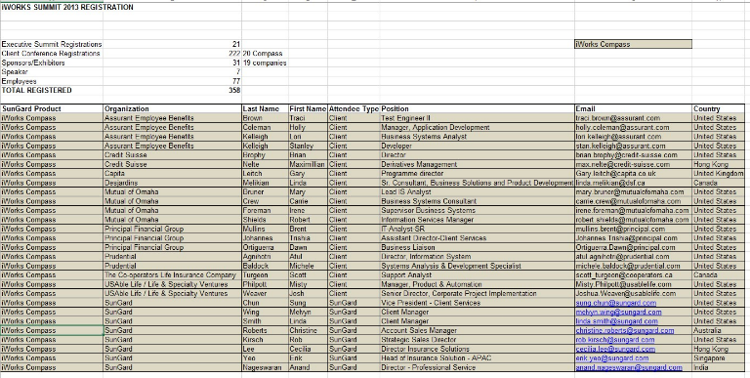
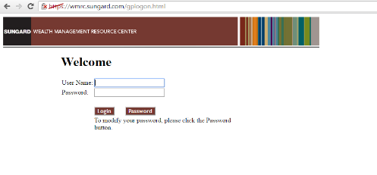
Google Hacking on SunGard Sample queries used
site:sungard.com -site:support.sungard.com -site:www.sungard.com -site:financialsystemsjobs.sungard.com
Basic query to filter out common results
site:sungard.com intext:"confidential“
Returned document with confidential information
Explanation on how SunGard systems work
Diagrams
Email address of a client
Possible Account NO
site:sungard.com filetype:xlsx
Returned excel with client registration information for a presentation
Found a login site with no HTTPS
Can be prone to man-in-the-middle attack
Examples of docs
https://www.sungard.com/-/media/fs/wealth-retirement/resources/newsletter-docs/2015-CLT-News/0315-Fee_Unbundling.pdf?la=en
https://www.sungard.com/-/media/fs/banking/resources/events/Rethinking-the-Cards-Business-Erick-Ho.pdf?la=en

