Slide 1
Guardian Square
Mauchel Barthelemy – MIS 5211|Fall 2016
Scan “Pen” Test Analysis Report | Nessus
Medium Alert 1
SMB Signing Diabled
Medium Alert 2
SSL Certificate cannot Be Trusted
33 Port Scanners (w/out major risk factor)
Netstat portscanner (SSH)

Slide 2
Cutting-Edge
Mauchel Barthelemy – MIS 5211|Fall 2016
Scan “Pen” Test Analysis Report | Nessus
Medium Alert 1
SSL Certificate Cannot Be Trusted
Medium Alert 2
Medium Alert 3
SSL Certificate Expiry
SSL Self-Signed Certificate
Low Alert(Info)
SSL Certificate Cannot Be Trusted

Slide 3
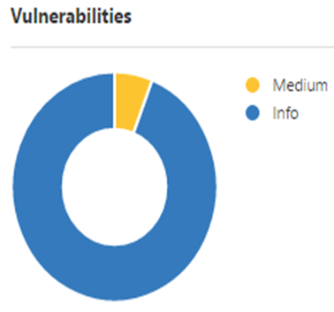
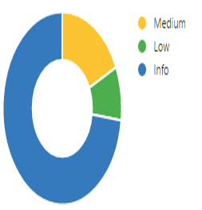
Vulnerabilities
Mauchel Barthelemy – MIS 5211|Fall 2016
Scan “Pen” Test Analysis Report | Nessus
Guardian Square: Scan Details
Name: Test Scan
Status: Completed
Policy: Basic Network Scan
Scanner: Local Scanner
Folder: My Scans
Start: October 4 at 8:47 PM
End: October 4 at 8:52 PM
Elapsed: 5 minutes
Cutting-Edge
Cutting-Edge: Scan Details
OS: Linux Kernel 2.6
Folder: My Scans
Start: October 4 at 3:08 PM
End: October 4 at 3:32 PM
Elapsed: 14 minutes
KB: Download

Slide 4
It is highly recommended to:
Mauchel Barthelemy – MIS 5211|Fall 2016
Scan “Pen” Test Analysis Report | Nessus
Negotiate/Obtain written consent from/with testers
Good intention is NOT a good defense strategy
Design testing environment
Get lawyers involved
Documentation

