Slide 1
Nessus Scan Overview
Source System: Windows PC Desktop
OS: Windows 7 Service Pack 1
Target System: MacBook Air Laptop
OS: Mac OS X 10.10
Scan Type: Basic Network Scan
Elapsed Time: 3 Minutes
Target IP: 192.168.XX.XX
19 total vulnerabilities
Marcus Wilson
MIS 5211

Slide 2
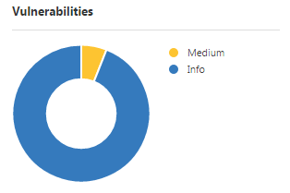
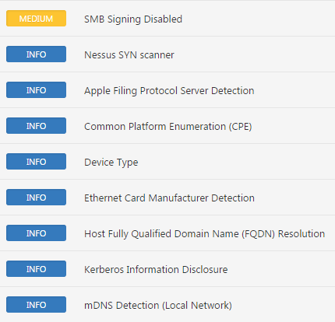
Nessus Scan Results
Medium
Info
Vulnerabilities
1
18
Top Vulnerabilities
! SMB Signing Disabled !
Signing is not required on the remote SMB server. An unauthenticated, remote attacker can exploit this to conduct man-in-the-middle attacks against the SMB server
Marcus Wilson
MIS 5211

Slide 3
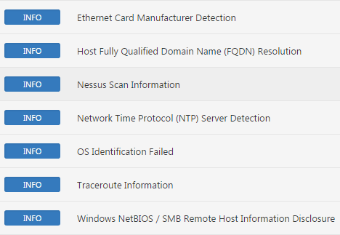
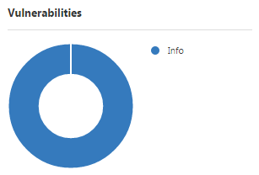
Nessus Scan Solutions
57608- SMB Signing Disabled (Medium)
Nessus recommended resolving this vulnerability by enforcing message signing in the host’s configuration.
Fix Result (Success)- I disabled file sharing on my MacBook Air. This fix also resolved a majority of the information-only alerts that I was receiving from the scan. The remaining results are non-threatening information only alerts.
Nessus Post-Fix Scan Results
Resolved Vulnerabilities
Medium - 1 of 1resolved
Info - 11 of 18 resolved
Marcus Wilson
MIS 5211

