Slide 1
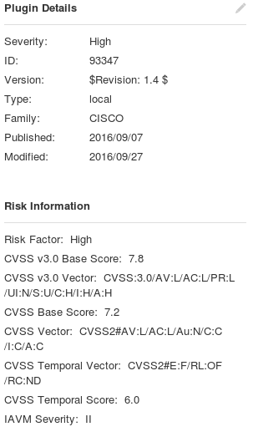
Nessus Vulnerability Scan
Why a Samsung Smart TV
Knew that there was an update available that was not installed
Many Smart TVs are probably not updated
Used Advanced Scan policy
Uncovered 27 vulnerabilities
1 High
5 Medium
2 Low
Ahmed Alkaysi

Slide 2
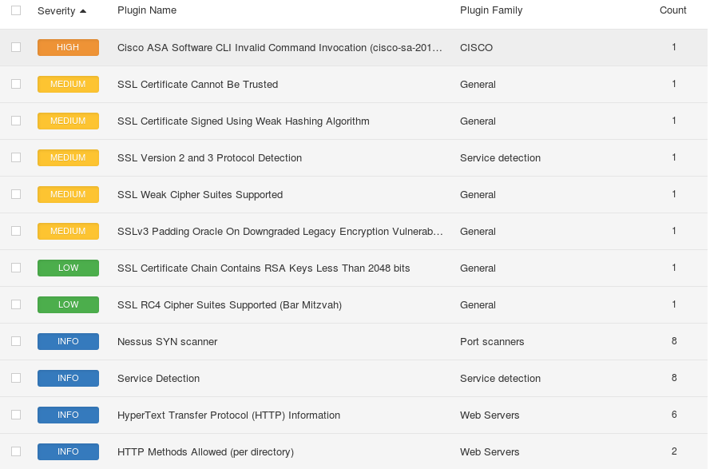
Results
1 High vulnerability
Cisco ASA software CLI invalid command Invocation
Flaw in the CLI
Attacker can exploit by causing denial-of-service or execute arbitrary code
5 Medium and 2 Low
SSL related
Certificate can’t be trusted
Certificate signed using weak hashing algorithm
Weak cipher suites supported
Ahmed Alkaysi

Slide 3
Solutions
Update firmware
Purchase or generate proper certificate for service
Contact Certificate Authority to reissue certificate
Reconfigure affected application to avoid using weak SSL cipher
Ahmed Alkaysi

