Slide 1
Nessus Vulnerability Scan
Nessus Scan – Vulnerabilty Research

Slide 2
Scan – Client Computer
Host Details
IP: 10.0.0.x
MAC: 00:14:a5:xx:xx:xx
OS: Microsoft Windows XP Service Pack 2
Microsoft Windows XP Service Pack 3
Windows XP for Embedded Systems

Slide 3
Scan – Target OS Windows XP
Vulnerability ➔ Microsoft Windows SMB NULL Session Authentication
Description
The remote host is running Microsoft Windows. It is possible to log into it using a NULL session (i.e., with no login or password).
Depending on the configuration, it may be possible for an unauthenticated, remote attacker to leverage this issue to get information about the remote host.

Slide 4
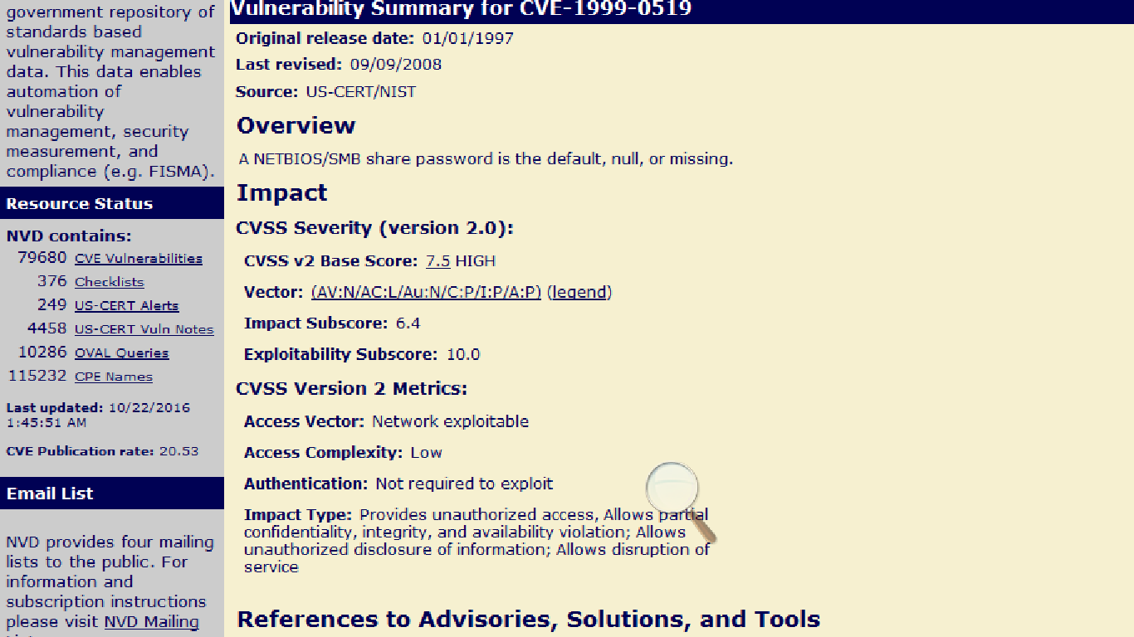
National Vulnerability Database

Slide 5
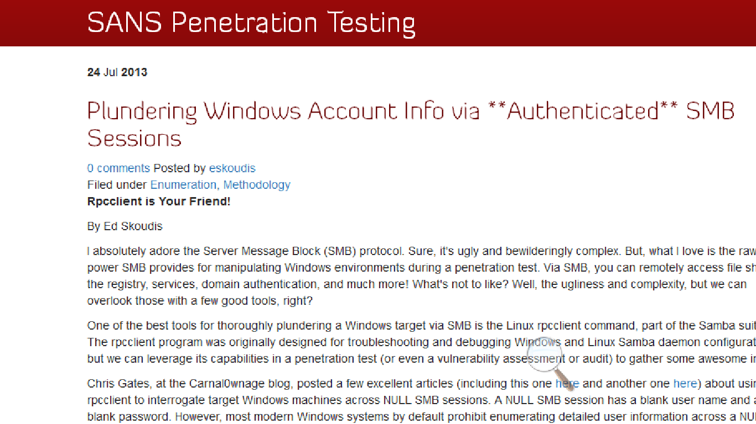
Exploit Via – Sans Pen Testing

