Slide 1
NESSUS SCANNING
By:
Vaibhav Shukla

Slide 2
Scan Target
Target 1
Fedora installed in a VM Ware Workstation for Testing Purpose
IP Address-192.168.152.1xx

Slide 3
Basic Network scan
1 Critical vulnerability
2 Medium vulnerability
1 Low vulnerability
27 Info

Slide 4
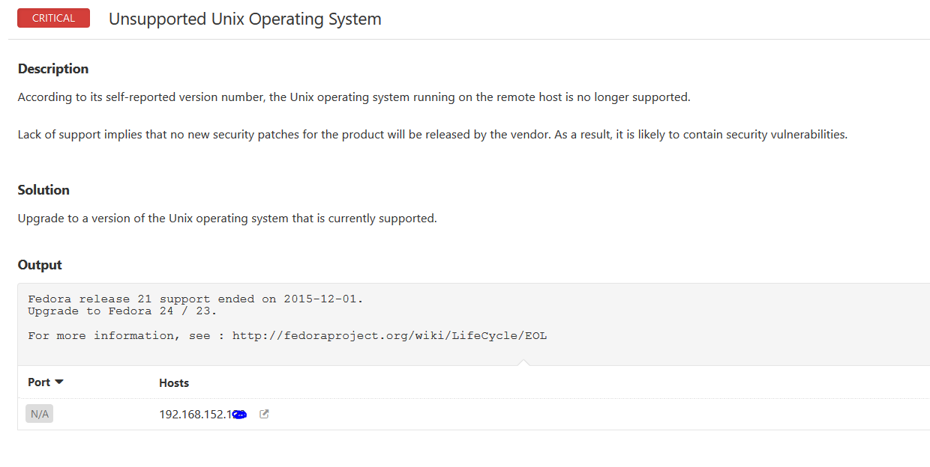
Critical Vulnerability

Slide 5
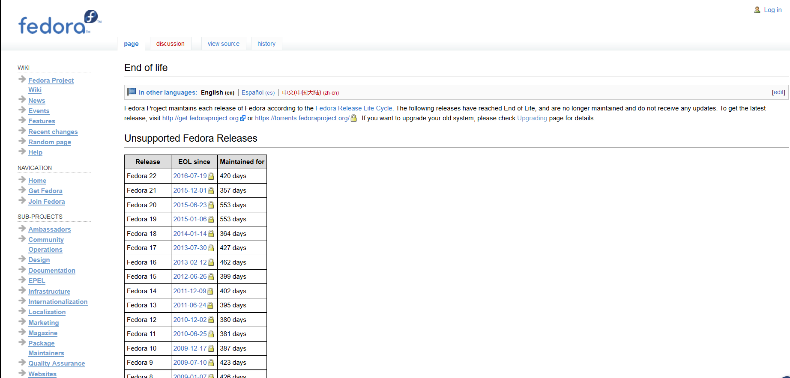
Critical Vulnerability
Fedora 21 EOL is 1st Dec 2015

Slide 6
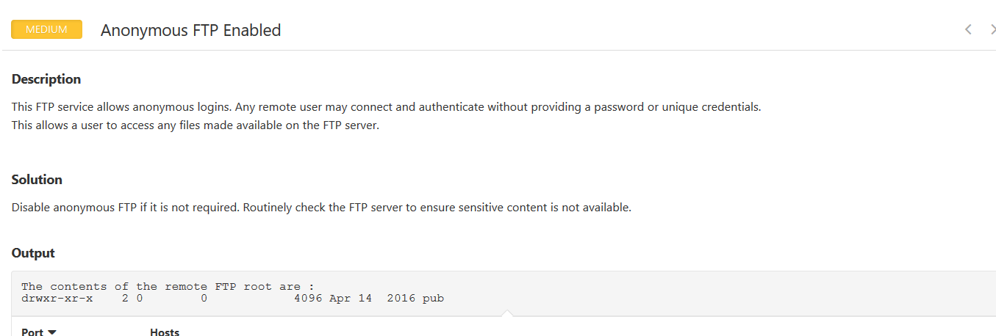
Medium Vulnerability 1
FTP Port is enabled

Slide 7
Checked for FTP and HTTP Service

Slide 8
Medium Vulnerability 2

Slide 9
Why HTTP Trace should be Off
The HTTP TRACE method asks a web server to echo the contents of the request back to the client for debugging purposes.
These HTTP Trace methods can be used for nefarious purposes like (XST), a form of cross site scripting using the server's
In the presence of other cross-domain vulnerabilities in web browsers, sensitive header information could be read from any domains that support the HTTP TRACE method.

Slide 10
Mitigating the vulnerability
vi /etc/httpd/conf/httpd.conf
Add the TraceEnable directive into your httpd.conf and set the value to Off.

Slide 11
Scan Target
Target 2
Personal laptop
IP Address-192.168.1xx.1xx

Slide 12
Basic Network scan
0 Critical vulnerability
4 Medium vulnerability
0 Low vulnerability
30 Info

Slide 13
Medium Vulnerability
The server's X.509 certificate does not have a signature from a known public certificate authority.

