Slide 1
Nessus Vulnerability Scanning
Mengxue Ni, Mengqi He

Slide 2
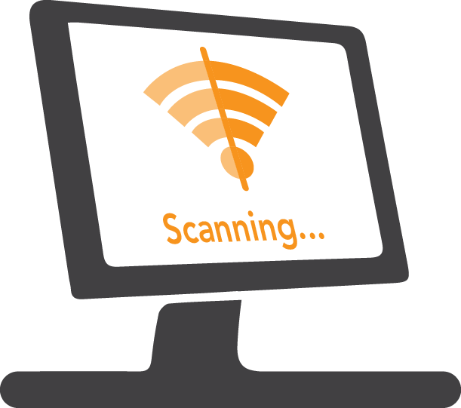
Introduction
We are using two computers to run the Nessus Scan:
MacBook Air (OS X 10.9.1)
HP (Windows 10, Intel Core i7-6500U, 64-bit)
Notes:
We conducted Nessus vulnerability scans on two computers: a Macbook Air and a HP laptop. The Macbook Air was bought in 2012 and was not used often. Its OS was OS X 10.9.1 and not updated for a long time. The HP was bought half year ago for daily use. Its OS was Windows 10. To find out what differences are between the vulnerabilities of these two computers with different systems in different conditions, we compared the scan results, and found that there are 88 vulnerabilities in the Macbook Air, only two in the HP.

Slide 3
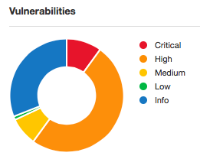
Nessus Result (MacBook Air)
Vulnerabilities | Critical | High | Medium | Low | Total
Vulnerabilities due to low version of OS | 9 | 1 |  |  | 10
Vulnerabilities due to low version of Adobe Photoshop | 2 |  |  |  | 2
Vulnerabilities due to low version of FireFox |  | 26 | 4 |  | 30
Vulnerabilities due to low version of Apple Safari |  | 16 | 4 |  | 20
Vulnerabilities in Microsoft Office allow remote code execution |  | 20 |  |  | 20
Vulnerabilities due to low version of iTunes |  |  | 1 | 1 | 2
Others | 2 | 1 | 1 |  | 4
Total | 13 | 64 | 10 | 1 | 88
Notes:
Let’s talk about the Mac first. We had an advanced scan with default setting on the Mac. The scan took 5 minutes to complete and uncovered 88 vulnerabilities: 13 critical, 64 high, 10 medium and 1 low. From the chart, we found out that most of vulnerabilities are due to low version of operating system and applications, and lack of updates. Among them, 10 vulnerabilities are on OS, 30 on Firefox, 20 on Safari, 20 on Microsoft Office and 2 on Adobe and iTunes. We also found that the last upgrades and updates of most applications are at the end of 2013 or in early 2014.
The running OS version is 10.9.1 released at the end of 2013. The version Firefox on the host is 28.0 which was launched back to early 2014. The running Apple Safari version is 7.0.1 released in December 2013. Current version of Microsoft Office is 2011 14.3.9, but the lack of necessary patches may result in a remote code execution vulnerability, Current Adobe Photoshop version is 14.0 released in June 2013. The running version of iTunes is 11.1 released in January 2014. This is because the pre-owner rarely used the Mac since 2014, and it was given to the current owner as a gift at the end of 2015. The current owner started frequently using it from the beginning of this year, but she didn’t upgrade the system and applications, and not realize that there are so many vulnerabilities existing on the computer. There are also some other vulnerabilities such as SSL certificate cannot be trusted, and lack of NTP security update.

Slide 4
Suggested Solutions (Macbook Air)
Upgrade OS to Mac OS X 10.11
Upgrade Firefox to version 44.0.2
Upgrade Apple Safari to version 7.1.8
Upgrade Adobe Photoshop to version CC 2015 16.0
Upgrade iTunes to version 12.5.1
Update and install patches for Microsoft Office 2011
Install the vendor-supplied security patch to
APPLE-SA-2014-12-22-1
Purchase or generate a proper certificate for the service
Notes:
Since most the vulnerabilities can be solved easily through upgrading or installing patches, we suggested the owner to upgrade ……. And also install patches for Microsoft Office 2011. And also install the vendor-supplied security patch to APPLE-SA-2014-12-22-1 and purchase or generate a proper certificate for this service to solve the SSL certificate problem.

Slide 5
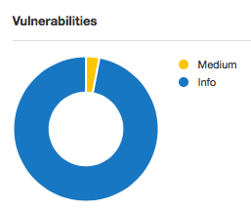
Re-Scan Result
Pre-update: 88
Pro-update: 1
Notes:
After doing as we suggested, the owner allowed we us to have another scan to check if the computer was optimized through upgrading and if vulnerabilities above are solved. The re-scan result was that the vulnerabilities reduced to only 1! The only remaining vulnerability is that SSL certificate cannot be trusted in medium level.

Slide 6
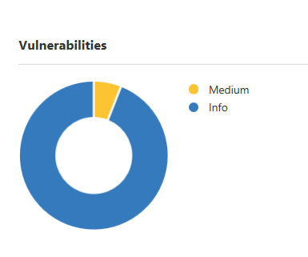
Nessus Result (HP)
SMB Signing Disabled :
Signing is not required on the remote SMB server. An unauthenticated, remote attacker can exploit this to conduct man-in-the-middle attacks against the SMB server.
SSL Certificate Cannot Be Trusted :
The server's X.509 certificate does not have a signature from a known public certificate authority. This situation can occur in three different ways, each of which results in a break in the chain below which certificates cannot be trusted.
Notes:
There are only two vulnerabilities in HP windows 10 computer.
The server's X.509 certificate does not have a signature from a known public certificate authority. This situation can occur in three different ways, each of which results in a break in the chain below which certificates cannot be trusted.
I didn’t list out all the info that Nessus scanned because info can be consider as very low risks. Also, there are 218 info that Nessus wanted me to check. But I do look into the first info-Netstat portscanner (SSH). This plugin runs ‘netstat’ on the remote machine to enumerate open ports. There are 182 ports are found to be open on the HP Windows 10 computer. Netstat is a command-line network utility tool that displays network connections for the Transmission Control Protocol, routing tables and a number of network interface and network protocol statistics. It is used for finding problems in the network and to determine the amount of traffic on the network as a performance measurement.

Slide 7
Suggested Solutions (HP)
Solution for SMB Signing Disabled
Enforce message signing in the host's configuration. On Windows, this is found in the policy setting 'Microsoft network server: Digitally sign communications (always)'. On Samba, the setting is called 'server signing'.
Solution for SSL Certificate Cannot Be Trusted
Purchase or generate a proper certificate for this service.
Notes:
First, the top of the certificate chain sent by the server might not be descended from a known public certificate authority. This can occur either when the top of the chain is an unrecognized, self-signed certificate, or when intermediate certificates are missing that would connect the top of the certificate chain to a known public certificate authority.
Second, the certificate chain may contain a certificate that is not valid at the time of the scan. This can occur either when the scan occurs before one of the certificate's 'notBefore' dates, or after one of the certificate's 'notAfter' dates.
Third, the certificate chain may contain a signature that either didn't match the certificate's information, or could not be verified. Bad signatures can be fixed by getting the certificate with the bad signature to be re-signed by its issuer. Signatures that could not be verified are the result of the certificate's issuer using a signing algorithm that Nessus either does not support or does not recognize.
If the remote host is a public host in production, any break in the chain makes it more difficult for users to verify the authenticity and identity of the web server. This could make it easier to carry out man-in-the-middle attacks against the remote host.

Slide 8
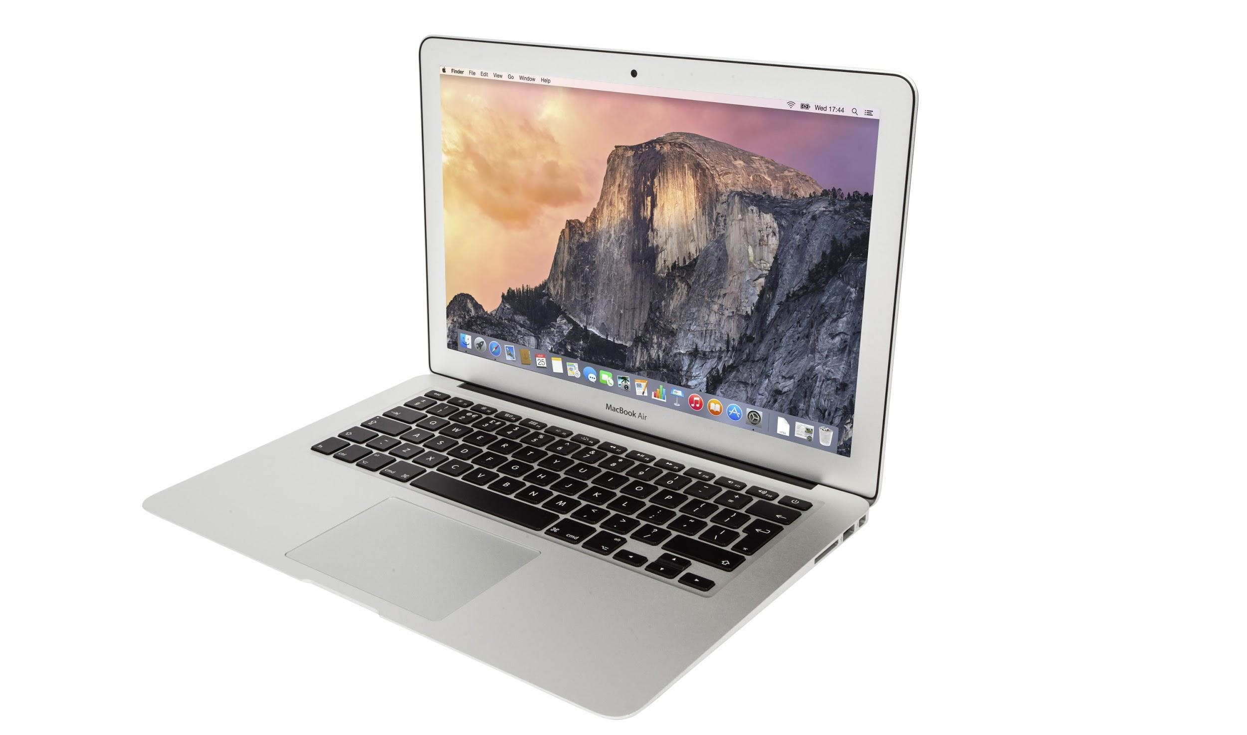
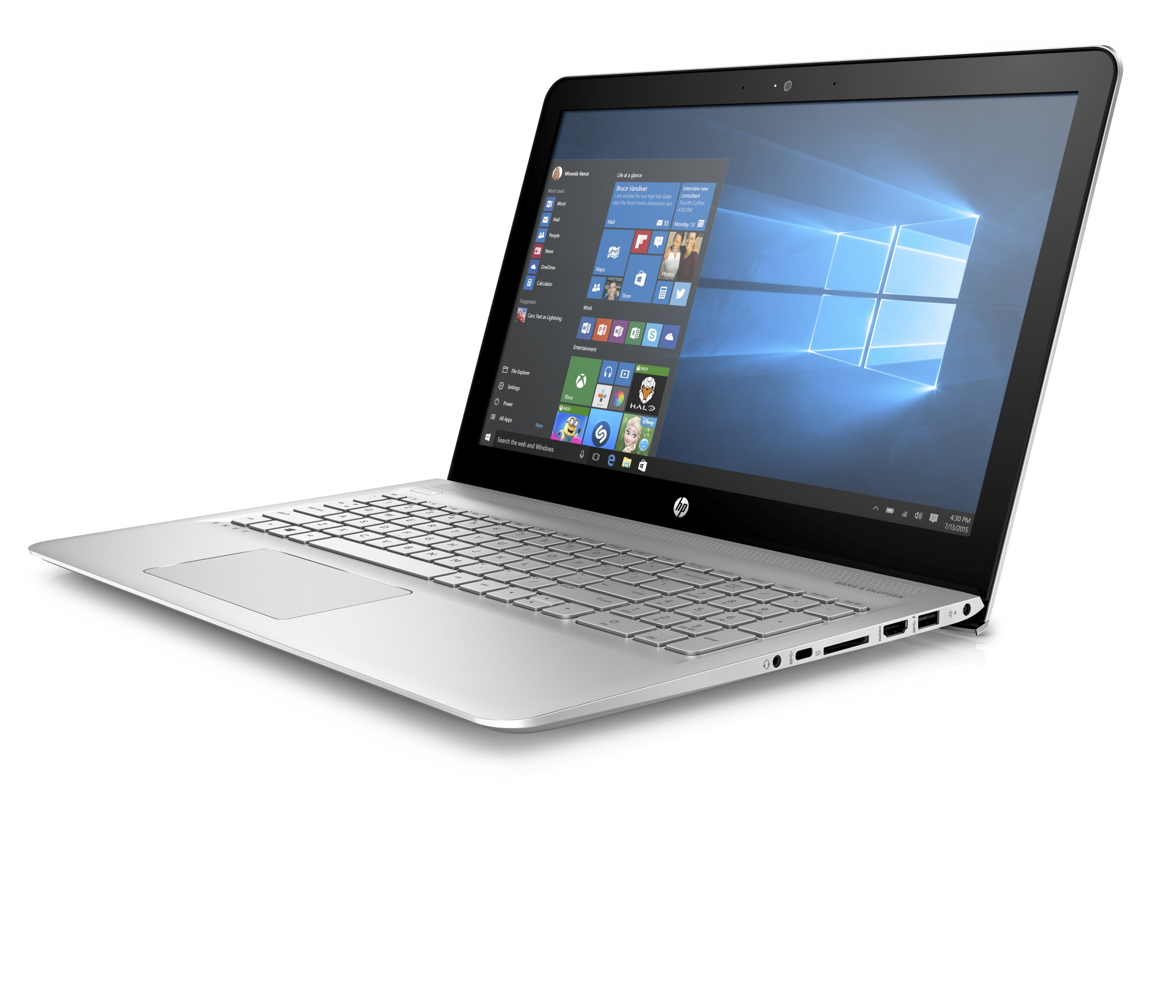
Conclusion
MacBook Air was bought in 2012 and was not used frequently. It contains 13 critical, 64 high, 10 medium and 1 low vulnerabilities.
HP Windows 10 was bought only half year and used daily. It only contains 2 median vulnerabilities.
Notes:
For the Macbook Air which was bought in 2012 and was not used frequently. It contains 13 critical, 64 high, 10 medium and 1 low vulnerabilities. It indicates that computers that are used before but abandoned years later are exposed to high risks. If a hacker want to get your personal information, this kind of computers are the best targets. Updating softwares and systems is very important in order to protect your own information. Or you can delete all the information once you decide not to use the computer anymore. On the other hand, the HP Windows 10 computer was bought only half year and used daily. Nessus showed it only contained 2 median vulnerabilities. One requires to enable SMB signing, another requires to purchases or generate a proper certificate. Daily used computers are not easy to be hacked, but still they have vulnerabilities. Scanning should be conducted regularly. Keep updating systems and softwares is necessary as well.

