Slide 1
BURP SUITE Analysis Philadelphia Gas Works(PGW)

Slide 2
BURP SUITE Analysis Philadelphia Gas Works(PGW)
User Name & Password captured in clear text

Slide 3
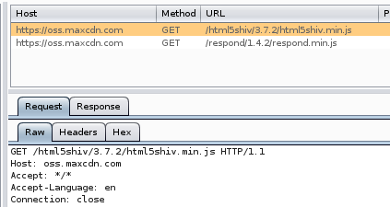
BURP SUITE Analysis Philadelphia Gas Works(PGW)
Forms created using ASP.NET Framework
Content Delivery Network

Slide 4
BURP SUITE Analysis Philadelphia Gas Works(PGW)
PGW social media user account information

Slide 5
BURP SUITE Analysis Philadelphia Gas Works(PGW)
Apache Tomcat Server
Javascript in use

