Slide 1
Ahmed Alkaysi
QVC Burp Suite

Slide 2
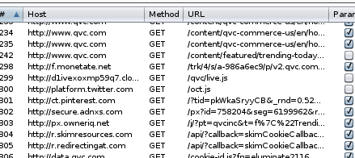
3rd party sites
Multiple different sites used to communicate with QVC.com
Sites included Google, Bing, Facebook, Monetate.net, tiqcdn.com, and skimresources.com
Google and Bing were used for ads
Monetate.net used for customer intelligence
Tiqcdn.com used to manage tags for user-tracking and tag management for the website
Skimresources.com was leveraged for affiliate marketing

Slide 3
Interesting parameters
Tried using My Account page to login
Saw a number of Parameters that could be modified in a packet
A couple interesting Parameters that tempted me to modify:
CART_QTY with a value of ‘0’, wanted to change a value to greater than ‘0’
CMNPOTYPE with a value of ‘NOTCHECKOUT’, wanted to change to ‘CHECKOUT’
CURNTCHNL with a value of ‘QVC’, assumed that there were other QVC owned entities one could purchase products from

Slide 4
Live Chat
For the live chat function, a domain called ‘live.qvcchat.com’ was being used
This site directed to a page with words ‘IIS7’ displayed and ‘Welcome’ translated in multiple different languages.
Clicking on ‘IIS7’ redirected to www.iis.net which was owned by Microsoft
Some of the data from a packet used in the live chat included:
Information regarding a Video Chat or File Transfer an employee could use
Specific messages regarding contacting admin for any issues, which I assumed was aimed at an agent using live chat to speak with customer

