Slide 1
Burp Suite analysis
Brent Easley
intro to ethical hacking
itacs 5211

Slide 2
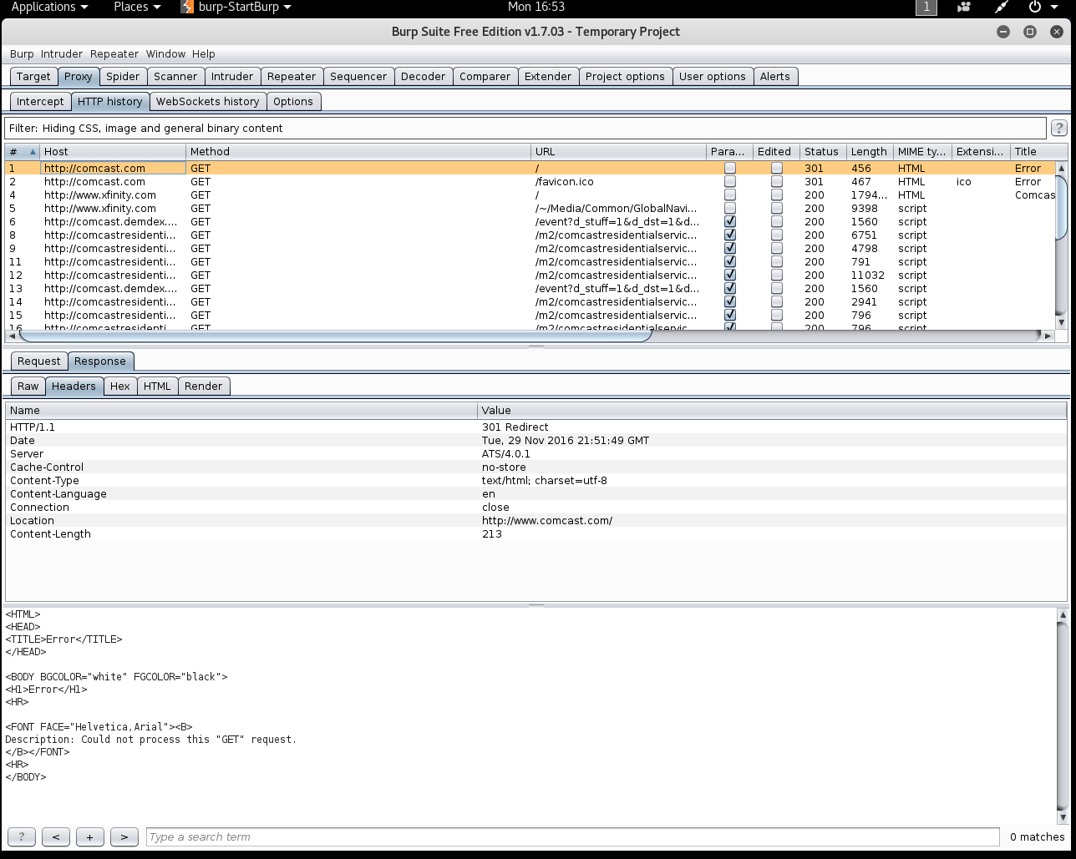
Response information for http://comcast.com

Slide 3
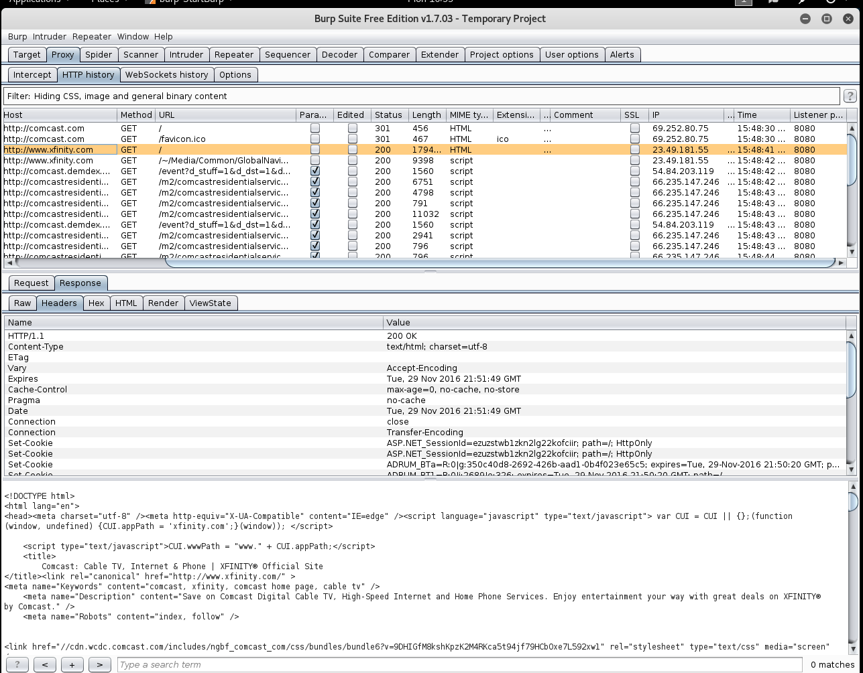
Response information for http://xfinity.com

Slide 4
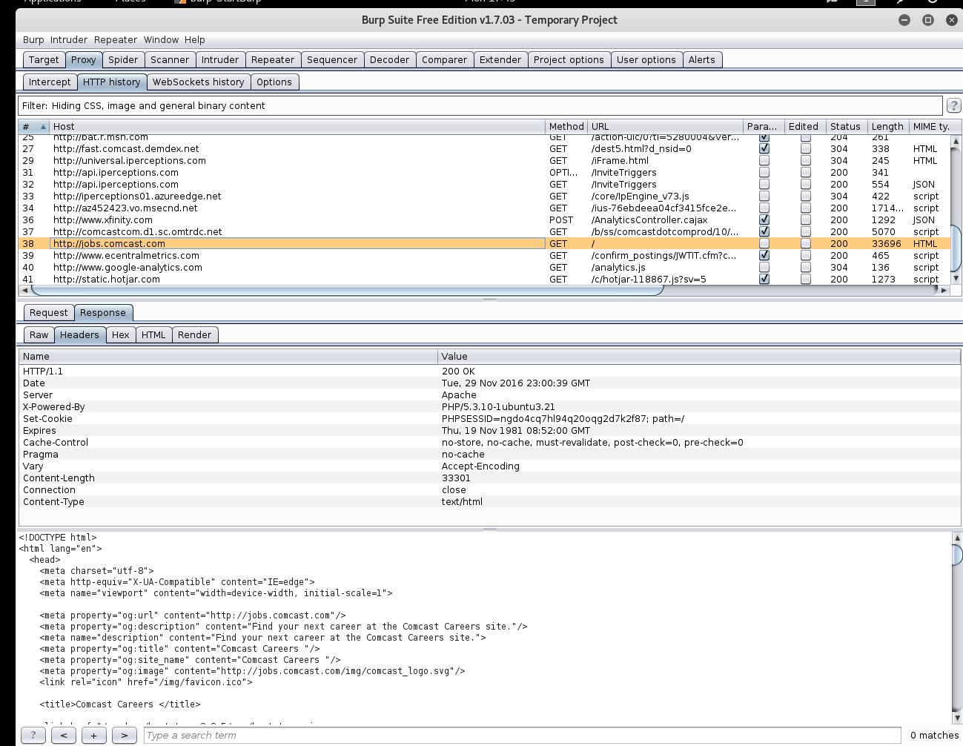
Careers link on http://xfinity.com

Slide 5
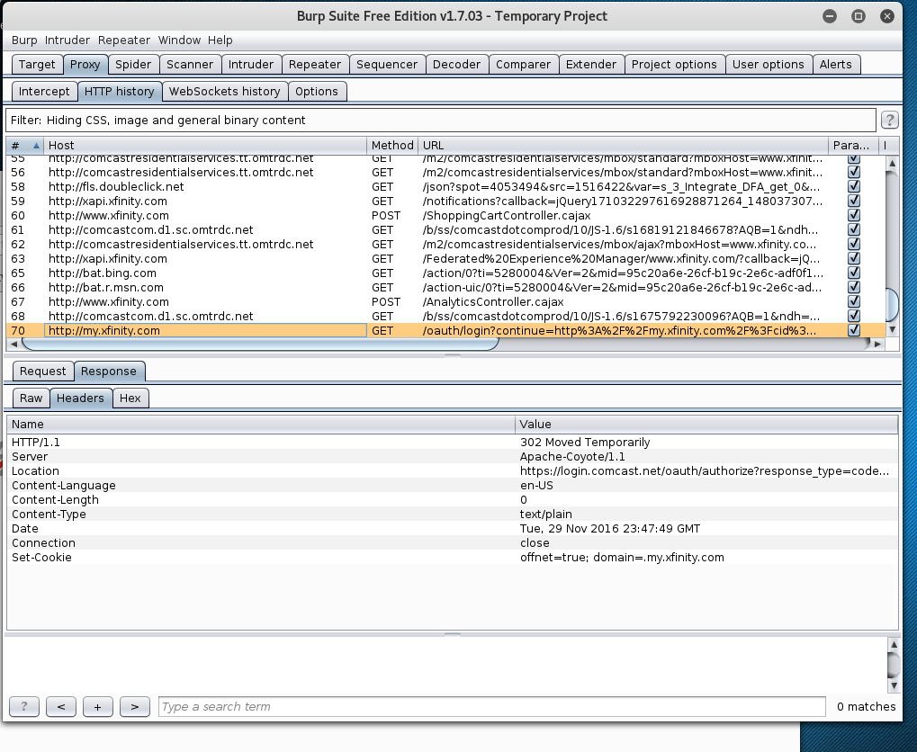
Sign in link on http://xfinity.com

Slide 6
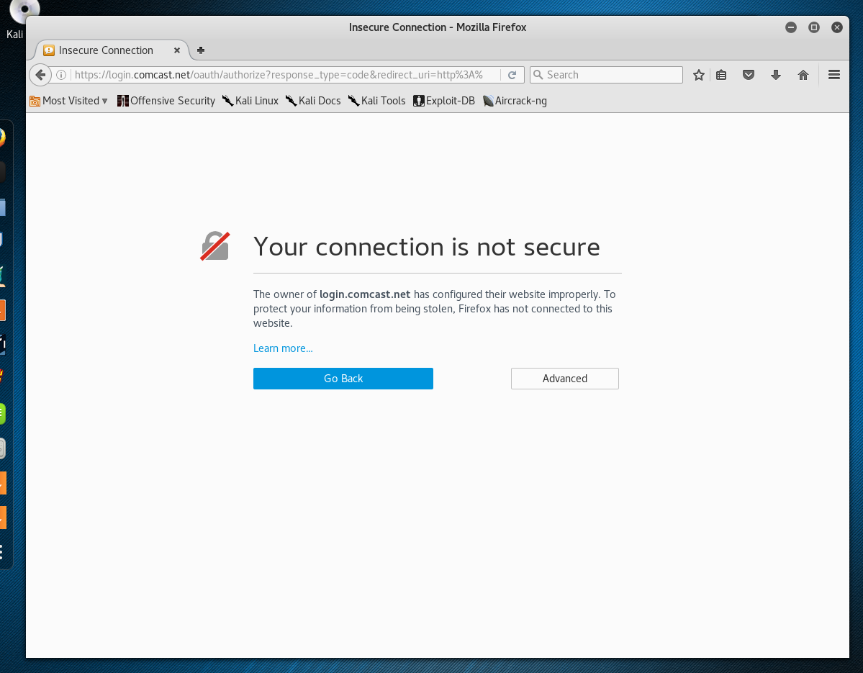
Error page when trying to access a https site using burp suite

