Slide 1
Burp Suite Web Analysis
Bilaal Williams

Slide 2
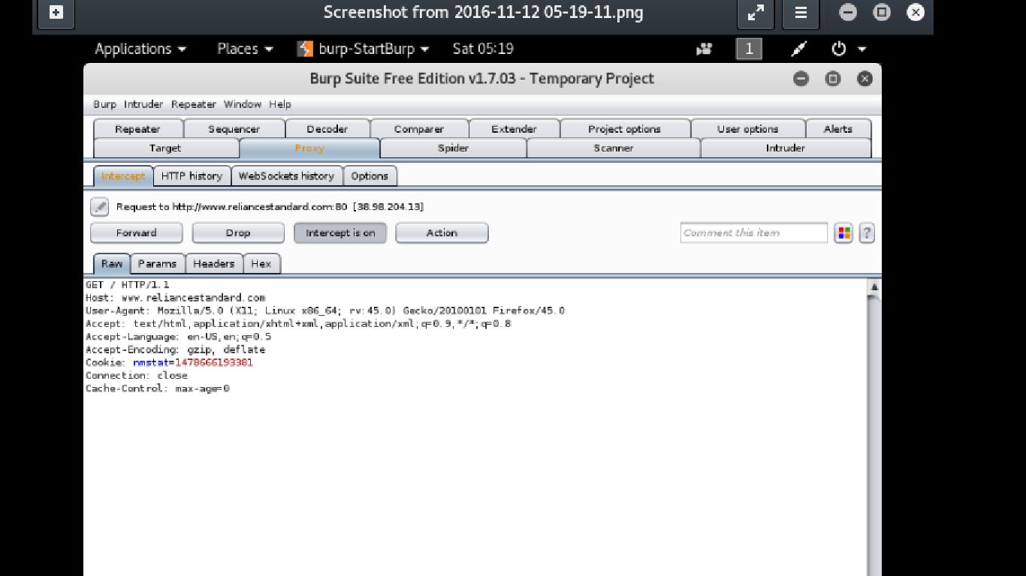
Initial Browser Request Capture ➔ www.reliancestandard .com

Slide 3
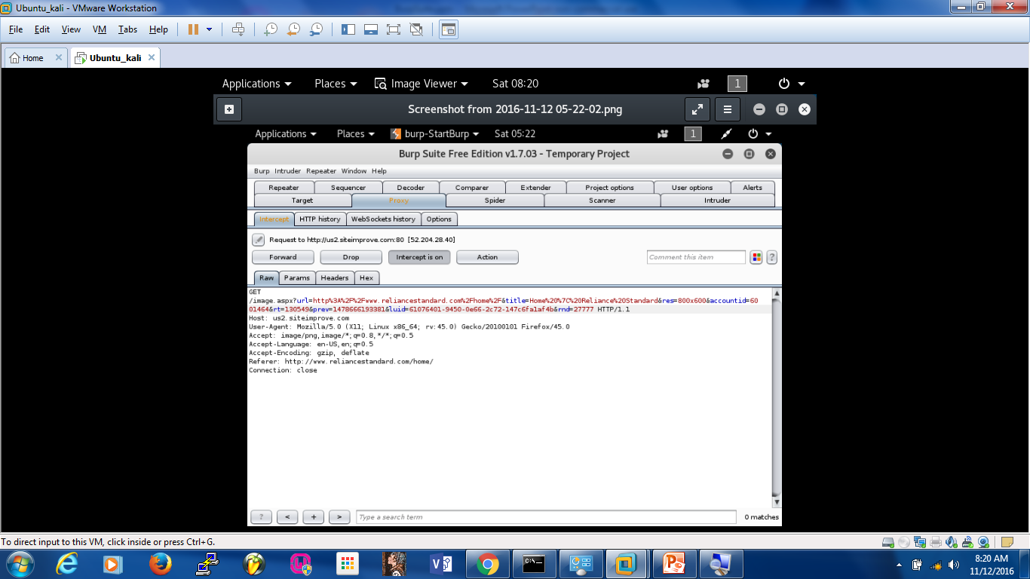
Site is hosted by u2.siteimprove.com ➔ Redirect / request for web page content

Slide 4
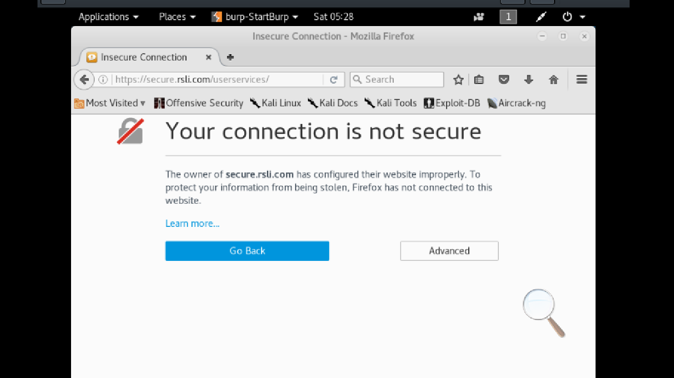
Warning from browser since communication is being intercepted by burp proxy

Slide 5
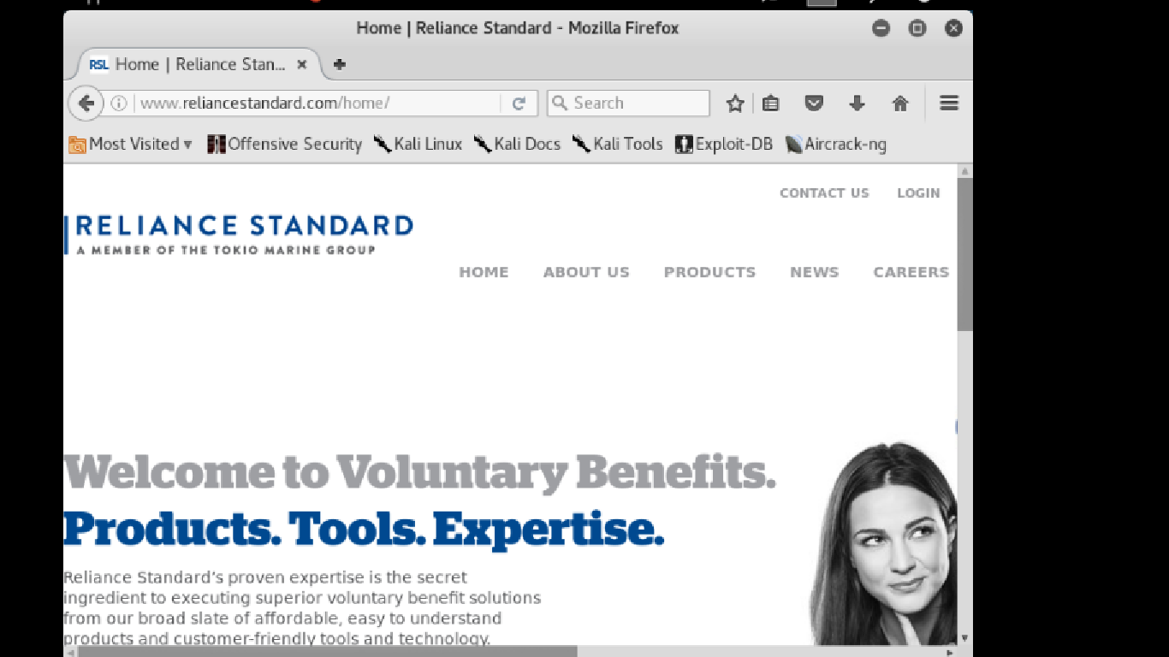
After warning is bypassed..page is delivered. Next I will attempt login to see if userid and password is captured by burp

Slide 6
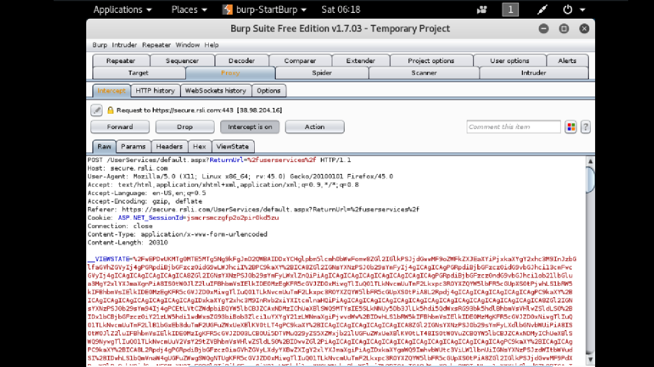
Post request Captured by burp – Cookie Information and at the bottom of the ‘View State’ section…

Slide 7
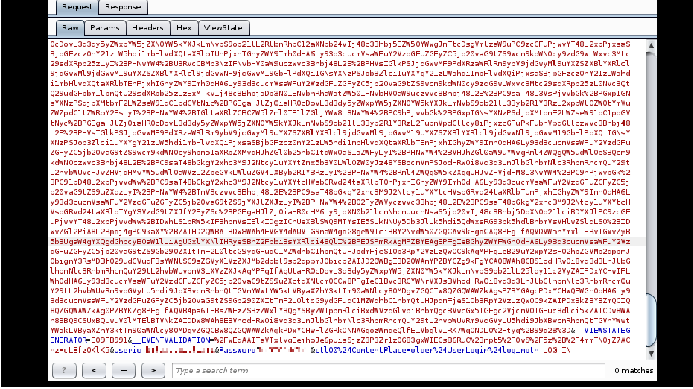
Userid and Password is captured in plain text by burp (see at very bottom)..if an intruder is able to proxy a connection from user, credentials can be obtained! (credentials blurred for security)

