Slide 1
Burpe Suite Web Analysis
By:
Vaibhav Shukla

Slide 2
Target
The small business and startup are the perfect target for hackers nowadays as they have least spending on IT Security.
A leading test taking site of India which offer the tests for exams after payment and subscribing to their test series
https://www.testpanda.com
.

Slide 3
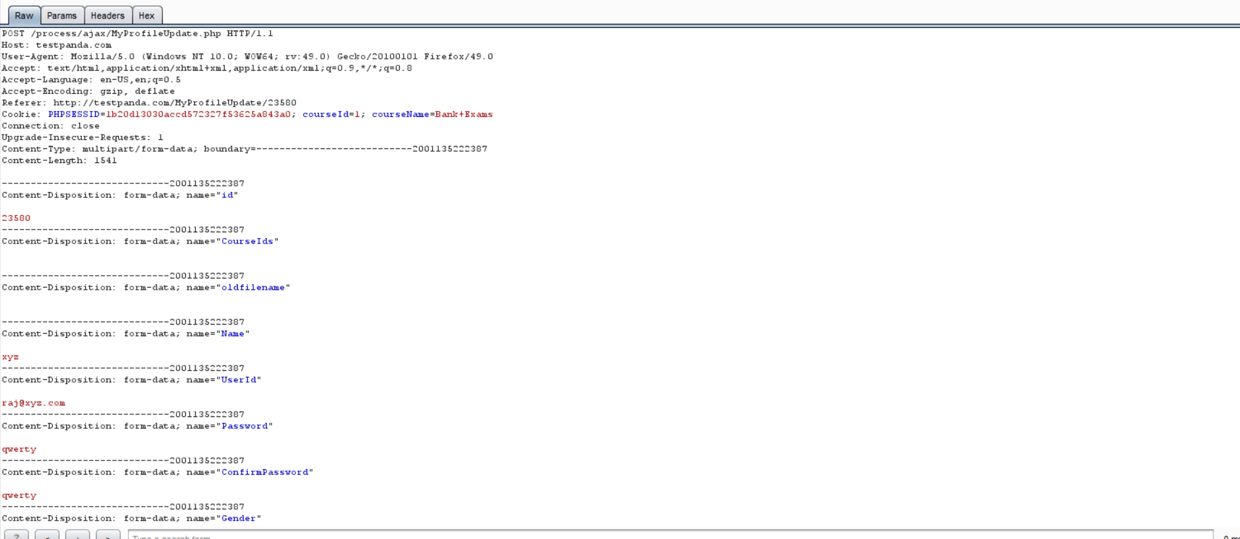
Edit Profile Information The Register and Login information were being encrypted when sent but Edit Profile information is unencrypted and is sent to server as it is. Figure shows name ,id ,password and gender clearly visible

Slide 4
Course Name, Birth Date, Email, Mobile Number and area are clearly visible

Slide 5
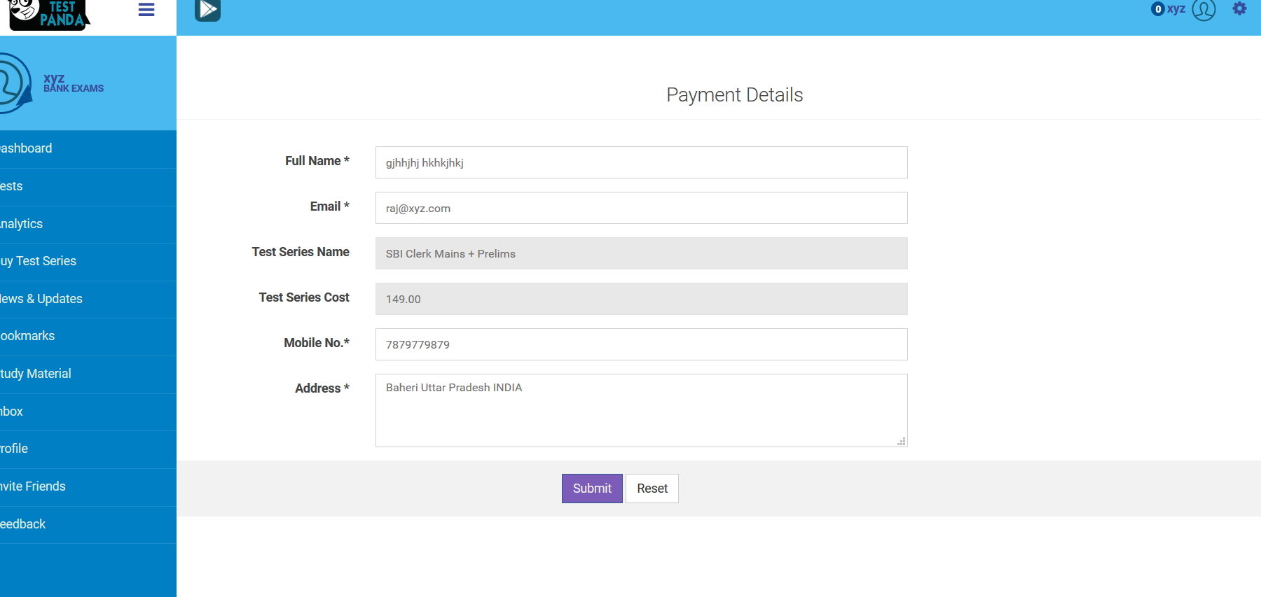
Payment Details Page The page to select the test series and it shows the cost .This get redirected a to a third party payment page.

Slide 6
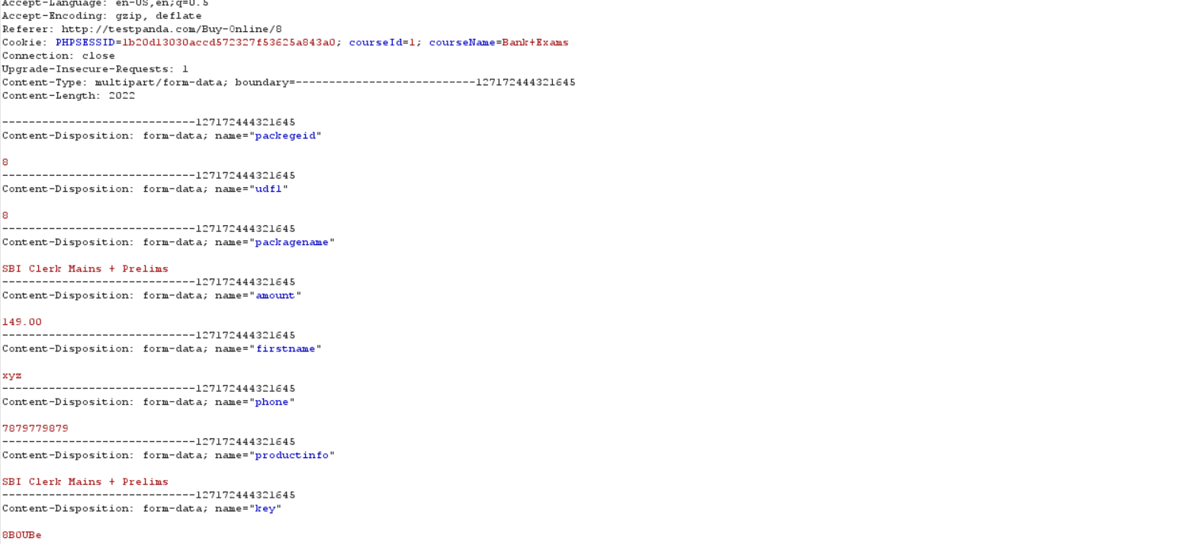
Payment Information Captured The payment amount is clearly visible and it can be altered before being sent to the server

