Slide 1
Tastykake Company
Burp Suite Analysis

Slide 2
About Tastykake Company
Founded in 1914
Headquartered in Philadelphia, PA (Philadelphia Naval Business Center)
Acquired by Flower Foods (Thomasville, GA) in 2011 for $34M
Sells baked snack foods such as Krimpets, Kandy Kakes, pies, and donuts along the East Coast
“Nobody bakes a cake as tasty as a Tastykake!”

Slide 3
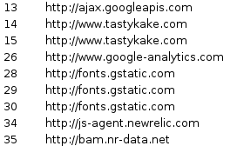
Web Server Environments
Tastykake.com
Apache 2.2.15 (CentOS)
PHP based web application
3rd Party Services:
FlowerFoods.com
Microsoft - IIS 8.5
ASP.NET web application
3rd Party Services:
Google APIs – e.g. Search, Maps, Gmail
Google Analytics – Tracks and reports site traffic
Twitter - Social Media “follow” link
Gstatic – Google Content Delivery Network (CDN)
New Relic – Performance and Browser Monitoring
Success Factors - Search Job Postings

Slide 4
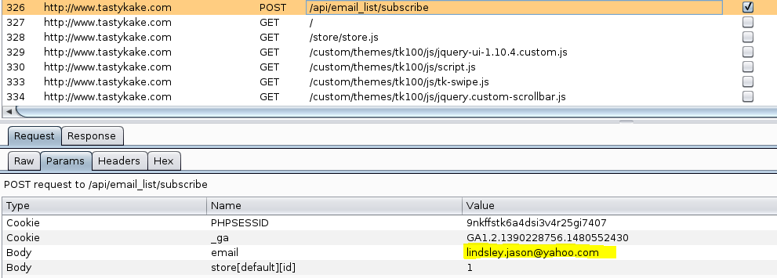
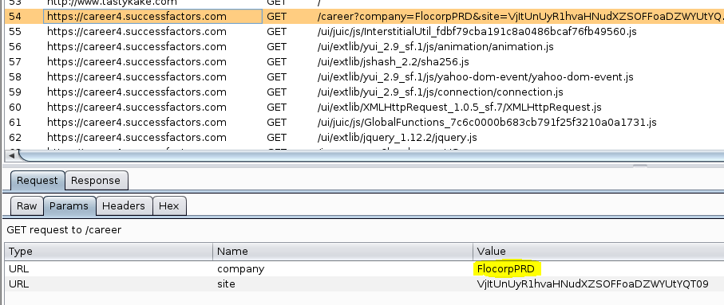
Additional Observations
Tastykake.com uses APIs to pass parameters for functions such as e-mail subscription and store locator:
Success Factors passes the parent company’s name as a parameter to search Tastykake job postings:

Slide 5
Conclusions
Website environments for Parent company (FlowerFoods.com) and Subsidiary (Tastykake.com) are very different:
Apache vs. Windows
PHP vs. ASP.NET
Additional third party services used by Subsidiary for monitoring and content delivery
Potential support cost savings by standardizing web environments (and possibly other functions not yet standardized – e.g. ERP, Finance, HR)

