Slide 1
Roberto Nogueda Introductions to Ethical Hacking
Burp Suite Exercise
Professor: Wade Mackey

Slide 2
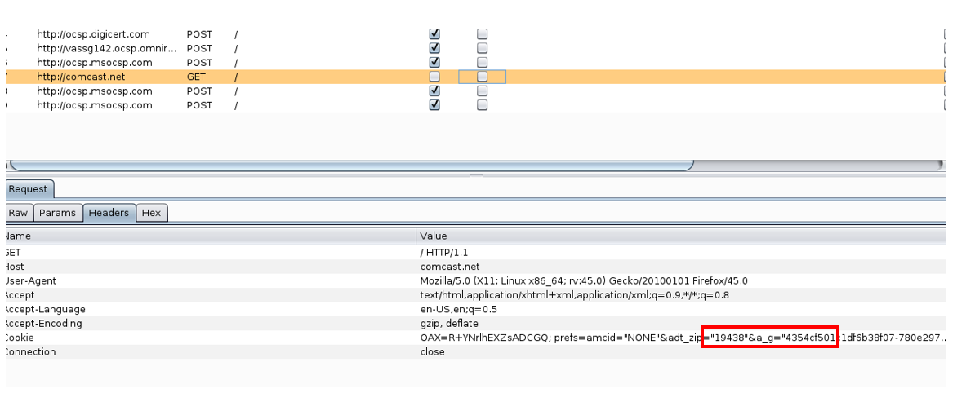
I was able to intercept www.Comcast.net and identify my zip code and some cookies that could allow me to sign in with no credentials. Note: this is an account I created for this exercise.

Slide 3
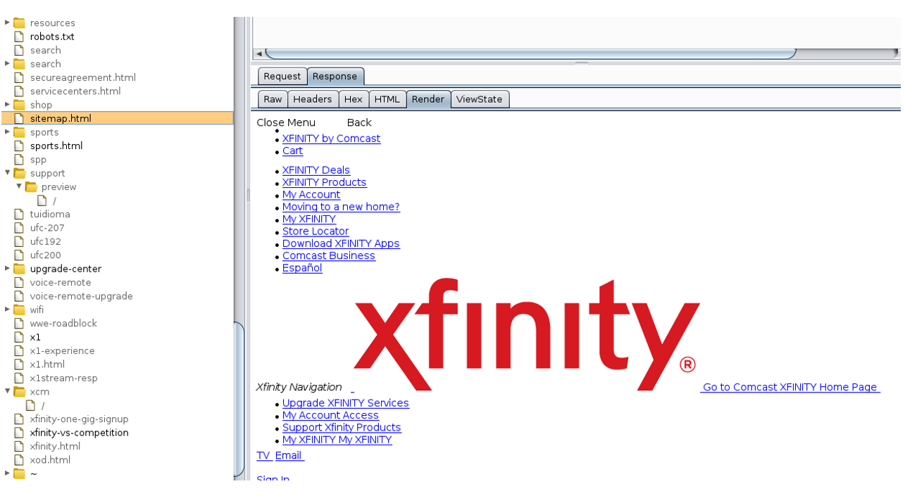
Once in Burp, I send the proxy interception to intruder, and this is the render results:

Slide 4
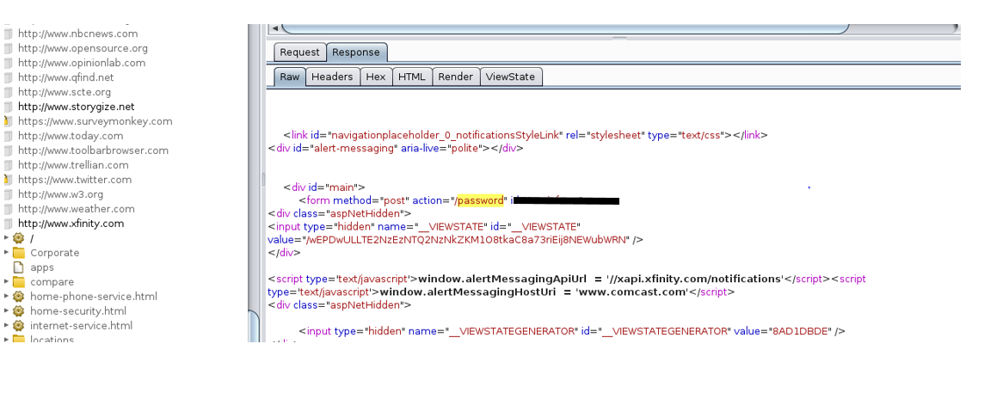
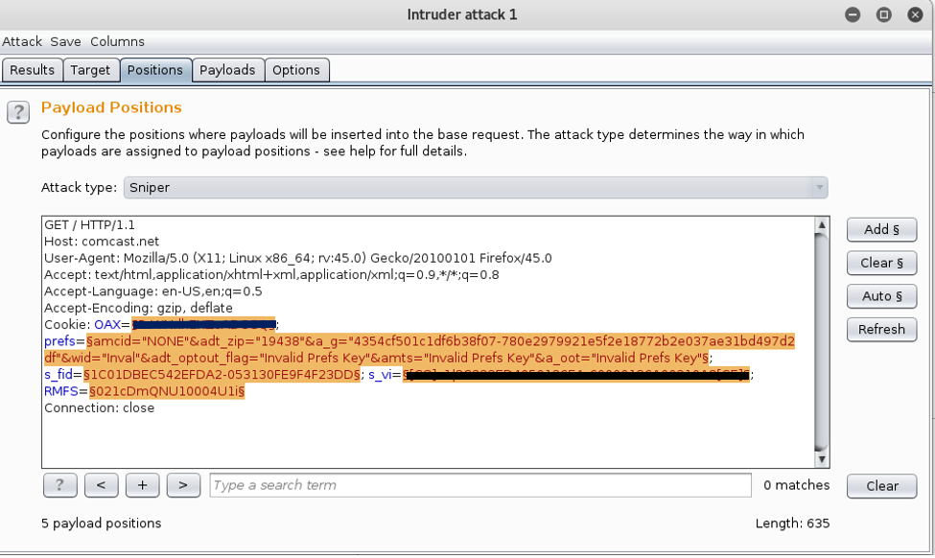
We could prepare an attack to the site by selection a payload and some other settings and penetrate as an admin user by coping and pasting some of the cookies listed here into a web browser:

Slide 5
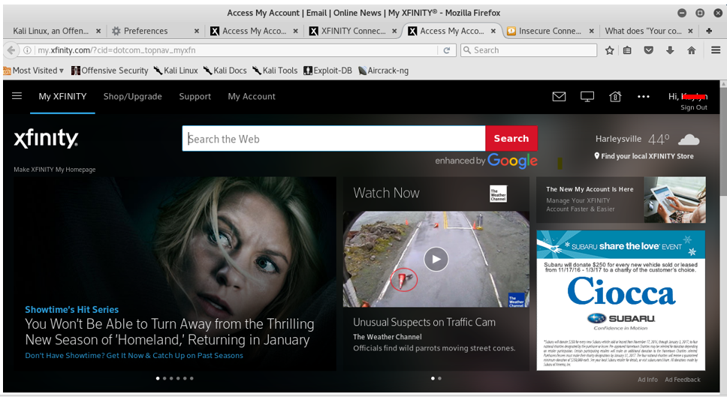
Once credential were used, we were in user’s page.

