Slide 1
Newegg.com
Anthony Fecondo

Slide 2
Newegg
Online Retailer
Sells Computer Hardware/Software
Founded 2001
Over $3 billion yearly revenue

Slide 3
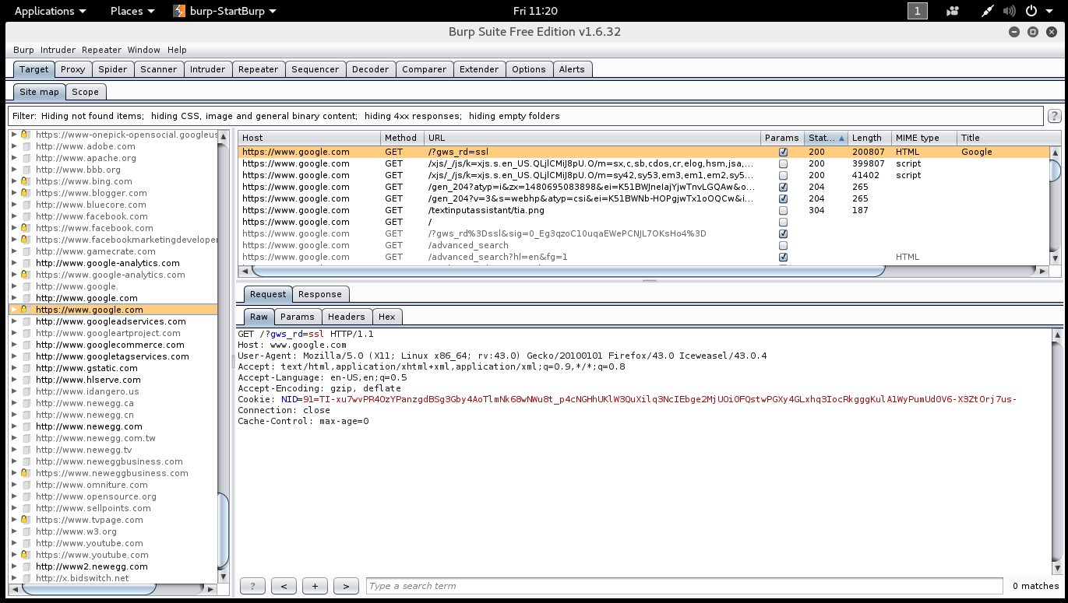
Site map window
Lists resources
Tells you Method
Orients user: Content Origins

Slide 4
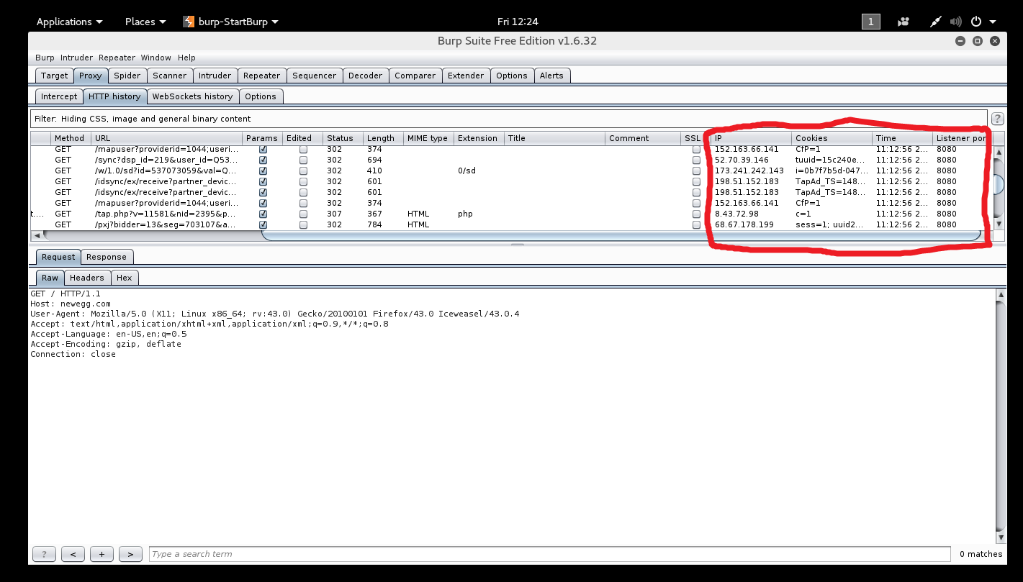
Proxy screen
Provides IP address of each URL
Lists Cookies
Time accessed
Which port site was accessed through

Slide 5
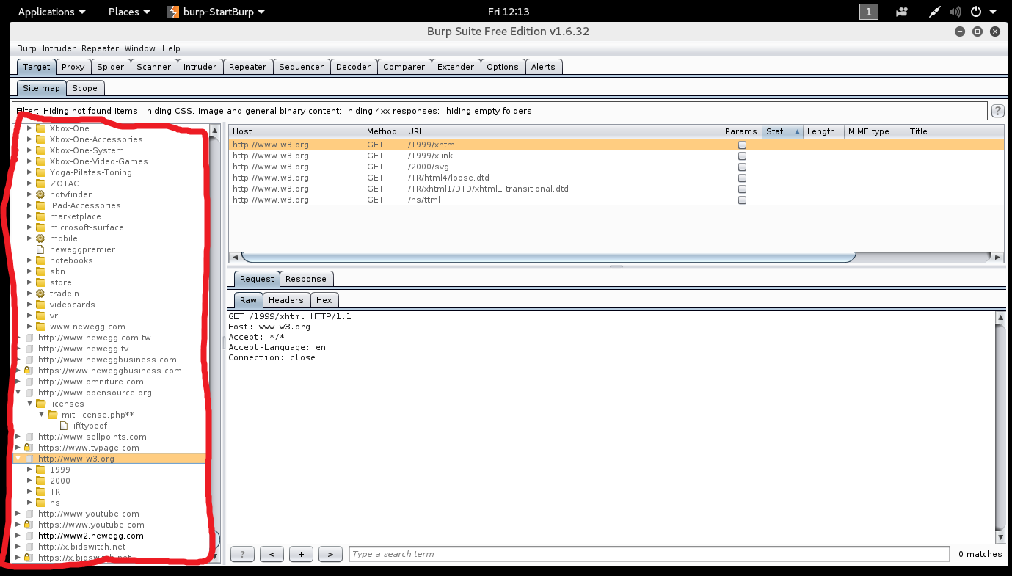
SITE mAP Panel
Shows all URLs accessed
Drop-downs illustrate site architecture

Slide 6
Sources
https://en.wikipedia.org/wiki/Newegg

