Slide 1
Intro to Ethical Hacking
MIS 5211.001
Week 11
Site: http://community.mis.temple.edu/mis5211sec001f15/

Slide 2
SQL Injection
We are going to cover some “Basics”
SQL Injection is a subset of the general flaw “Injection” covered last week
Client supplied data passed to an application without appropriate data validation
Processed as commands by the database
Remember in all of this that we can also use the intercepting proxy to “add” text the browser doesn’t want to accept

Slide 3
Frequently Used To:
Perform operations on the database
Bypass authentication mechanisms
Read otherwise unavailable information from the database
Write information such as new user accounts to the database

Slide 4

Caution
Do not use your powers for evil.
Ultimately, the reason for covering these attacks is to teach you how to prevent them.
Well established sites are generally hardened to this type of attack.
You might cause irreparable harm to a small “mom-and-pop” business.
Even if you don’t, breaking into someone else’s database is illegal and unethical.

Slide 5
Brief SQL Review
Querying tables:
select column1, column2 from table_name;
or
select * from table_name;
Conditions:
select columns from table_name where condition;

Slide 6
Brief SQL Review
Inserting new rows:
  insert into table_name values (value1, value2);
  or
  insert into table_name set column1=value1, column2=value2, ...;
Updating rows:
  update table_name set column1=value1 where condition;

Slide 7
Brief SQL Review
Deleting rows:
  delete from table_name where condition;
Set values in conditions:
  select * from table_name
  where column in (select_statement);
or
  select * from table_name
  where column in (value1, value2, ...);

Slide 8
Brief SQL Review
Joining tables:
  select * from table1, table2 where table1.attribute1 = table2.attribute2;
Built-in Functions
  select count(*) from test;

Slide 9
Brief SQL Review
Pattern Matching
select * from test where a like '%c_t%';
Other Keywords
select * from test where a is null;
Metadata Tables
  Highly vendor-specific
  Available tables, table structures are usually stored in some reserved table name(s).

Slide 10
Form Specific to Version
Different Vendor’s Databases use different forms
May want to use reconn techniques to determine which database is in use
What follows are some general techniques

Slide 11
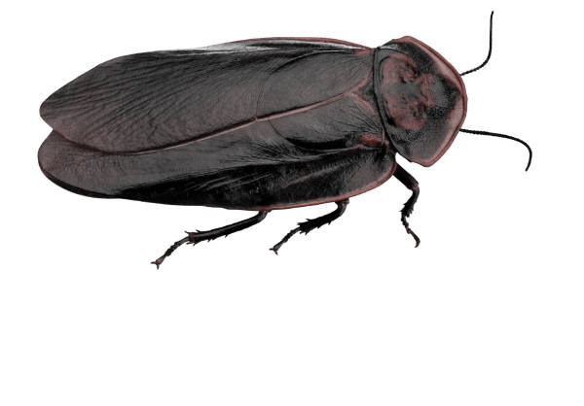
Finding SQL Injection Bugs
Submit a single quote (‘), this is used in SQL as a string terminator and, if not filtered by the application, would lead to an incorrect query
Submit a semicolon (;) this is used to end a SQL statement and, if it is not filtered, it is also likely to generate an error
In either case:
  If an error results, app is vulnerable.
  If no error, check for any output changes.

Slide 12
Finding SQL Injection Bugs
Can also try
  Submit two single quotes (‘’).
    Databases use ’’ to represent literal ’
    If error disappears, app is vulnerable
  Comment deliminators (-- or /* */, etc)
  SQL keywords like ‘AND’ and ‘OR’
  String where a number is expected
    Might also slip by SQL Injection detection system

Slide 13
Simple Example
Assume actual SQL is
  SELECT * FROM Users WHERE Username='$username' AND Password='$password‘
Now consider
  $username = 1' or '1' = '1
  $password = 1' or '1' = '1
Becomes
  SELECT * FROM Users WHERE Username='1' OR '1' = '1' AND Password='1' OR '1' = '1'
https://www.owasp.org/index.php/Testing_for_SQL_Injection_(OTG-INPVAL-005)

Slide 14
Simple Example (2)
Assume actual SQL is
  SELECT * FROM products WHERE id_product=$id_product
  Or
  http://www.example.com/product.php?id=10
Now consider:
  http://www.example.com/product.php?id=10 AND 1=2
If you get a response that there are no matches try:
  http://www.example.com/product.php?id=10 AND 1=1

Slide 15
Fingerprinting Databases
Look at your error messages
MySQL
  You have an error in your SQL syntax; check the manual that corresponds to your MySQL server version for the right syntax to use near '\'' at line 1
SQL Server
  ORA-00933: SQL command not properly ended
PostgresSQL
  Query failed: ERROR: syntax error at or near "’" at character 56 in /www/site/test.php on line 121.

Slide 16
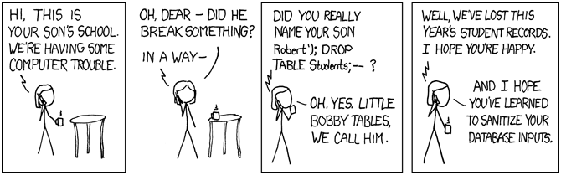
Famous SQL Humor
http://xkcd.com/327/

Slide 17
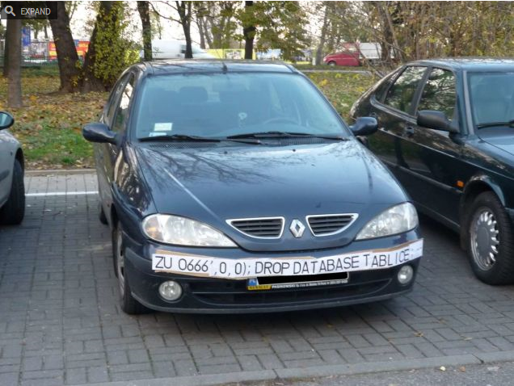
Famous SQL Humor
http://gizmodo.com/5498412/sql-injection-license-plate-hopes-to-foil-euro-traffic-cameras

Slide 18
Next Week
Web Services

Slide 19
Questions
?

