Slide 1
Intro to Ethical Hacking
MIS 5211.001
Week 13
Site: http://community.mis.temple.edu/itacs5211fall16/

Slide 2
Tonight's Plan
Evasion
Odds and Ends

Slide 3
Evasion
You are the attacker, you made it in. Now what?
We’ll cover some basics of what an attacker might do once inside

Slide 4
Secure a Way In
The first thing an attacker wants to do after getting in is to ensure they can get back in
Can you create a new privileged account for yourself?
Can you fix the vulnerability you used to get in
  Don’t want another attacker stepping on top of you

Slide 5
Basic Track Covering
Is logging even turned on?
  No, you are in luck
  Yes, more work to do
Is logging kept on the box?
  Yes, great. Delete it.
  No. Check for syslog services sending data out
  This tells you there is a logging server somewhere
  Also gives you the starting address for the logging server
  Maybe you can get in and delete records there

Slide 6
More on Logging Servers
Even if you can’t delete records it’s still a gold mine. Every machine worth protecting is sending logs to the service
If you can read the stored data or listen to the data coming in you can grab UserIDs and maybe even passwords

Slide 7
Pivoting
The box you break in on should not be the box you launch attacks from
Just like outside, pivot through boxes to use another machine for your attack
If detected, likely only the attacking machine is taken down, not you gateway in to the network

Slide 8
More on Pivoting
Don’t keep the data you steal on your attack machine or your gateway machine
Look for an open file share or a desktop to store what you steal
Don’t use box for anything else, don’t want to call attention to your loot!

Slide 9
Boxing up on Moving Day
Break your data up in to blocks
Consider RAR or PAR with error correction
  If you lose part of your traffic, you might be able to reconstruct
Don’t be in a hurry
  Volume traffic attracts attention
Don’t go to slow
  The driver doing exactly the speed limit looks very suspicious
You want your activity to blend in

Slide 10
How do I get out of here?
Small volume of data?
  Email it
  Post to a website
  Drop box
Need to worry about Data Loss Protection systems
  They look for data matching patterns
    SSNs
    Account numbers
    PII

Slide 11
How do I get out of here? (2)
Sensitive data?
  Obfuscation
  Encryption
Larger volumes?
  Fragmentation
  Redundancy

Slide 12
Obfuscation
Can I do some simple data manipulation
  Substitute letters for numbers and vice versa
  Might confuse DLP
Can I use code words?
Answers depend on what data I’m trying to get out

Slide 13
Fragmentation
Large volumes of data need to be packaged and broken in to manageable chunks
Compression is your friend as well
In short
  Package
  Zip
  Break in to pieces (RAR)
Here’s a link for RAR if you want to play with it: http://www.rarlab.com/download.htm
Also available in Linux
If you do look a RAR, also look at CRC options

Slide 14
Encryption
Do I need to go to full blown encryption?
  Might need to if a robust DLP solution is in place
Can also do encryption as part of fragmentation process

Slide 15
Tunneling
Recall from beginning of course when we talked about TCP/IP, ping, etc…
Ping can carry data
Replies can carry data
DNS can carry data

Slide 16
Physical Access
If you can get physical access consider:
Cellular data connection
Point to Point WiFi
Printing
Your own SAN Storage

Slide 17
WiFi Cards for Testing
The card that I use, and the one recommended by the testers I know is from the Alfa line
I have these two:
  AWUS051NH-802-11b-802-11a-802-11g-Wireless
  AWUS036H-802-11g
Both are high power (1000mw) and work with wireless pen testing tools

Slide 18
TOR Onion Routing
What is Tor Onion Routing?
  Tor is a distributed overlay network which anonymizes TCP-based applications (e.g. web browsing, secure shell, instant messaging applications.)
  Clients choose the circuit paths
  Messages are put in cells and unwrapped at each node or onion router with a symmetric key.
  The ORs only know the successor or predecessor but not any other Onion Router.

Slide 19
TOR Design
Tor is an overlay network
  Each router has a user-level process w/o special privileges.
  Each onion router maintains a TLS connection to every other onion router.
  Each user runs local software called onion proxy (OP) to fetch directories, establish circuits across the network, and handle connections from users.
  Each router maintains a long-term & short term onion identity key. These are used to sign TLS certificates which sign the OR’s router descriptor(summary of keys, address, bandwidth ,etc.)

Slide 20
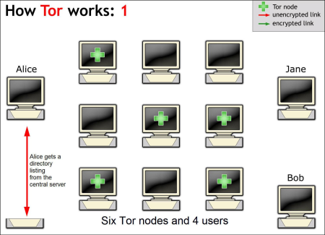
How TOR Works
http://www.iusmentis.com/society/privacy/remailers/onionrouting/

Slide 21
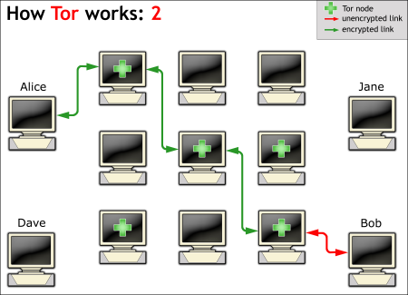
How TOR Works (2)
http://www.iusmentis.com/society/privacy/remailers/onionrouting/

Slide 22
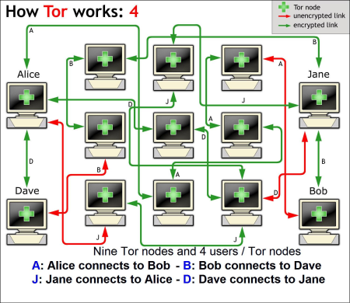
How TOR Works (3)
http://www.iusmentis.com/society/privacy/remailers/onionrouting/

Slide 23
References for TOR
https://www.torproject.org/
http://www.iusmentis.com/society/privacy/remailers/onionrouting/
http://www.onion-router.net/

Slide 24
Ping Sweep
This was covered when we talked about nmap
There are tools that just do a ping of a list of addresses
However:
  Be careful if you look for one of these tools
  Lots of “free” download sites
Can be done straight from command line:
  Try: C:\> FOR /L %i in (1,1,255) do @ping -n 1 10.10.10.%i | find "Reply“
  Pings all addresses in range 10.10.10.1-255

Slide 25
Ping War
Yet another “Free” POS (piece of software)
See remarks from previous page

Slide 26
War Dialing
Old school technique of calling successive phone numbers to see if a modem answers
If modem does answer, some tools will attempt to try basic attacks to see if they work
Tools are still used, but generally don’t find much as they are ineffective in modern VOIP phone networks

Slide 27
Questions
?

