Slide 1
Intro to Ethical Hacking
MIS 5211.001
Week 6
http://community.mis.temple.edu/itacs5211fall16/

Slide 2
Tonight's Plan
NetCat
DOS Batch Files

Slide 3
Netcat
Netcat is a utility used by Penetration Tester and Hackers to establish network connections over UDP or TCP.
Takes “Standard In”, and sends it across the network as data
Receives network data and puts it on “Standard Out”
Messages from netcat itself go on “Standard Error”

Slide 4
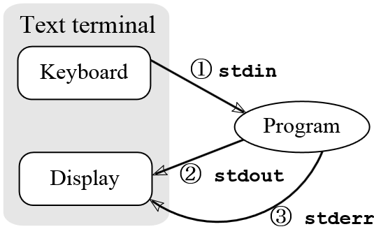
A Word About stdin, stdout, and stderror
These are terms from programming that refer to expected streams in software
As an example
stdin would be the keyboard
Stdout would be the screen
Stderror may be dropped or sent to logging
From: http://en.wikipedia.org/wiki/Standard_streams#Standard_error_.28stderr.29

Slide 5
Netcat in Linux and Windows
In Linux netcat is typically installed and can be activate simply by typing “nc” at the command line
In Windows, the file is not installed
A version can be downloaded from:
http://nmap.org/ncat/
Once downloaded and extracted type “ncat” at the command line to get started
Note – AV will likely automatically remove it

Slide 6
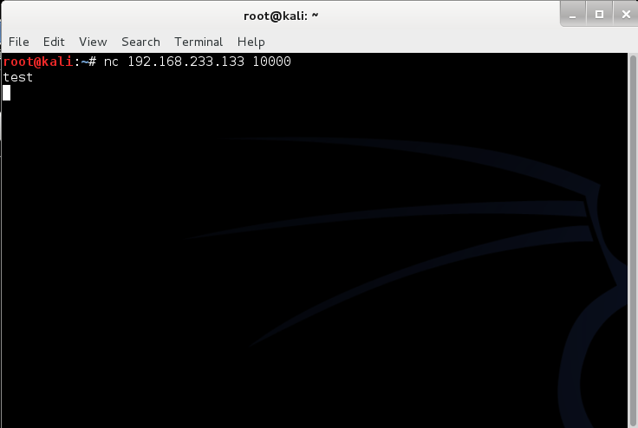
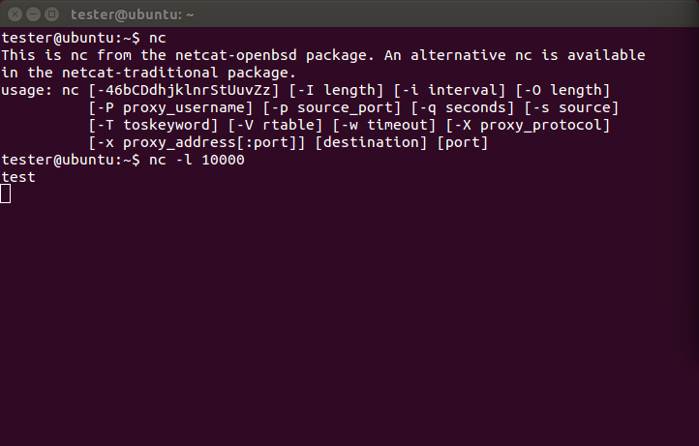
Simple Demo

Slide 7
Netcat Structure
Basic format is
Send
$nc [Target IP] [Remote Port]
Receive
$nc [flag(s)] [Local Port]
Assumes TCP unless –u flag is set forcing to UDP
Link to SANS Cheat Sheet
URL: http://www.sans.org/security-resources/sec560/netcat_cheat_sheet_v1.pdf

Slide 8
Pipes
So, netcat can send what I type to another machine. So what!
The pipe commands “|”, “>”, and “<“ let you do more interesting things
For example, transfer a file between systems
$nc –l –p [Local Port] > [Out File]
Listen on local port and store result in file
$nc –w3 [TargetIP] [Port] < [In File]
Push file to target IP on port
See SANS Cheat Sheet on previous page for more examples

Slide 9
Port Scanning
You can even use netcat as a simple port scanner
Example
$nc –v –n –z –w1 [Target IP] [Starting Port] – [Ending Port]
Systematically attempts to connect on each port within the defined range
Note:
-v – Verbose
-n – Do not resolve names
-z – Do not send data
-w1 – Wait no more then one second to connect

Slide 10
DOS Batch Scripting
First off, almost everything I present here started at:
http://blog.commandlinekungfu.com/

Slide 11
Reading Files w/o Editor
Similar to Linux, try these:
“type test.txt”
Or “type *.txt”

Slide 12
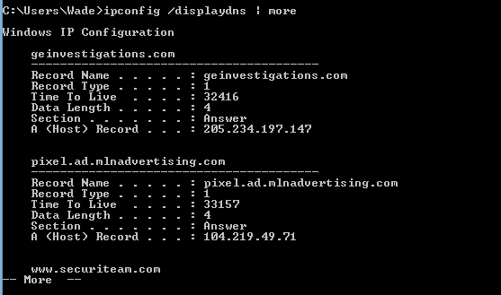
Finding Other Machines
Try: “ipconfig /displaydns
I added “| more” to avoid overflow

Slide 13
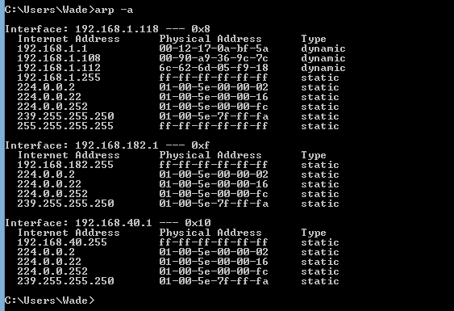
Finding Other Machines
Try “arp –a”

Slide 14
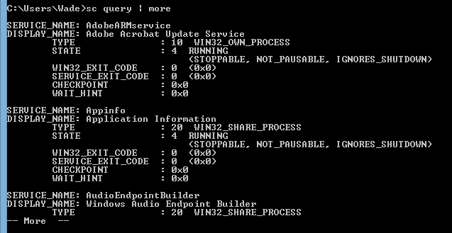
Find “Running” Services
Try “sc query”

Slide 15
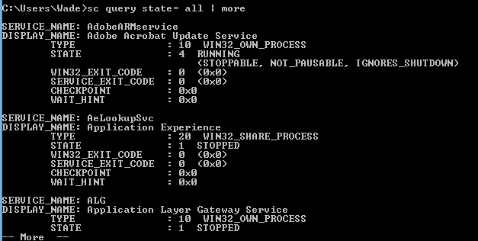
Find “All” Service
Try “sc query state=all”

Slide 16
Details on a Service
Try “sc qc [service_name]

Slide 17
Start/Stop Services
Try “sc start [service_name]” or “sc stop [service_name]
Remember, you can use “sc query state= all” to find the service names
If you have access to a similar machine, you could also look at the GUI

Slide 18
Basic Coding
For Loops
FOR /L -> Counter
FOR /F - > Iterates through a file

Slide 19
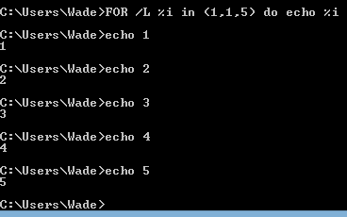
FOR /L -> Counter
Example
FOR /L %i in ([Start],[Step],[Stop]) do [command]
Translates to
FOR /L %i in (1,1,5) do echo %i

Slide 20
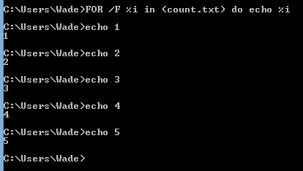
FOR /F - > Iterates through a file
FOR /F (“options”) %i in ([text_file]) do [command]
Translates to:
FOR /F %i in count.txt do echo %i

Slide 21
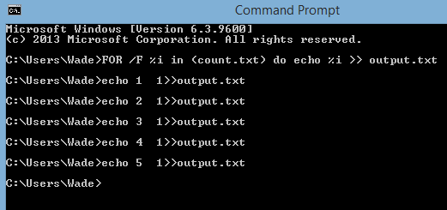
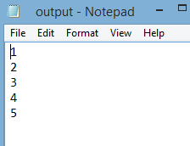
Sending to Outfile
Can add “ >> output.txt” to redirect to an output file
Try “FOR /F %i in (count.txt) do echo %i >> output.txt”

Slide 22
Reference
Lots more at:
http://blog.commandlinekungfu.com/

Slide 23
Questions
?

