Slide 1
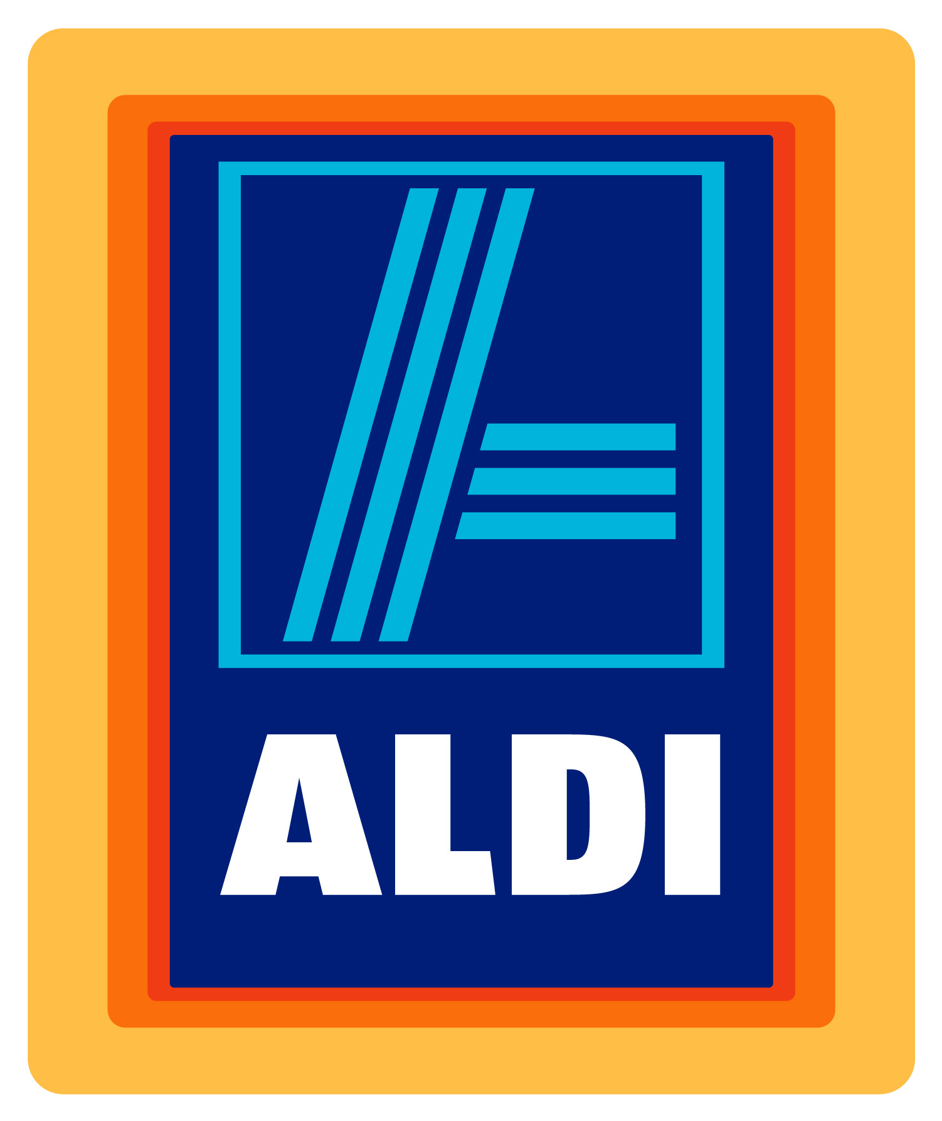
Approaching Advertising Aldi
Taylor Emmons, Tyler Kochenash, Antonio Perez, Jason Randolph, Emily Wernly

Slide 2
Aldi Background
Theo and Karl Albercht in 1962
Low prices, limited products
Expanded into multiple countries
In the United States alone...
More than 1,600 stores across 35 states
Over 24,000 employees
650 new stores by 2018
Focus remains on:
Limited inventory
Bigger discounts
Exclusive brand products
Keeping out non-essential services

Slide 3
Micro-Environmental Shifts
Macro-Environmental Shifts
Customers
Lack of advertising
Not attracting targeted customers
Competitors
Biggest competitors:
Target
Wal-Mart
Trader Joe’s
Economic Factors
Robust Economy
Sluggish Economy
Operating in different regions
Technological Factors
Home Shopping Network
Amazon.com
Jet.com

Slide 4
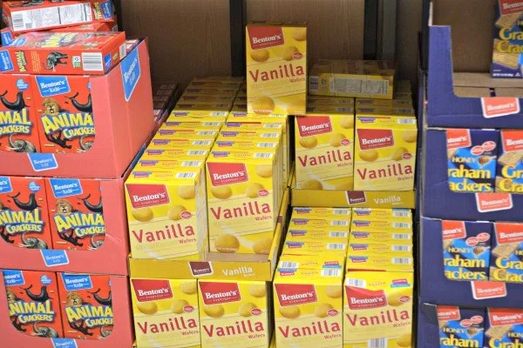
Problems To Be Analyzed
Limited advertising
Aldi’s weekly newsletter
Very few customers see weekly sales and products that are available.
Commercial campaigns
Only 10 nationally aired TV ads in the past 30 years
Not a broad selection of specific products
Most items have one product available to purchase.
Might be able to choose between two different sizes.
Competing brands
(Keebler, Nabisco, Great Value, Market Pantry)
No option to select best product between different brands.
Benton’s

Slide 5
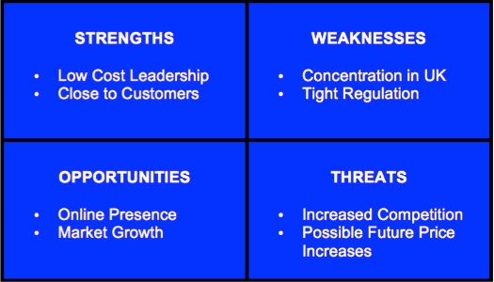
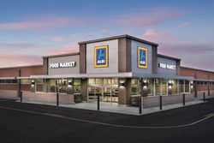
Problems To Be Analyzed
Competitive market with no future goals
No external market research
Customer surveys -needs and preferences
No budget forecast - financial planning
No calculation method for setting prices for products
Keeping a low profile
No public relations
Appearance - discounted store
Earn customers through trust
Choose products for price, not for brands.

Slide 6
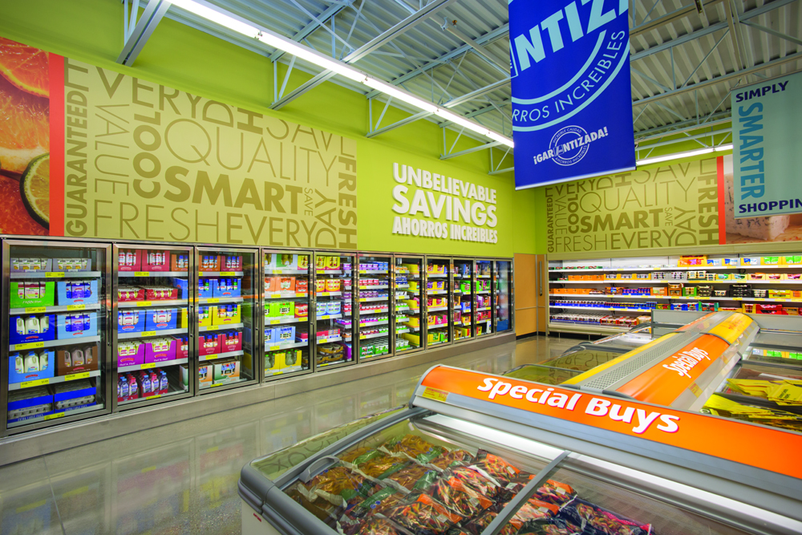
Alternative Solutions
Acceptance of customer surveys
Understand customer’s preferences
Elevate customer’s shopping experience
Edge over competitors (ex.Walmart)
Increase media exposure
Increase presence in local media
Limited cost
Potential new customers

Slide 7
Alternative Solutions
Get involved with local charities
Increases the store’s brand image
No longer keep low profile
Begin to budget forecast
Could lower competitive prices
Cash flow can lead to an investment into new products

Slide 8
Aldi’s U.S. Performance Goals
To successfully implement 650 new stores in the US
50% increase
163% increase in store openings per year
From 80 to 130
Generate a return on its Investment of $3 Billion
Notes:
The Performance Goals that Aldi is trying to achieve within the US are to successfully implement 650 new stores, increase the rate at which these store are opening, by over 160% in 2018, and to maintain growth and a successful return on its $3 Billion dollar investment.

Slide 9
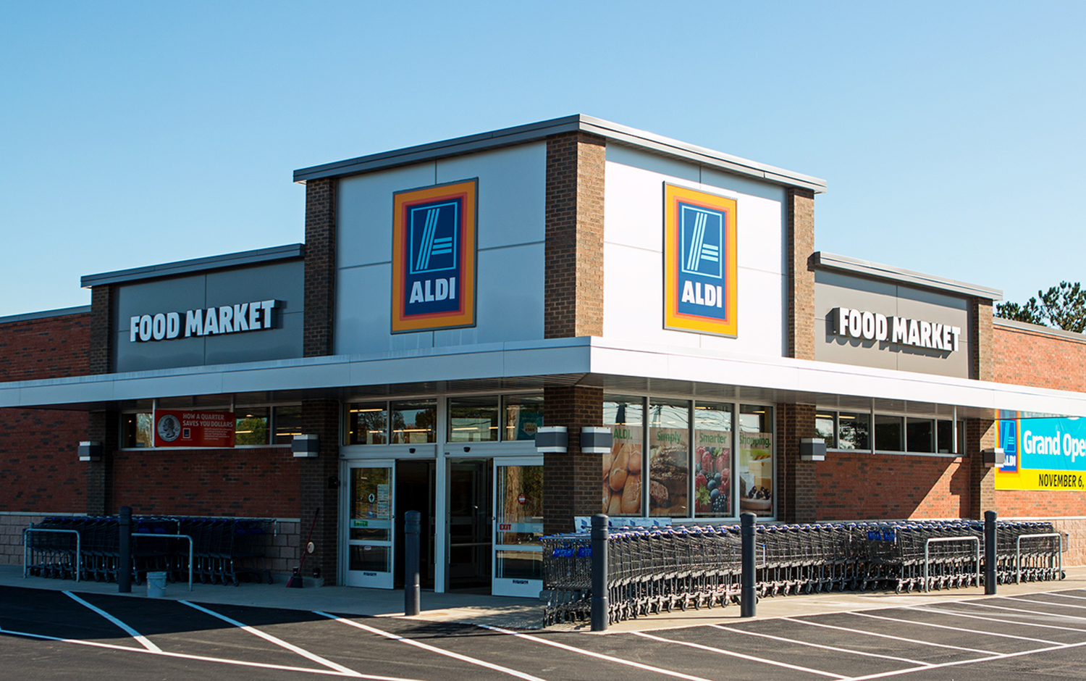
Aldi in the U.S.
Aldi currently has 1200 US stores (12.3% of stores)
Only <10% of Aldi’s Global Revenue is generated in the US
Walmart is Aldi’s Main Competition
Grocery Store Market is Highly Competitive:
Companies are struggling to attract and retain loyal customers
-
Notes:
http://www.businessinsider.com/reasons-people-are-obsessed-with-aldi-2015-4
http://customerthink.com/what-matters-for-customers-in-grocery-stores/
http://www.grocery.com/aldis-market-share-experiences-a-growth-this-year/

Slide 10
Top 5 Key Drivers to Customer Grocery Store Choice
Price: 15- 20% lower prices than Walmart, 30- 40% Lower than Regional Grocery Stores
Product Choice: Aldi sells top 1,500 most popular items, mainly private brands
Ease: Every store has identical layout for ease of shopping
Service: Staff on hand to assist but shopping/ checking out is largely customer driven
Expertise: Aldi is a Global Leader in Quality and Price
Morrisons (2014)

Slide 11
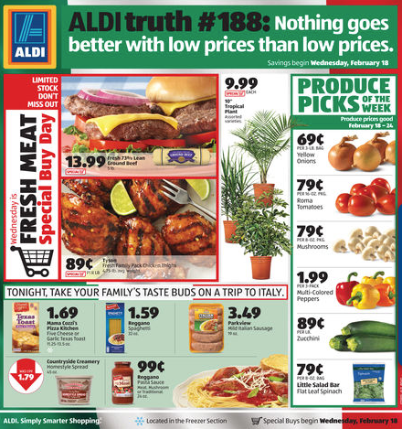
Media Exposure
Currently, Aldi relies on online customer mailing lists and word of mouth to market their company.
Lack of aggressive advertising has stemmed from the Albrecht brother’s fear of public exposure
This is limiting the company from expanding its customer base
Notes:
The best solution to help Aldi meet its Performance Criteria is to increase its advertising.

Slide 12
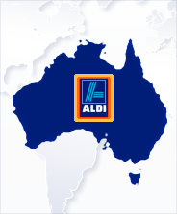
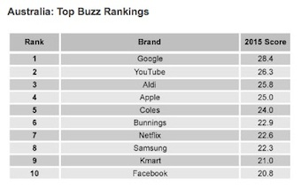
Australian Campaign Experiment
1st Australian Aldi opened in 2001
Aldi began a huge Marketing Campaign in Australia
Slogan “Like Brands, Only Cheaper”
Aldi is now ranked #3 in terms of brand awareness in Australia
Net Profit Increase from $121 Million in 2010 to $261 Million.
Notes:
Only surpassed by huge Global Leaders, such as Google and YouTube.
http://www.displays2go.com.au/blog/aldi-brand-awareness/
http://www.ausfoodnews.com.au/2015/07/13/aldi-opens-up-on-its-fantastic-profits-without-fantasy-on-tax.html

Slide 13
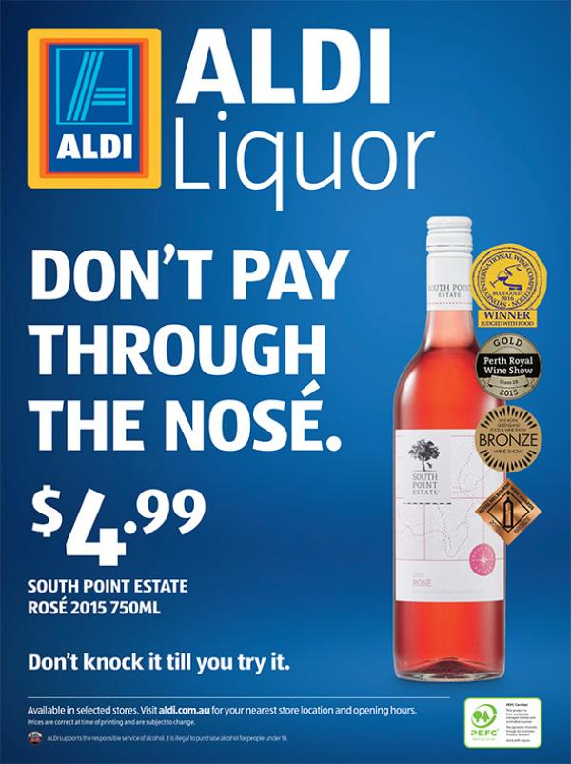
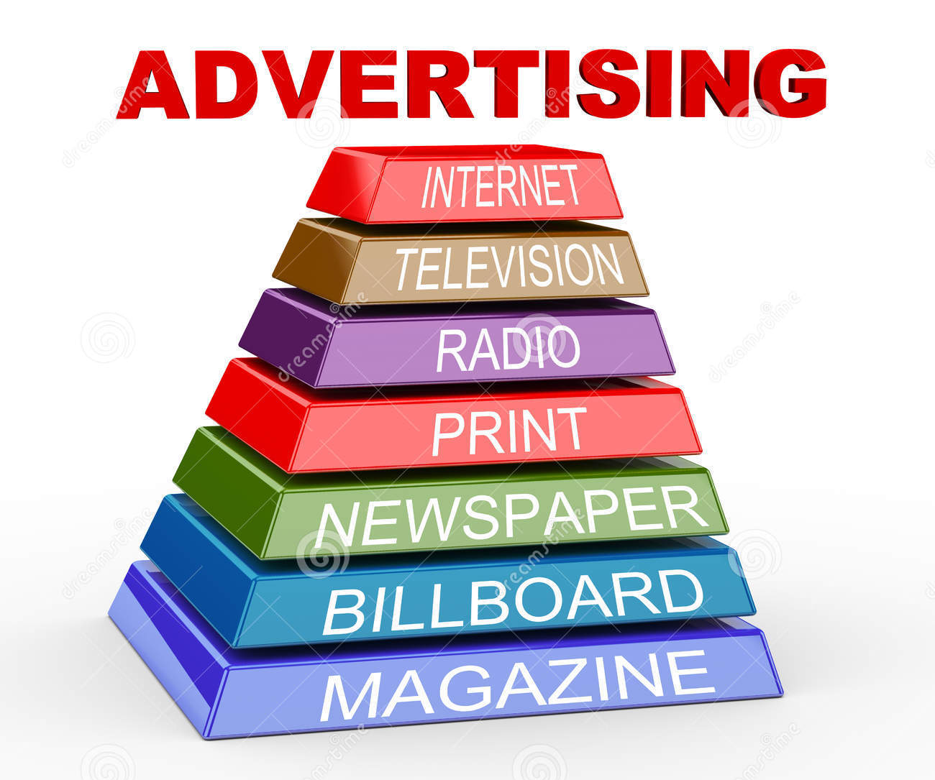
Solution? Advertising!
Aldi’s low prices and efficient store layouts are a brilliant business strategy and make Aldi a strong competitor for U.S. market shares. It’s main focus needs to be on accumulating and retaining more customers.
Aldi should increase its advertising budget to expand its U.S. market share and support its efforts to open more successful U.S. locations.

Slide 14
Intermediate Metrics
Conduct a survey to see if U.S. consumers are more aware of Aldi and its business strategy following the advertising campaign
Set certain goals for number of likes on their Facebook and Twitter page quarterly, to show an increase in engagement with consumers
Get connected with Google Analytics to show the number of times people have searched for Aldi on the internet

Slide 15
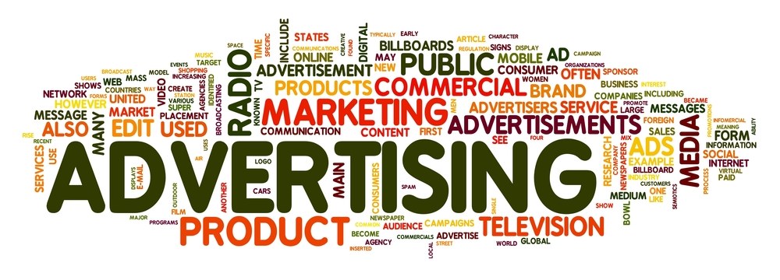
Conclusive Metrics
Track Aldi’s US Market Share
Should double to reflect influx in stores
Look for a positive ROI for Aldi’s $3 Billion U.S. Investment

Slide 16
References
https://www.webprofits.com.au/blog/aldi
http://www.businessinsider.com/reasons-people-are-obsessed-with-aldi-2015-4
http://www.displays2go.com.au/blog/aldi-brand-awareness/
http://customerthink.com/what-matters-for-customers-in-grocery-stores/
http://finance.yahoo.com/news/10-secrets-shoppers-know-aldi-142001565.html;_ylt=A0LEV0fIPatYPLMAl_xXNyoA;_ylu=X3oDMTEyNzNlbjV1BGNvbG8DYmYxBHBvcwM2BHZ0aWQDQTAyNzFfMQRzZWMDc3I-
http://www.thedrum.com/news/2011/02/14/new-aldi-ads-highlight-brand-quality
http://www.ausfoodnews.com.au/2015/07/13/aldi-opens-up-on-its-fantastic-profits-without-fantasy-on-tax.html

