Slide 1
Making Nokia Great Again
Taylor Emmons, Tyler Kochenash, Antonio Perez, Jason Randolph, Emily Wernly

Slide 2
Macro-Environmental Shifts
Micro-Environmental Shifts
Economic
Finland Economy Crash 1991
Socio-Cultural
Changing needs for consumers
Technological
Did not keep up with change to software
Microsoft
Acquisition in 2013
Consumers
Power of Buyers
Competitors
Apple
Sony
Samsung

Slide 3
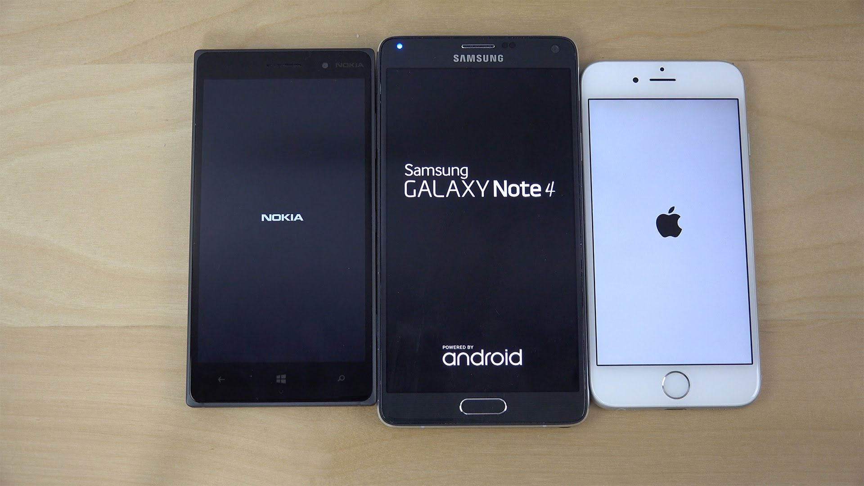
Problems To Be Analyzed
Applications in 2010
Apple- 300,000
Android- 130,000
Symbian(ovi)- 30,000
Nokia was a hardware company competing against software companies.
Consumers demand for strong operating systems
Apple’s iOS and Google’s android are the best operating systems.
Symbian was underdeveloped
Developers did not want to write applications
Consumers moved away from Nokia
Unable to download applications
Unable to update to better software systems
Consumer Wants: affordable, most featured-packed, and “cool”

Slide 4
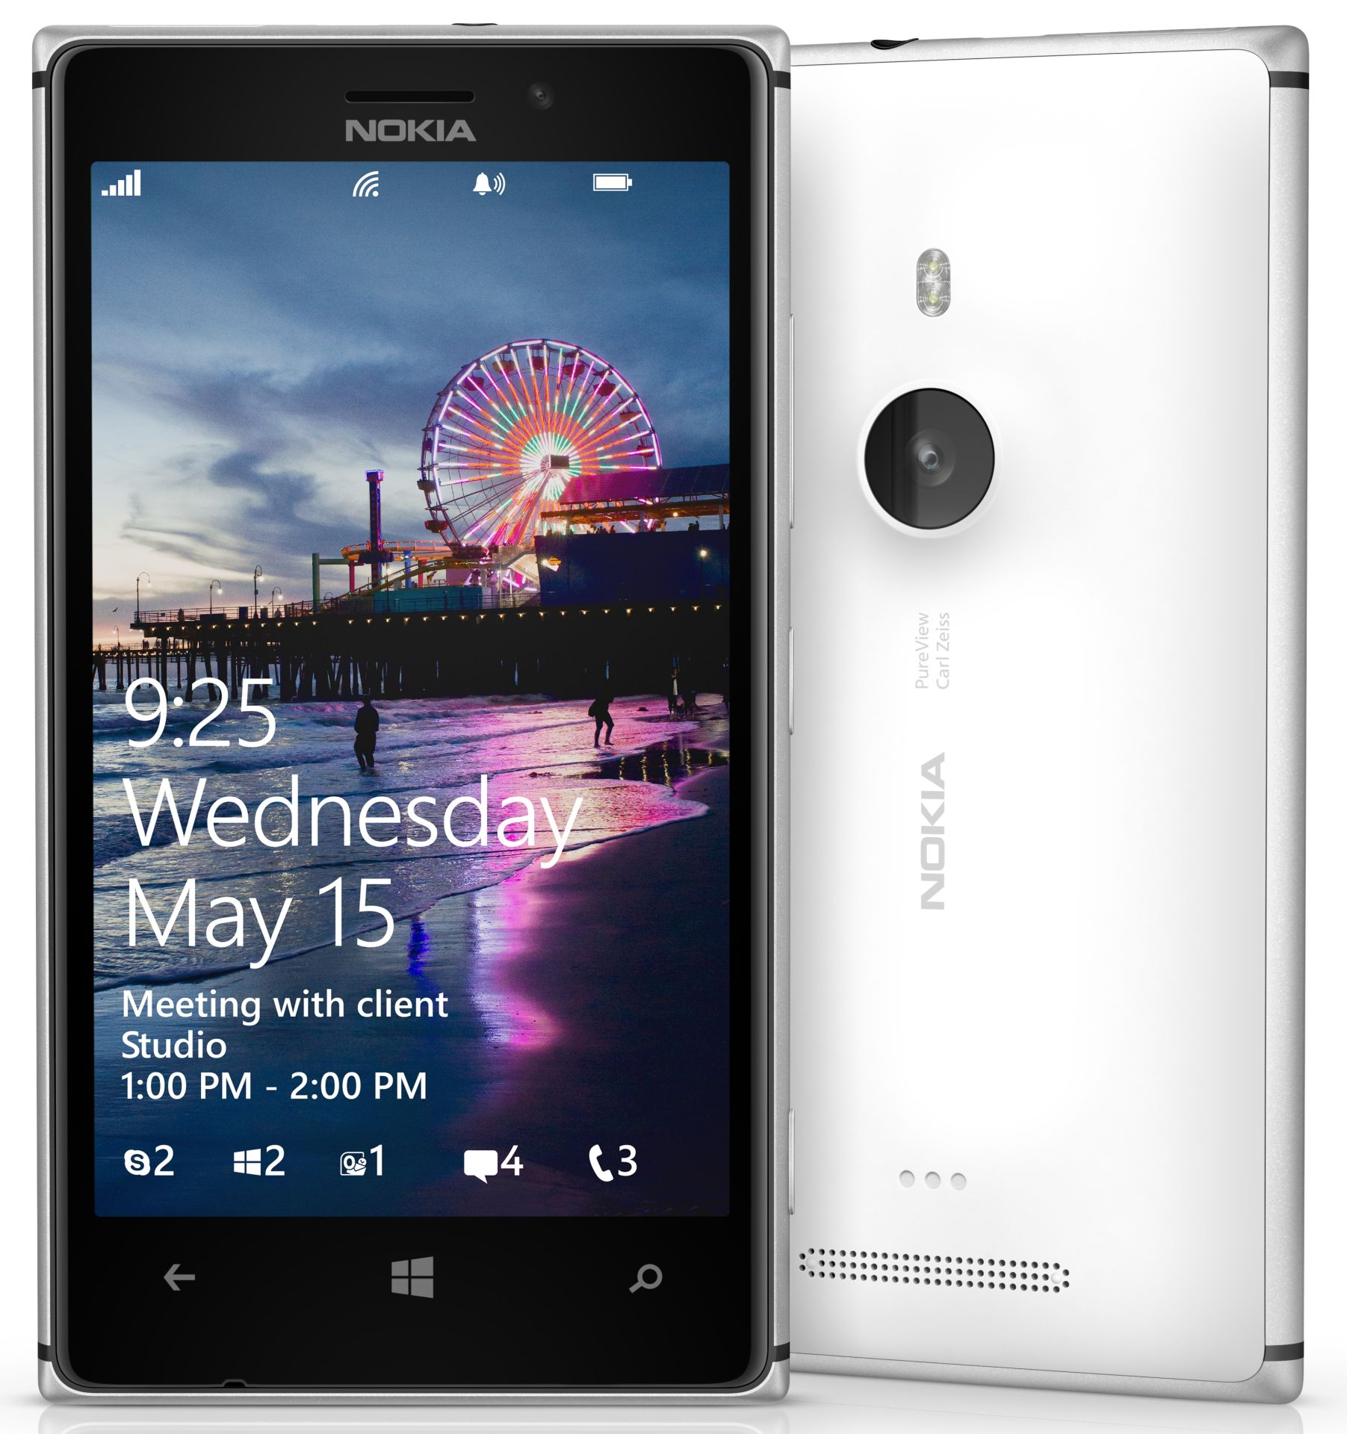
Alternative Solutions
Limit number of products offered to the public
Compatibility Issues
Capitalize on “Mapping” market share
Currently leading Apple and Google
Continue to differentiate Nokia Maps

Slide 5
Alternative Solutions
Continue to promote partnership with Google’s operating system
Solves hardware issue
Continue to differentiate their smartphones and tablets
Create a sense of nostalgia for loyal customers

Slide 6
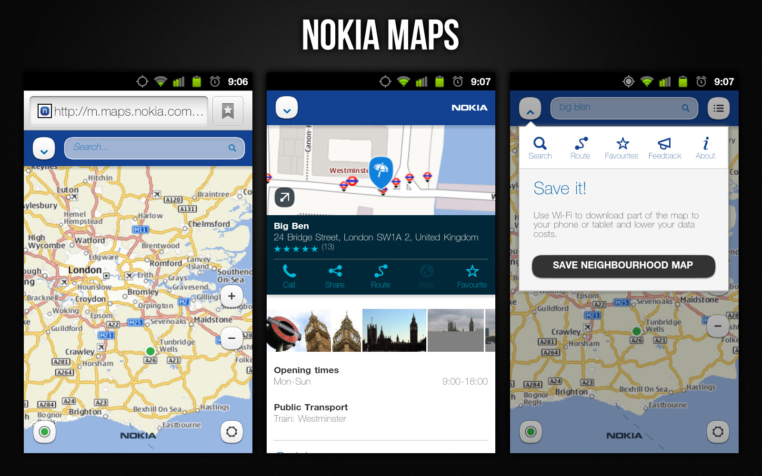
Recommended Alternative Solutions:
-Nokia should stop producing smartphones
-Not profitable for the company and the market is already dominated by Apple and Android
-Reallocate those funds into the Research and Development Sector of their Apps and Software Department
-Specific areas of focus should be the continued development of Nokia maps and Nostalgic Apps, both of which are profitable products for Nokia
Notes:
Other Group Ideas:
Integrate Microsoft operating system with more mobile capabilities. Umbrella branding strategy, open source software, and add a cloud based system
Ther were a cost leader.

Slide 7
Performance Metrics
Intermediate Metrics
Market share
-Nokia discontinuing their phones and reinvesting will lead to increased market share.
New Customer Capture
-The investment of Nokia Here Maps will lead to improved products allowing them to gain new customers.
Customer Retention
-customers will gain trust and customer loyalty will increase.
Conclusive Metrics
Net Present Vaue
-Measures the profitability of a the suggested alternative solutions.
Customer Acquisition Cost
-Nokia will compare advertising costs to their number of new customers in a specific period
Return on Invested Capital
-Nokia to measure the return for stockholder’s investment. Heavy investment in Nokia Maps will result in the highest return for stockholders.

