Slide 1
Resources for Human
Development (RHD)
Jeta Gjana
MIS 3581

Slide 2
RHD
Diversified human services - nonprofit
Founded in 1970
Headquarters in Philadelphia, PA
More than 160 programs in 14 states
4,000 Employees

Slide 3
Mission
To provide caring, effective, efficient and innovative services that help people overcome obstacles and build better lives for themselves, their families and their communities.

Slide 4
Multi-level thinking
Empowerment of groups
Decentralization of authority
Safe and open environment
Creativity
Honesty and trust
Diversity
Organizational integrity
Ongoing growth and development

Slide 5
Intellectual Disabilities
Behavioral Health
Addiction Recovery
Homelessness
Women & Children
Family Health & Counseling
Youth Development
Post-Adjudication
Economic Development
Employment & Training
Veterans Issues
Nonprofit Incubator
Outsider Art

Slide 6
Over 40 years, it handled governmental contracts in excess of $ 1 billion.
Donors & Supporters
Families & Caregivers
Business Model
http://www.youtube.com/user/myRHDTV#p/u/20/6Ftfy7iEu7g

Slide 7
My Role in RHD
MIS Department Intern – Infrastructure Teams
Total of 12 interns
IT/MIS Department Office
Work with the Help Desk team, my supervisor and CTO
Variation of projects: Sysaid & Groomlake database maintenance , installation of software, such as Microsoft Office Professional 2010, development of Business Continuity Plan, computer imaging, etc
Site Visits
Lunch & Learns

Slide 8
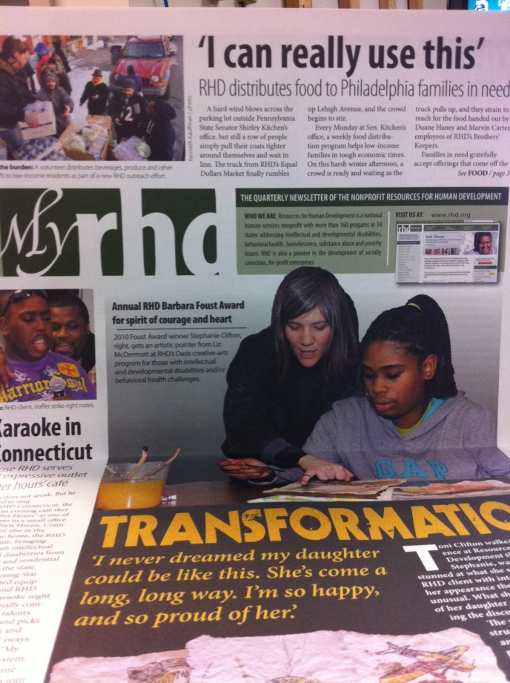
MEDIA

Slide 9
Major impact from MIS courses: MIS 2501, MIS 2502, MIS 3596.
Gen Ed requirements: Cyberspace and Society.
TU Courses

Slide 10
E-Portfolio
http://community.mis.temple.edu/jetagjana

