Slide 1
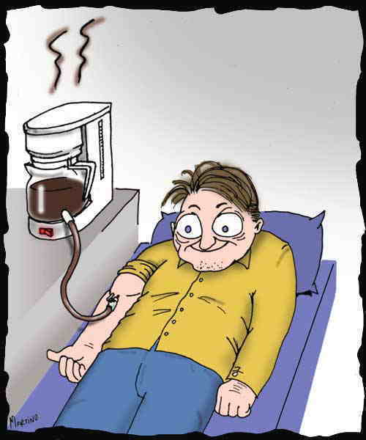
JORDAN SZENICER
KEY ISSUES for CRM
CRM – Success or Failure – When should an organization be complacent?
Successful CRM ≠ individual sales.
For CRM to be successful, current customers need to be kept happy, and new customers need to become returning customers.
Ex: Coupons
Gartner:
“Unhappy customers may be abandoning companies and their products in great numbers”
“Dissatisfied customers cost enterprises large sums of money and damage to the brand.”
Moving Forward: Which CRM areas need the most attention?:
Customer Service Contact Center
Workforce Optimization
Voice of the Customer (VoC)/Enterprise Feedback Management System
Social CRM
$UCE$$
WRONG
You successfully get a customer to buy your product.
You collect their money
The customer continues to buy your product in the future
http://my.gartner.com/portal/server.pt?open=512&objID=260&mode=2&PageID=3460702&id=1589014&ref=g_sitelink

Slide 2
JORDAN SZENICER
KEY ISSUES for CRM
How can organizations best improve their customer experience?
Understanding the “before, during, and after” of a customer interaction:
Not just a sale → a potential relationship
Discerning customer interactions can create not just any customer, but a loyal customer.
Ex: Amazon
Move to a context-sensitive dialogue with the customer
Don’t generalize! Don’t assume!
Who, Where, What
Arrive at an outside-in set of customer processes
Design and test your customer service processes directly with your customer base.
http://my.gartner.com/portal/server.pt?open=512&objID=260&mode=2&PageID=3460702&id=1589014&ref=g_sitelink

Slide 3
JORDAN SZENICER
KEY ISSUES for CRM
How will the contact center evolve to handle multichannel customer service?
Mobile
Web
On the Phone
Channels
Social Media
In Person
Problem:
Current customer service and support (CSS) applications for contact centers were not designed to support multiple communication channels!
Gartner:
“Through 2016, 75% of current CSS apps in the contact center will require an overhaul to keep pace with shifting business needs”
Revamping CSS = Costly Process
Automation? Saves money but potentially less satisfying to customer.
Potential savings in CSS would be mitigated by any drop in customer satisfaction.
http://my.gartner.com/portal/server.pt?open=512&objID=260&mode=2&PageID=3460702&id=1589014&ref=g_sitelink

Slide 4
JORDAN SZENICER
KEY ISSUES for CRM
How to sort through the CSS vendor playing field?
CSS apps ≠ domain general.
Usually tailored specifically to individual organizations’ needs.
Glut of CSS vendors crowding the CSS application playing field.
What should an organization do?
Single-channel apps
Multi-channel apps
Industry-specific apps
“More than half of customer service applications are custom-built” (Gartner)
Organization
http://my.gartner.com/portal/server.pt?open=512&objID=260&mode=2&PageID=3460702&id=1589014&ref=g_sitelink

