Slide 1
Marriott’s Customer-Focused E-Business Strategy
Jordan Szenicer
Angel Peguero
Sam McCutchin
Will Valentin

Slide 2
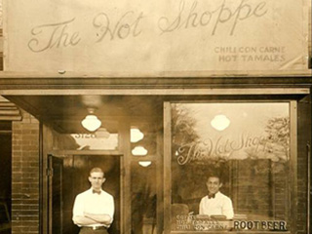
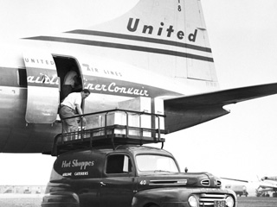
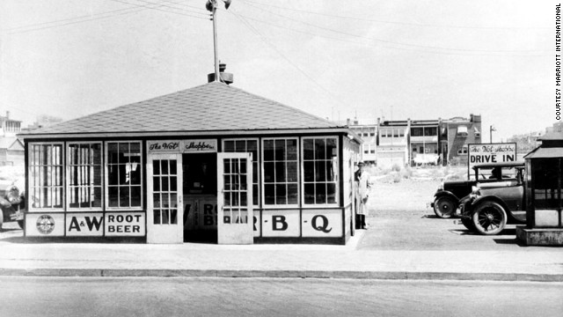
Humble Beginnings
Nine-seat A&W Root Beer Shop
Hot Shoppes
Airline Catering
1927
1929
1937
How did they evolve from a nine-seat root beer shop to a multibillion dollar hotel corporation?
http://timeline.marriott.com/
Jordan Szenicer

Slide 3
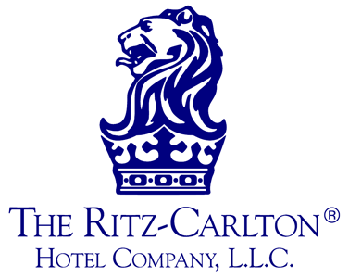
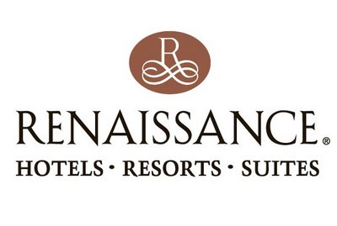
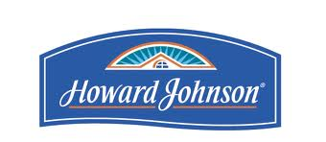
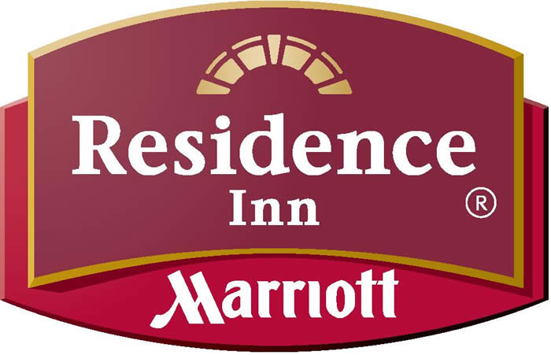
Transformation to Hotels: Bill Marriott Takes Over
1957 – The Marriott’s open their first hotel.
Bill Marriott takes over the hotel side of the Marriot’s business portfolio.
Helps concentrate their efforts in hotels.
Acquisition Hungry:
“I figured out we’d make more money in the hotel business than we would ever make in the restaurant business” – Bill Marriott
“My father was a restaurateur and he didn’t really understand the (hotel) side…of the business” – Bill Marriott
https://encrypted-tbn3.google.com/images?q=tbn:ANd9GcRanR9wWvlWUTQSmwCHD_xWvajdsRo4898rWPgM5DVGBQoelI0t3A
http://atlantapride.org/wp-content/uploads/Renaissance-Logo-Brown1.jpg
Jordan Szenicer

Slide 4
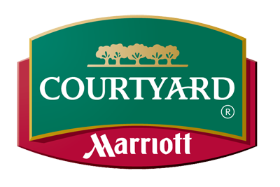
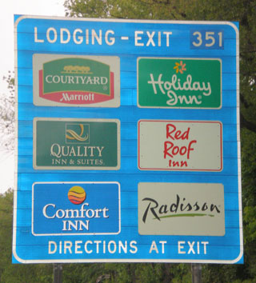
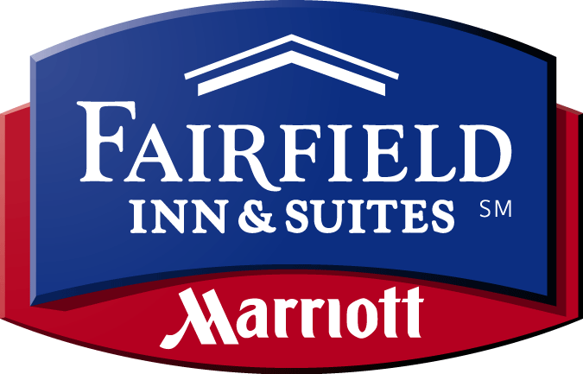
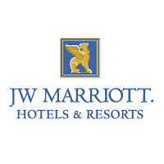
Recipe to Marriott’s Success
Key Ingredients to Marriott’s Success:
(Acquisitions)
Excellent Customer Service
Innovation
Some Key Innovations
First motor hotel, pioneering a culture of roadside lodging
First hotel company to offer reservation confirmations via mail.
First hotel company to offer a portfolio of many brands
http://www.google.com/imgres?start=89&hl=en&gbv=2&biw=976&bih=623&addh=36&tbm=isch&tbnid=6_B0nh_i4-ViaM:&imgrefurl=http://www.travelboards.com/logosigns/sign.asp%3Fe%3D180%26s%3DOH%26t%3DLodging&docid=zSreoOE7ylY55M&imgurl=http://www.travelboards.com/gfx/logosigns/OH/OH180L.jpg&w=320&h=269&ei=h6WUT9L7Lae30gGuhI3nBw&zoom=1&iact=rc&dur=443&sig=106122463376519616358&page=6&tbnh=127&tbnw=149&ndsp=18&ved=1t:429,r:7,s:89,i:20&tx=52&ty=61
Jordan Szenicer

Slide 5
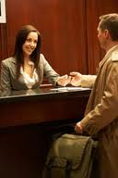
Areas to Improve in Customer Service
Improving customer satisfaction.
Easing the reservation process.
Increasing customer retention.
https://encrypted-tbn1.google.com/images?q=tbn:ANd9GcQ_mxYj_Ss6nLONItAjKFZtMfIL0TNvABcDIy0Ip2Y41Dv8RFJe
Angel Peguero

Slide 6
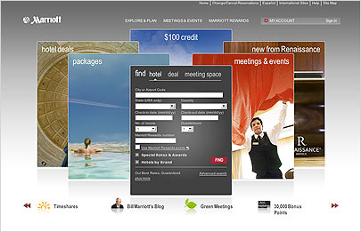
The Solution: E-Business Strategy
Acquiring CRM
Marriott.com
Centralized Customer-Orientation
http://m.mediapost.com/publications/16/marriott-b.jpg
Angel Peguero

Slide 7
Effect of E-Business on Sales
Source: Marriott Annual Report 2002, www.marriott.com
Angel Peguero

Slide 8
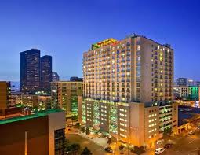
Marriott’s Network
Data Integration
Worldwide Operation
http://www.vita-liquid.com/data/site_images/globe.jpg
http://tinyurl.com/72q2p5n
Angel Peguero

Slide 9
Communication Issues Between Owners and Franchisees (O/F)
Different Hardware and Software Infrastructures at each Location
Coordination Problems with new possible franchisees
Managing 2,500 contracts and 500 prospective clients requires communication
http://www.desmogblog.com/sites/beta.desmogblog.com/files/blogimages/communication3.gif
Sam McCutchin
Notes:
http://blog.timesunion.com/opinion/files/2010/10/1029_WVamericandream.jpg

Slide 10
Solving Communication Issues After Implementation
Data can be exchanged between departments without problems
New properties can be developed faster while current properties could be maintained with more efficiency
Increased customer satisfaction due to communication between branches
http://blog.timesunion.com/opinion/files/2010/10/1029_WVamericandream.jpg
Sam McCutchin

Slide 11
New System, Old Employee Issues
Old Business Strategy
Data Silos
Branches Separate from one another
New CRM and e-Business Strategy
Consolidated data into one common database
Much faster exchange of data between different areas
Slow transportation of data from one branch to another
Employees must be able to work together to make new software efficient
http://www.thefoa.org/tech/ref/appln/data-centers-1-l.jpg
Sam McCutchin

Slide 12
Adjusting to the New Way of Doing Business
Hospitality trained IT Professionals
Business Professionals invested in project
Common goal between two sides
“A culture of IT-literate, business-knowledgeable professionals” – Marriott CIO Carl Wilson
http://www.anotherway.org/wp-content/uploads/2011/11/working-together.jpg
Sam McCutchin

Slide 13
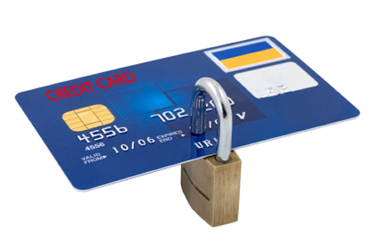
e-Business Security Issues
Personal and financial data now in one main database
Intrusions can lead to credit card fraud or burglary
Lack of security online would be a bad impression on company
http://palpapers.plynt.com/images/padss.jpg
Sam McCutchin

Slide 14
Marriott Puts Security on the Forefront
. Chris Zoladz sets out to enhance company e-security
Marriott Executives give his team an unprecedented 90 minute window to present their ideas
Marriott creates 4-pronged Information Protection Advisory Committee (IPAC)
Different branches given separate tasks to focus on in their respective fields
Marriott makes security a key point in their business model
Marriott invests 4-5% of budget in e-security, while moving swiftly to enact a policy.
http://www.trexglobal.com/property-management/wp-content/uploa
ds/2010/08/Property-Managers-Make-Data-Security-Priority.jpg
Sam McCutchin

Slide 15
Threat of 3rd-Party Sites
3rd-Party reservation sites allowed for quick price comparison
If one hotel was full, other competitors would be listed
Some sites were able to list cheaper prices than the hotel’s home site
Sam McCutchin

Slide 16
Revamping of Marriott’s Homepage
User friendly interface with equal pricing to 3rd-party sites
Online booking revenue increased by $850 million in 3 years
¾’s of all reservations for Marriott properties were done online
http://cedargrand.com/home-jquery/online-reservation.jpg
Sam McCutchin

Slide 17
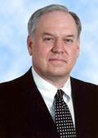
Competitive Analysis and Futures
“We don’t want to just satisfy our customers—we want to delight them” Stephen P Weisz, Senior Vice president of marketing.
http://marriott2.typepad.com/.a/6a0128763ee05d970c012876d68dd6970c-120wi
Will Valentin

Slide 18
How has this helped them Competitively?
70mill in 2 years on I.T
Siebel Systems CRM
Website
100% Customer Service
http://tinyurl.com/74lcqf5
Will Valentin

Slide 19
Continued
Franchises
Website
Profits!
http://i999.photobucket.com/albums/af111/charlesgreen123/money-bag.gif
Will Valentin

Slide 20
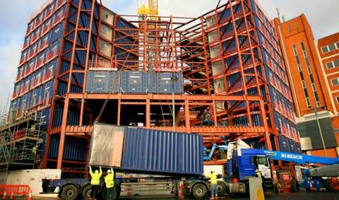
What are their competitors doing?
Most Decided to Change their CRM to keep up with Marriott's growth which includes their websites.
Most took up the per-room-capita(P.R.C) over per-customer-capita(P.C.C)
Some Hotel Chains decided to expand to meet consumer demand in different regions of the world.
http://tinyurl.com/73krs6v
Will Valentin

Slide 21
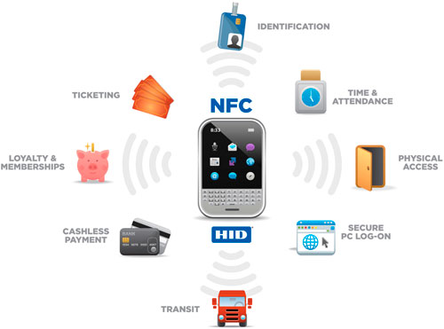
What is the Hospitality business doing in the future?
N.F.C (Near field communications) in mobile phones to open your room and to check-in.
Mobile applications for reservation and Point of sales transactions.
Social Networking. I.E (Facebook , Tweeter, Google+)
http://tinyurl.com/87hn4la
Will Valentin

Slide 22
Works Cited
Will's Sources
Beavis, Artie. "How Will NFC Impact the Hospitality Industry?." ask identive. N.p., 5 Jan. 2012. Web. 16 Apr. 2012. <http://www.askidentive.com/nfc-technology/nfc-impact-hospitality-industry>.
Butcher, Dan. "Marriott’s Renaissance Mayflower Hotel integrates mobile into CRM platform." Mobile Commerce Daily. Napean, 21 Oct. 2010. Web. 16 Apr. 2012. <http://www.mobilecommercedaily.com/2010/10/21/marriott%E2%80%99s-renaissance-mayflower-hotel-integrates-mobile-into-crm-platform>.
Charlton, Graham. "Site review: Four Seasons $18m redesign." Econsultancy. N.p., 12 Feb. 2012. Web. 16 Apr. 2012. <http://econsultancy.com/us/blog/8844-four-seasons-18m-website-reviewed>.
De Lollis, Barbara. "Clarion to test smartphone as hotel room key." USA Today Travel. USA Today, 2 Nov. 2010. Web. 16 Apr. 2012. <http://travel.usatoday.com/hotels/post/2010/11/clarion-tests-mobile-hotel-room-key-concept-/129615/1>.
Desmond, John. "Marriott's e-security strategy:A business-IT collaboration." eSecurity Planet. QuinStreet, 16 Apr. 2001. Web. 16 Apr. 2012. <http://www.esecurityplanet.com/trends/article.php/688803/Marriotts-esecurity-strategyA-businessIT-collaboration.htm>.
Four Seasons. "Four Seasons Hotels and Resorts | Luxury Hotels | Four Seasons." Four Seasons Hotels and Resorts. N.p., n.d. Web. 16 Apr. 2012. <http://www.fourseasons.com/>.
Gose, Joe. "Hilton hotel corp in middle of aggressive growth strategy." National Real Estate Investor. Penton Media, 1 Oct. 2006. Web. 16 Apr. 2012. <http://nreionline.com/mag/real_estate_hilton_elevates_game/>.
Hilton Resorts. "Hotels by Hilton - Hotel Reservations, Deals, and Room Rates." Hilton Resorts. N.p., n.d. Web. 16 Apr. 2012. <http://www1.hilton.com/en_US/hi/index.do>.
HotelMarketing. "Four Seasons, Hilton, and Marriott most digitally competent hotel brands." HOTELMARKETING.COM. N.p., 12 Apr. 2012. Web. 16 Apr. 2012. <http://hotelmarketing.com/index.php/content/article/four_seasons_hilton_and_marriott_most_digitally_competent_hotel_brands>.
Overby, Stephanie. "The Keys to Marriott's Success." CIO. CXO Media, 15 Aug. 2003. Web. <http://www.cio.com/article/29617/The_Keys_to_Marriott_s_Success>.
Rosen, Cheryl. "Marriott Uses CRM Application To Boost Sales." InformationWeek: The Business Value of Technology. UBM Tech Web, 25 June 2001. Web. <http://www.informationweek.com/news/6506964>.
Trew, James. "OpenWays adds NFC to its Mobile Key for hotels." Engadget. AoL tech, 28 Feb. 2012. Web. 16 Apr. 2012. <http://www.engadget.com/2012/02/28/openways-adds-nfc-to-its-mobile-key-for-hotels/>.

Slide 23
Works Cited
Angel's Sources
"Excella Consulting." Excella Consulting. Web. 18 Apr. 2012. <http://excella.com/case-studies/marriott-international.aspx>.
Swanborg, Rick. "CRM: How Marriott Broke Down Customer Data Siloes." CIO.com. CIO, 16 Nov. 2009. Web. 18 Apr. 2012. <http://www.cio.com.au/article/325944/crm_how_marriott_broke_down_customer_data_siloes/>.
Sam's Sources
Overby, Stephanie. "The Keys to Marriott's Success." CIO. CXO Media, 15 Aug. 2003. Web. <http://www.cio.com/article/29617/The_Keys_to_Marriott_s_Success>.
Desmond, John. "Marriott's e-security strategy:A business-IT collaboration." eSecurity Planet. QuinStreet, 16 Apr. 2001. Web. 16 Apr. 2012. <http://www.esecurityplanet.com/trends/article.php/688803/Marriotts-esecurity-strategyA-businessIT-collaboration.htm>.
Jordan's Sources
Gailliard, Flora. "The Hospitality Industry." THE BLACK COLLEGIAN Online: The Career Site for African-American College Students. Web. 22 Apr. 2012. <http://www.black-collegian.com/career/hospitality-199806.shtml>.
"Â» Marriott Reflects on 40 Years Leading Hotel Giant." Â» Marriott Reflects on 40 Years Leading Hotel Giant. 14 Mar. 2012. Web. 22 Apr. 2012. <http://thedailyrecord.com/2012/03/14/marriott-reflects-on-40-years-leading-hotel-giant/>.
"Hotels 325." Web. <http://www.marketingandtechnology.com/repository/webFeatures/HOTELS/2011_HOTELS_325.pdf [pdf]>.
"Marriott Mogul on 55 Years of Change in the Hotel Business." CNN. Cable News Network, 01 Jan. 1970. Web. 22 Apr. 2012. http://www.cnn.com/2012/04/12/business/marriott-hotel-industry/index.html?hpt=tr_c2.
"Our History of Innovation." About Marriott Hotels. Web. 22 Apr. 2012. http://timeline.marriott.com/.
"Core Values & Heritage." Core Values and Heritage. Web. 22 Apr. 2012. <http://www.marriott.com/culture-and-values/core-values.mi>.
Casestudy (Collective Source)
Prashanth, Konakanchi. "ICMR Center for Managent Research." Marriott's Customer-Focused E-Business Strategy (2009): 1-13. www.icmrindia.org. Web. 9 Apr. 2012. <http://astro.temple.edu/~wurban/Case%20Studies/Marriott%27s%20E-business.pdf>.
Marriott. "Find Hotel Rooms." Hotel Rooms and Hotel Reservations from Marriott. Marriott, n.d. Web. 16 Apr. 2012. <http://www.marriott.com/default.mi>.

