Slide 1

MIS JavaScript and API Workshop
(Part 1)
Jeremy Shafer
Department of MIS
Fox School of Business
Temple University

Slide 2
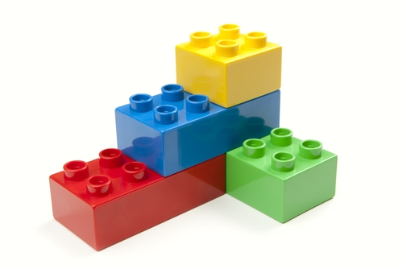
Let’s talk about…
Legos
Legos are easy!
Notes:
Hand out legos
Legos are easy!
I could spend the whole class talking about fine detail – this is a 2x6 brick, and this is a 2x2 brick, and this is a specialty brick.
Or, I could focus exclusively on the finished product – and present something that was overly complex, and ultimately not very useful.
Talk about the red brick – perspective that comes from building

Slide 3

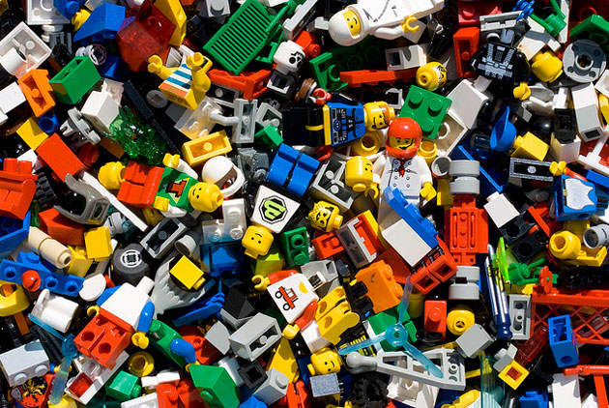


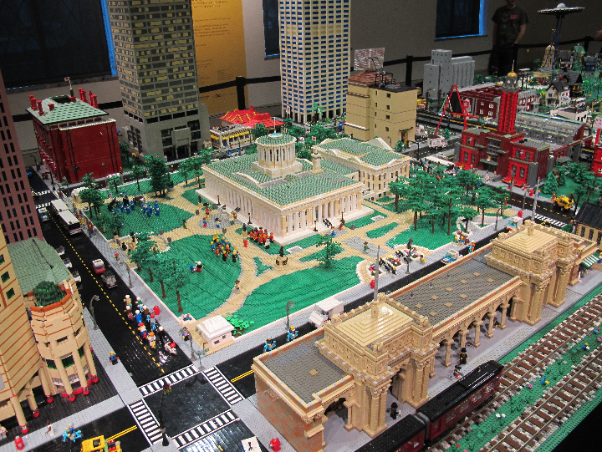
Let’s talk about…
Legos are hard…
Notes:
Hand out legos
Legos are easy!
I could spend the whole class talking about fine detail – this is a 2x6 brick, and this is a 2x2 brick, and this is a specialty brick.
Or, I could focus exclusively on the finished product – and present something that was overly complex, and ultimately not very useful.
Talk about the red brick – perspective that comes from building

Slide 4
Our agenda
Basic building blocks of a web application
A little bit about JavaScript
A little bit about jQuery
An introduction to Ajax and JSON
Demonstration of an application that consumes APIs
Reflection and wrap up

Slide 5
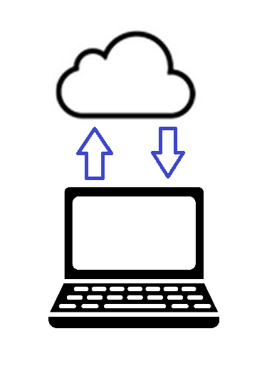
The most basic building block of all: request and response
The URL you asked for …
The response you got back.

Slide 6
The components of an HTTP URL used by the Internet
URL is short for “Uniform Resource Locator”

Slide 7

Three ways to call an HTML page on the Internet
Of course, code we will see today, will also be able to reach out to a URL in response to one or more events… but let’s not get ahead of ourselves.

Slide 8
What’s in the response?
A successful response will return at least one text file. (Really, usually more than one… but let’s start here!)
HTML
CSS
JavaScript
In the HTTP response you are likely to find all three of these languages in a single text file.
HTML and CSS are special purpose languages, while JavaScript is a general purpose programming language.
Each language is interpreted by the browser and each language has a job to do.

Slide 9
Why three languages?
Each language is interpreted by the browser and each language has a job to do.
HTML
HTML provides us with the structure of a document.
CSS
CSS is used to control the visual appearance (or style) of the HTML document
CSS is analogous to how your term paper looks. (Choice of font, margins, etc.)
JavaScript
JavaScript is is used to manipulate the HTML document in response to one or more events.
HTML structure should convey some meaning, like the outline to term paper.
Fun fact: HTML is short for: HyperText Markup Language
Fun fact: CSS is short for Cascading Style Sheet
Fun fact: JavaScript is officially managed by the Mozilla Foundation. It is based on a language specification defined by the ECMA International organization.

Slide 10
Let’s see some examples of CSS and HTML
HTML
CSS
JavaScript
See:
http://misdemo.temple.edu/jeremy/demo_hello/
http://misdemo.temple.edu/jeremy/demo_html/
http://misdemo.temple.edu/jeremy/ice_cream/

Slide 11


OK… so what about JavaScript?
Before we talk about it,
let’s see some examples.
See demo1 and demo2 in demo_js

Slide 12
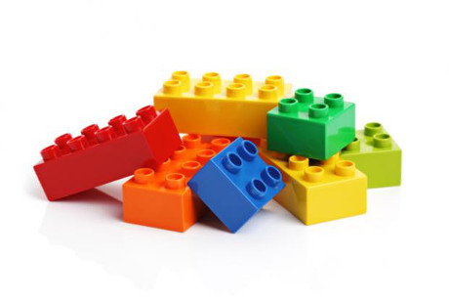
What we just saw…
Variables:
var x = 10;
Arithmetic operators:
+ / * -
The assignment operator:
=
Comparison operators:
== !=
Comments:
/* */
//
Conditional statements
if (condition) {
}
Data types: numbers, strings and booleans
Every programming language has these elements, and more.

Slide 13
What makes JavaScript special?
Recall that the world around us is made up of things.
We call those things:
nouns,
entities
or …
OBJECTS.
Objects are described by their:
properties
and
methods.

Slide 14
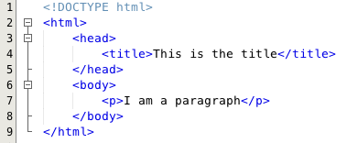
So... Here’s a big idea.
Our HTML documents are really objects. They are composite objects made up of smaller objects.
JavaScript is a powerful language, that lets us do math, work with text, and manipulate those objects.

Slide 15
The document object and the window object
JavaScript allows us to refer to the browser environment using something called the window object.
Similarly, we can manipulate the current HTML document with the document object.
The window.onload event is JavaScript’s way of detecting when the window is ready with a document that is being retrieved from a server.
The document.getElementById() method is a very useful way to reference a tag inside the HTML document.
See examples 3, 4 and 5 in: demo_js

Slide 16
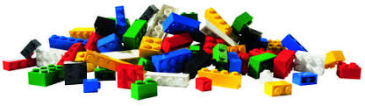
BREAK!

