Slide 1
MIS JavaScript and API Workshop (Part 2)
Jeremy Shafer
Department of MIS
Fox School of Business
Temple University

Slide 2
Objectives
Describe jQuery.
Describe two ways to include the jQuery library in your web pages.
In general terms, describe the use of jQuery selectors, methods, and event methods.
Use jQuery selectors, events, and methods to make changes to the DOM

Slide 3
Linking to the jQuery library
Pro tip! Knowing what a CDN URL is, and how to add one to your solution, is a powerful way to extend the options available to you, the programmer.

Slide 4
jQuery Described
jQuery is a cross-platform JavaScript library designed to simplify the client-side scripting of HTML.
jQuery is the most popular JavaScript library in use today.
jQuery is free, open-source software licensed under the MIT License.
Initial release date: August 26, 2006; 12 years ago
Created by American software engineer and entrepreneur, John Resig.
John Resig is an alumni of the Rochester Institute of Technology.
He was going to call it jSelect, but that name was already taken. That would have been a *great* name, because “selecting” is a fundamental concept in jQuery

Slide 5
What jQuery feels like to a first time programmer…
Why does it feel that way? Because the syntax of jQuery is slightly different from that of a traditional imperative language.
jQuery relies heavily on some things called “selectors”
In many cases, jQuery abbreviates the syntax used in JavaScript.
jQuery relies heavily on functions. We use the assignment operator (=) less often when writing jQuery logic.

Slide 6
The $ core object in jQuery
Stop a moment and reflect on that. The $ object better have some pretty impressive functionality behind it in order to justify those 10,364 lines of code!

Slide 7
The “Vanilla” JavaScript approach to the DOM:
Step 1 – Select some elements to work with
Step 2 – Take some action on each element
With jQuery we now have a new, simplified, two-step process. The basic structure of a jQuery command is: $(“some selector goes here”).SomeMethod();

Slide 8
jQuery selectors
These are the simple selectors. These same conventions used in CSS.

Slide 9
Some jQuery methods
Add a css class
Toggle a css class
Hide a tag (or tags)
Show a tag (or tags)
These methods and others like them can work on multiple elements.
To put it another way, the jQuery methods work on *all the elements* returned by a selector.
(And you don’t even need to write a loop to do it!)
Let’s see it:
Look at index_01.html in demo_jquery

Slide 10
Some more advanced jQuery selectors
We’ll get a chance to use some of these (the ones in red) in our exercise today. The point here is not to try to memorize them all, but to understand that you have a wide variety of options when it comes to selecting content in the HTML document.
Good, interactive, reference material can be found here: https://www.w3schools.com/jquery/jquery_ref_selectors.asp

Slide 11
jQuery methods
For the value of an input tag
For the innerHTML of a node
To move to the next element
To initiate the form submit event
To set the focus to an element

Slide 12
Notice that we are passing “30” into the value of the #gallons tag.
We do that by passing an argument to the val method.
We don’t use the assignment operator ( = ) here!
$(“#gallons”).val() = 30;
Let’s see jQuery at work! (see index_02.html and index_03.html in jquery_demo.zip)

Slide 13
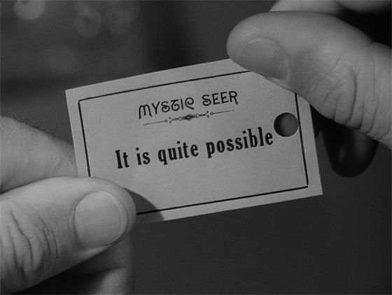
What about events?

Slide 15
Instead of window.onload now we have…
I always do it this way.

Slide 16
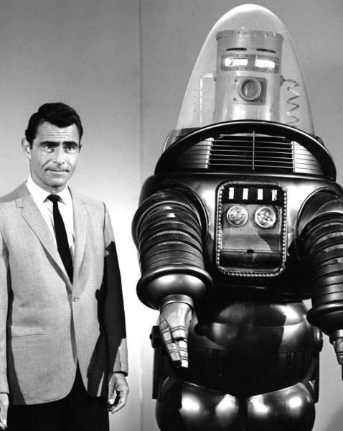
It’s time for some experiments!
In jquery_demo.zip, explore
index_04.html
index_05.html
index_06.html

