Slide 1
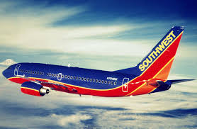
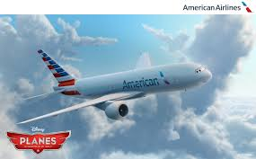
Introduction video

Slide 3
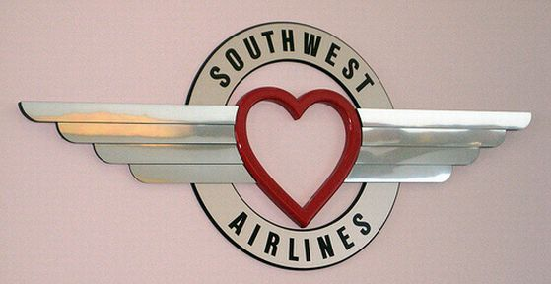
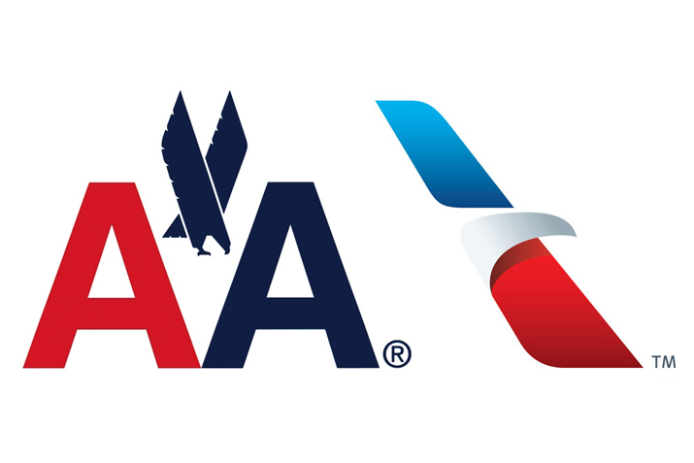
Southwest Airlines
VS
American Airlines

Slide 4
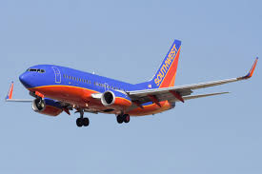
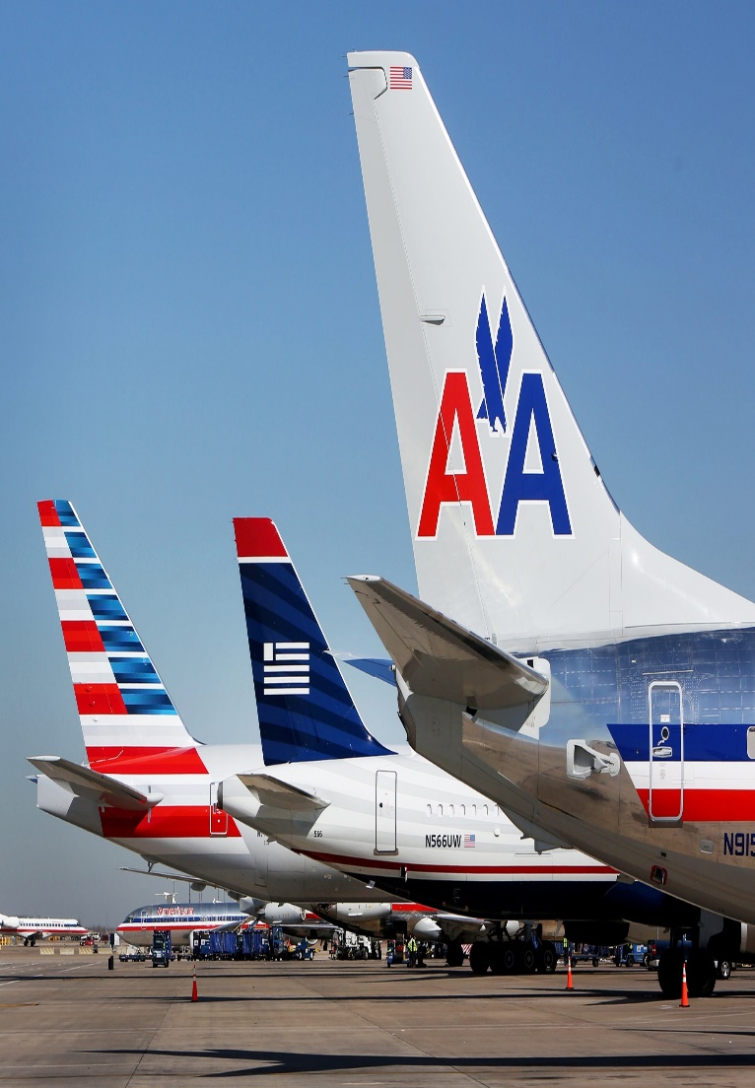
BY:
Tahquan Evans – Past.
Khaled Alkurdi – Present and Advertisement.
Haley McCullian – Human Resources and Competition.
Michael Bongiorno – Finance.
Steve Norwood – Legal Environment.
Nick Sworob – Technology and The Future.

Slide 5
By: Tahquan Evans

Slide 6
Southwest vs. American Airlines
Southwest Airlines Past
American Airlines Past
Was founded on March 15, 1967.
Founded by Rollin King and Herb Kelleher to provide service to the state of Texas.
Headquarters is in Dallas, Texas.
They began flights on June 18, 1971 with three 737-200s.
Was founded in 1930 as American Airways.
By 1933 American Airways operated a route network serving 72 cities in the U.S.
They started off carrying U.S. mail.
In 1934 E.L. Cord acquired who renamed it American Airways.

Slide 7
Southwest vs. American Airlines
American Airlines Past
Southwest Airlines Past
In 1971 and 1972 they saw operating losses and One of the four 737-200s were sold.
The Wright amendment of 1979 is a federal law that governs traffic at Dallas Love Field airport.
Under the amendment southwest and other airlines were barred operating or ticketing passengers on flights from the field beyond the states that border Texas.
On March 16,1995 southwest was the first airline to have a website.
American was the first to fly in 1936 and the DC-3 earned a profit by transporting passengers.
Moved its headquarters from Fort Worth, Texas to New York City in 1979.
Throughout the 1990s American Airlines expanded and became a dominant U.S. carrier in the region.

Slide 8
Southwest Airline
By: Khaled Alkurdi

Slide 9
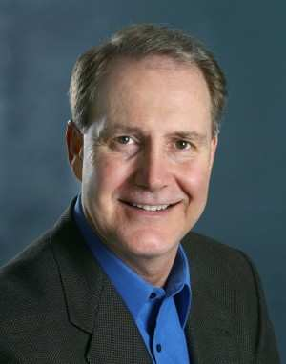
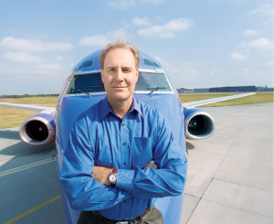
Gary C. Kelly is the current CEO and chairman of Southwest Airlines.
Gary C. Kelly received a Bachelor of Business Administration in accounting from The University of Texas at Austin and is a certified Public Accountant.
Kelly was named one of the best CEO’s in America for 2008 and 2009 by institutional magazines.

Slide 10
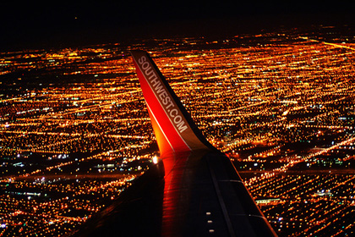
Southwest Airlines is a major well known U.S airline and the worlds largest low-cost carrier.
Southwest headquarters is located in Dallas, Texas.
Southwest has 44,831 employees as of December 2013.
Southwest operates more than 3,400 flight per day.
As of January 2014 Southwest airlines has scheduled service to 89 destinations in 42 states and Puerto Rico.
South west is tha largest operator of the Boeing 737 worldwide with over 550 services, each operating at 6 per day.
In May, 2011 Southwest acquired AirTran Airways, with integration of the carriers expected to be completed by 2014.

Slide 11
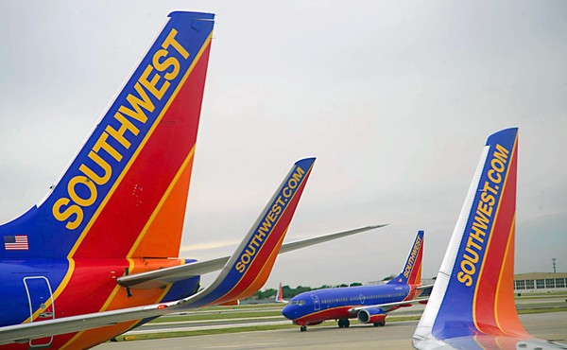
On March 1, 2012 the company was issued a single operating certificate, technically becoming one airline.
As of December 31, 2013 Southwest and AirTran operated 680 Boeing jets.
Number, type, and seats of Boeing jets:
There is 66 planes of the 717-200 with 117 seats.
There is 122 planes of the 737-300 with 137/143 seats.
There is 15 planes of 737-500 with 122 seats.
There is 425 planes of 737-700 with 137/143 seats.
There is 52 planes of 737-800 with 175 seats.

Slide 12
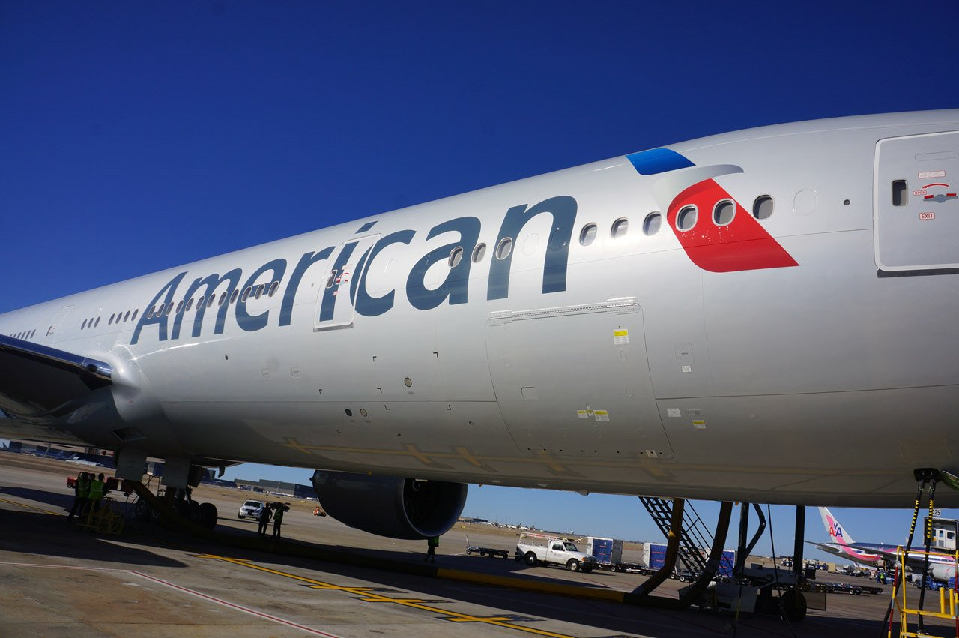
NOW
By: Khaled Alkurdi

Slide 13
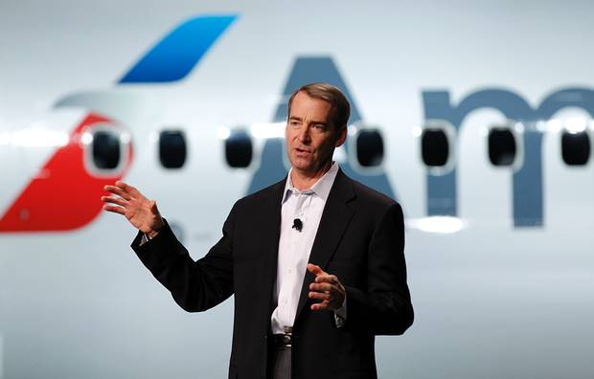
Doug Parker is the Chief Executive Officer of American Airlines.
Parker became CEO following the merger of US Airways and American Airlines in 2013.
Parker has a BA in Economics from Albion College, and an MBA from Owen Graduate School of Management at Vanderbilt University.
Parker lives currently in Dallas, Texas with his wife and three children.

Slide 14
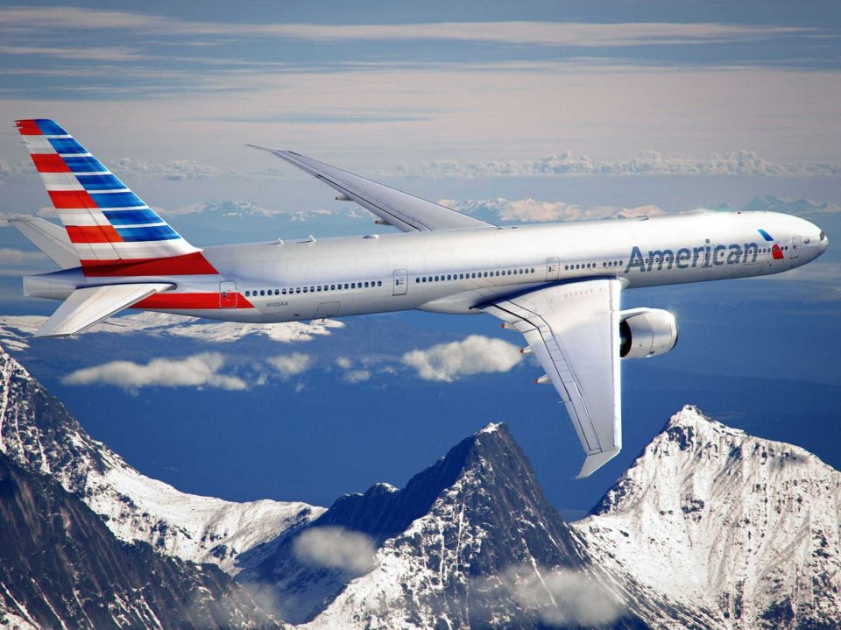
US Airways and American Airline merged in 2013.
American Airlines is a major U.S airline headquarter in Fort Worth, Texas
American Airlines operates an extensive international and domestic network, with scheduled flights throughout North America, the Caribbean, South America Europe and Asia.
American Airlines is part of the one world airline alliance, and coordinates fares, services, and scheduling with British Airways, Finnair, and Iberia in the transatlantic market and with Japan Airlines and Qantas in the transpacific market.
In 2012 American Airlines welcomed 100 million customers, and safely flew their customers to 273 domestic and international locations in 51 countries and territories.

Slide 15
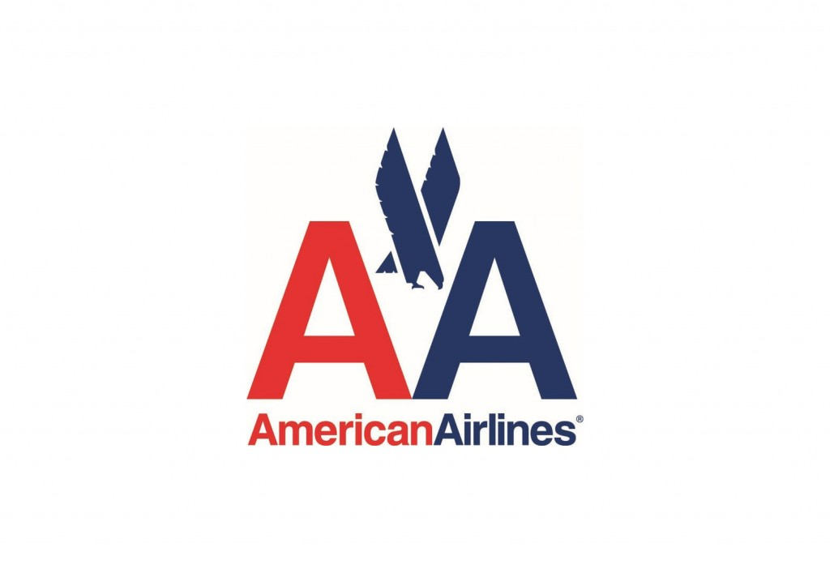
American Airlines coordinates more than 3,500 flights per day.
American Airlines has 627 aircrafts; it has 8 different kinds of aircrafts.
There is 10 planes of the Boeing 777-300ER.
There is 47 planes of the Boeing 777-200ER.
There is 58 planes of the Boeing 767-300ER.
There is 10 planes of the Boeing 767-200ER.
There is 93 planes of the Boeing 757-200.
There is 226 planes of the Boeing 737-800.
There is 163 planes of the MD-80.
There is 15 planes of the A319.
There is 5 planes that are Transcontinental.

Slide 16
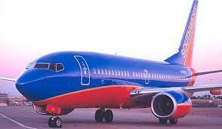
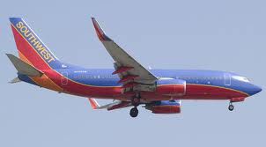
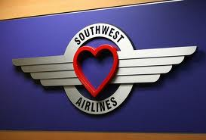
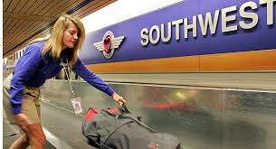
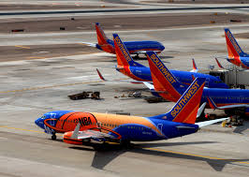
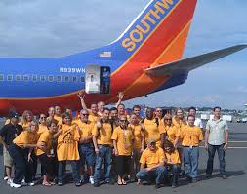
Advertisement
By: Khaled Alkurdi

Slide 17
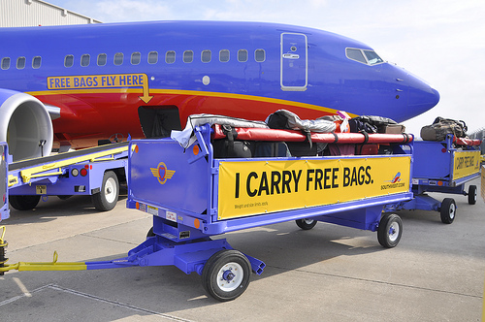
Southwest Airlines spend 199 million dollars on advertisement.
Southwest famous slogans are:
Stop Searching. Start Traveling.
A Symbol of Freedom.
Southwest Airlines. THE Low Fare Airline.
How do we love you? Let us count the ways.
Southwest Airlines tries really hard to encourage their customers to come back by different way using their advertisement skills, some of them are:
Unlimited reward seats: Which means if there is a seat available, you can redeem your points for it.
No blackout dates: Which means we’ve done away with blackout dates, which means your choices and your possibilities.

Slide 18
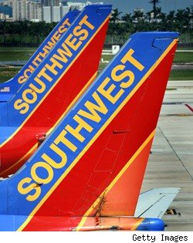
3- Your points don’t expire: Which means you can plan your getaway for next week or next year. Either way, it’s no problem since your points no longer have an expiration date.
4- Earn points for every dollar you spend: The amount of your fare now determines how many points you earn. And since you can also earn points with our Partners, that reward flight won’t be far behind.
5- Redeem for international flights and more: With the Southwest Airlines Rapid Rewards® Credit Card from Chase, you can now redeem your points for International flights, cruises, hotel stays, car rentals, gift cards, and more.

Slide 19
Advertisement Video

Slide 20
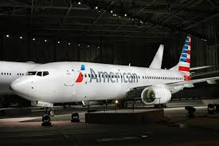
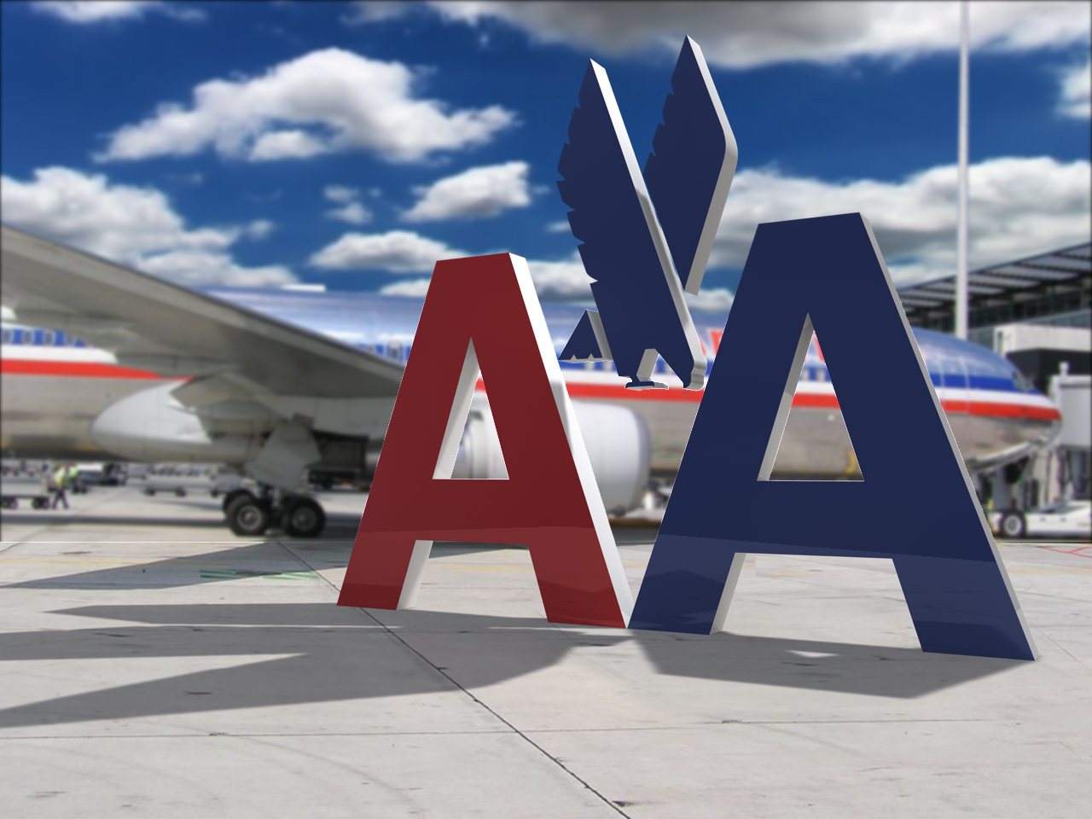
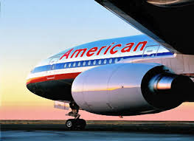
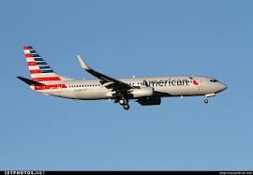
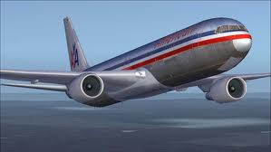
Advertisement
American Airlines

Slide 21
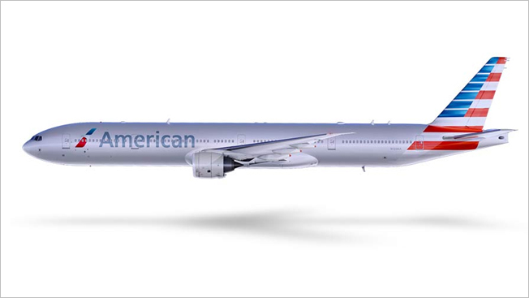
American Airline spent 40 million on advertisement in 2012 down from 70 million in 2011.
American Airlines has Advertising Campaigns all around. They have:
African American Advertisement.
Asian Advertisement.
General Market Advertisement.
Hispanic Advertising.
Lesbian, Gay, Bisexual and Transgender Advertising.
Promotional Requests.
American Airlines famous slogans:
We know why you fly. We’re American Airlines.
Something Special in the air.
Doing what we do best.
Advertisement

Slide 22
Advertisement Video

Slide 23
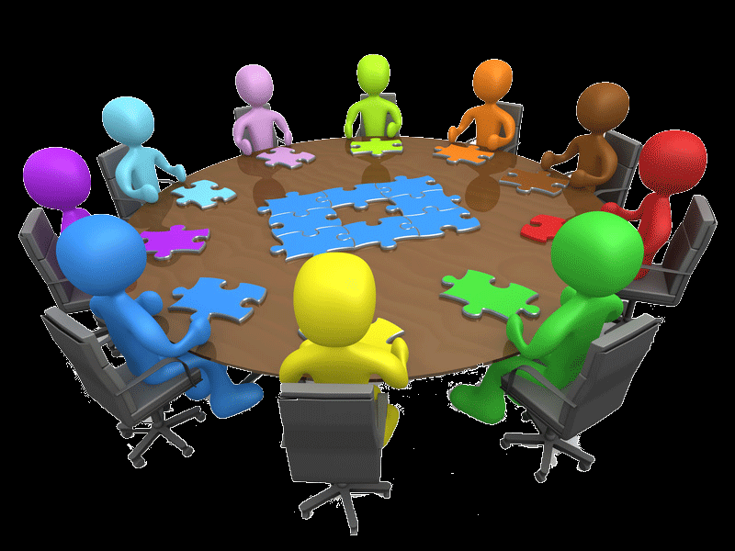
Human Resources
By:
Haley McCullian

Slide 24
Purpose of Southwest Airlines is to connect people to what’s important in their lives through friendly, reliable, and low-cost air travel.
The mission of Southwest Airlines is dedication to the highest quality of Customer Service delivered with a sense of warmth, friendliness, individual pride, and Company Spirit.
We are committed to provide our Employees a stable work environment with equal opportunity for learning and personal growth. Creativity and innovation are encouraged for improving the effectiveness of Southwest Airlines. Above all, Employees will be provided the same concern, respect, and caring attitude within the organization that they are expected to share externally with every Southwest Customer.

Slide 25
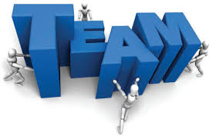
Southwest Airlines is known for two key things. One, it has a fun-loving corporate culture. Second, it is the only airline to have consistent profitability for over 30 years.
Human Resources has a key role in recruiting, hiring, selecting, promoting, and training personnel who will be a good fit with the strategy and with the fun-loving organizational culture.
Southwest's strategy of short-haul, point-to-point flights using less congested airports have contributed greatly to the airline's efficiency.
A significant cost saving factor is the productive and motivated workforce
Southwest ranks highly in employee satisfaction, having been one of Fortune’s top one hundred companies to work for.

Slide 27
American Airlines (AA) is a international airline based in United States. It serves over 273 routes in Africa, Asia, Europe, North America, and South America. American Airlines is also a member of Oneworld, which currently has 13 member airlines that fly around the world.
HR for American Airlines takes care of employment opportunities at American Airlines.
We offer a competitive total rewards package that few other companies match. American's benefits and many other employment privileges are extended to family members and domestic partners.
Our employees, their families, and friends enjoy the ability to travel almost anywhere in the world on American and American Eagle. Plus they can take advantage of discounted travel on other airlines and enjoy special rates on hotels, car rentals, cruises, and more.
Employees are encouraged to grow professionally, and receive the support and resources to reach their full potential
At American, we fully recognize that each individual has unique needs, so we provide a variety of resources to help employees and their families meet their own business and personal life challenges.
Employees can take advantage of a number of financial benefits, including an outstanding employee credit union, 401(k) matching funds, profit sharing and incentives.

Slide 28
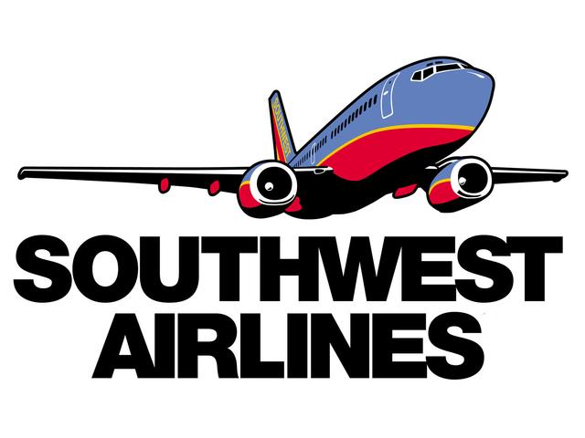
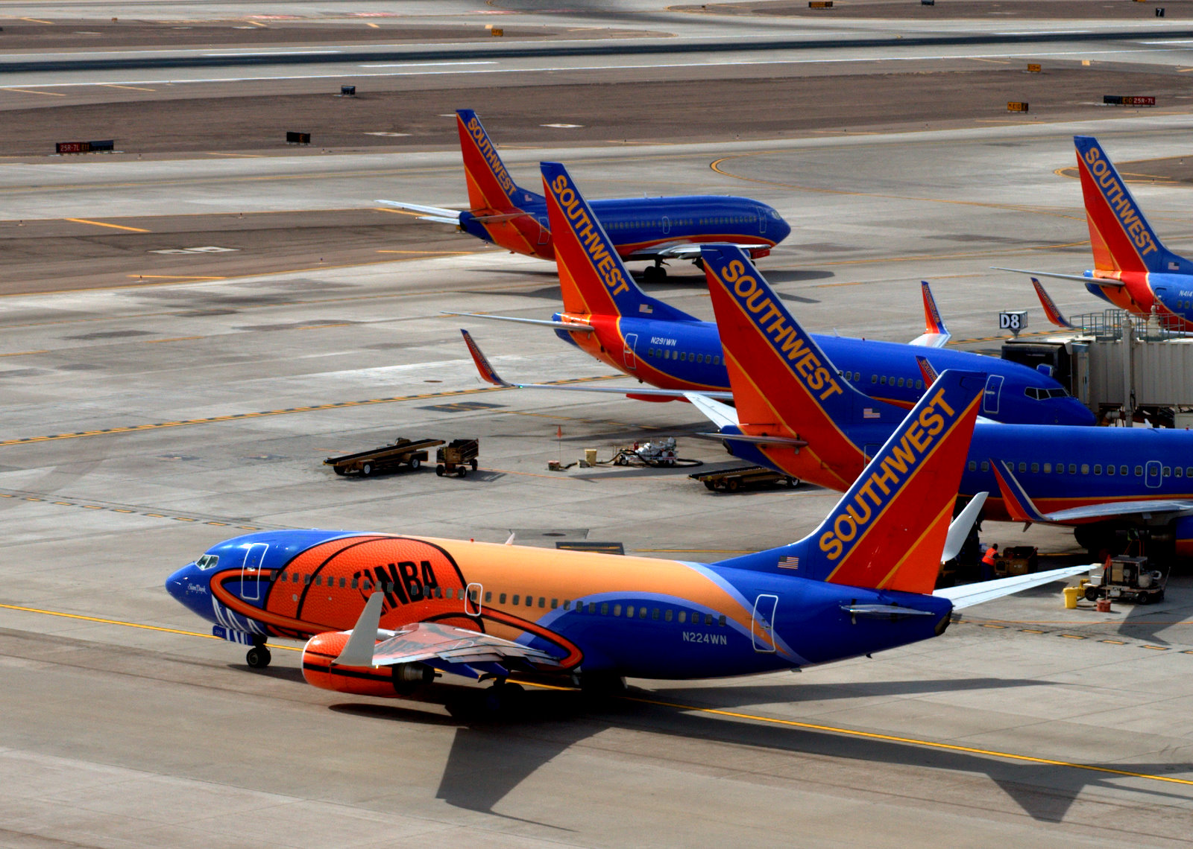
Competition By:
Haley McCullian

Slide 29
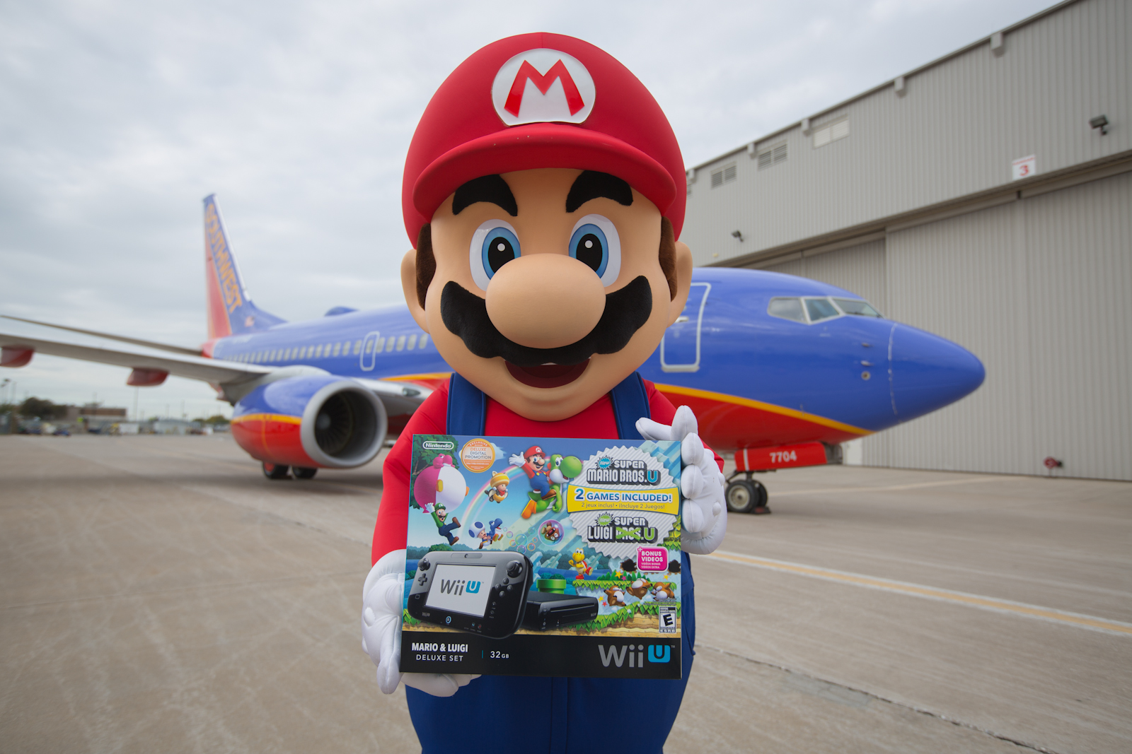
Southwest Airlines will fly any plane, as long as it's a Boeing, and let passengers sit anywhere they like -- as long as they get there first.
Southwest has expanded its low-cost, no-frills, no-reserved-seats approach to air travel throughout the US to serve nearly 100 destinations in more than 40 states.
Southwest still stands as an inspiration for scrappy low-fare upstarts the world over. The carrier has enjoyed 39 straight profitable years, amid the airline industry's ups and downs.
Southwest's fleet numbers about 700 aircraft.
Delta Air Lines symbolizes the changing mathematics of the airline industry.
Delta became one of the world's largest airlines by traffic after its $2.8 billion acquisition of Northwest Airlines in 2008.
Its main subsidiary is American Airlines, one of the largest airlines in the world. Together with sister company American Eagle and a regional carrier that operates as American Connection under contract, American Airlines serves more than 330 destinations in 50+ countries in the Americas, Europe, and Asia/Pacific.

Slide 30
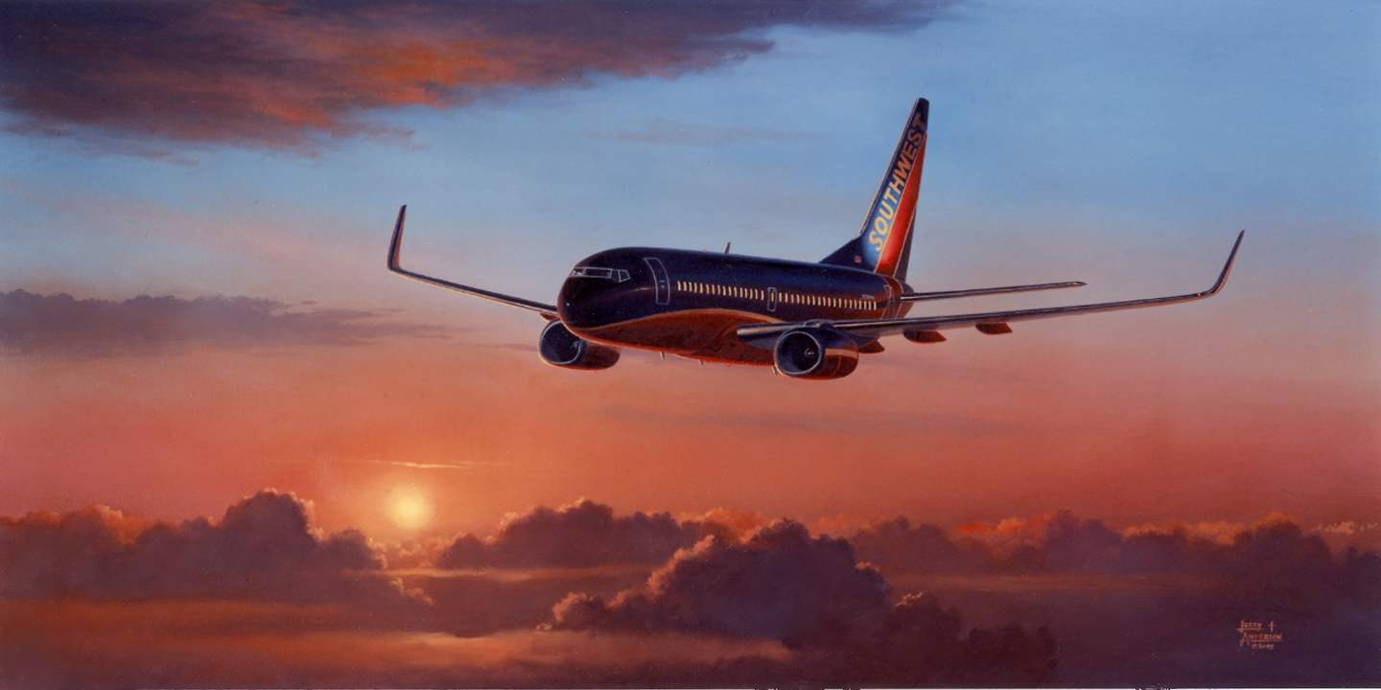
The overall fleet exceeds 880 aircraft; American Airlines operates about 600 jets.
The Company grew even bigger by merging with US Airways in late 2013.
JetBlue Airways is counting on more than low fares to make its ledgers jet-black. The carrier offers one-class service -- with leather seats, satellite TV from DIRECTV, satellite radio from XM, and movies -- to about 80 cities with 850 daily flights in more than 20 US states.

Slide 31
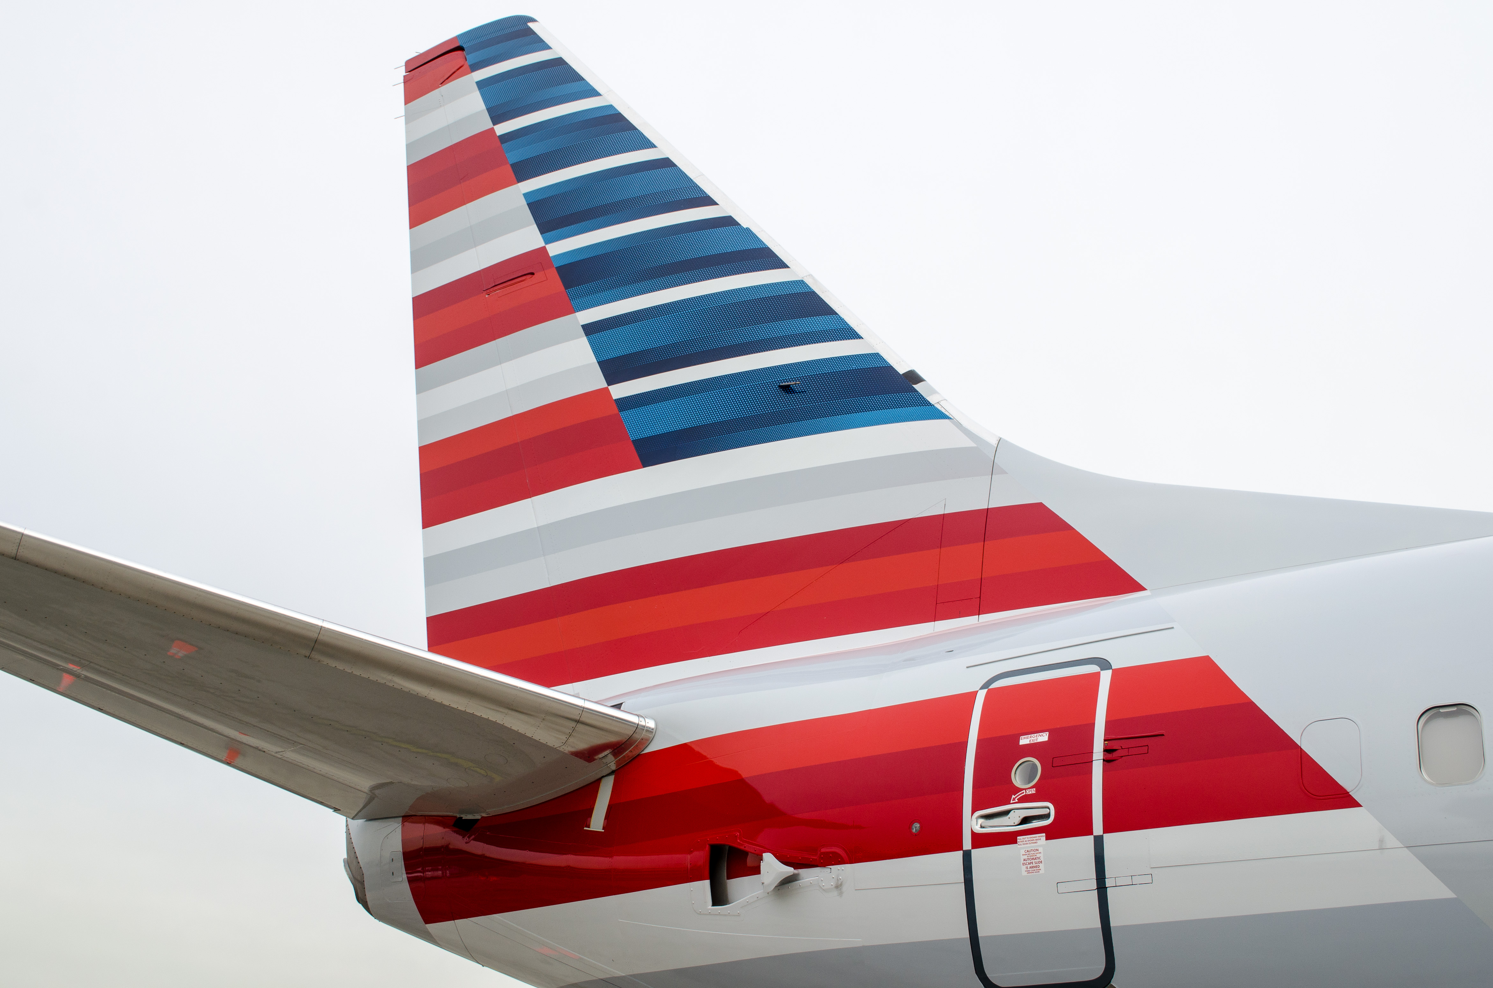
American Airline
Competition
By: Haley McCullian

Slide 32
The Department of Justice said that US Airways and American Airlines had agreed to give up dozens of gates in New York and Washington to make way for their merger, now valued at $17 billion.
More competition will not necessarily translate into consumer-friendly fare wars.
The two airlines are required to give up 52 slot pairs at Ronald Reagan Washington National; 17 slot pairs at New York LaGuardia; and others at Boston Logan International, Chicago O'Hare International, Dallas' Love Field, Los Angeles International and Miami International. Holder said those reassignments will benefit the low-cost carriers.
JetBlue and Southwest are among the likely winners. The deal may even give rise to the creation of low-cost start-ups.

Slide 33
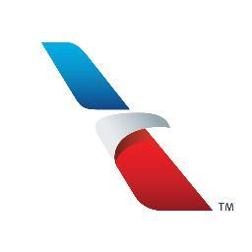
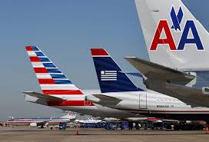
But the loss of gates at Reagan probably means smaller and midsize cites could lose less lucrative routes unless the federal government chooses to reassign them with certain cities in mind.
The combined company will have 6,700 flights a day in 330 destinations, making it the biggest airline in the world.
The creation of the world's biggest airline may actually be a good deal for some of its low-cost competitors, but it's still unclear if the merger will come at a cost to passengers in small towns that could lose service.

Slide 34
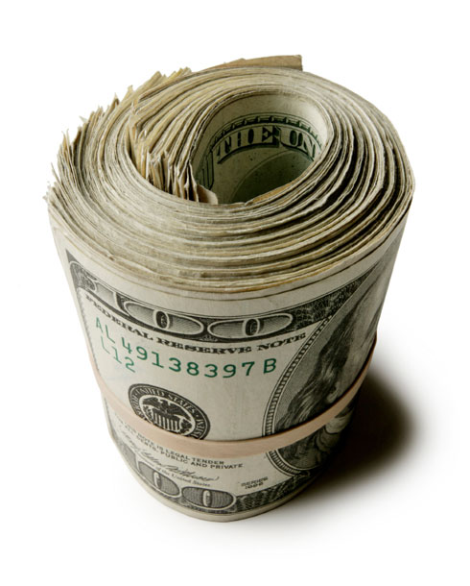
Finances
By: Michael Bongiorno

Slide 35
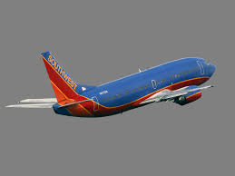
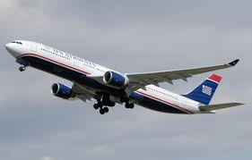
Finances
Southwest VS American Airlines

Slide 36
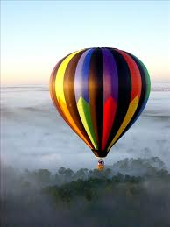
Hot Air for American Airlines
American airways wasn’t created until December 9th 2013
The financial statement isn’t out yet due to their accounting year
For purpose of comparing to South West, we’ll use one of the two merged companies.
USA Airlines

Slide 37
Comparing Assets
Southwest Airlines
Around 5.5 million in operation revenues
Around 4.9 operation expenses
More open about information in dealing with finances
American US Airlines
Around 2 million in operation revenues
Around 2.3 operation expenses
Not as open in information dealing with finances

Slide 38
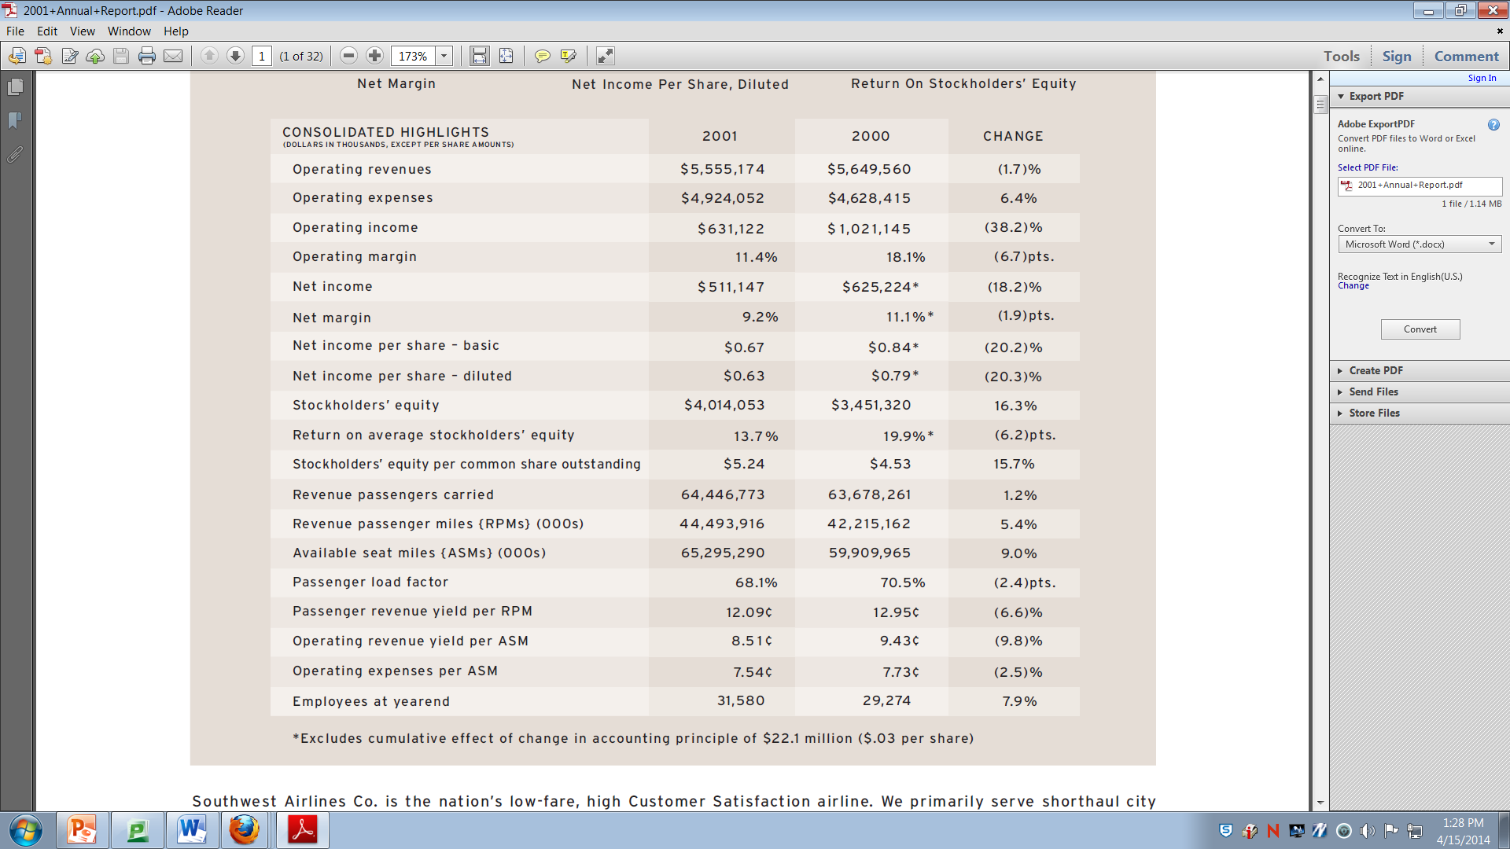

Slide 39
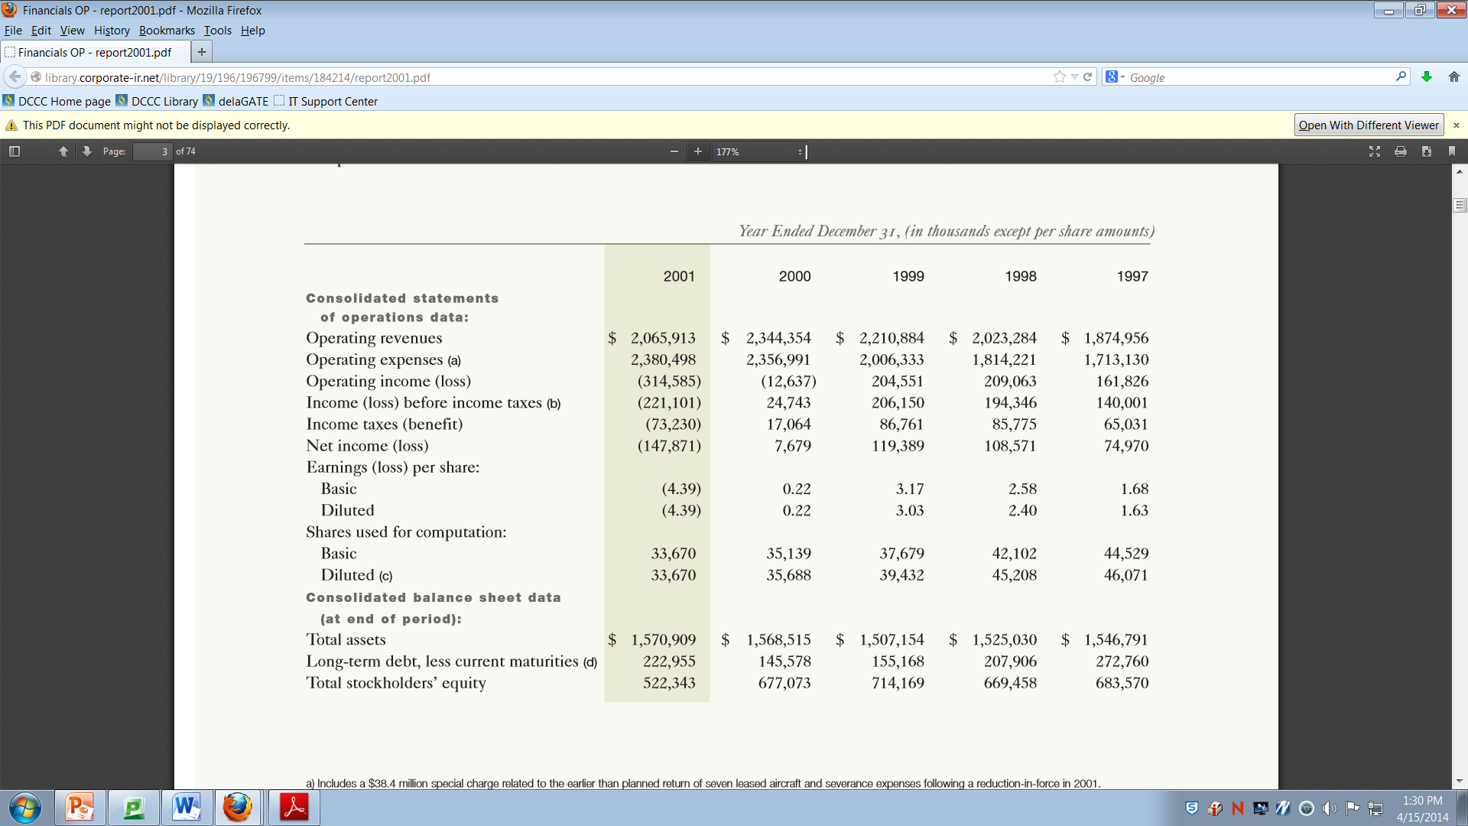

Slide 40
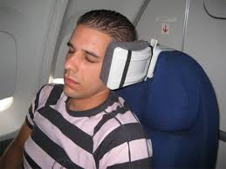
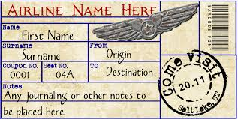
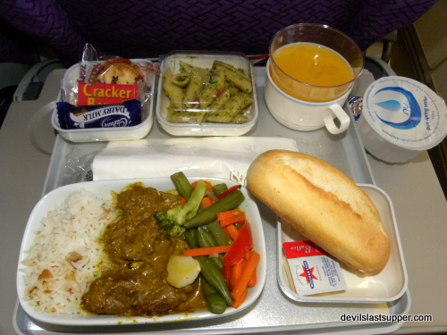
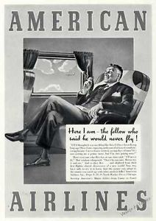
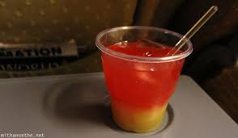
American Airlines VS. Southwest Airlines
Likes in Airlines
Both company’s make their profit in what seems to be the same ways:
Food.
Tickets.
Accessories.
Drinks.
Advertisement.
Satisfaction of customers.

Slide 41
Legal Environment
By: Steve Norwood

Slide 42
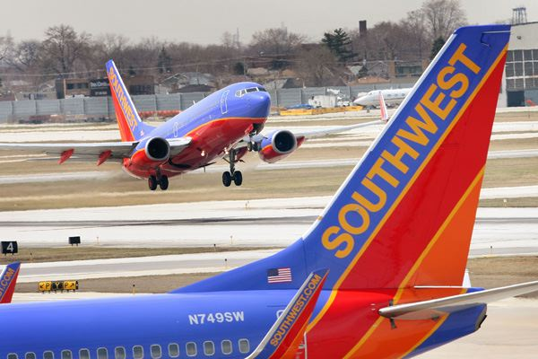
Southwest sued over 'customer size policy‘
Larger customers pay more on Southwest
Company policy only requires passengers to buy a second seat if they "encroach upon any part of the neighboring seat(s).“
A passenger unable to fit in one seat would pay $160 one-way for a Houston-Dallas ticket bought on the day of travel, instead of the usual $91 fare.
Southwest employees "did not follow their company policy and chose to discriminate, humiliate and harass" customers.
Customers want clarification on policy.
Lawsuit is bringing attention to Southwest's Customers of Size Policy, which arguably could be better publicized and enforced.

Slide 43
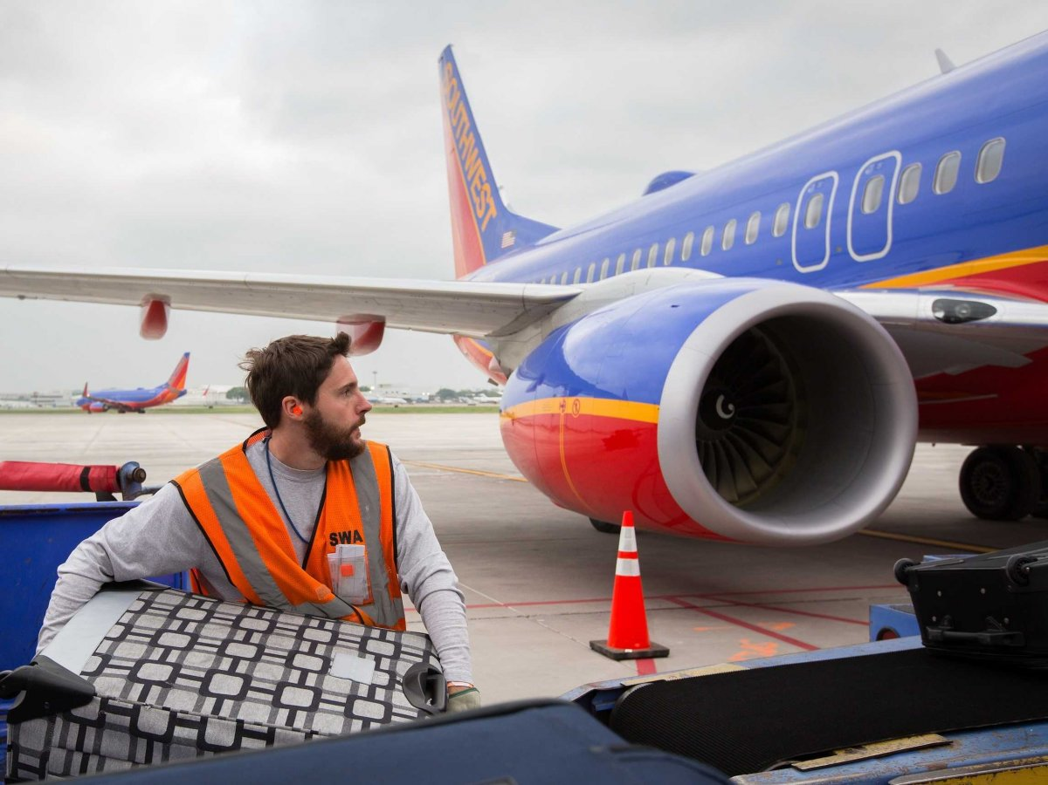
FAA inspectors: Southwest tried to hide safety problems.
Southwest Airlines tried to keep serious problems with its maintenance program hidden.
They pressured the Federal Aviation Administration to keep out an inspector who noticed the problems.
Airline kept dozens of aircraft in the air without mandatory inspections -- and in some cases, with defects the inspections were designed to detect.
The inspectors wrote that Southwest, which carried more passengers in the United States last year than any other airline, flew at least 70 planes without a mandatory inspection on the rudder unit, part of the steering mechanism, some of them as much as 30 months beyond the mandatory rudder inspection.

Slide 44
American Airlines
Legal Environment

Slide 45
US Airways pilot union sues American, US Airways and American's pilots over seniority issues.
US Airline Pilots Association filed a lawsuit to force arbitration to decide how the seniority lists of American Airlines and US Airways pilots are merged.
USAPA asked the court to require all parties to use the process provided in the McCaskill-Bond federal law, which sets up a process in which labor unions decide how to integrate their seniority lists.
Merger lawsuit with AA, US Airways.
People unhappy with merger between American/ US Airways
Poor passenger service
Questionable benefits for shareholders
Ongoing employee misery

Slide 46
Technology
By: Nick Sworob

Slide 47
Southwest

Slide 48
Water Vapor Sensor
750 turbulence, 100 million dollars.
National weather service.
Southwest 737's gather moister readings
Thanksgiving 2013, ice storm over Dallas, 400 flight cancelations.

Slide 49
Required Navigation Performance
2/3 of Southwest plane's cockpit software.
Three year process, training 6,000 pilots.
Shorter flight times, save fuel, cut noise and reduce delays

Slide 50
Wi-Fi
Row 44
GoGo, 10,000

Slide 51
American
American Airlines

Slide 52
Multi Scan Threat Track
Thunderstorm
Severe and ride quality

Slide 53
Code Sharing
January
Boost revenue
Two years

Slide 54
By: Nick Sworob

Slide 56
Place Making
Project for Public Spaces
Detroit and Providence,
Travis park, in San Antonio

Slide 57
International flights
Starting July 1
Aruba, Jamaica and the Bahamas.
The Air Tran merge in 2011

Slide 58
American
American Airlines

Slide 59
US Airways
December 9, 2013
Two years
6,700 flights per day.
world's largest airline.

Slide 60
New Frequent Flier Plan
Less busy times, less miles needed to get a free ticket.
Non-busy day award use to cost 25,000 miles, new cost is at 20,000 miles.
More demand, 30,000 miles.
Busiest days 50,000 miles

Slide 61
Which airline do you chose for your next vacation?
SWA
AA
VS.

Slide 63
Reasons:
You chose your own seat.
Drinks and snacks are free.
They carry free bags without expense.
Their lovely and caring way of making their customers want to come back to them for each trip they make.
Southwest has a budget on advertisement worth 199 million dollars they care about their reputation.

Slide 65
Southwest has served more than 1.5 billion Customers since our inception.
Southwest has operated more than 22 million flights since our inception.
Southwest Airlines enplaned approximately 133 million Customers during 2013, which is an average of more than 11 million onboard Customers per month.
Southwest received 100,682 resumes and hired 1,521 new Employees in 2013.
In 2013, Southwest served 68 million cans of soda, juices, and water; 16 million alcoholic beverages; 47 million bags of pretzels; 90 million bags of peanuts; 19 million Select-A-Snacks; and 45 million other snacks. Southwest consumed approximately 1.9 billion gallons of jet fuel in 2012.
In 2013, Southwest moved 198 million pounds of cargo.
In 2012, Southwest led the industry with more than 1,031 pieces of electric ground support equipment, which conserves fuel and reduces emissions.
The shortest daily Southwest flight is between Austin (AUS) and Houston Hobby (HOU) (148 miles). The longest daily Southwest flight is between Baltimore-Washington (BWI) and Seattle (SEA) (2,335 miles).
Southwest has 1,415 married couples. In other words, 2,830 Southwest Employees have spouses who also work for the Company.
Fun Facts

