Slide 1
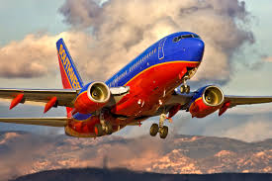
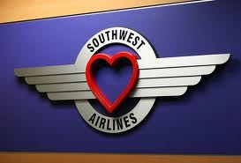
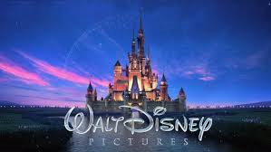
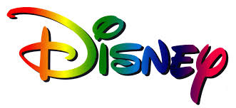
Welcome
To
Southwest
Our next destination

Slide 3
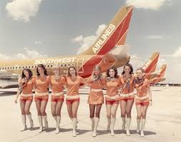
About Southwest
Southwest is in its 43rd year of service.
Was founded on March 15, 1967.
Founded by Rollin King and Herb Kelleher.
Headquarters is in Dallas, Texas.
They began flights on June 18, 1971 with three 737-200s.
They have more than 45,000 employees.
They have more than 100 million customers annually.
The current CEO is Garry C. Kelly, he was named one of the best CEO’s in the United states in 2008-2009 by institutional magazines.
Southwest has more than 100 flights daily to Orlando, FL.

Slide 5
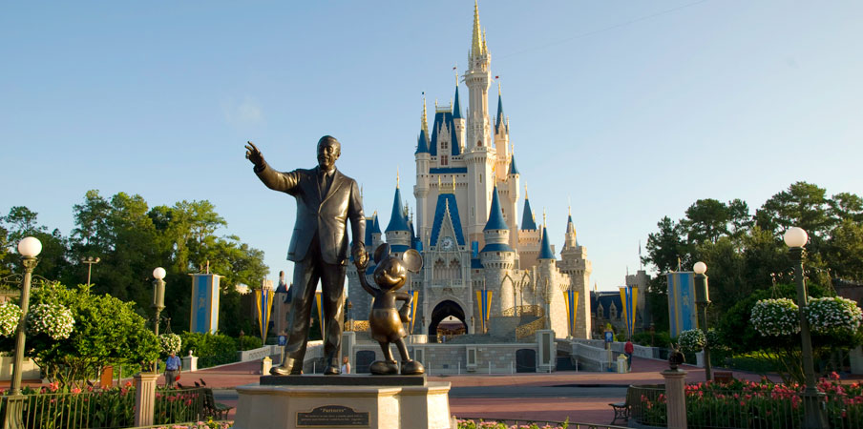
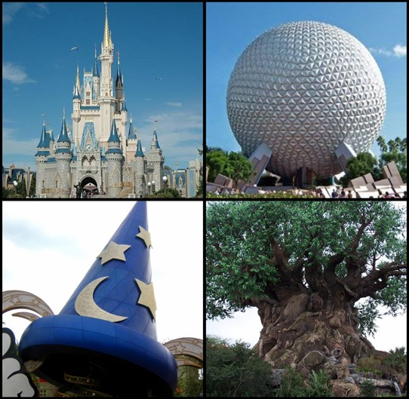
Walt Disney World

Slide 6
Agenda
Opener – Nick Sworob
Past - Tahquan Evans
Present - Khaled Alkurdi
Advertisement - Khaled Alkurdi
Human Resources - Haley McCullian
Competition - Haley McCullian
Finance - Michael Bongiorno
Public Relations - Steve Norwood
Technology – Nick Sworob
Future – Nick Sworob
Questions

Slide 7
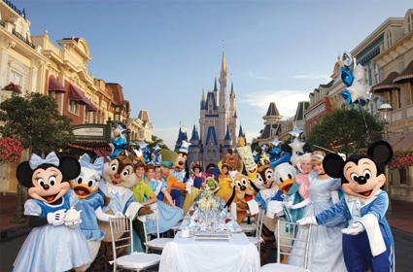
Walt Disney World
Where Dreams Come True

Slide 8
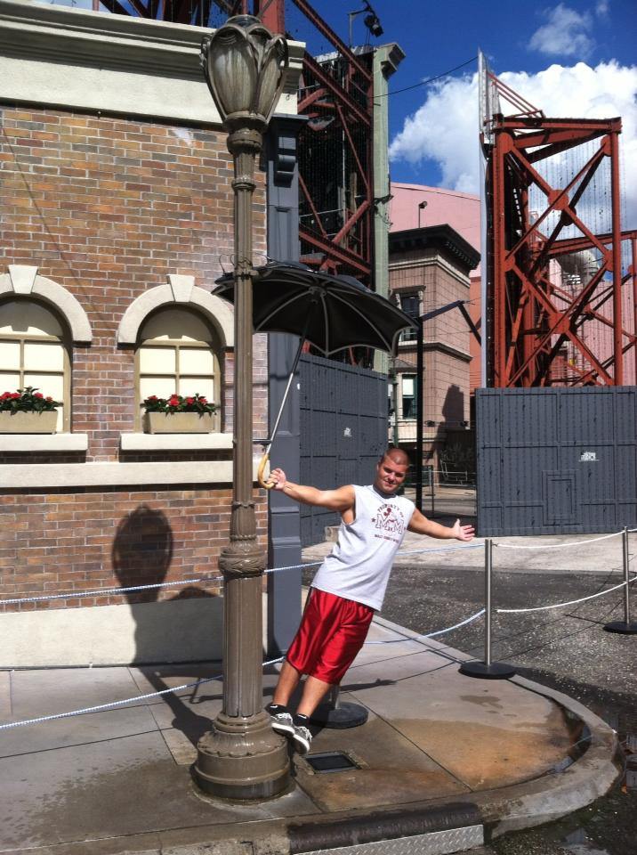
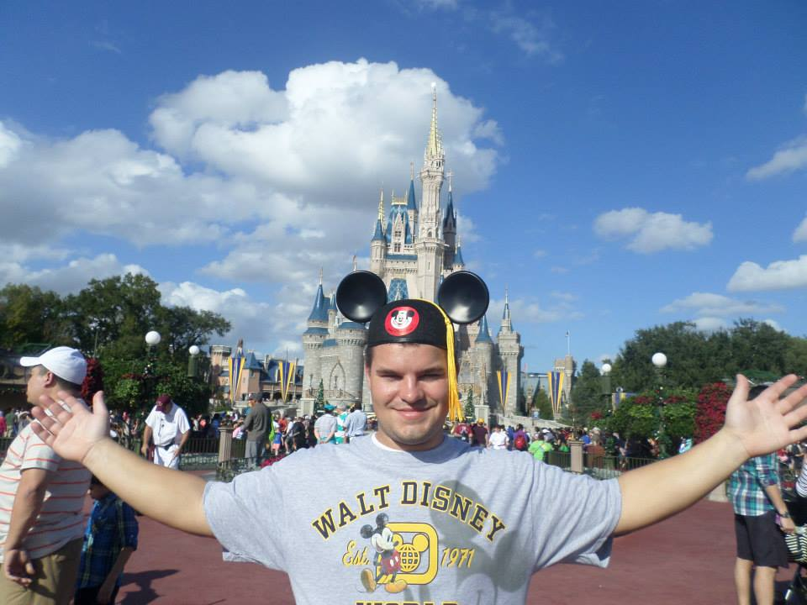
Where no matter how old you are…

Slide 9
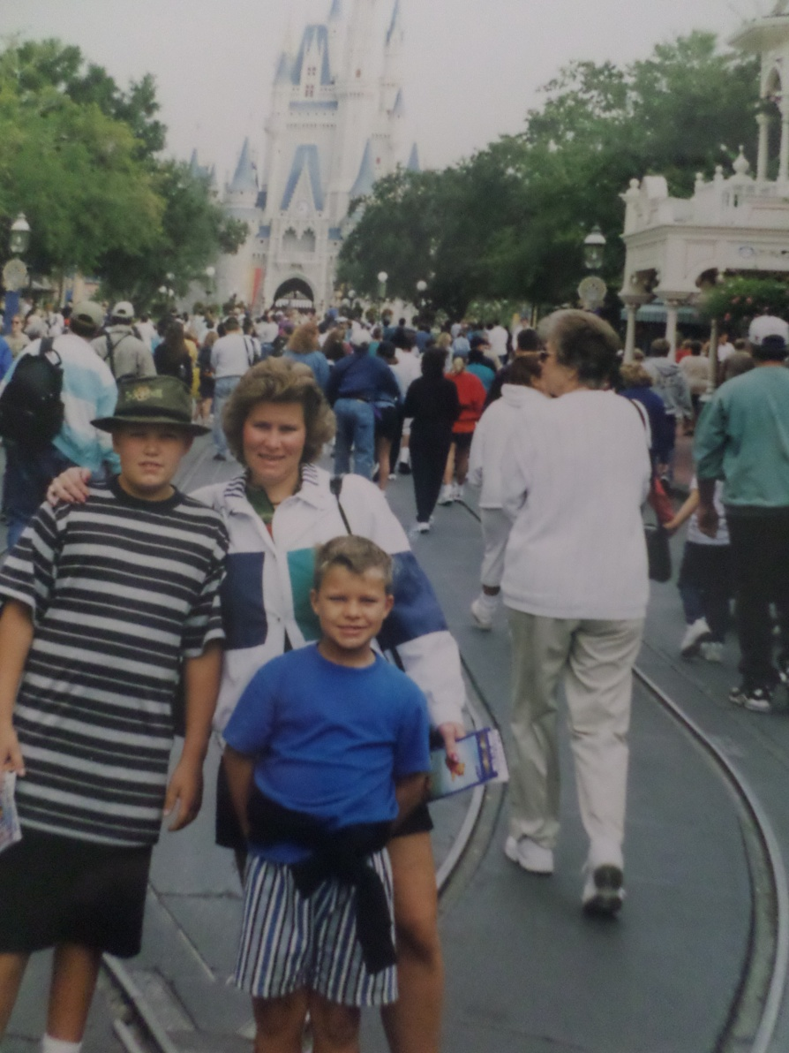
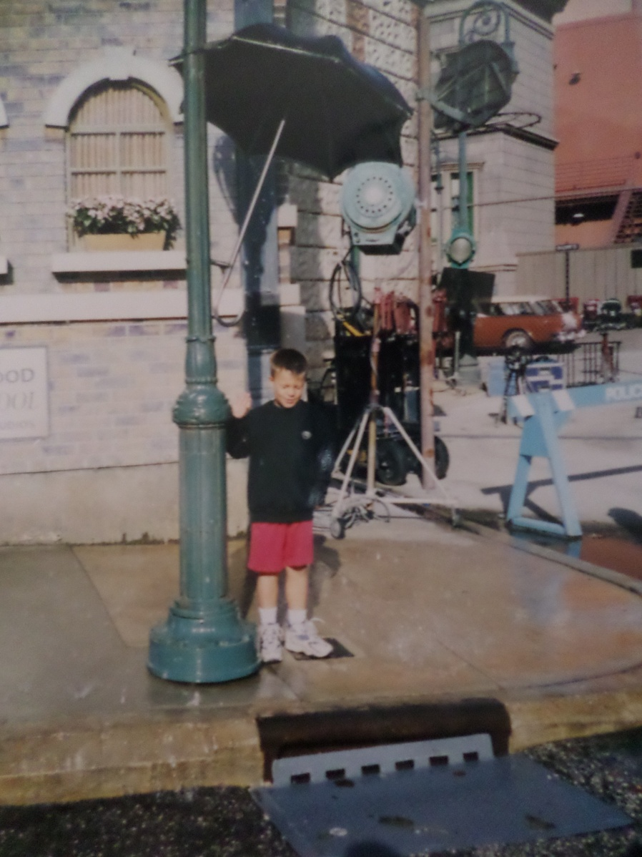
You’re always a kid at Disney World!

Slide 10
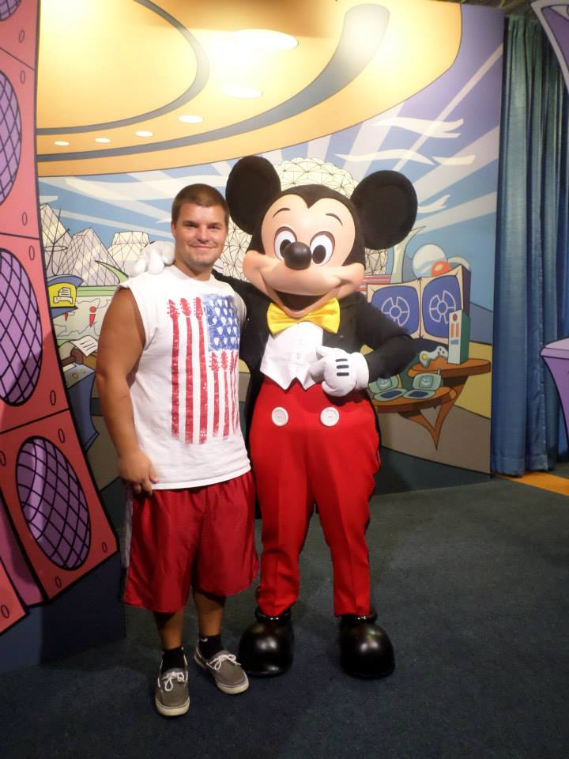
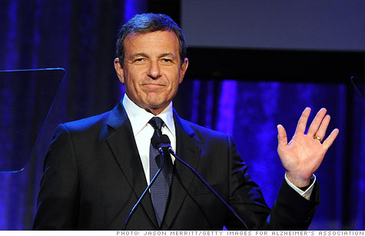

Slide 11
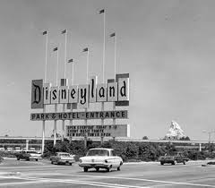
Disney world Past

Slide 12
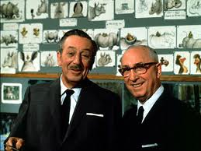
Breaking Ground
1965 creates the Florida Project
Walt and Roy Disney are the founders
Walt died in 1966 from lung cancer
1967 first park is built

Slide 13
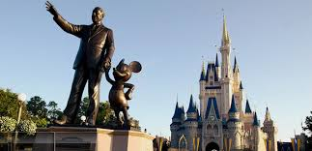
Continuing His Legacy
Magic Kingdom was the first park built.
Dedicated to the fairy tales and characters of Disney.

Slide 14
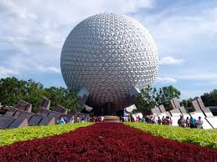
Epcot
Epcot opened on October 1, 1982
Experimental Prototype Community of Tomorrow
Showcase to the world of the ingenuity and imagination of American free enterprise.

Slide 15
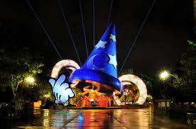
Disney Hollywood Studios
Opened on May 1, 1989 dedicated to show business, drawing inspiration from Hollywood.
Represents the golden age of movies to a celebration of today’s entertainment.

Slide 16
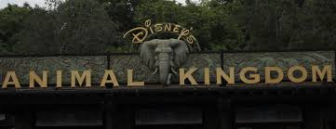
Animal Kingdom
April 22, 1998 the animal kingdom was opened.
Entirely themed around animal conversation.
Filled with zoo’s and aquariums.

Slide 17
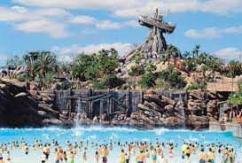
Disney’s Typhoon Lagoon
Opened on June 1, 1989

Slide 18
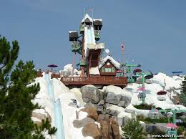
Disney’s Blizzard Beach
Opened on April 1, 1995

Slide 19
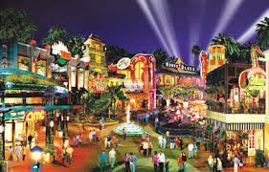
Disney
It opened on March 22, 1975

Slide 20
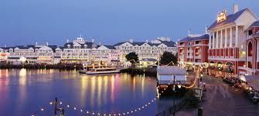
Disney’s Boardwalk
Opened on July 1, 1996

Slide 21
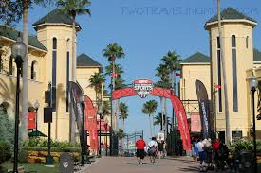
Disney’s ESPN worldwide of sports
This opened on March 28, 1997. This is where the sports event are held for children or professionals for practicing or games.

Slide 22
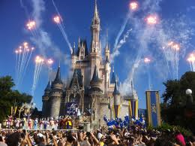
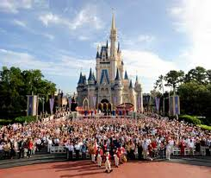
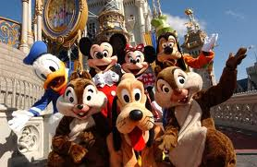
Disney World Now

Slide 23
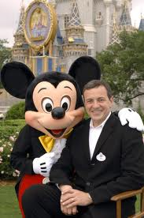
CEO of Disney World:
The current CEO of Disney World is Robert Allen Iger (Bob).
Mr. Iger is the chairman and Chief Executive Officer of the Walt Disney Company.
Mr. Iger is the steward of the world’s largest media company and some of the most respected and beloved brands around the world.
He was named president of Disney in 2000.
He graduated from Ithaca College.

Slide 24
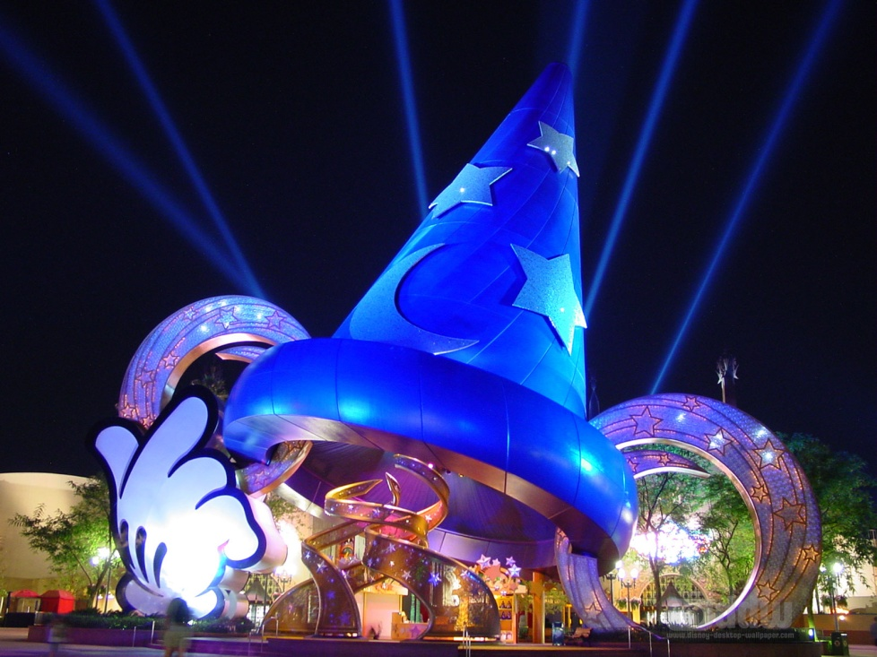
Disney World’s Parks:
At Disney World there is six parks in total.
Four of those parks are Theme Parks, and the other two parks are Water Parks.
Disney Theme Parks are: Magic Kingdom. Epcot. Disney’s Hollywood Studios. Disney’s Animal Kingdom.
Disney Water Parks are: Disney’s Typhoon Lagoon. Disney’s Blizzard Beach.
Where Dreams Come true

Slide 25
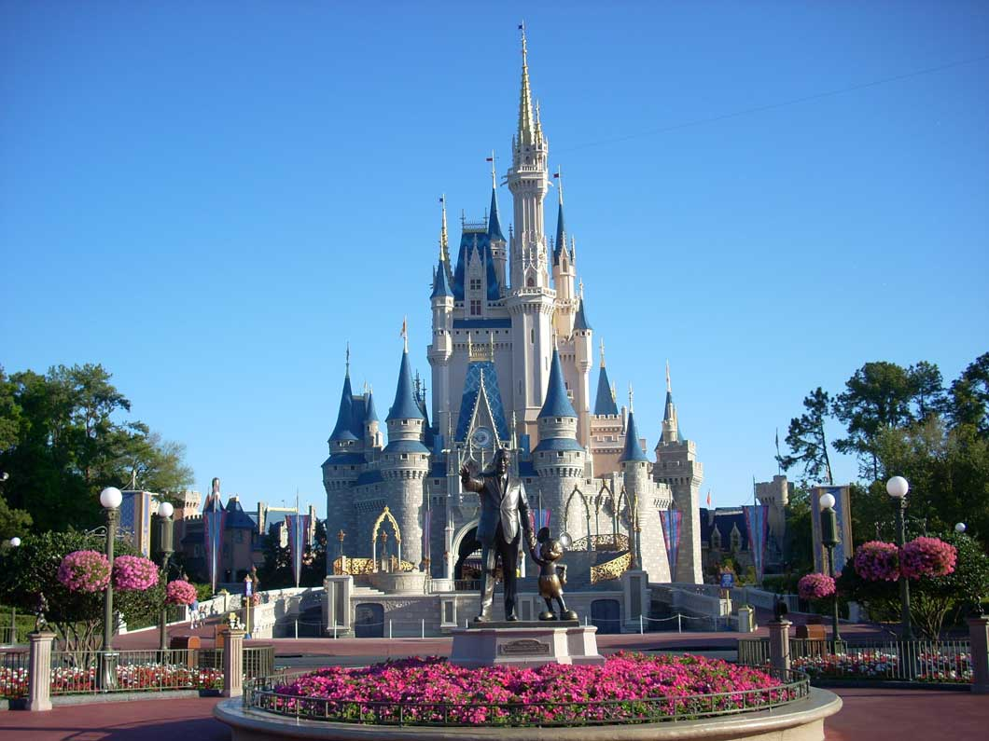
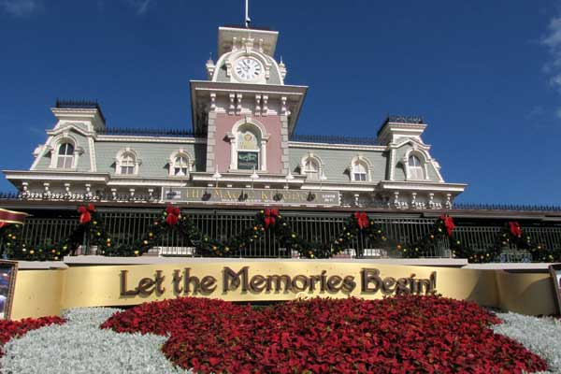

Slide 26
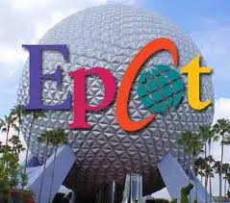
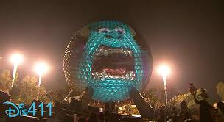
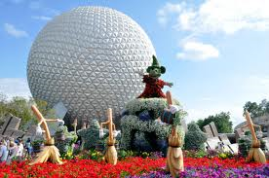
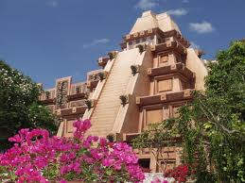
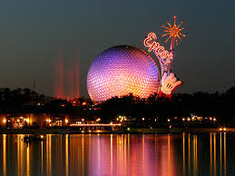
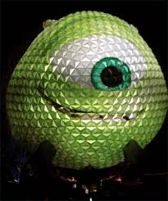

Slide 27
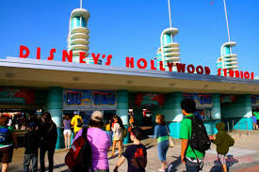
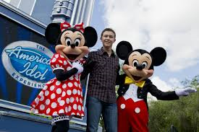
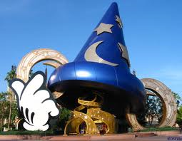
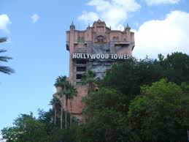
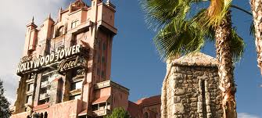

Slide 28
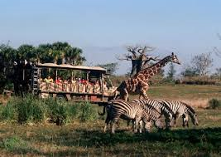
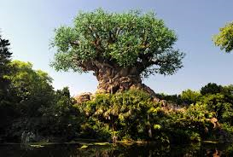
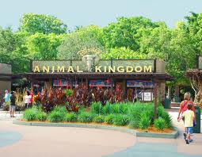
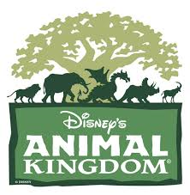
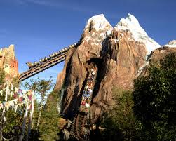
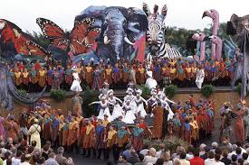

Slide 29
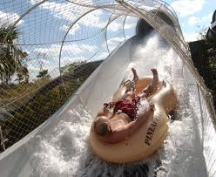

Slide 31
Disney World’s Hotel and Resorts

Slide 32
Hotel and Resorts
At Disney World we have thirty-four Resorts and Hotels.
Twenty four of those hotels and Resorts are owned and operated by Walt Disney Parks and Resorts.
The hotel and resorts are Classified into four categories. A) Deluxe, B) Moderate, C) Value, D) Disney Vacation Club Villas.

Slide 34
Disney World around the World
Disney isn’t just located in the US. Believe it or not, Disney is located in 31 different countries including the US.
Some of those countries are: Canada. France. Japan. Germany. Spain. Italy. Australia. India. Greater China. Russia. Poland.

Slide 35
Disney Advertisement

Slide 36
Disney’s Advertisement Budget
Disney World is one of the twelve companies world wide that has the highest budget in advertisement.
Disney Spends approximately 1.9 billion dollar per year.
Classified expenses per resource. Television 546 Million Dollars. Magazines 178 Million Dollars. Newspapers 88 Million Dollars. Internet 187 Million Dollars. Other resources 933 Million Dollars.

Slide 37
Our Advertisement goals
Our commercials are plastered on television, in print, and on the internet reminding people everywhere about the magic of Disney.
The Disney World commercials play straight to the heart of children and parents painting Disney world as exactly what it claims to be “ The Happiest Place on Earth”
Our ads urge parents to plan a Disney trip before their children get “too old”.
Our television advertisement feature the spirit pf having fun, and proves that Disney World is The Happiest Place on Earth by showing pictures of families smiling and laughing.
One of our major symbols that people recognize is Mickey Mouse. Mickey was our most successful symbol that stayed in the heart of parents and children reminding them of the happiest memories they will never forget.

Slide 38
Special Occasions and Holidays
Disney World tries its best to give each occasion a great advertisement that could be recognized throughout the world. For an example we had two occasions earlier this month at Disney World which were, Valentine’s Day, and President’s day.

Slide 39
A Valentine’s trip to Disney World
It turn out that the legendary Disney magic can touch even the romantically impaired. Reminding people that Disney world isn’t just for children it’s for everyone!

Slide 40
Presidents Day
For president’s day, Disney President's Day Soccer Festival was filled with great soccer competitions and great fun for the whole family at the Walt Disney World® Resort.

Slide 41
Disney’s achievements
- Disney World gets 46 thousand visitors per day!
- In 2011, Animal Kingdom hosted approximately 9.8 million guests, ranking it the fourth-most visited amusement park in the United States and seventh-most visited in the world.
- In 2011, Epcot hosted approximately 10.83 million guests, making it the third most visited theme park in the United States, and sixth most visited theme park in the world.
- In 2012, Typhoon Lagoon admitted approximately 2,100,000 visitors, currently making it the most visited water park in the world.
- In 2011, Disney’s Hollywood Studios hosted approximately 9.7 million guests, making it the fifth-most visited amusement park in the United States, and eighth-most visited in the world.
- In 2012, the Magic Kingdom hosted 17.54 million visitors, making it the most visited theme park in the world for 2012
- In 2012, the park hosted approximately 1,929,000 guests, ranking it the second-most visited water park in the world.

Slide 42
Human Resources of Disney

Slide 43
What it means being apart of Disneys team
As part of the Human Resources team at The Walt Disney Company, you can help attract and develop the people that'll share our stories with the world.
You may partner with our various businesses to develop strategies specific to each segment.
You may also provide innovative business solutions throughout our global work environment to promote success, integrity and collaboration across all businesses.

Slide 44
Human Resources in Disney world
The company's human resource company component manages the needs of employees and cast members.
The agency maintains equal opportunity employment. It works to meet the needs of the company's various divisions while also working to maintain employment practices.

Slide 45
At Disney they find a learning environment that encourages everyone, no matter what your role -- to increase engagement and assist in reaching your goals.
Human Resources includes: the hiring of individuals for the organization, learning, development, and training of these individuals, and the management of employee benefits programs.

Slide 46
Opportunities working HR for Disney
Benefits
Compensation
Disney University
Diversity
Employee Communications
Employee Initiatives
- Generalist
- Global Mobility
- Human Resources Information Systems
- Labor Relations
- Organizational Development
- Talent Acquisition
- Talent Planning

Slide 47
Disney Competition

Slide 48
Disney World
The Walt Disney Company is the world's largest media conglomerate, with assets encompassing movies, television, publishing, and theme parks.
Its Disney/ABC Television Group includes the ABC television network and 10 broadcast stations, as well as a portfolio of cable networks including ABC Family, Disney Channel, and ESPN (80%-owned).

Slide 49
Six Flags
Six Flags is the standard-bearer for theme park thrills. The company is the #2 amusement park operator in the world (behind Walt Disney).
Six Flags draws about 25 million visitors to its nearly 20 parks in North America.
They offer roller coasters and other thrill rides, water slides, and additional family entertainment.

Slide 50
Universal Parks
Time traveling DeLoreans, great white sharks, and dinosaurs are just part of a normal day at Universal Parks & Resorts
The parks feature attractions based on movies from sister studio Universal Pictures such as Back to the Future, Jaws, and Jurassic Park.
They also house hotels, IMAX theaters, and water parks.

Slide 51
Sea World
Sea World Entertainment is one of the US's largest theme park operators.
The company markets its parks as family-friendly, offering learning opportunities all-ages entertainment and traditional amusement parks.
SeaWorld ended up with visitors in 2012 totalling 5,358,000 giving it a global position of 19th.

Slide 52
Disney Finance

Slide 53
Disney Financial
Disney receives wealth in various ways
Stocks
Disney parks
Movies

Slide 54
Stocks
Disney Stocks vary every year
They have increased drastically since around 1981
Today they are worth about 80 billion USD

Slide 55
Disney Parks
Disney also receives a lot of their financial wealth from their theme parks
In 2012 they received 2.2 billion dollars in revenue.

Slide 56
Movies
It is arguable that Disney makes most of it’s profit through movies.

Slide 58
Disney PR

Slide 59
Disney World PR
PR Team Responsibilities
Managing the reputation of The Walt Disney Company
Developing strategic, cohesive external and internal communications
Managing large-scale, high-visibility projects

Slide 60
Disney World PR
Disney Youth Programs
Countdown to Seven Dwarfs Mine Train grand-opening
Disney's ongoing commitment to safety

Slide 61
Disney Technology

Slide 62
Magic Bands
Everything you need with one touch

Slide 63
Fast Pass +
New and improved fast pass
Plan your trip months before you arrive

Slide 64
MyDisneyExperience
Plan your whole vacation
Start the fun and magic from home

Slide 65
Glow with the Show
Be apart of the show
Celebrate the magic
Wishes
Fantasmic

Slide 66
Disney Projection

Slide 67
The Magic, The Memories and You
Cinderella's Castle
January 2011
12 Projectors
500 pictures

Slide 68
Celebrate the Magic
Cinderella’s castle
November 2012
Movies, Music, Disney
Projection Mapping

Slide 69
Fantasmic
1998
Mickey’s Imagination
1.9 Million gallon Moat

Slide 70
Disney Future

Slide 71
Avatar
Released December 2009
Over two billion dollars world wide
Over 760 million dollars domestic
Most making movie ever
3 movies to come

Slide 72
Timeline
2011
January 2014
2017

Slide 73
What to Expect
Animal Kingdom
Goodbye Mickey’s Retreat
Pandora
Attractions
Entertainment

Slide 75
Why?
Fits the message and environment of Animal Kingdom
Allow the park to be open late

Slide 76
Facts
500 million
Disney has exclusive global rights
Balloons

Slide 77
Disney Springs

Slide 78
Downtown Disney
Redone in 1995
Originally Lake Buena Vista Shopping Village in 1975
Disney Village Marketplace in 1989

Slide 79
Disney Springs
2016
Pleasure Island
Family Environment
From 75 to 150
4,000 new jobs, 1200 construction jobs
Twin Garage, 6,000 spots, 85 million dollars

Slide 80
Break Down
Town center – retail
Waterfront – restaurant
Marketplace- family area, going to be connected to rest of area by a bridge
West side- live entertainment

Slide 81
Seven Dwarf Mine Train
Family roller coaster
Eyes of the dwarfs
2014
Indoor and outdoor
New technology

Slide 83
Thank You
From all of us from Disney World to you!

