Slide 1
MS-Digital Innovation in Marketing
Business Analyst:
Shawn Niederriter
Malik Donald
John Canavati
Khaled Alkurdi

Slide 2
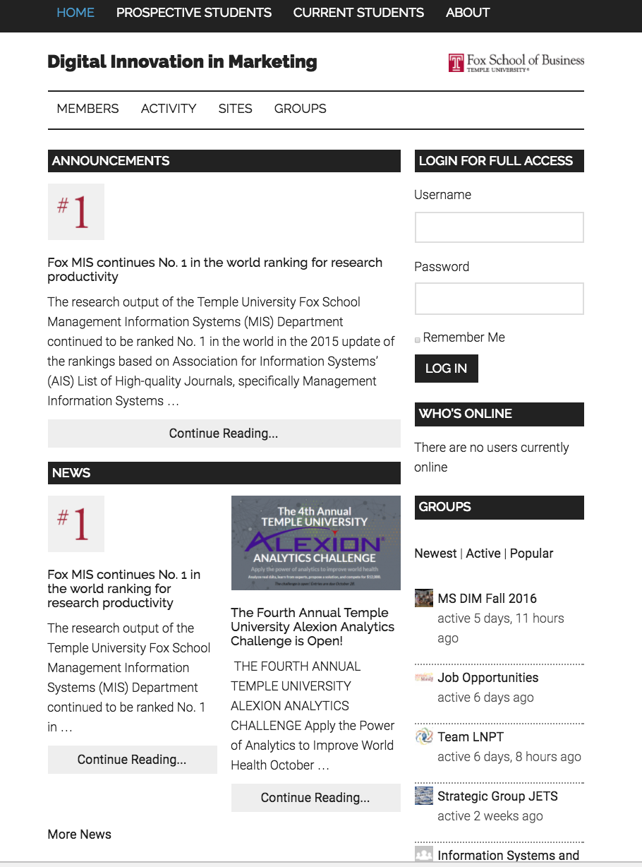
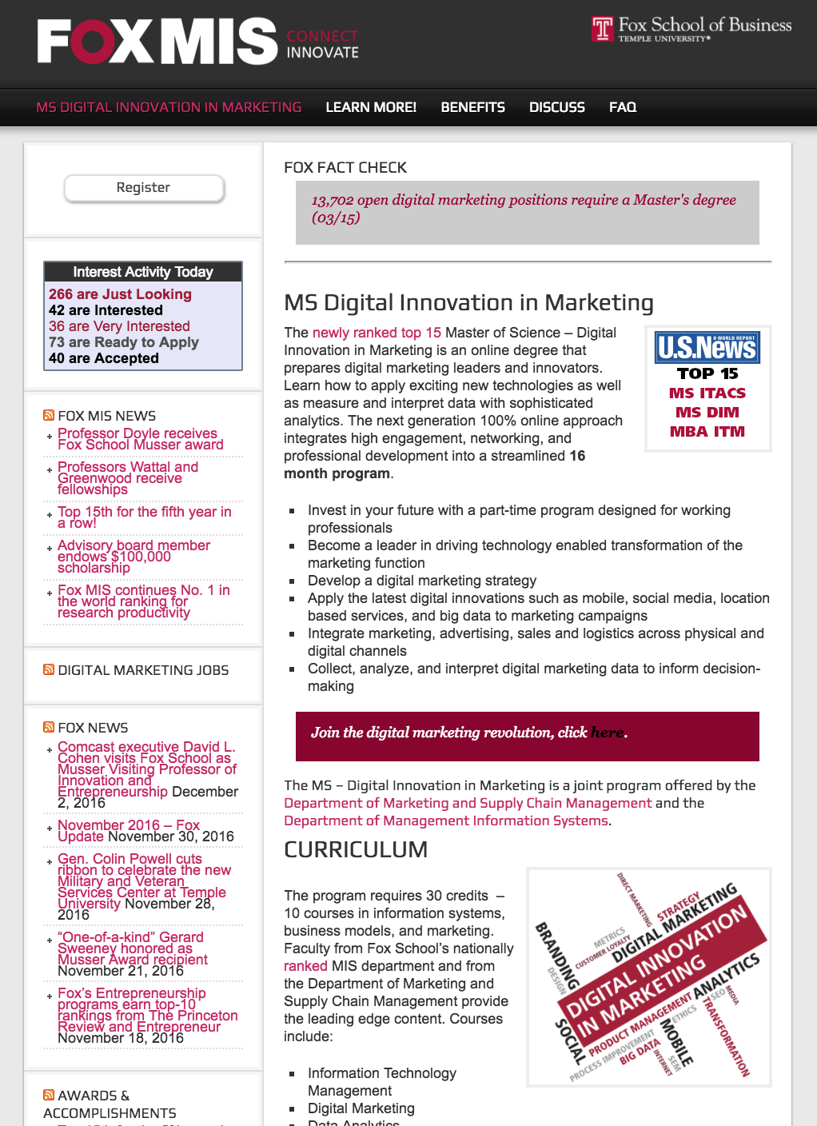
Problem
Current website fails to engage students and Alumni.
Current community lacks fluid engagement.
Current site lacks incentives for continued particapation.

Slide 3
Stakeholders
Administrators (Joe Allegra, Amy Lavin)
Prospective Students, Current Students, Alumni

Slide 4
Prospective Student
Polly Peterson
“After 4 years as a web designer I am motivated to improve my skillset to take my career to the next level”
Age:26
Education: NC State
Major: Digital Design
GPA:3.74
GMAT:700
Children: none
Marital Status:
not married
Experience: 4 years
Freelance web designer
Salary: $55,000-$65,000
Hobbies: Photography, Blogging, Travel

Slide 5
Current Student
Kyle Collins
“I am looking to build a better future for me and my family and through the DIM program at Temple I hope to achieve better career prospects ”
Age:28
Education: Virginia Tech
Major: Accounting & Information Systems
GPA:3.55
Experience: 6 years
Current Employer: Amazon
Salary:$72,000
Salary: $72,000
Hobbies: Football, Deer hunting.
Employer: Amazon
Marital Status: Married
Children: 1

Slide 6
Alumni
Allison Adams
“I love the DIM program at Temple and I want to give back to the program that gave me so much”
Age:31
Education: University of Arkansas, Temple University DIM
Experience: 7 years
Current Employer: Walmart
Salary:$115,000
Hobbies: Tennis, Puzzles
Marital Status: Married
Children: 3

Slide 7
Big idea
Create an active community.
Give Opportunities for prospective students.
Create networking opportunities.
Job posting.

Slide 8
Active Community
Create meaningful interactions.
Offer a glimpse inside of our community.
Connect current students with Alumni.
Engage alumni through real world experience.

Slide 9
What if the solution was a tap away?

Slide 10
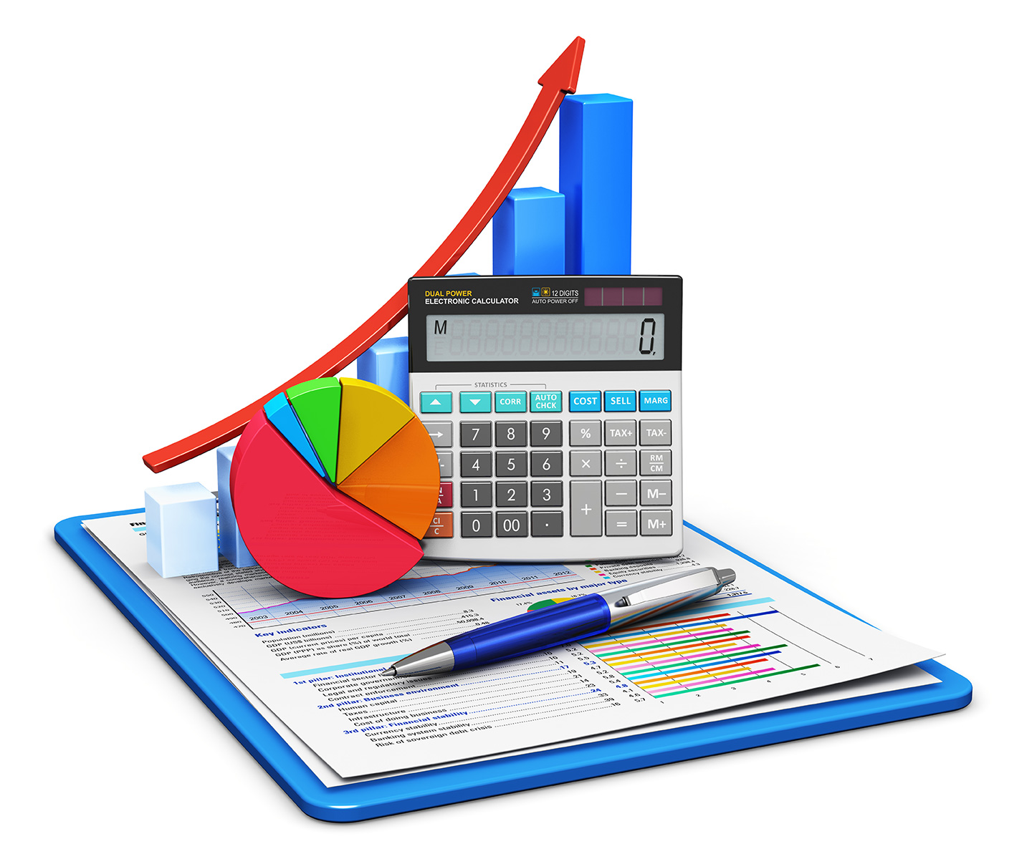
What resources do we need to sustain this solution?
Why our solution?
Cost efficient.
Easy back-end integration.
Enable administrators to focus on day-to-day operations.

Slide 11
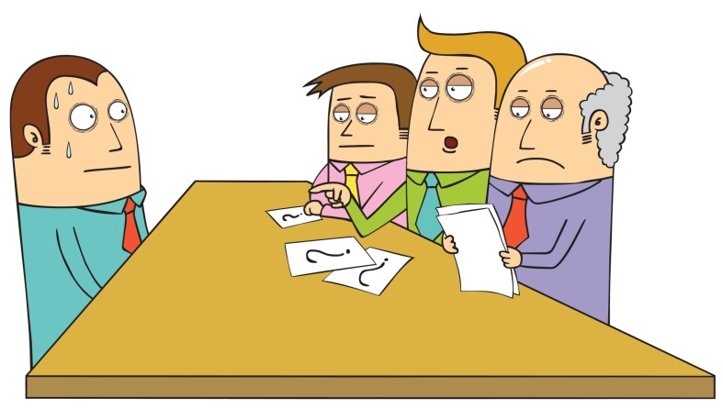
Q&A

