Slide 1
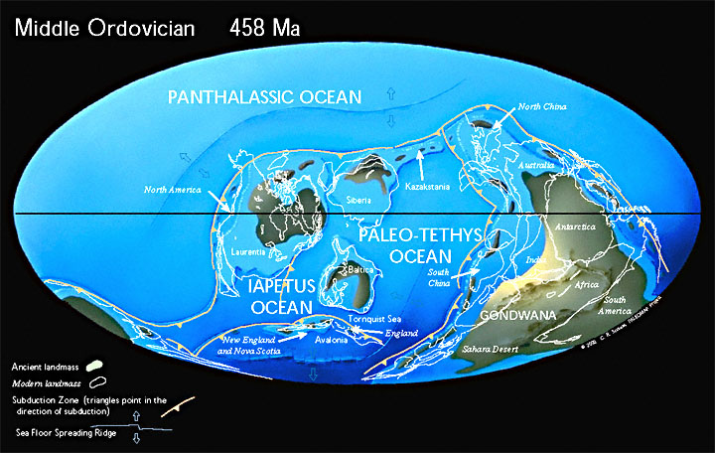
The Ordovician Period
490 to 443 Mya
Notes:
Land and Sea
The Ordovician Period lasted about 45 million years, taking place between 490 million to 443 million years ago.
During this period, ancient oceans separated the barren continents of Laurentia, Baltica, Siberia and Gondwana. The area north of the tropics was almost entirely ocean, and most of the world's land was collected into the southern supercontinent Gondwana. Throughout the Ordovician, Gondwana shifted towards the South Pole and much of it was submerged underwater.

Slide 2
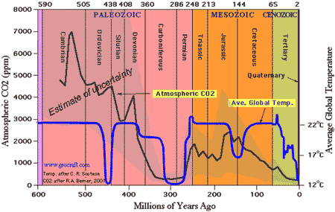
Average Temperature and Atmospheric CO2
Notes:
Climate
Widespread volcanic activity drove Co2 levels 14 to 16 times higher than they are today. These high levels of carbon dioxide contributed to the greenhouse effect that caused temperatures from the equator to the poles to remain warm.

Slide 3
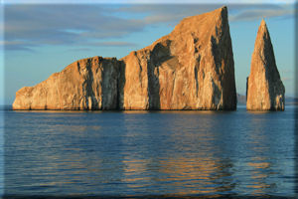
Ordivician Climate
Notes:
From the Lower to Middle Ordovician, the Earth experienced a mild tropical climate — the weather was warm and the atmosphere contained a lot of moisture. Above sea level, on the barren continents, there was no life. Below sea level, however, the rich ocean environment supported a growing biological ecosystem.

Slide 4
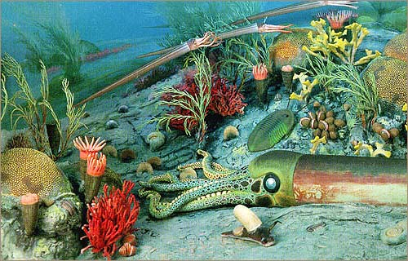
Ordivician Life
Notes:
Ordivician Life
In a vivid display of adaptive radiation, more and more variations of life emerged, developed, and thrived in the hospitable and bountiful ocean. Creatures that made their first appearance in the Cambrian period, like trilobites and conodants diversified during the Ordovician period as new species emerged in sympatric speciation. Ordovician plants, animals, and microorganisms occupied their ideal niches in this complex marine ecosystem.

Slide 5
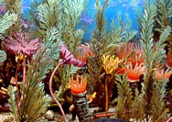
Primitive Reefs
Notes:
In the shallow seas surrounding the continents, this marine life flourished. On the reefs that were dominated by algae and sponges, many creatures including rugose coral and crinoids made their first appearance. Crinoids, or sea lilies, were relatives of sea stars. They had a long stem-like structure that anchored to the sea bottom. They collected food particles with feathery arms that waved in the ocean currents. During global disturbances due to tectonic plate shifts, tropical cyclones, and volcanic eruptions, there were periods of complete reef collapse. However, the nutrient rich ocean quickly incubated new populations of the most environmentally “fit” species. And, diverse species radiated away from the shallow seas toward the deeper ocean.

Slide 6
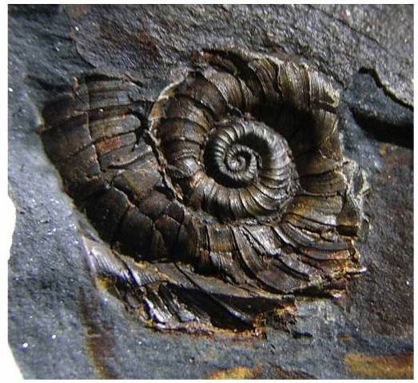
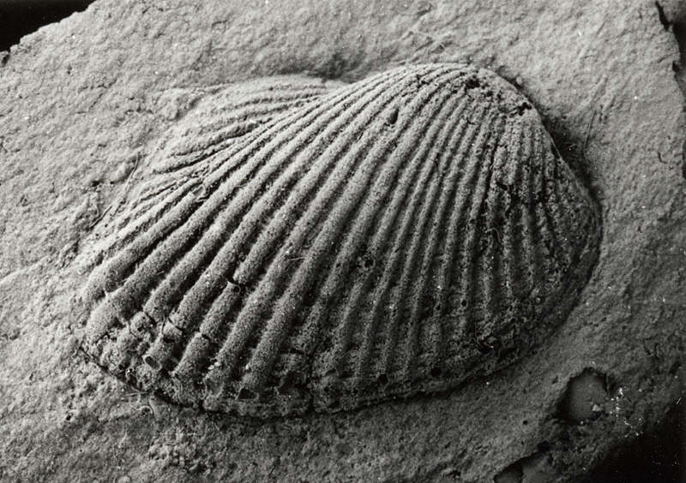
Major evolutionary radiation of Mollusks
Snail
Bivalve
Notes:
Specific Characteristics of Living Things
Mollusks
During the Ordovician a major radiation of mollusks also occurred, with thousands of species of mollusks appearing in the fossil record of that time. Mollusks of the time included shelled bivalves, snails, squids and nautiloids. Some mollusks developed buoyancy which enabled them to float.

Slide 7
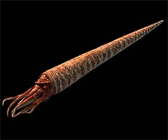
Orthocone - Ordovician Top Predator
Mollusk - nautiloid
Largest animal
Jet propulsion
Buoyancy
Carnivore
Prey – fish, arthropods
Notes:
The top predator of the Ordovician seas was a Mollusk. The nautiloid, orthocone was also the largest animal growing up to 11 meters long (36 feet).
Its tentacled, fleshy body occupied one end of it’s long cone-shaped shell. The orthocone used a fleshy tube running the length of it’s cone in order to move. It accomplished this by blowing air in the opposite direction it wanted to go. To move vertically, it adjusted the amount of seawater in the chambers of its shell. This carnivore feasted on fish and arthropods (sea scorpions) by seizing the prey with its tentacles and ripping it apart with its beak-like mouth.

Slide 8
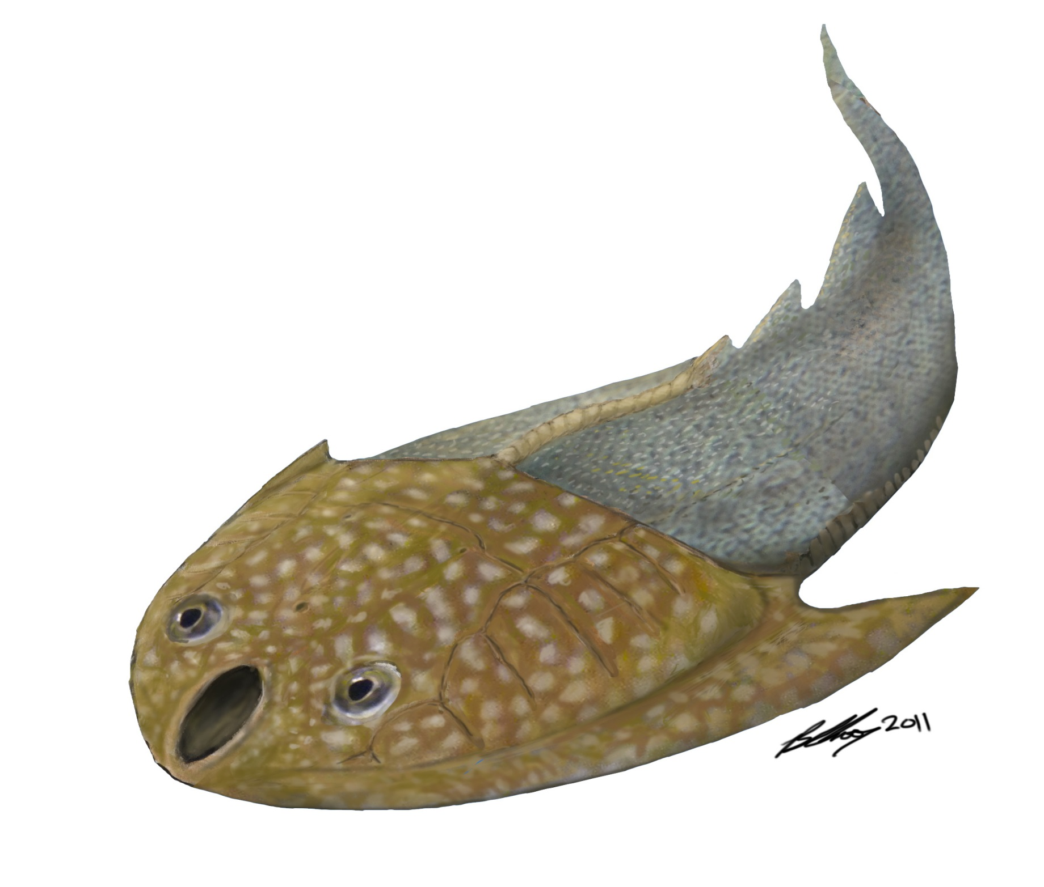
Jawless Fish
Ostracoderm
Less than one foot long
First true vertebrates.
Mouths permanently open.
Notes:
First Vertebrates
Ostracoderms were jawless fishes and one of the oldest and most primitive chordates. They were small, often less than 1 foot (30 cm) long. They were probably slow, bottom-dwelling animals. Large bony shields covered their heads and their mouths were permanently open. They used their muscular gill pouch to create a suction that pulled in small and slow moving prey.

Slide 9
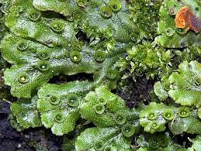
Primitive Moss and Fungi Colonize Barren Land
Liverworts
Seedless Plants
Can survive on bare rock
Dying tissue helps build soil
Notes:
Life Moves to Land
Land was first colonized during the Ordivician by primitive liverwort moss plants and fungi. Liverworts are seedless moss plants that can survive on bare rock. Moss is a terrific first colonizer because its dying tissue helps to build soil which creates a growing medium for subsequent plants. Fungi are known to form symbiotic relationships with other living organisms.

Slide 10
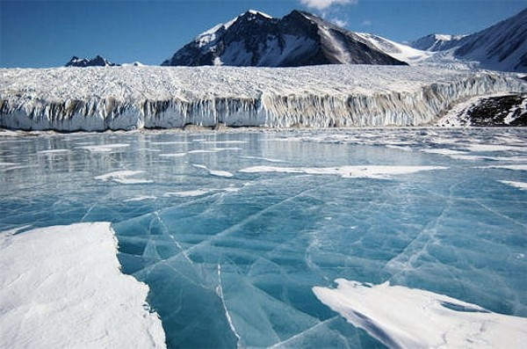
Glaciation leads to Mass Extinction
Co2 levels, global temperatures drop.
Glaciers form causing sea levels to drop.
Highly populated shallow seas are drained.
Notes:
Glaciation leads to Mass Extinction
The freezing conditions that seized the planet toward the end of the Ordovician halted the colonization of life on land. When the continent Gondwana finally settled on the South Pole during the Upper Ordovician, massive glaciers formed, causing sea levels to drop and highly populated shallow seas to drain. Global cooling, glaciation, and falling sea levels eliminated habitats along the continental shelves. This resulted in the second largest mass extinction of all time in which 60% of all marine invertebrate genera and 25% of all families went extinct.
Scotese, C.R., “Ancient Oceans Separate the Continents”, Plate tectonic maps and Continental drift animations,PALEOMAP Project (www.scotese.com) November 23, 2013.
Ordovician–Silurian extinction event kills more than 60% of marine species as Gondwana moves into the south polar region. Global cooling, glaciation and falling sea levels eliminate habitats along the continental shelves.

Slide 11
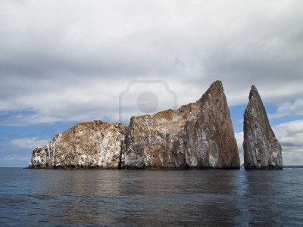
THE BEST SUITED
TO THE NEW ENVIRONMENT SURVIVE
Notes:
The end of the Ordovician was one of the coldest times in Earth’s history as ice covered much of the southern region of Gondwana. No major groups were completely lost during the mass extinction. Those populations that could find food, avoid predators and reproduce in the new environment survived and continued into the next period.

Slide 12
References
Advilson, Christina, Jennifer Bie, and Chirag Patel. "The Ordovician Period." The Ordovician Period. University of California Museum of Paleontology. Web. 16 Nov. 2013. <http://www.ucmp.berkeley.edu/ordovician/ordovician.php>.
BBC News. BBC, n.d. Web. 3 Dec. 2013. <http://www.bbc.co.uk/science/seamonsters/factfiles/giantorthocone.shtml>.
"Mollusks." Fossil Groups -. N.p., n.d. Web. 01 Dec. 2013. <http://geology.er.usgs.gov/paleo/mollusks.shtml>.
"Ordovician Period." National Geographic. N.p., n.d. Web. 03 Dec. 2013. <http://science.nationalgeographic.com/science/prehistoric-world/ordovician/>.
"Ostracoderm." - New World Encyclopedia. N.p., n.d. Web. 30 Nov. 2013. <http://www.newworldencyclopedia.org/entry/Ostracoderm>.
"Paleoclimate." Encyclopedia Britannica Online. Encyclopedia Britannica, n.d. Web. 23 Nov. 2013. <http://www.britannica.com/EBchecked/topic/431581/Ordovician-Period/258446/Paleoclimate>.
PBS. PBS, n.d. Web. 23 Nov. 2013. <http://www.pbs.org/wgbh/nova/link/hist_03.html>.
Scotese, C.R., “Ancient Oceans Separate the Continents”, Plate tectonic maps and Continental drift animations,PALEOMAP Project (www.scotese.com) November 23, 2013.
"THE ORDOVICIAN PERIOD488 TO 443 Million Years Ago." History of Earth. N.p., n.d. Web. 01 Dec. 2013. <http://www.corzakinteractive.com/earth-life-history/412_ordovician.htm>.

