Slide 1
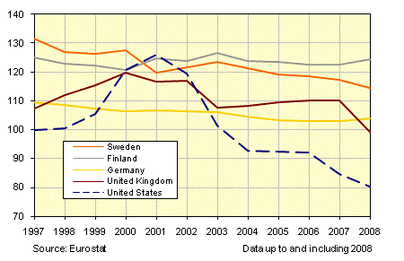
1997 to 2008 Comparative Price Levels Prior to the Global Financial and Economic Crisis
CPI – Consumer Price Index
The European Union average CPI is 100.
Price levels in Sweden have consistently hovered at about 20% above EU average.
Prices in the U.S. were volatile.
Notes:
Slide One
The Price Levels in Sweden are high.
Of the twenty-seven countries in the European Union, Sweden’s price levels are currently fifth highest.
This Consumer Price Index graph compares price levels to the European Union average. It covers the years leading up to the 2008 Global Financial and Economic Crisis.
The graph sets the EU average CPI at 100 and it shows that in the years leading up to the Crisis, Sweden consistently hovered at about 20% above average.
Prices in the United States at that same time were generally lower than Sweden’s but they rose and fell dramatically.

Slide 2
Although Sweden’s Price Levels are High, They are Fairly Stable This CPI graph reflects the short-lived recession caused by the 2008 Global Financial and Economic Crisis
Nation uses economic strategies to keep prices stable
Inflation Targeting
Fiscal Responsibility
Conservative Spending Ceilings
Notes:
Slide Two
So, although Sweden’s price levels are high, they are fairly stable. During the Economic Crisis, Sweden’s price levels fell with a short-lived recession but quickly rose again to their typical high level.
Fewer purchases of exports by the rest of the globe explains the small recession.
While the high level of prices is a concern to Sweden, they are most interested in keeping their prices stable.
The nation uses many economic strategies to make this happen.
One strategy is inflation targeting. They set a target inflation rate and manipulate the interest rate to keep prices from rising or falling too drastically. The long-term inflation target goal is 2%.
Sweden also works to achieve fiscal responsibility by imposing spending ceilings on the government budget.

Slide 3
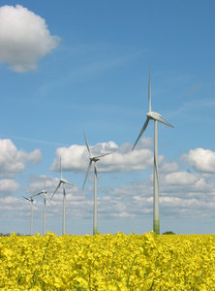
National Environmental Goals Affect Energy Product Prices
Desire to be energy independent led to heavy investment in alternative energy sources.
With alternative energy sources available, oil consumption is reduced.
Percentage of Sweden’s energy coming from oil has decreased from 77% in 1970 to less than 32% today.
Notes:
Slide Three
Of the many economic factors that contribute to Sweden’s high price levels, the most notable are due to government interventionism.
The government controls and affects certain markets to achieve specific socialistic goals.
For instance, because of the oil crisis of the 1970’s, Sweden developed a plan to become more energy independent and responsible.
For decades they invested heavily in their own alternative power sources such as hydroelectric power plants, wind energy farms, and bio-fuel factories.
Once the alternatives were available, oil consumption was reduced because alternatives make the demand for oil more elastic.
Sweden has effectively reduced their consumption of oil from 77% in 1970 to 32% today.

Slide 4
Targeted Tax Structures Ensure Complete Reduction of Oil Consumption
Sweden is now confident they can be an
“oil-free nation” by the year 2020.
In 1991, Sweden added a Carbon Dioxide tax to fossil fuels. The highest percentage tax is levied on oil.
Bio-fuels are not taxed and, therefore, are relatively less expensive.
Renewable energy vehicles are exempt from tolls and parking fees.
Notes:
Slide Four
In 1991, to ensure further reduction in oil consumption, Sweden imposed a Carbon Dioxide Tax on fossil fuels.
The highest percentage tax is applied to oil and oil products like gasoline.
Bio-fuels are not taxed at all. As a result, Ethanol is more attractive to consumers because it is priced 30% cheaper than gasoline.
Sweden uses other financial incentives to promote their alternative energy plan. For instance, cars using renewable fuels are exempt from parking fees and tolls.
Because the demand for oil is shrinking and the demand for alternative fuels is increasing, Sweden is confident that they will be an “oil-free nation” by the year 2020.

Slide 5
Price Comparison One Gallon of Gasoline Using August, 2011 Prices
 | Price Sweden | Price USA
Per Gallon Average | $8.22 | $3.56
Levied taxes increase prices which
reduces
demand for fossil fuels.
Notes:
Slide Five
What does this all mean at the pump?
An August, 2011 price comparison shows that the cost of a gallon of gas in Sweden is more than twice as high as a gallon of gas in the United States.

Slide 6
National Goal to Reduce Alcohol Consumption Affects Liquor Prices
Swede’s are notoriously heavy drinkers.
State believes that private companies selling alcohol for profit will encourage consumption.
Government uses a non-profit nationally owned monopoly on alcohol as an attempt to control consumption.
Notes:
Slide Six
Because the Swedish people have a long history of heavy drinking, the government has decided to use economic means to reduce alcohol consumption.
The government believes that alcohol sales for the purpose of profit would increase alcohol use.
Therefore, Sweden holds a monopoly on all sales of alcohol hoping to eliminate any competitive advertising that might encourage people to drink.
The state-owned monopoly is called the Systembolaget.

Slide 7
Systembolaget Monopoly Controls Alcohol Prices
High taxes based on alcohol content attempt to reduce demand.
As the product proof increases, so does the tax percentages.
Hard liquor is relatively more expensive than beer or wine.
Ferry trips to buy liquor in Denmark and Germany are common.
Notes:
Slide Seven
The Systembolaget sets and controls the prices. On top of the purchase price, the state imposes high taxes on every alcoholic product.
As the product proof increases, so does the tax percentage.
Lower proof items like beer and wine are taxed at a lower rate and are more affordable than higher proof items like whiskey or vodka.
Selling alcohol at higher prices hasn’t really reduced the amount of drinking in Sweden.
Many Swede’s get around the high prices by taking a short ferry trip to Denmark or Germany where they can buy hard liquor at a much lower price.

Slide 8
Price Comparison One Liter Bottle of Absolut Vodka
Systembolaget
$36.19
(239SEK)
Pennsylvania State Store
$23.95
Notes:
Slide Eight
This price comparison shows that a one-liter bottle of Absolut vodka costs far less in the United States than it does in Sweden.
Even though Absolut is made in Sweden, the price is 66% less 4,000 miles away.

Slide 9
Poor Competition Plays a Role in Sweden’s High Prices
Non-Tariff Barriers
Municipal Planning Restricts Number of Retailers in Markets
Government Controlled Housing Rental Market Returns Low Yields for Private Investors
Notes:
Slide Nine
Taxes aren’t the only way that the well meaning government of Sweden affects price levels.
Non-tariff barriers affect some Retail Food Markets and the Housing Rental Market.
These barriers increase prices by inadvertently reducing free market competition.

Slide 10
Municipal Planning Curbs Efficient Competition among Grocery Markets
New retailers must be approved by municipalities.
Approval process discourages entrepreneurs.
Lack of competition exerts no force to drive prices down.
ICA Maxi Retailing Corporation
Holds a 50% market share.
Notes:
Slide Ten
Municipal planning often stops new grocery stores from entering the local markets.
Each municipality must approve new entrants into their markets. For instance, a new food store would have to apply for permission to open their business.
Municipalities hire consultants to evaluate the effects the new food store would have on their town.
The food store has to pay for these costs even though they might be turned away and denied entrance.
This process discourages entrepreneurs from entering the market.
As a result, the market share is held by just a few companies.
The European grocery chain ICA Maxi holds a 50% market share.

Slide 11
Price Comparison Grocery Basket
Swedish Basket
Milk 5.68 gallon
Eggs 4.06 per dz.
Coffee 6.43 per lb.
Beef 5.50 per lb.
Chicken 1.50 per lb.
Apples 3.13 per lb.
Us Basket
Milk 3.71 gallon
Eggs 1.71 per dz.
Coffee 5.77 per lb.
Beef 3.21 per lb.
Chicken 1.29 per lb.
Apples 1.52 per lb.
Notes:
Slide 11
Without enough competition, businesses don’t have to keep their prices low in order to attract more customers.
In this price comparison, a typical grocery bag full of basic food products costs almost ten dollars more in Sweden than it would in the U.S.

Slide 12
Regional Rent Tribunals Dictate Price Ceilings
Strict pro-tenant controls keep rental rates down.
Price ceilings limit supplier’s returns on investment.
Suppliers can’t afford to invest with low returns.
Shortages create black market sub-leasing at above market prices.
Notes:
Slide 12
Sweden’s housing market is controlled by Regional Rent Tribunals.
Low rental rates are set by the pro-tenant Tribunals.
These rent ceilings make it impossible for investors to cover their costs and make a profit.
Fewer investors lower the supply of rental housing.
The high demand and low supply leads to black market subletting, where tenants illegally lease out their apartments to the highest bidders.

Slide 13
Housing Shortages Push Prices Up
Demand for individual ownership of real estate has increased.
Increased demand along with shortage of housing supply has pushed prices up since the mid 1990’s.
Real estate bubble is now bursting.
Notes:
Slide 13
Because the rental market has been so tightly controlled, investors have been attracted to purchasing and reselling property.
With the increase in demand along with an overall shortage of property, real estate prices have been steadily rising since the mid 1990’s.
This created a bubble in Sweden’s real estate market. Currently, the bubble is beginning to burst and prices are now falling.

Slide 14
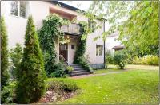
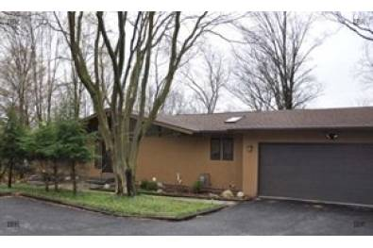
Price Comparison Single Family House
Upsalla, Sweden
2500 sq. ft.
$1,047,816
Ithaca, New York
2500 sq. ft.
$425,000
Notes:
Slide 14
Sweden’s housing shortage and high demand is reflected in this price comparison.
A 2500 square foot single family home in the University town of Upsalla, Sweden costs over a million dollars.
A comparable home in the college town of Ithaca, New York costs less than half of that.
Overall, Sweden is always analyzing their economy.
They are currently paying close attention to the effects of their social goals on their open markets and price levels.
Some changes in restrictions have recently been put in place.
Rental rate ceilings have been increased to attract more investors which would improve the housing supply.
And municipalities have been encouraged to consider healthy competition when reviewing retail business applications.
Ultimately, it is not likely that Sweden will abandon their national goals in favor of lower prices.

