Slide 1
Blueberry Software
IT Security Audit Results

Slide 2
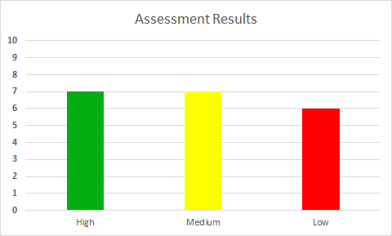
Results: Good

Slide 3
Strong Areas
Security Organization
Strong and organized security infrastructure
Access Control & A.C. Procedures
Strong password controls/Rotation
Files well-protected
Procedures in place for authorization

Slide 4
Strong Areas (Cont’d)
Vendor Management
Management must approve third-party connectivity
Third-party connections are monitored
Virus Protection
Protection/Detection software on all devices
E-mail attachments pre-screened
Strong Security Policies/Standards

Slide 5
Weak Areas
Computer and Network Management
Vulnerabilities/Exploits not prioritized
Compliance
No compliance checks in place
Business Continuity & B.C. Plans
Backup procedures not documented

Slide 6
Weak Areas (Cont’d)
Patch Management Processes
High priority patches take 48 hours for implementation
Security Testing
Security Test results not well-documented

Slide 7
Suggested Improvements
Identify and prioritize patches daily
Enforce policy compliance w/ checking tools
e.g. eTrust
Document Restore/Backup procedures
Produce and Retain written results of Security Tests

