Slide 1
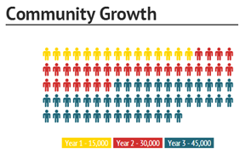
$200
Increase of 10% each year

