Slide 1
LimitList
Ahmad, Anna, Ian

Slide 2
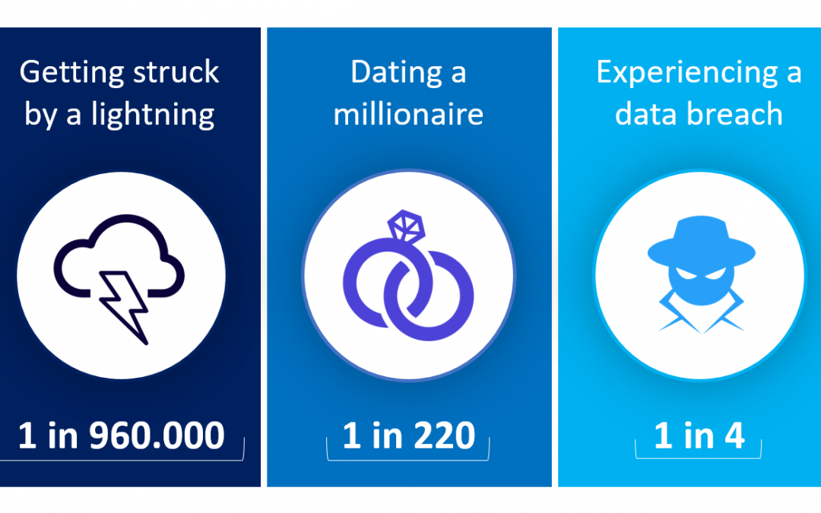
Overview
Goals
Scaleable
Affordable
Customer benefits
Risks
Data breaches
Notes:
Keeping our goals generic so it can be adjusted to most mini markets and have our project to be affordable for the business who cannot afford a costly system. Give customers the ability to easily place an order without the need of physically walking into a store, for elderly, people without cars, or even placing orders for other people. We also need to consider the cyber risks such as data breaches of personal information such as names and addresses.

Slide 3
Income Assumptions
First Year | Second Year | Third Year
100 customers per day $65 per customer | 250 customers per day $65 per customer | 370 customers per day $65 per customer
10% service charge per order | 10% service charge per order | 10% service charge per order
15 markets hosted | 35 markets hosted | 45 markets hosted
$99/month per store | $99/month per store | $99/month per store

Slide 4
Cost Assumptions
Mobile application developer | $ 85,377
Project Manager | $ 85,281
Marketing Manager | $ 75,249
Sales Manager | $ 67,114

Slide 5
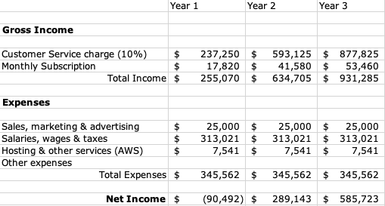
Financial Analysis

Slide 6
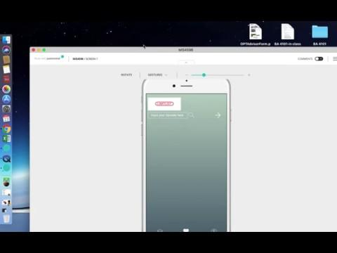
Prototype

