Slide 1
LimitList
Ahmad, Anna, Ian

Slide 2
Business Case
In-store & Online Shopping and Delivery Service
Decrease the gap between small business and IT.
Scalable application that can be utilized by privately owned supermarkets.
Allows them to keep up with larger grocery store chains.
Facilitate an increase in competitive value

Slide 3
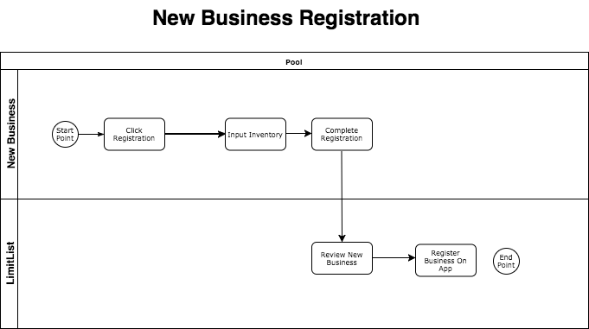
Process Model

Slide 4
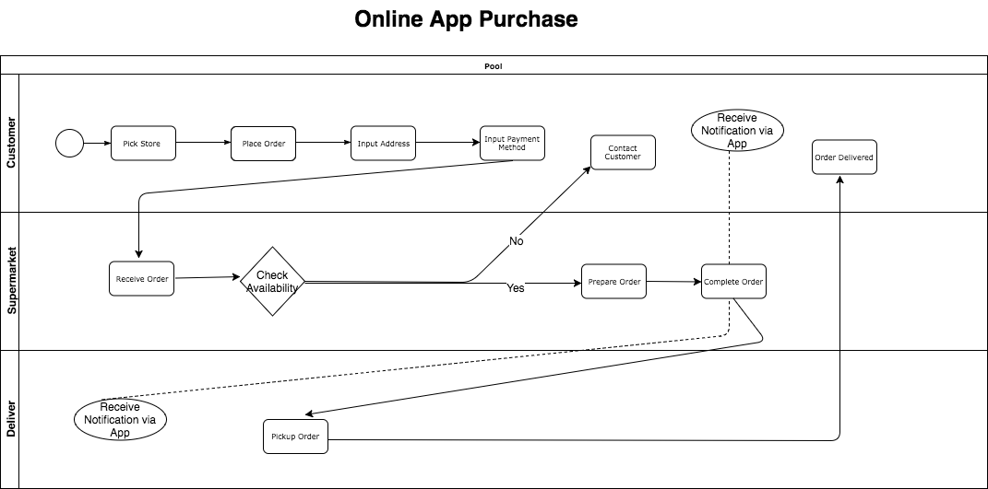
Process Model

Slide 5
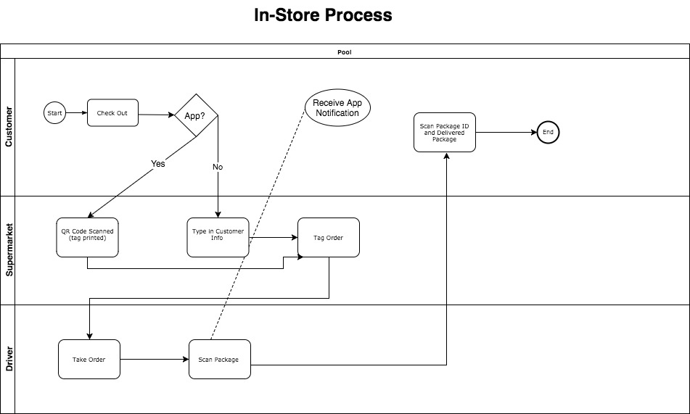
Process Model

Slide 6
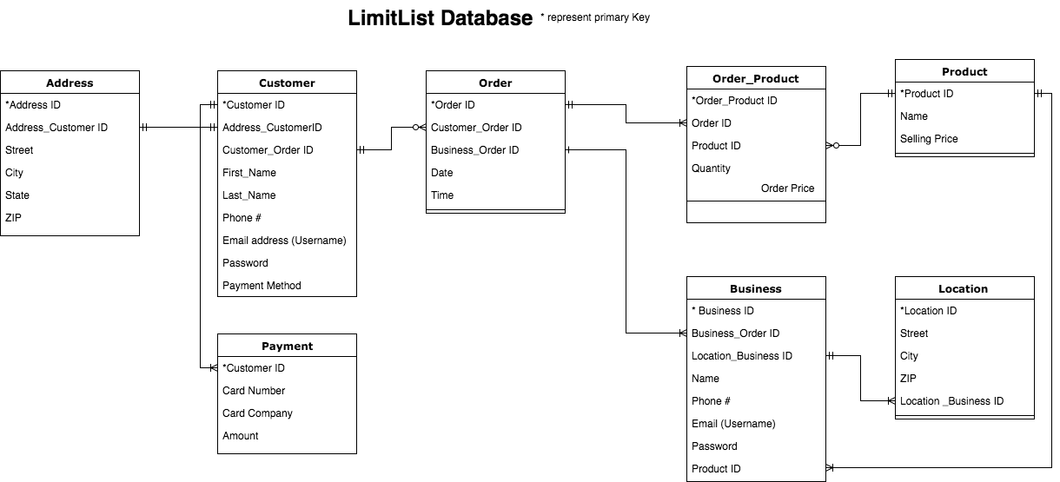
Data Model

Slide 7
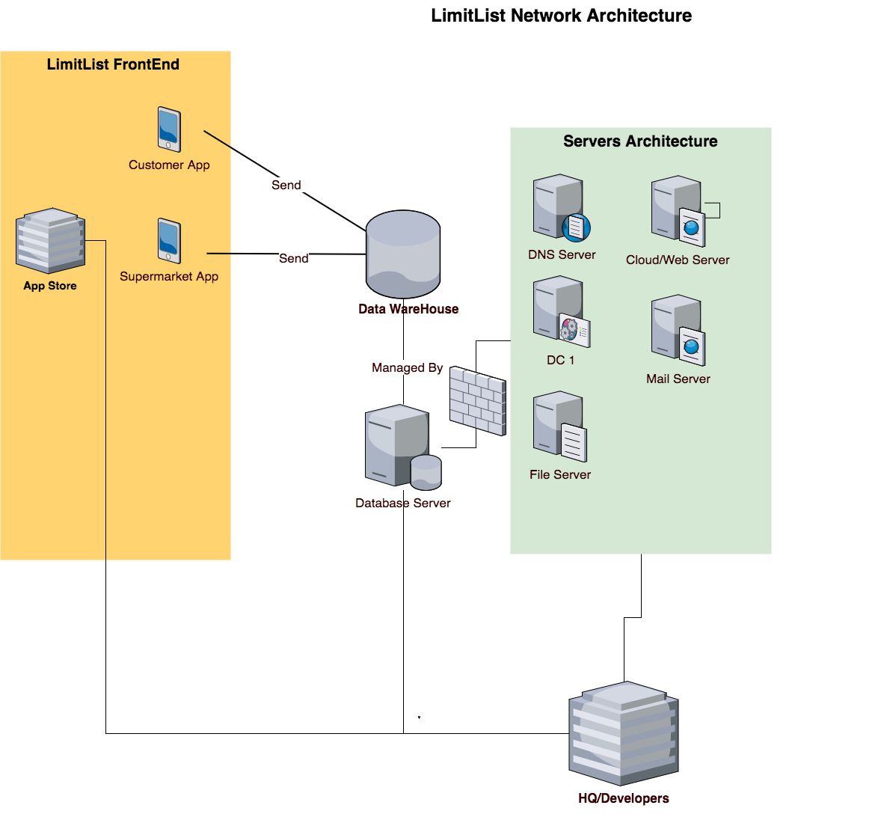
Systems Architecture

