Slide 1
LimitList
November 6, 2018
Ahmad, Anna, Chung Han

Slide 2
Overview
Data Model
Technical Artchitecture
Business Case
Prototype

Slide 3
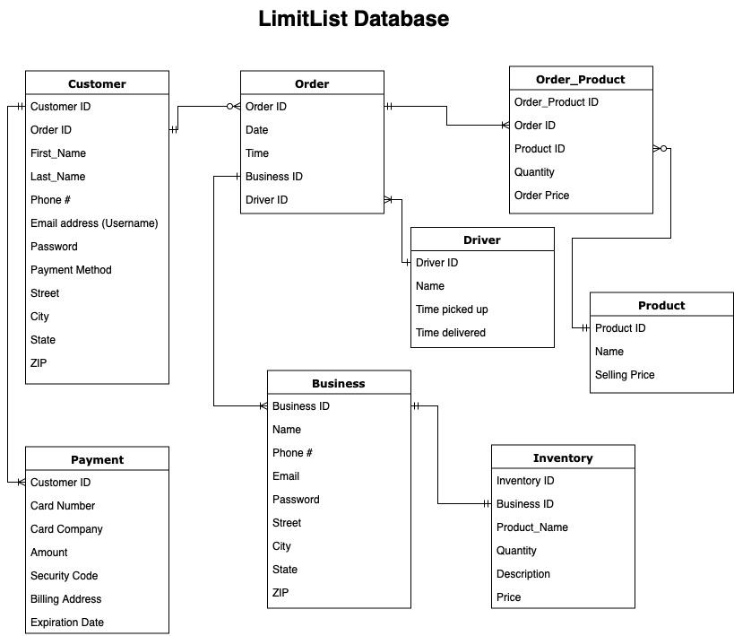
Data Model

Slide 4
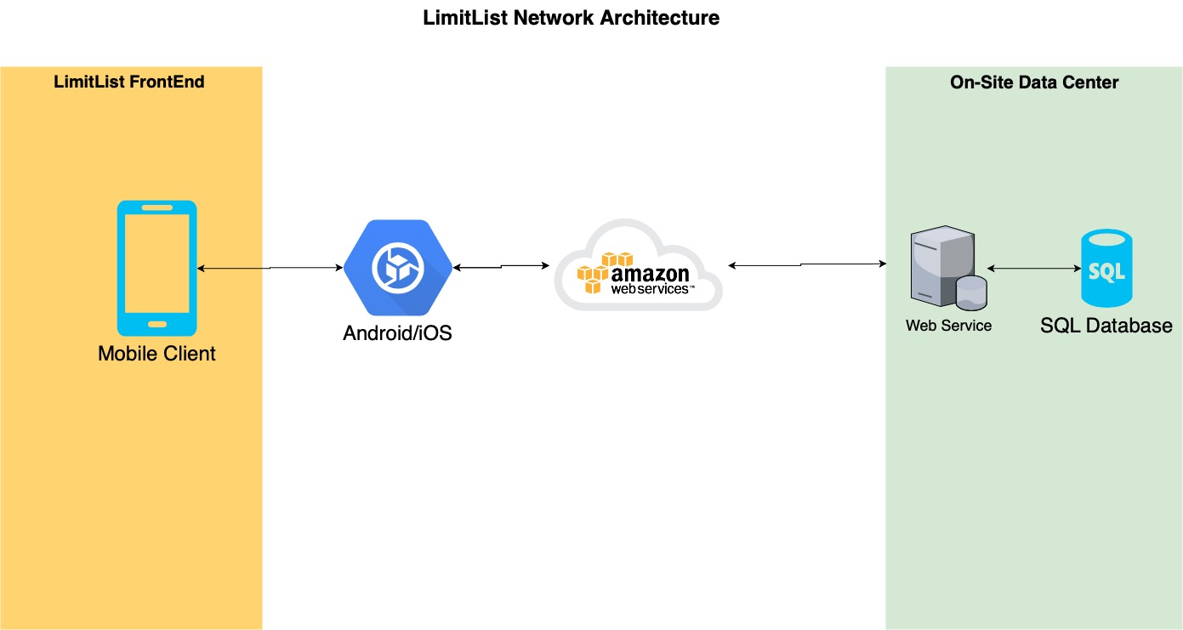
Technical Architecture

Slide 5
Business Case
Assumptions
Service charge (8%) per order (store end)
Start in Philadelphia county (~60 zip codes)
Stores have their own drivers
 | Year 1 | Year 2 | Year 3
Zip Codes | 25% | 35% | 40%
Orders Per Day per Zip code | 5 | 7 | 7
Stores per Zip Code | 3 | 3 | 4

Slide 6
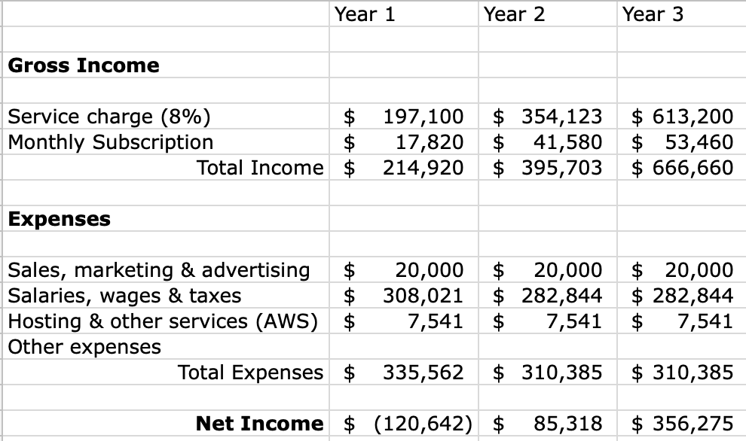

Slide 7
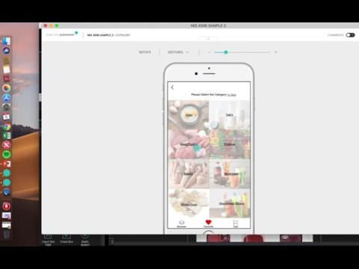
Prototype

