Slide 1
Limitlist
Anna, Ahmad, Ian
November 13, 2018

Slide 2
Overview
Business Case
Data Model
Process Model
System Architecture
Prototype

Slide 3
Business Case
Service charge off of each order
Less than the leading competitors (8% vs. 13%)
Quarterly Fee ($99)

Slide 4
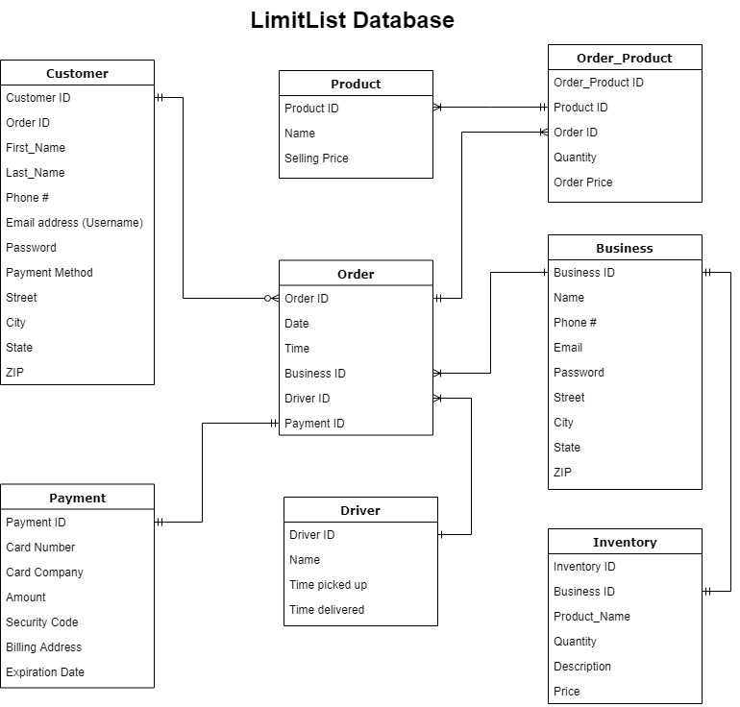
Data Model
Notes:
Payment connects to order instead of customer. Driver will tracked in real time for customer and employer use.

Slide 5
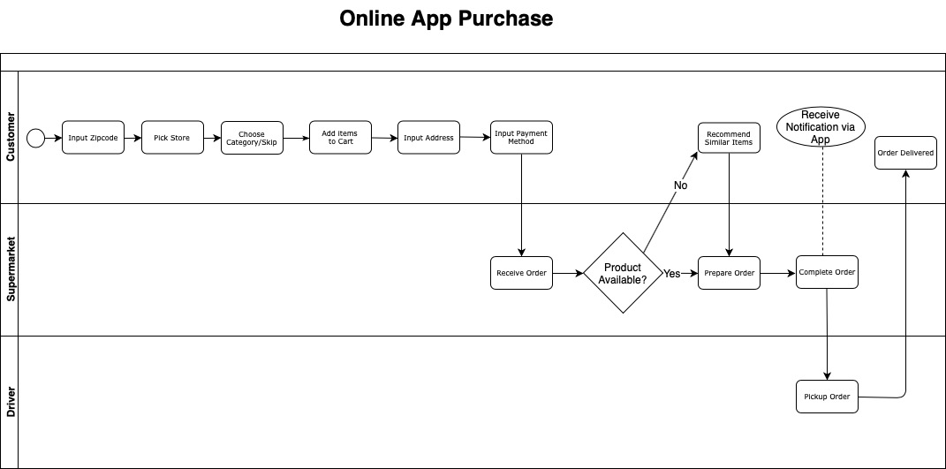
Process Model
Notes:
Less vague ordering processes. If product not available, recommend similar items instead of potentially losing the whole order.

Slide 6
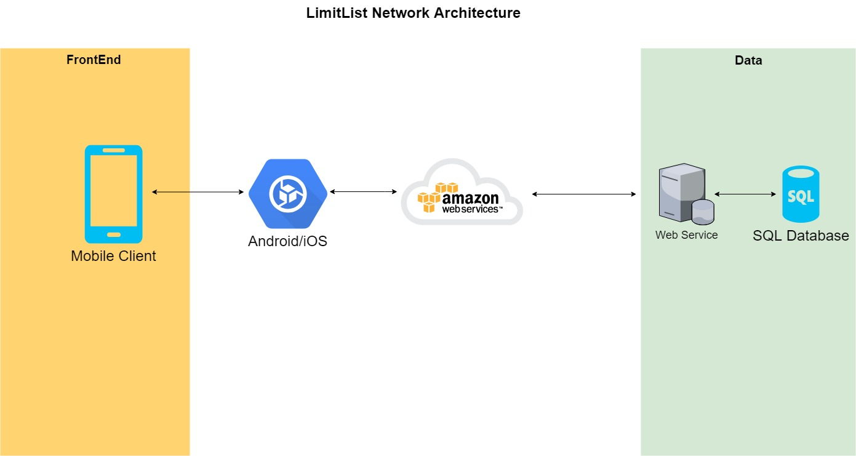
System Architecture
Notes:
No Hardware involved.

Slide 7
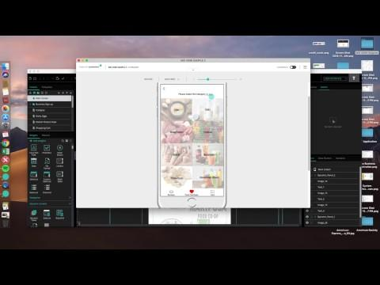
Prototype

