Slide 1
TEAM NGINX
Internal Interface
Amanda Chavis, Maaz Khan,
Kamchinn Cheang,
Andrew Lin, Jacky Zhang

Slide 2
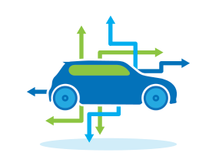
THE BIG IDEA
Develop a tool that manages all vehicles contracted for sale
Capture updates of the vehicle lifecycle
Improve communications with current and potential future clients
Notes:
We aim to solve your problems effectively and efficiently
We aim to give you the best solution that meets all the unmet needs you expressed to us
Our solution improves communication
Mention cars?
Our solution also saves all the information in one place

Slide 3
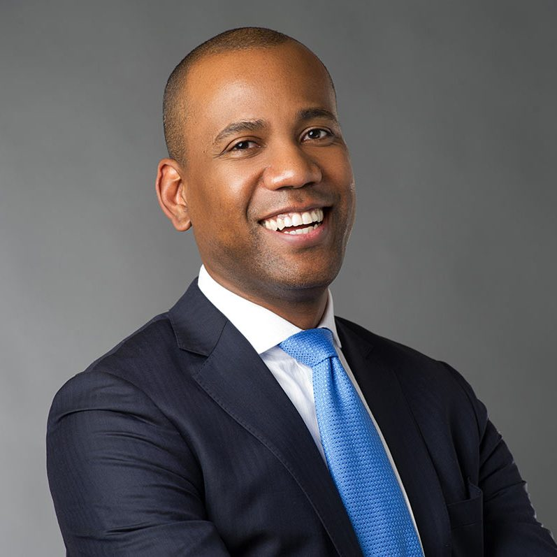
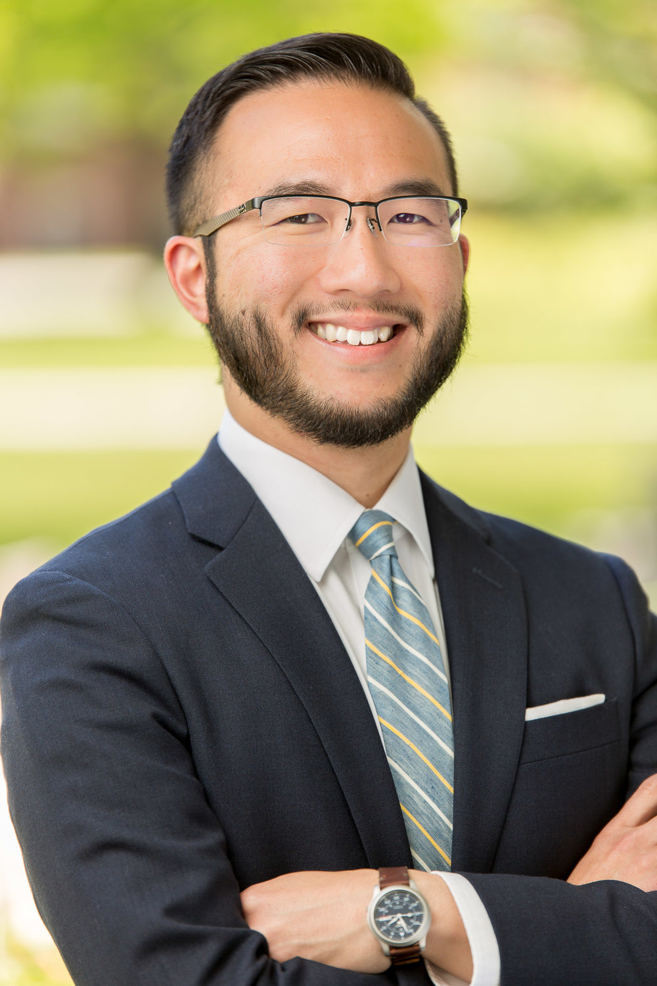
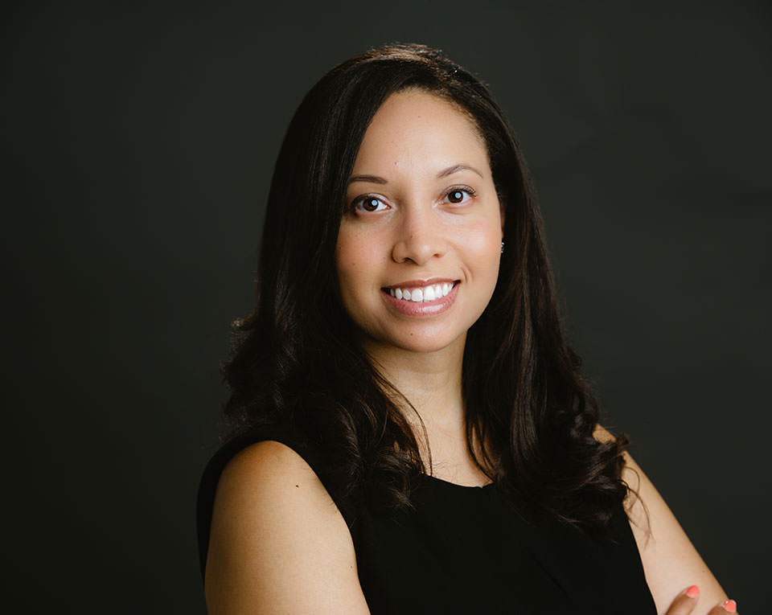
THE STAKEHOLDERS
William Hunt
Henry Grant
Ashley Miller

Slide 4
WILLIAM HUNT
Global Service Excellence Representative
Age: 30
Married with 1 son
Location: Mt. Laurel, NJ
Income: $60K
Communications
Degree
Outgoing, Personable, and great with numbers.
Golfing, Traveling, and collecting cars
“At ARI we want to do everything we can to get back to clients within a reasonable timeframe. It would be helpful to have a record of frequently asked questions from clients to better assist them”
Notes:
William Hunt, Global Service Excellence Representative
log-in and check on a ticket/chat from a client
Age: 30
Marital Status: Married, 1 son
Location: Mt. Laurel NJ
Education: Communications Degree
Income: $60K
Characteristics:
Financial Management
Outgoing
Personable
Hobbies:
Golfing
Collecting miniature cars (figurines)
Traveling
“Here at ARI, we are dedicated to customer service! We want to do everything we can to get back to clients within a reasonable timeframe. It would be helpful to have a record of frequently asked questions from clients to better assist them”

Slide 5
HENRY GRANT
Support Coordinator
Age: 28
Single, no kids
Location: Mt. Laurel, NJ
Income: $51K
Business Management Degree
Organized, Takes Initiative, and Detail
Oriented
Going to beer tastings, photography, and spending time with friends
“My boss has me reach out to our clients whenever we need additional information. I normally have to sit through old emails to find their contact info. Having it all in one place would be great!”
Notes:
Henry Grant, Support Coordinator
log-in and need to email the client for a reason
28
Not married, no kids
Mt. Laurel NJ
Income $51K
Characteristics:
Organized
Self-motivated; takes initiative
Detailed oriented
Hobbies:
Photography
Beer tastings
Spending time with friends
“My boss has me reach out to our clients whenever we need additional information. I normally have to sift through old emails to find their contact info. Having it all in one place would be great!”

Slide 6
ASHLEY MILLER
Remarketing Sales Manager
Age: 34
Married with 1 son
Location: Mt. Laurel, NJ
Income: $68K
Marketing Degree
Friendly, Reliable, and Detail Oriented
Jogging, Painting, and Yoga
“Currently, I have to go through a lot of paperwork to make sure we have everything in order to each step in a vehicle’s lifecycle. It would be great if I could quickly view where a vehicle is in a lifecycle so that I can give updates in a timely fashion”
Notes:
Ashley Miller, Remarketing Sales Manager
log-in and check the status of a vehicle within the lifecycle
34 years old
Marketing degree
Married, 1 son
Income: $68K
Characteristics:
Friendly; people person
Reliable
Respectful
Hobbies:
Jogging
Painting w/ Paint Nite
“Currently, I have to go through a lot of paperwork to make sure we have everything in order to each step in a vehicle’s lifecycle. It would be great if I could quickly view where a vehicle is in a lifecycle so that I can give updates in a timely fashion”

Slide 7
THE UNMET NEEDS
THE SOLUTION
Client Communications
Live Chat & Email Communication
Client Management
Client Information Page
(Accessible By ARI Employees)
Real-Time Lifecycle Updates
Metric Dashboard & Car Lifecycle
Notes:
Unmet needs (What are their needs? how are they currently not being met?)
Client communication with ease
View metrics of the portal/dashboard
notifications/alerts pertaining to the vehicle in the life cycle
The opportunities
*break down how our solution will meet each one of these*

Slide 8
THE UNMET NEEDS
THE SOLUTION
Client Communications
Live Chat & Email Communication
Notes:
Unmet needs (What are their needs? how are they currently not being met?)
Client communication with ease
View metrics of the portal/dashboard
notifications/alerts pertaining to the vehicle in the life cycle
The opportunities
*break down how our solution will meet each one of these*

Slide 10
THE UNMET NEEDS
THE SOLUTION
Client Management
Client Information Page
(Accessible By ARI Employees)
Notes:
Unmet needs (What are their needs? how are they currently not being met?)
Client communication with ease
View metrics of the portal/dashboard
notifications/alerts pertaining to the vehicle in the life cycle
The opportunities
*break down how our solution will meet each one of these*

Slide 12
THE UNMET NEEDS
THE SOLUTION
Real-Time Lifecycle Updates
Metric Dashboard & Car Lifecycle
Notes:
Unmet needs (What are their needs? how are they currently not being met?)
Client communication with ease
View metrics of the portal/dashboard
notifications/alerts pertaining to the vehicle in the life cycle
The opportunities
*break down how our solution will meet each one of these*

Slide 14
THE BUDGET
Production Time | 2 Months (8 Weeks)
AWS S3 – Database Management System | $1,500 per Month
Developers | 2
Developer Per Hour Cost | Developer - $75 Tester – $23.58
Project Manager | 1
PM Per Hour Cost | Manager - $40.50
Total Cost = $47505.60 | 75 * 8 * 40 = $24000 23.58 * 8 * 40 = $7545.60 40.50 * 8 * 40 = $12960 $1500 * 2 = $3000
Notes:
Why they should pick our solution with how much it will cost them.
Production Time: 2-3 months
Developers: 2
Project Manager: 1
System/dashboard upkeep?

Slide 15
THANK YOU FOR LISTENING! QUESTIONS?
“We pride ourselves on improving our customers’ fleet management operations and—ultimately—their bottom line.” (ARI)

