Slide 1
BeHeardPhilly Client-Facing Web Tool
Business Analysts
Brandan Mackowsky
Adama Traore
Evan Chiao
Lucas Lam
Michael Dennis
Project Managers
Noah Mercado
Anna Kim

Slide 2
Needs of Clients
Opportunities for Change
Need a way to communicate with BHP online.
Easy way to access their survey results and data.
Ability to be more active in survey creation and progress.
Create a greater online presences for BHP and closer relations with its clients
Opportunity to have multiple survey results saved in one place.
Put more power into the hands of clients and appeal to a broader audience.

Slide 3
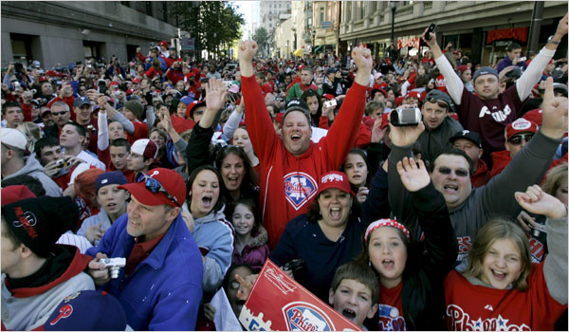
The Big Idea
Make communication easy
Create a simple way to get services
Create a full client experience
Centralized workflow

Slide 4
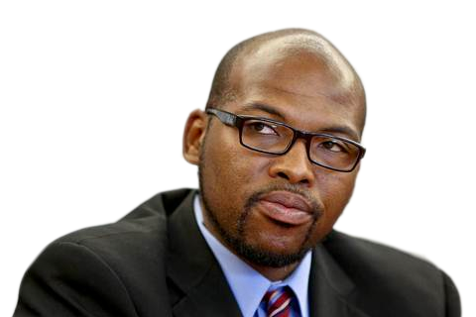
The Users
Daryl Stein
Professor of Marketing at Drexel University
“I need a cost effective method to give my students real data on effective advertising in Philadelphia.”
Jennifer Hughes
Survey Lead at Penn Medicine’s Department of Family Medicine and Community Health
“I need to stay up to date with the health of people in Philadelphia.”

Slide 5
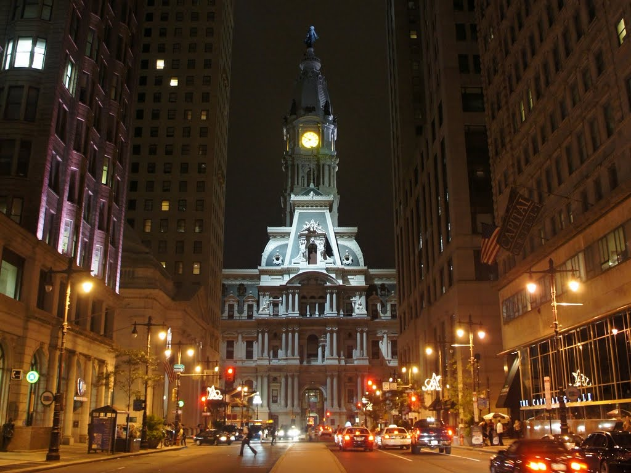
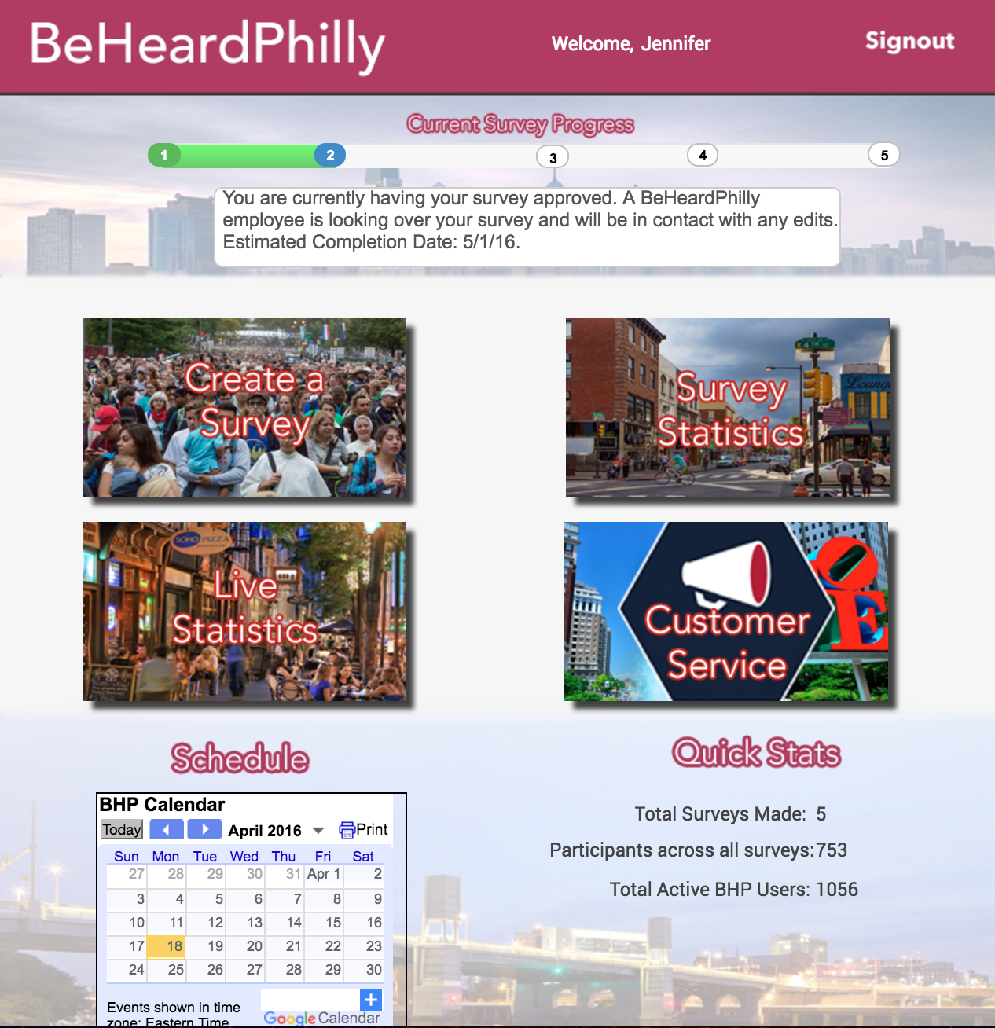
Prototype
Client registration and login portal
Cross party survey collaboration
Real time dashboard

Slide 6
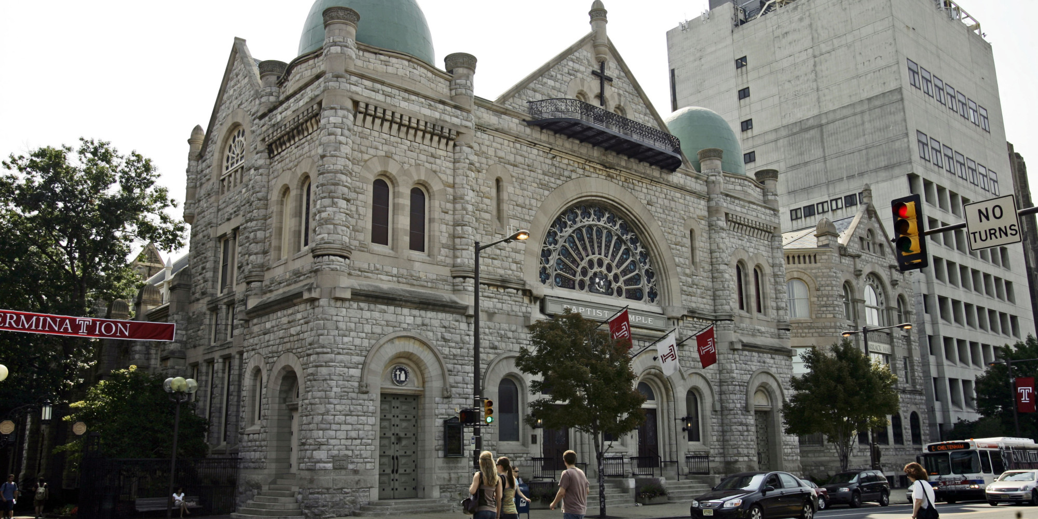
The Business Case
Why This Solution?
Automation
Easy Navigation
Point of communication with clients
Easily accessible
Encompasses multiple needs
Resources Needed
Financial investment
Dedicated customer support personnel
On staff developer

