Slide 1
BBA in MIS
A complete redesign – November 2010

Slide 2
Process
Engage Alumni
Some learning outcomes in MIS are timeless but the world in which we apply these basic lessons is changing rapidly
IS 2009
Faculty compares current curriculum to IS 2009 – Model Curriculum from AIS
Domains & Topics
Faculty creates list of domains and topics to be included in the next generation curriculum
The rest of the world is finally catching up to where we were in 2005
Engage Advisory Board
Faculty & Joe Spagnoletti
Faculty & Niraj Patel, Kent Seinfeld, and Bruce Fadem
Faculty and most of remaining advisory board members
If I saw a student with this set of skills, I’d hire them in a minute!
The real value add for IT is in the “Front Office”
At the lowest level, the basics are still the same but how we do these things has changed radically in the past 5 years
We need to maintain a leadership position
Notes:
Describe the major steps of the process (left), including what we learned from each major step (right).

Slide 3
BBA IN MIS - Vision
Future A digital centric world in which a group of large and growing IT centric firms and providers provide infrastructure like services which an ever increasing group of smaller entrepreneurial firms apply and reimagine to create innovative and value added services for consumers and business.
Our students will successfully compete in a new world in which traditional large corporations continue to streamline their IT operations but grow and add new technologically enhanced innovative capabilities
Contrast
A local insurance firm had more than 1800 IT jobs in 1999 but now has less than half. Twitter has 27 employees. Who has the better brand? Who has the better job prospects?
Goal
Prepare students for jobs that are at the intersection of the needs of large IT firms, smaller entrepreneurial firms, and traditional large business.

Slide 4
Themes
Media Apply social, digital, integrative media to create opportunities and collaboration
Entrepreneurial thinking Create innovative technology enabled corporate and consumer products/services
Collaboration Virtual teamwork, partnerships, customer interaction
Professional development Make persuasive arguments about technology
Leverage Fox Core Curriculum Utilize cost//benefit analysis as part of IT project portfolio management
Evolutionary and radical technology Build a datacenter today or utilize cloud computing and open source? Corporate and consumer technology
Critical thinking Identify and draw insight from data, apply the concept of objects
Lead change Champion change in small and large firms – Social media, create business intelligence, cyber security, risk management, knowledge management, cloud, etc.
Notes:
List some of the major themes and include a few comments to help audience understand why this is included.

Slide 5
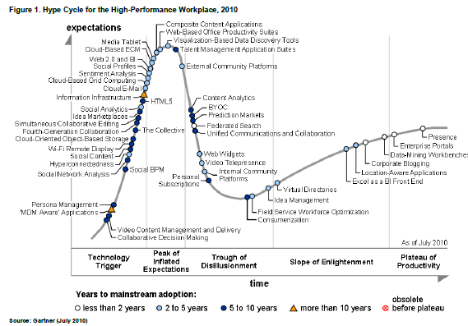
Hype Cycle for High-Performance Workplace 2010
Notes:
This doesn’t really work as I had hoped. I wanted to see how many of the topics we will be covering are on the hype cycle for the high-performance workplace to show that the topics we’re going to cover are going to be the hot topics in the future. I see a few like data-mining, corporate blogging, Excel as a BI front end, Web Widgets, content analytics, composite content applications, cloud based grid computing, cloud e-mail, social analytics, social network analysis.

Slide 6
Transition of IT Roles
2005
2010
Corporate IT
(in the datacenter)
Corporate IT
(in the business unit)
Small/Midsize Business
Business Analyst
Social Media Engineer
Systems Analyst
Solution Developer
Business Analyst
Application developer
Data
Analyst
Change Agent
Database Administrator
Entrepreneurial Firms
Systems Administrator
Digital Product and Service Development

Slide 7
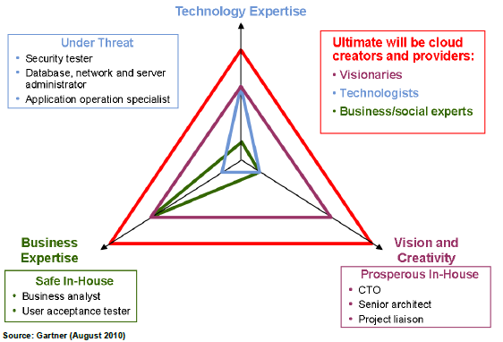
Where will our students contribute
Notes:
Research done by Gartner. Looks at skills across three dimensions, technology expertise, business expertise, vision/creativity.
Under Threat – This is closely aligned with what we have been teaching in significant portions of the existing curriculum.
Safe In-House, Prosperous In-House, and Ultimate will be Cloud Creators and Providers – This is where we are headed with the new curriculum.

Slide 8
Fundamental shift
“I integrate business and technology”
Tired
Large business
Technology
Wired
“I am a leader in technology-enabled products and services”
Business, consumers, non-profit
Technology

Slide 9
Demand
Open Source Solutions
Data Analytics
Cyber Security
Cloud Computing
Data Mining
Change Leadership
Mobile
Visualization
Virtualization
PHP/MySQL
IT Risk Management
Benefits Realization
Digital Design
Google Analytics
Data Warehousing
ERP
Human Factors
Outsourcing
AaaS – Salesforce.Com
IT Project Leadership
IaaS – Amazon EC2
Open Source Development Strategies
Business Process Optimization
Notes:
The skill set which was in demand 5 years ago isn’t the same skill set which will be in demand for the next 5 years. Most of these topics either didn’t exist or were significantly less mature 5 years ago. The next generation IT professional needs to have a basic understanding of these topics and how these topics create value for an organization. This skill set will truly differentiate our graduates from their competition and will lead to superior placement rates.

Slide 10
REVISED BBA in MIS DESCRIPTION
The top 10 ranked Fox BBA Major in Management Information Systems (MIS) produces business-oriented, technically proficient professionals. The Fox BBA in MIS will train you to identify, evaluate, build, and acquire technology solutions for large and start-up firms.
Initiate and lead technology enabled change (e.g., act as a change agent in a large firm)
Analyze and design innovative digital products and services (e.g., create and implement the social media strategy for a new start-up)
Apply IT to automate and improve business processes (e.g., patient information system for a hospital)
Transform a business function with IT (e.g., use iPhone apps to reach new customers)
Analyze clients, specify needs, integrate applications, and manage projects (e.g., select and acquire a new web conferencing system)

Slide 11
New Portfolio requirement
As a graduation requirement, all MIS majors will be required to compile a portfolio that includes:
An internship (or 3 months related part-time work experience)
An e-portfolio including their online resume and online projects
Documentation of other professional development activities

Slide 12
PROPOSED BBA in MIS
2. Data analytics
Analyze and present insights from business data
1. Enterprise architecture
Specify the IT architecture of the enterprise
4. Change leadership
Lead technology-enabled and process-centric transformation
5. Digital design and innovation
Create innovative technology enabled corporate and consumer products/services
Database structure and design (3)
Tools: Google ad words/analytics, Cognos/data warehouse, statistics
Information, application, & media architecture (3)
Cyber security and risk assessment (3)
Cloud computing and virtualization (3)
Platforms and ecosystems: corporate, open source, mobile, social, consumer, & gaming (5)
3. Data-centric application development
Create web based data centric applications
Process thinking and management (3)
Sourcing (RFP, outsourcing, contracts) (3)
6. IT value and service delivery
Leverage enterprise information technology assets and capabilities
IT organization (structure, services, strategy) (3)
Objects and architecture of integrated applications (2)
Lead technology enabled change (3)
Business process analysis and optimization (4)
Data mining and analysis (5)
Tools: SAP, Salesforce.com, Microsoft Azure (cloud), Xbox live, Apple app store
Tools: PHP/MySQL, components/widgets (WP E-commerce)
Tools: Case analysis, financial analysis
Tools: Microsoft project, case analysis, social media, collaborative systems
Benefits realization (2)
Portfolios (valuation, risks, scope) (3)
Design methods (storyboarding, prototyping) (4)
New media design (3)
Digital media marketing (3)
Development strategies (RAD, SDLC) (2)
Scripting (8)
Integrative project (3)
Warehousing (2)
Visualization (2)
Strategic and innovation analysis (3)
Data sourcing (traditional data / new media) (2)
Programming fundamentals (2)
Project management (5)
Tools: Process analysis, design, new media tools (WordPress, SEO, Facebook, YouTube)

Slide 13
Electives
Choose one from:
Social media
Cyber security
Mobile and web application development
Internet enabled supply chains
Design thinking
Internship

Slide 14
Key changes
Add/enhance/emphasize
Required internship or work experience
Entrepreneurial thinking and innovation
Analysis of data
Technology platforms
Design
Change leadership and management
Web and Plugin based scripting and data integration
Remove/reduce/change
2.5 semesters of programming to 1 semester
Object oriented and client/server
Database administration and creation
Project management and process analysis are now aspects of change leadership
Traditional textbooks
New delivery tools
Apply social media (FoxMIS community site)
Use e-books

Slide 15
Implications for The FOX CORE
Write a blog or use social media to influence others?
Utilize negotiation skills?
Utilize NPV analysis to make investment decisions?
Make a compelling business case for a technology enabled innovation?
Apply new media to marketing
Understand how business processes span functional areas and how they impact the income statement?
Notes:
Research done by Gartner. Looks at skills across three dimensions, technology expertise, business expertise, vision/creativity.
Under Threat – This is closely aligned with what we have been teaching in significant portions of the existing curriculum.
Safe In-House, Prosperous In-House, and Ultimate will be Cloud Creators and Providers – This is where we are headed with the new curriculum.

Slide 16
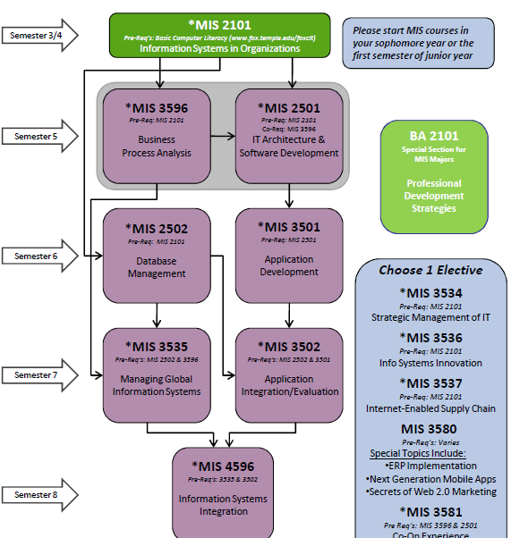
CURRENT BBA in MIS

Slide 17
Can we…
Not screw up our existing students
Protect the size of the traditionally “major only” courses
Allow a student to hustle and complete the program in 3 semesters

Slide 18
MIS 2501
Pre-Req: MIS 2101
Enterprise Architecture
MIS 2502
Pre-Req: MIS 2101
Data Analytics
Semester 5
MIS 3596
Pre-Req: MIS 2101
Digital Design
and Innovation
MIS 3501
Pre-Req: MIS 2502
Data-centric
Application
Development
Semester 6
Choose 1 Elective
*MIS 3534
Pre-Req: MIS 2101
Strategic Management of IT
*MIS 3536
Pre-Req: MIS 2101
Info Systems Innovation
*MIS 3537
Pre-Req: MIS 2101
Internet-Enabled Supply Chain
MIS 3580
Pre-Req’s: Varies
Special Topics Include:
ERP Implementation
Next Generation Mobile Apps
Secrets of Web 2.0 Marketing
*MIS 3581
Pre Req’s: MIS 3596 & 2501
Co-Op Experience
MIS 3582/3682
Independent Study
MIS 3535
Pre-Req’s: 3596
Change Leadership
*MIS 35xx
Pre-Req: Varies
MIS Elective
Semester 7
*MIS 4596
Pre-Req’s: 3535 & 3501
IT Value and
Service Delivery
Semester 8

Slide 19
MIS 3596
Pre-Req: MIS 2101
Digital Design
and Innovation
MIS 2501
Pre-Req: MIS 2101
Enterprise Architecture
MIS 2502
Pre-Req: MIS 2101
Data Analytics
Semester 5
Choose 1 Elective
*MIS 3534
Pre-Req: MIS 2101
Strategic Management of IT
*MIS 3536
Pre-Req: MIS 2101
Info Systems Innovation
*MIS 3537
Pre-Req: MIS 2101
Internet-Enabled Supply Chain
MIS 3580
Pre-Req’s: Varies
Special Topics Include:
ERP Implementation
Next Generation Mobile Apps
Secrets of Web 2.0 Marketing
*MIS 3581
Pre Req’s: MIS 3596 & 2501
Co-Op Experience
MIS 3582/3682
Independent Study
MIS 3535
Pre-Req’s: 3596
Change Leadership
MIS 3501
Pre-Req: MIS 2502
Data-centric
Application
Development
Semester 6
*MIS 4596
Pre-Req’s: 3535 & 3501
IT Value and
Service Delivery
*MIS 35xx
Pre-Req: Varies
MIS Elective
Semester 7
Semester 8

