Slide 1
Death to “Course in a Box”
Mart Doyle
mdoyle@temple.edu
Amy Lavin
tud06882@temple.edu
Conference Name: Presented Month dd, 2016
Session: other conference info

Slide 2
Agenda
Who we are
One Solution
The challenges
The problem

Slide 3
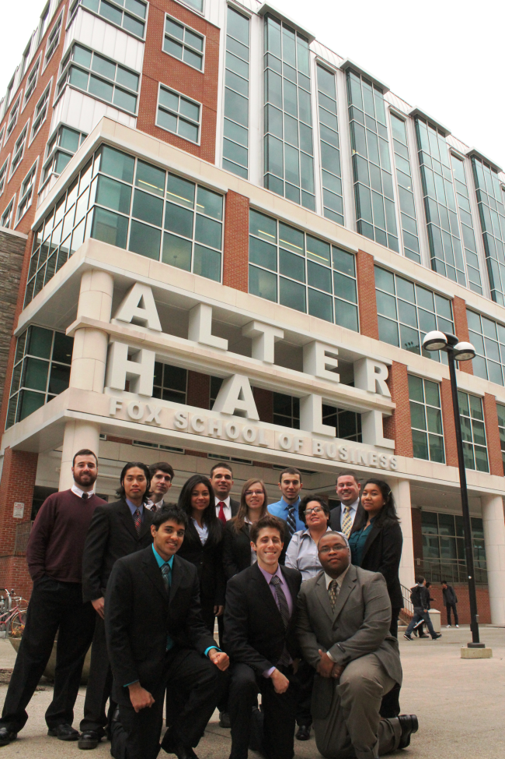
Who we are
Fox School of Business
Established in 1918
7,000 students
Largest business school in Philadelphia
Public, urban university
60,000+ alumni
Department of Management Information Systems
Established in 2000
367 majors, 343 minors
18 full-time faculty
BBA in MIS ranked 13th in US
MBA in ITM ranked 16th in US
Ranked #1 for MIS research in the world

Slide 4
Convenient and Efficient!
Convenient for the faculty member
Quantity: 14 weeks
Included:
Required reading
Slide decks
Assignments
Quizzes
Exam questions bank
Exam generation tool
Teaching notes
Paid for by the student

Slide 5
Convenient for Students!
Why exactly should I go to class when I can ace the exam by reading the book?
Why should I even buy the book when I can just study from these beautiful slide decks?
No thinking required!
Multiple choice exams that challenge a student’s ability to memorize 1,000 terms and facts.
Extremely superficial understanding of material with no ability to apply it.

Slide 6
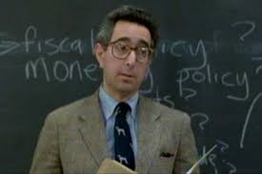
Outsourcing
And I don’t even need to think about the topics or how to weave them together because the author, editor and publisher have done this for me!

Slide 7
High-Quality Education?
Commodity education, boatloads of superficial information with no lasting value
Why have a faculty of world-class researchers and experienced practitioners only to receive a commodity education you could get anywhere?
How much can you learn about a course that is being taught simply by asking “What textbook are you using?”
Faculty should ask themselves:
“What kind of value do I bring to the classroom if I am teaching from this book?”
“Am I the professor who is educating these students or am I simply a facilitator who is delivering the knowledge of the textbook author?”

Slide 8
Question
?
Is your faculty defining your curriculum or is your curriculum being defined by the best textbook your faculty can find?
Is this what your students need or is this just convenient for your faculty?

Slide 9
No Textbook
Vs.
Force faculty members to think through what is really important and what students really need to know.
Stop covering 1,000 topics at a superficial level and use this time to help students truly understand and be able to apply the most important topics.
Get past basic memorization and get to genuine understanding.
When “the answer” is not in the textbook, attendance improves and more students learn.
“the answer” is something deeper that is learned in the classroom, not while cramming the night before an exam.

Slide 10
Lecture vs. Activities
Vs.
Replace 3 hours of lecture per week covering 1,000 topics at a superficial level
With 1 hour of lecture a week that focuses on the most important learning objectives
And
2 hours of in-class activities that reinforce those key learning objectives

Slide 11
Not all Rainbows and Unicorns
WAY more work for the faculty member. All of this work had been outsourced and not paid for by the faculty member.
Sounded great on day-1 when you just saved $150 but…
Collection of readings from
Different authors
For different audiences
With different formats
Not written to teach a topic
Student hate that they have to connect the dots, a job that the author, editors and publishers used to do for them.
Students don’t like the lack of structure. They had mastered the old formula and nobody likes change.

Slide 12
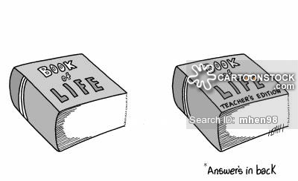
The Reality
No textbook with all of the answers to life.
This is how young business professional learn and grow after they graduate. Why not start preparing students for the real world?

Slide 13
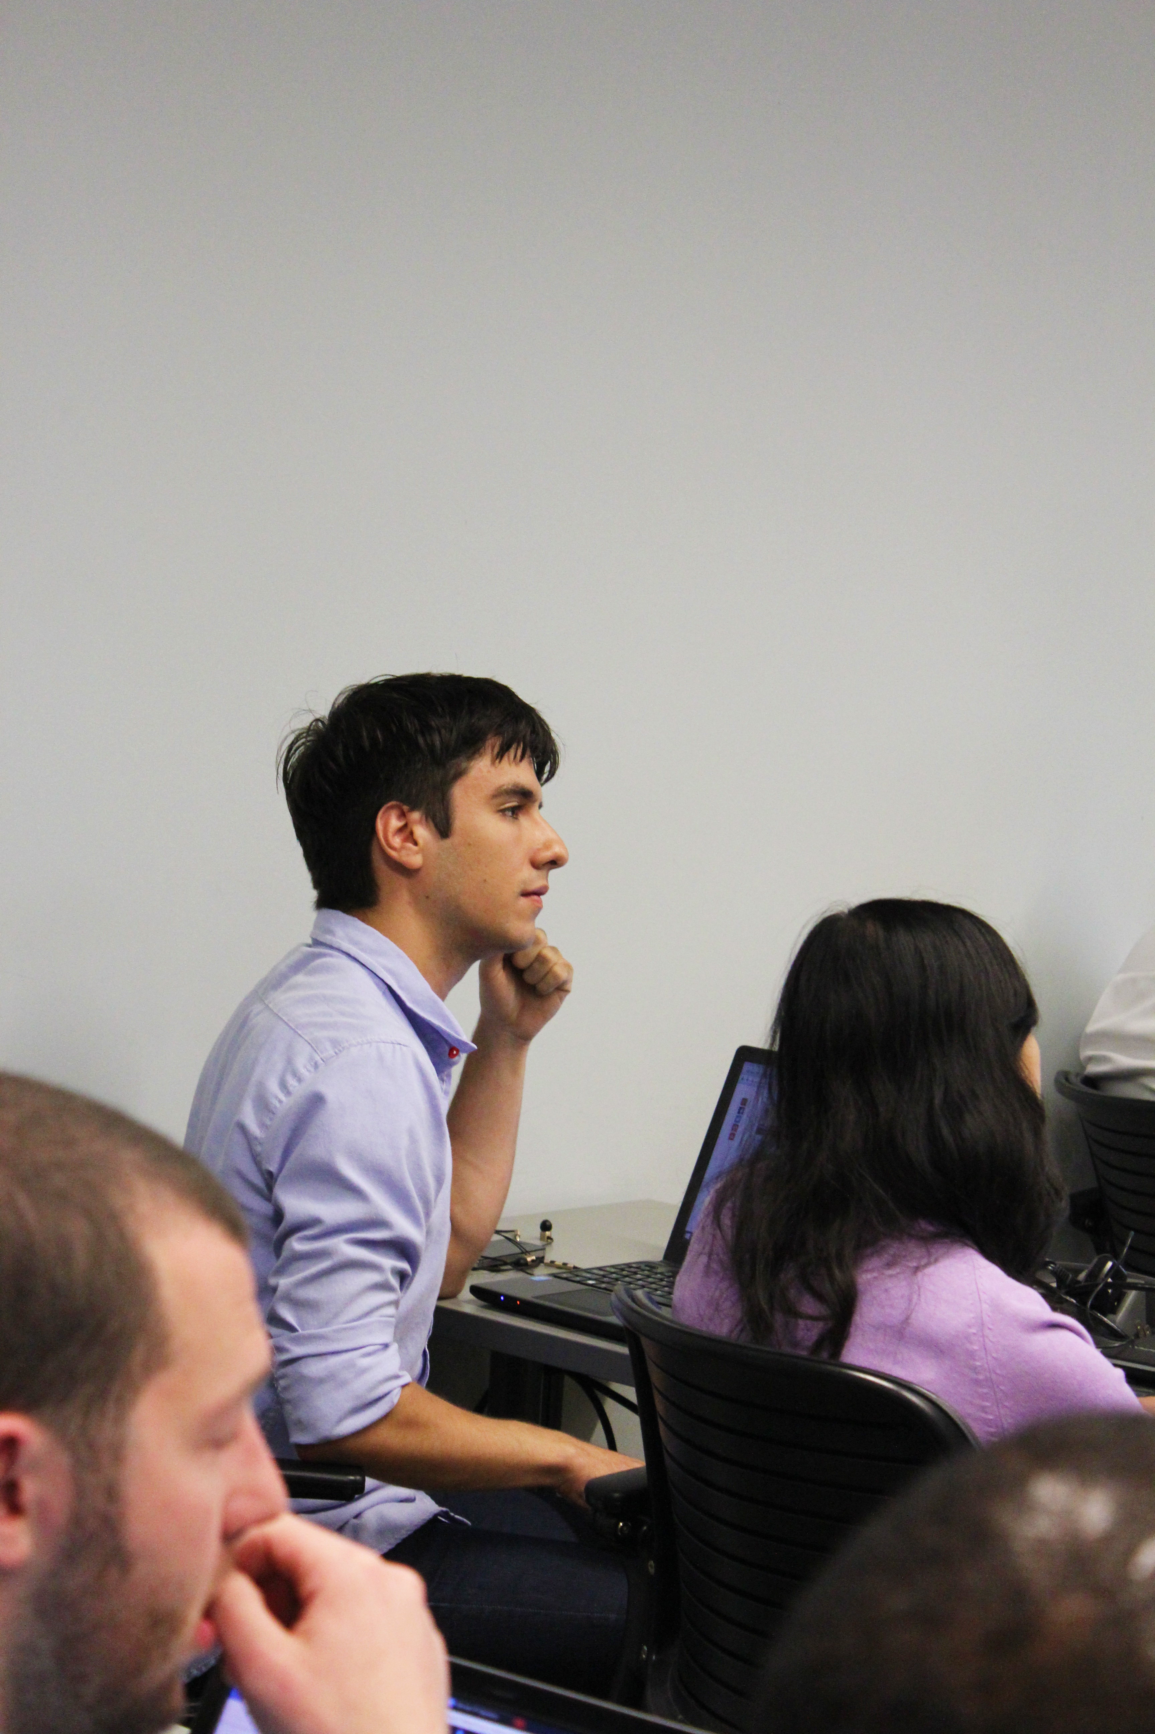
Next steps?
Questions?
Suggestions for improving education?
Suggestions for further research?

Slide 14
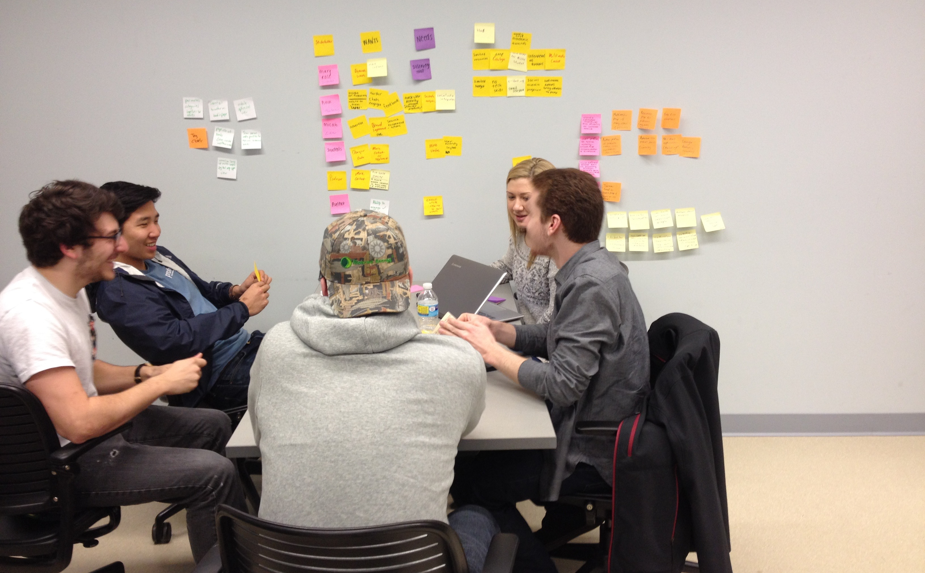
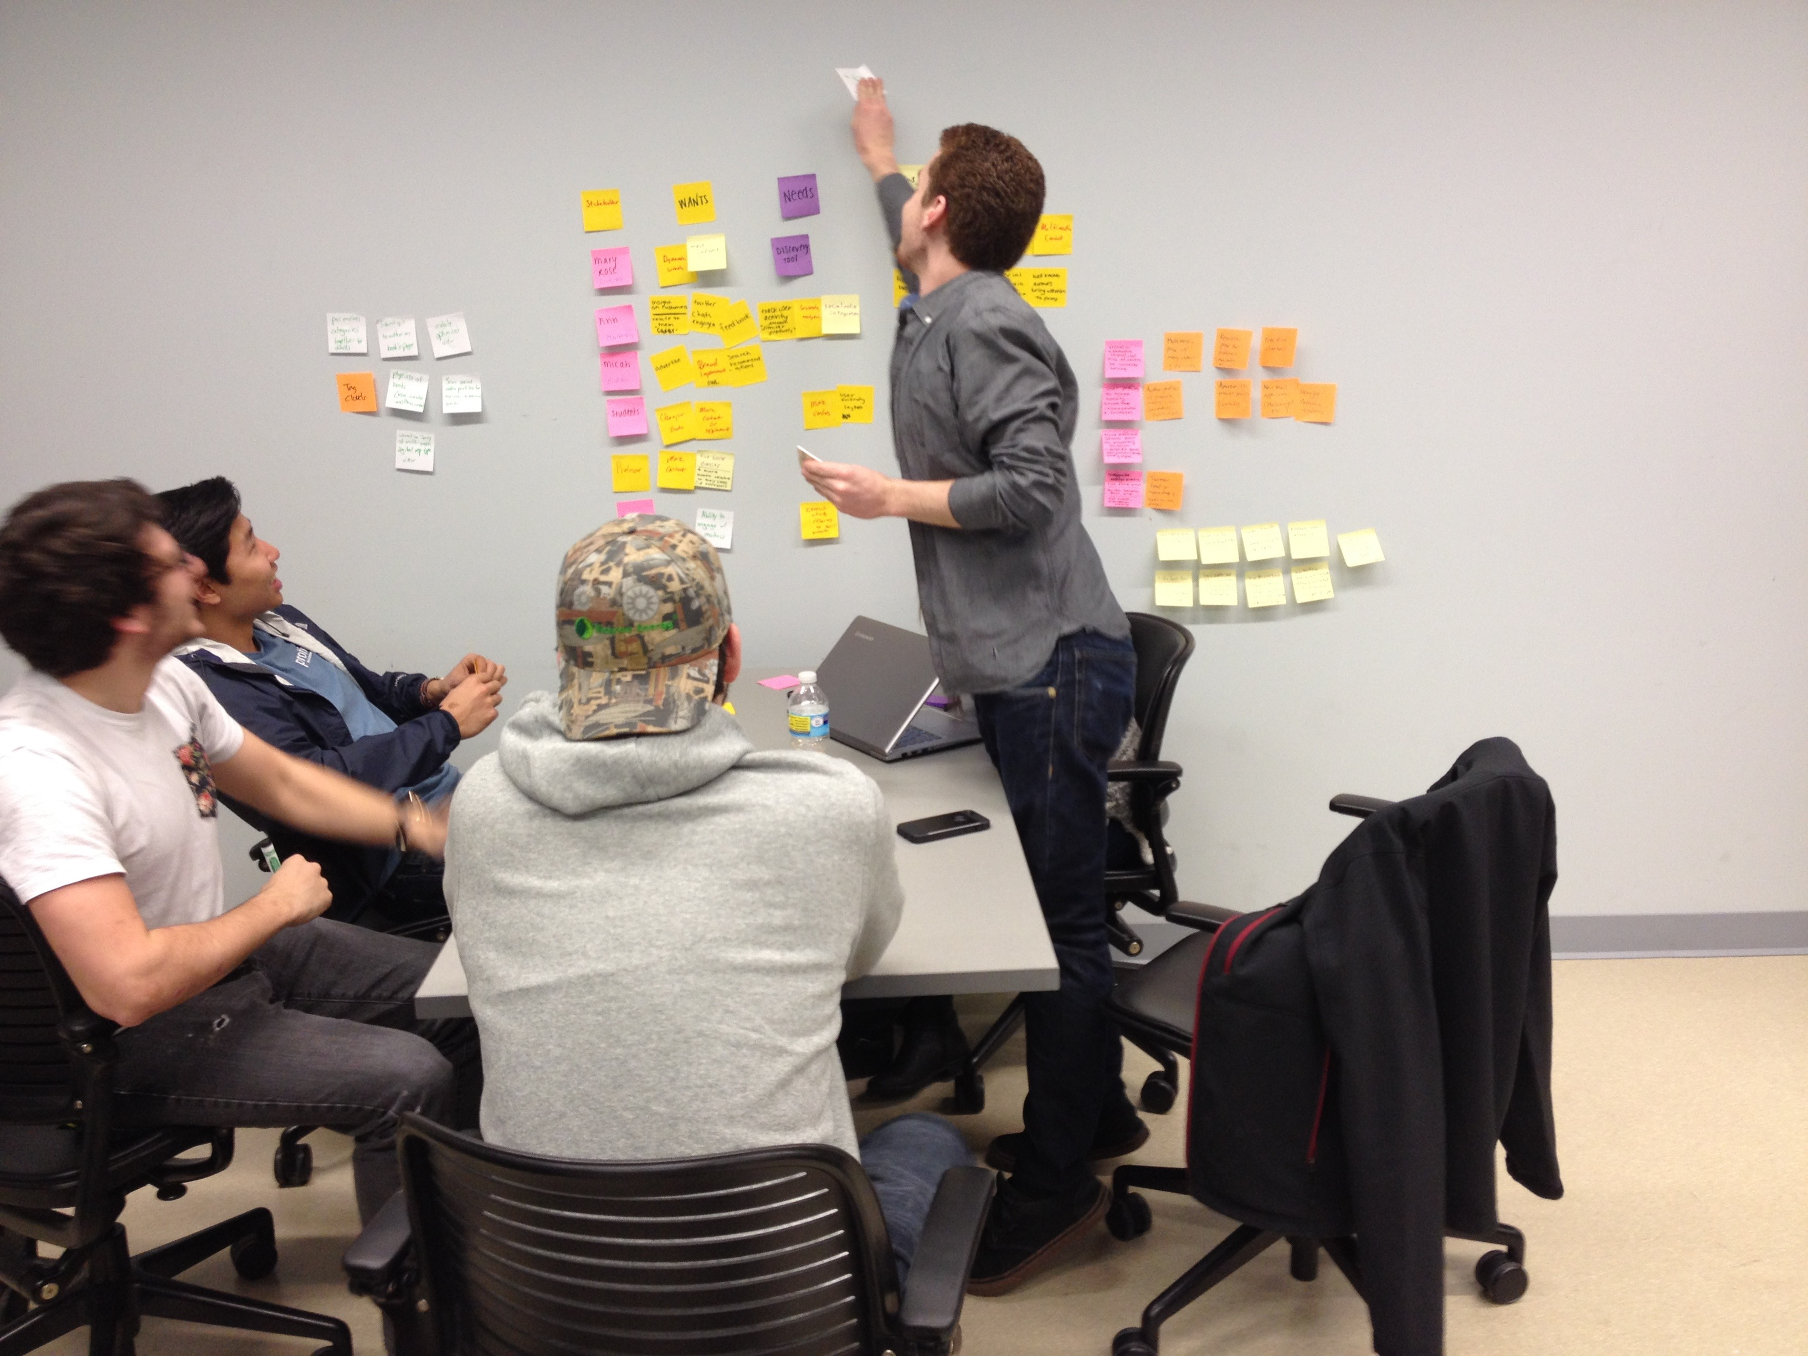
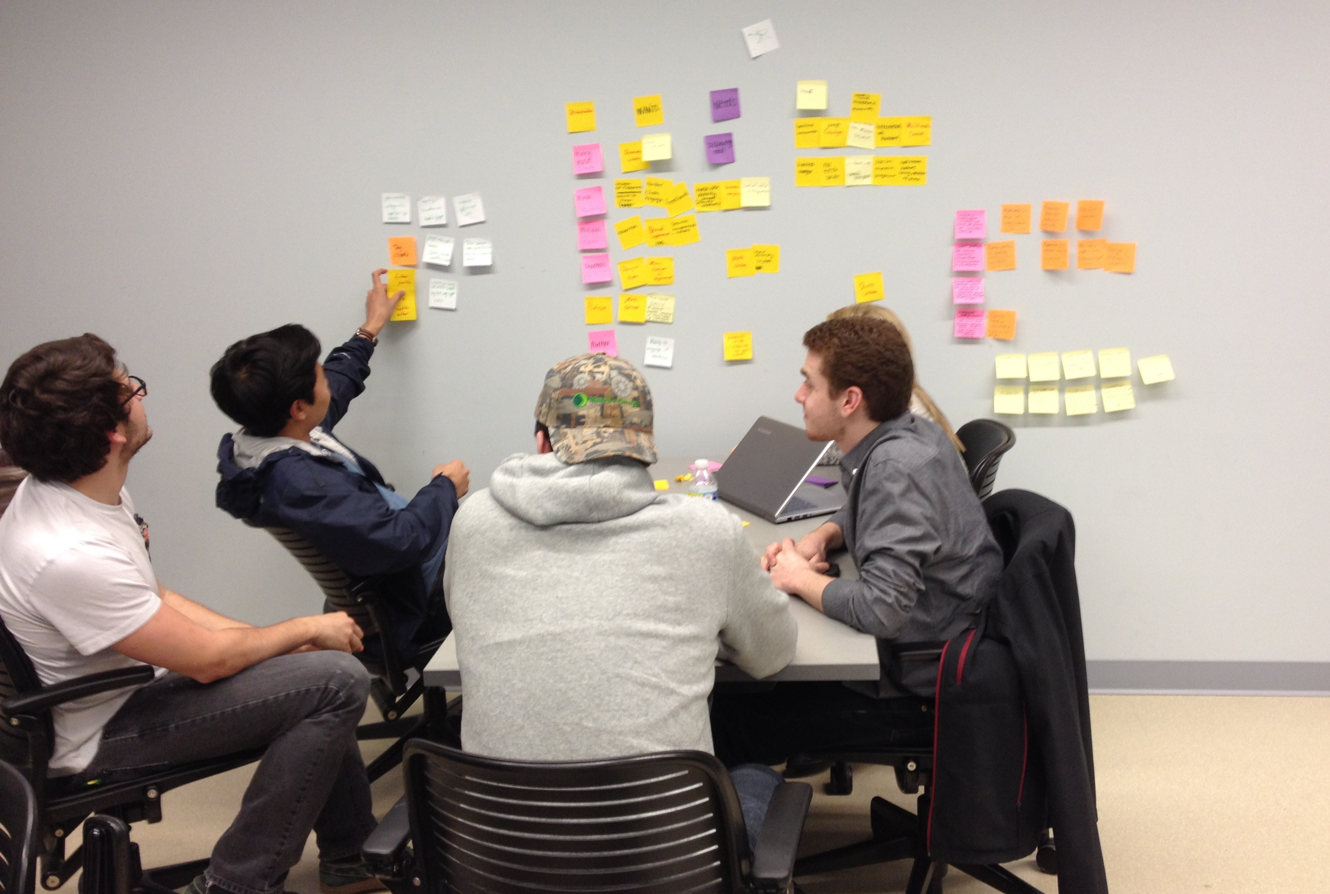
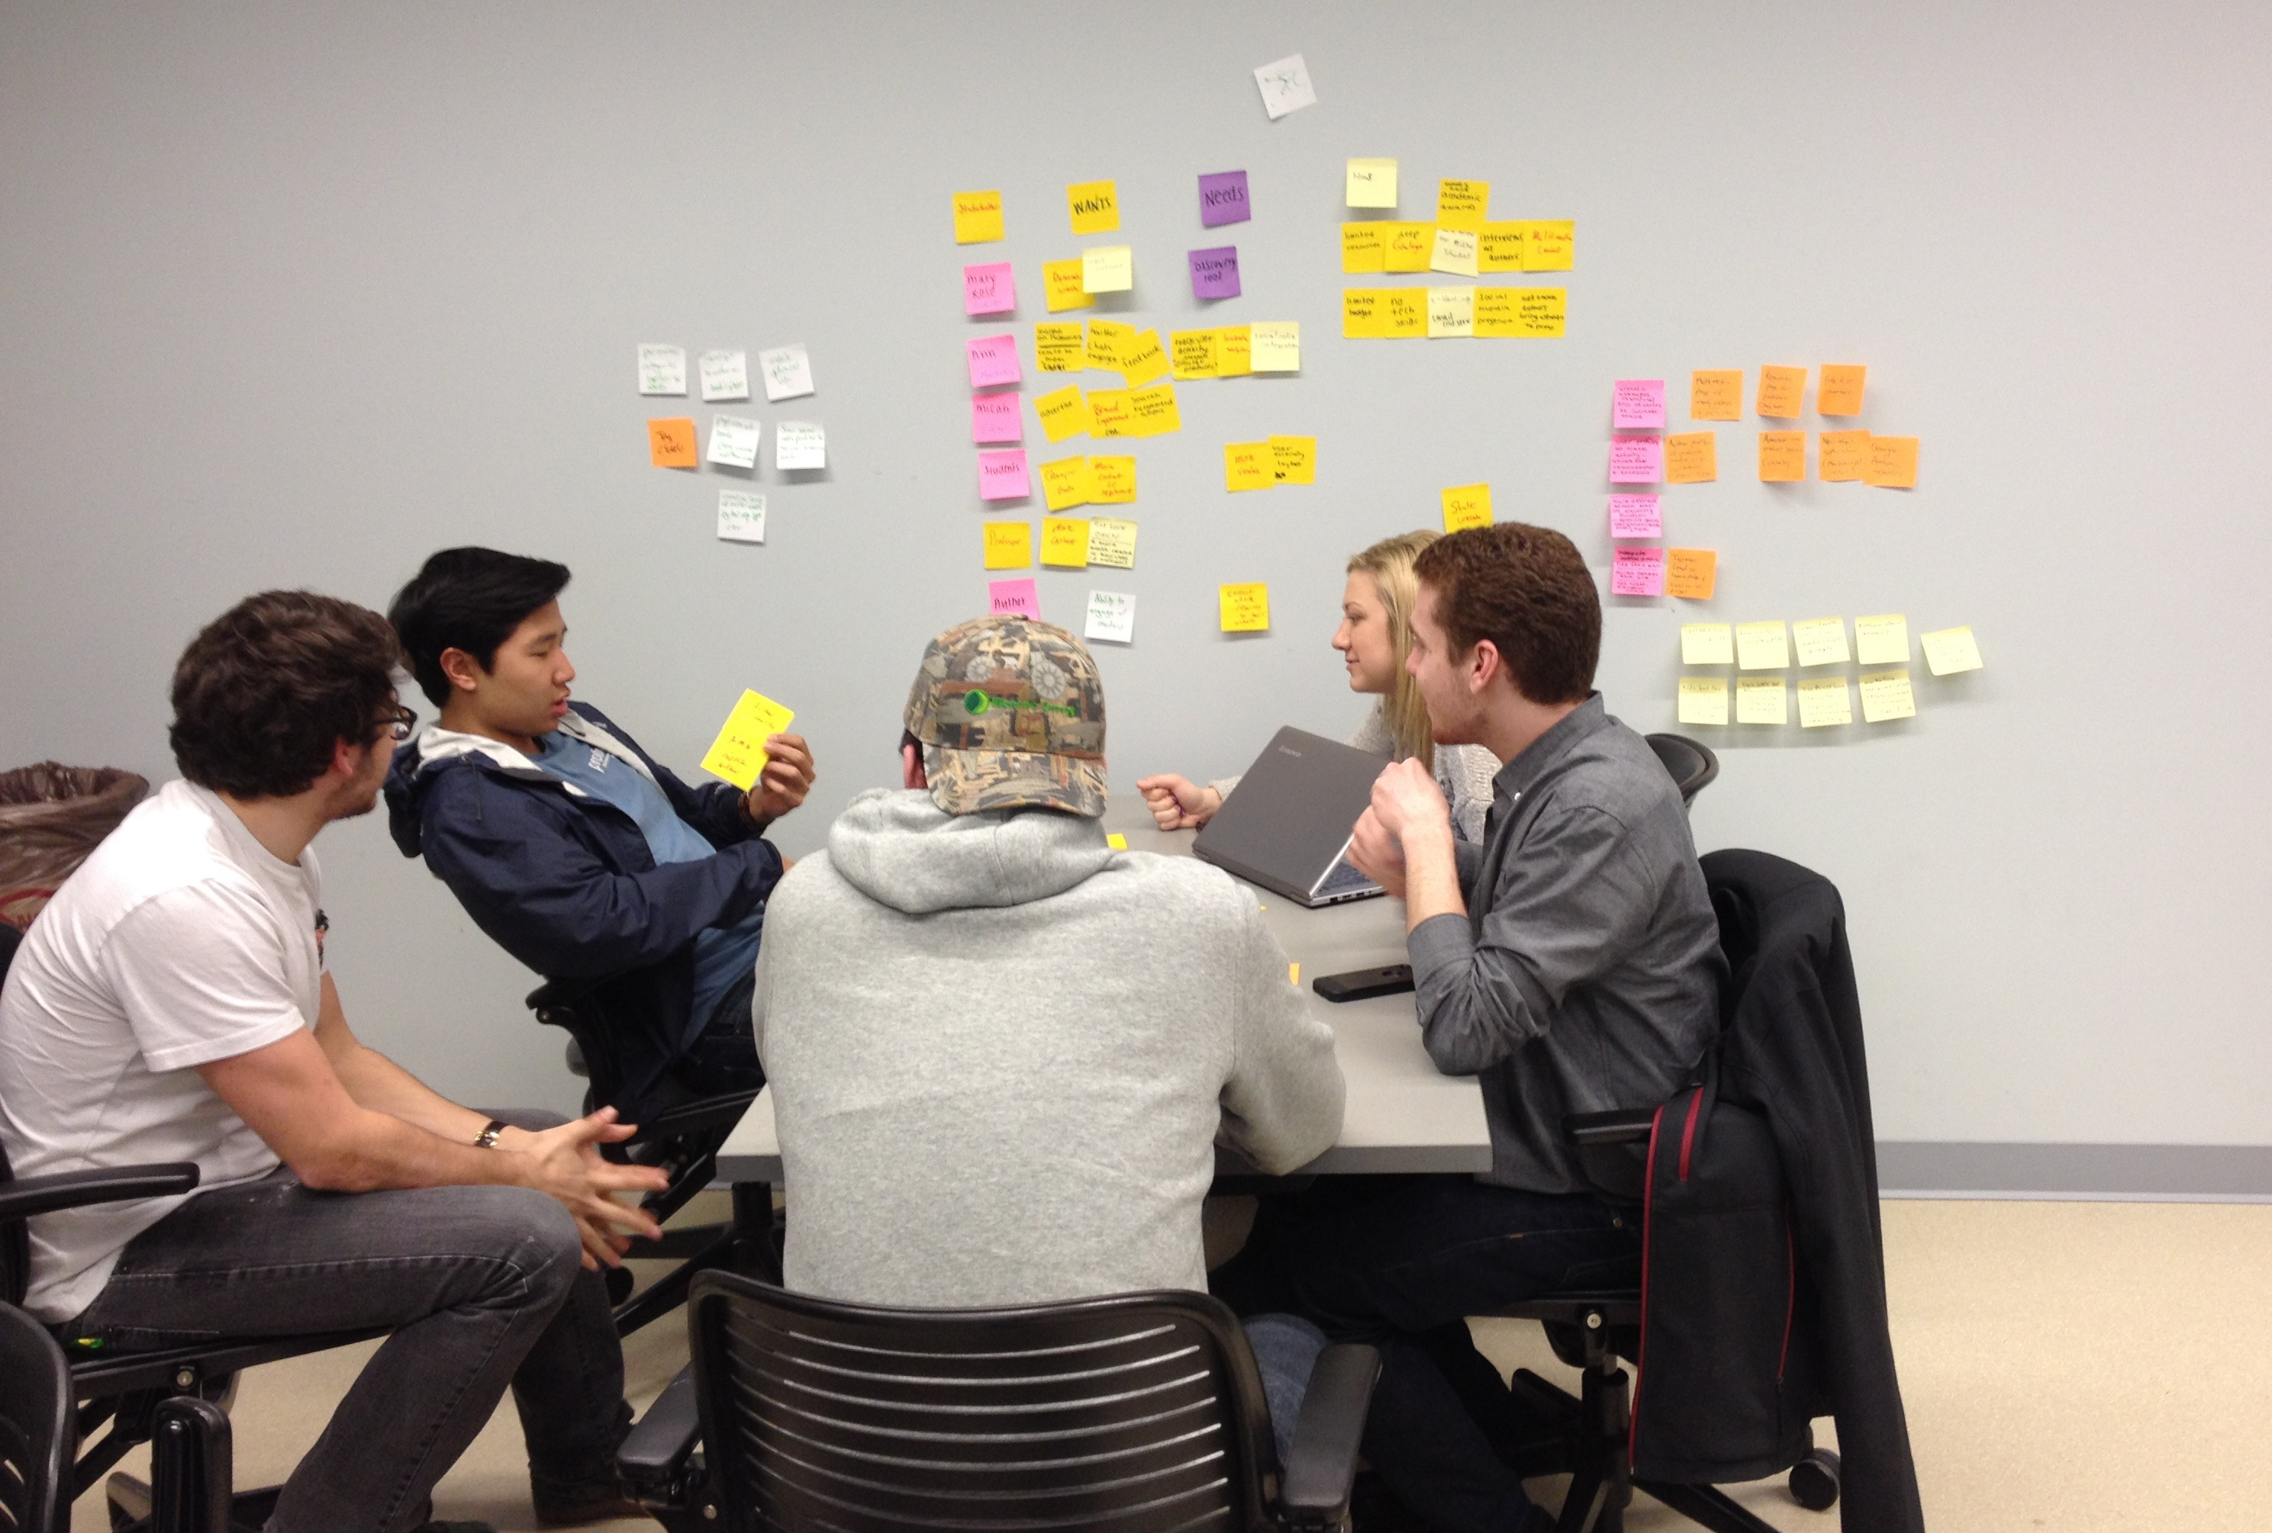
Thank you.

